Slide 1
INTRO to DATA SCIENCE regression & regularization

Slide 2
I. intro to regression iI. Regularization exercises: III. Implementing a regularized fit in r
agenda

Slide 3
I. linear regression
INTRO TO DATA SCIENCE

Slide 4
Regression problems
continuous categorical
supervised ??? ???
unsupervised ??? ???
Notes:
Q: Where does regression belong in this diagram?

Slide 5
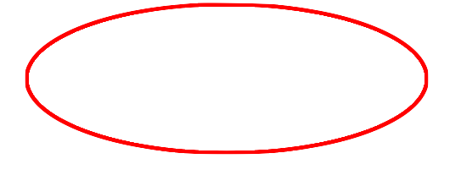
Regression problems
continuous categorical
supervised regression classification
unsupervised dimension reduction clustering
Notes:
Supervised learning problem w/ cts target variables
(predictions are real numbers)

Slide 6
Intro to regression
Q: What is a regression model?

Slide 7
Intro to regression
Q: What is a regression model?
A: A functional relationship between input & response variables.
Notes:
Parametric relationship

Slide 8
Intro to regression
Q: What is a regression model?
A: A functional relationship between input & response variables
The simple linear regression model captures a linear relationship between a single input variable x and a response variable y:

Slide 9
Intro to regression
Q: What is a regression model?
A: A functional relationship between input & response variables
The simple linear regression model captures a linear relationship between a single input variable x and a response variable y:
y = α + βx + ε

Slide 10
Intro to regression
Q: What do the terms in this model mean?
y = α + βx + ε

Slide 11
Intro to regression
Q: What do the terms in this model mean?
y = α + βx + ε
A: y = response variable (the one we want to predict)
Notes:
Dependent var, target var, output var

Slide 12
Intro to regression
Q: What do the terms in this model mean?
y = α + βx + ε
A: y = response variable (the one we want to predict)
x = input variable (the one we use to train the model)
Notes:
Indep var, covariate

Slide 13
Intro to regression
Q: What do the terms in this model mean?
y = α + βx + ε
A: y = response variable (the one we want to predict)
x = input variable (the one we use to train the model)
α = intercept (where the line crosses the y-axis)

Slide 14
Intro to regression
Q: What do the terms in this model mean?
y = α + βx + ε
A: y = response variable (the one we want to predict)
x = input variable (the one we use to train the model)
α = intercept (where the line crosses the y-axis)
β = regression coefficient (the model “parameter”)

Slide 15
Intro to regression
Q: What do the terms in this model mean?
y = α + βx + ε
A: y = response variable (the one we want to predict)
x = input variable (the one we use to train the model)
α = intercept (where the line crosses the y-axis)
β = regression coefficient (the model “parameter”)
ε = residual (the prediction error)
Notes:
Error term, disturbance
White noise (usually assumed to follow Gaussian distribution)

Slide 16
Intro to regression
We can extend this model to several input variables, giving us the multiple linear regression model:

Slide 17
Intro to regression
We can extend this model to several input variables, giving us the multiple linear regression model:
y = α + β₁x₁ + … + β_{n}x_{n} + ε

Slide 18
Intro to regression
Linear regression involves several technical assumptions and is often presented with lots of mathematical formality.
The math is not very important for our purposes, but you should check it out if you get serious about solving regression problems.

Slide 19
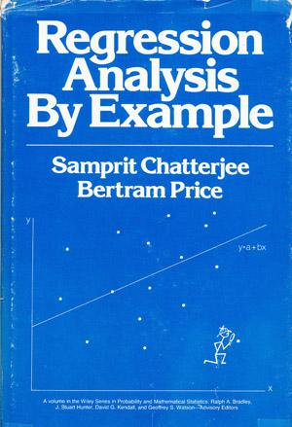
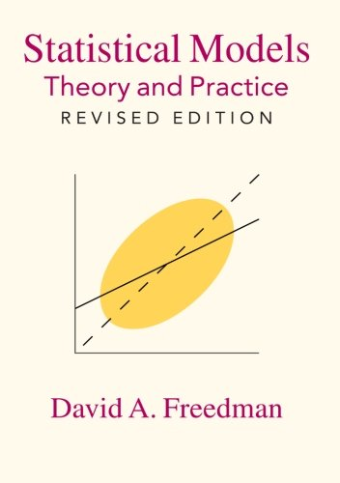
Intro to regression

Slide 20
Intro to regression
Q: How do we fit a regression model to a dataset?

Slide 21
Intro to regression
Q: How do we fit a regression model to a dataset?
A: In theory, minimize the sum of the squared residuals (OLS).

Slide 22
Intro to regression
Q: How do we fit a regression model to a dataset?
A: In theory, minimize the sum of the squared residuals (OLS).
In practice, any respectable piece of software will do this for you.

Slide 23
Intro to regression
Q: How do we fit a regression model to a dataset?
A: In theory, minimize the sum of the squared residuals (OLS).
In practice, any respectable piece of software will do this for you.
But again, if you get serious about regression, you should learn how this works!

Slide 24
II: POLYNOMIAL REGRESSION
INTRO TO DATA SCIENCE
Notes:
Polynomial regression is a linear modeling technique

Slide 25
Polynomial regression
Consider the following polynomial regression model:
y = α + β₁x + β₂x² + ε

Slide 26
Polynomial regression
Consider the following polynomial regression model:
y = α + β₁x + β₂x² + ε
Q: This represents a nonlinear relationship. Is it still a linear model?

Slide 27
Polynomial regression
Consider the following polynomial regression model:
y = α + β₁x + β₂x² + ε
Q: This represents a nonlinear relationship. Is it still a linear model?
A: Yes, because it’s linear in the β’s!
Notes:
Linear in the parameter vector.

Slide 28
Polynomial regression
Consider the following polynomial regression model:
y = α + β₁x + β₂x² + ε
Q: This represents a nonlinear relationship. Is it still a linear model?
A: Yes, because it’s linear in the β’s!
“Although polynomial regression fits a nonlinear model to the data, as a statistical estimation problem it is linear, in the sense that the regression function E(y|x) is linear in the unknown parameters that are estimated from the data. For this reason, polynomial regression is considered to be a special case of multiple linear regression.” -- Wikipedia
Notes:
Note: nonlinear regression refers to something different!

Slide 29
Polynomial regression
Polynomial regression allows us to fit very complex curves to data.
y = α + β₁x + β₂x² + … + β_{n}x^{n} + ε

Slide 30
Polynomial regression
Polynomial regression allows us to fit very complex curves to data.
y = α + β₁x + β₂x² + … + β_{n}x^{n} + ε
But there is one problem with the model we’ve written down so far.

Slide 31
Polynomial regression
Polynomial regression allows us to fit very complex curves to data.
y = α + β₁x + β₂x² + … + β_{n}x^{n} + ε
But there is one problem with the model we’ve written down so far.
Q: Does anyone know what it is?

Slide 32
Polynomial regression
Polynomial regression allows us to fit very complex curves to data.
y = α + β₁x + β₂x² + … + β_{n}x^{n} + ε
But there is one problem with the model we’ve written down so far.
Q: Does anyone know what it is?
A: This model violates one of the assumptions of linear regression!

Slide 33

Polynomial regression

Slide 34

Polynomial regression
This model displays multicollinearity, which means the predictor variables are highly correlated with each other.
y = α + β₁x + β₂x² + … + β_{n}x^{n} + ε
Notes:
Show scatterplot of x9, x10 in R.

Slide 35
Polynomial regression
This model displays multicollinearity, which means the predictor variables are highly correlated with each other.
y = α + β₁x + β₂x² + … + β_{n}x^{n} + ε
Multicollinearity causes the linear regression model to break down, because it can’t tell the predictor variables apart.

Slide 36

Polynomial regression
This model displays multicollinearity, which means the predictor variables are highly correlated with each other.
y = α + β₁x + β₂x² + … + β_{n}x^{n} + ε
Multicollinearity causes the linear regression model to break down, because it can’t tell the predictor variables apart.
NOTE
This results in a singularity. We will see an example of this in just a minute!

Slide 37
Polynomial regression
Q: What can we do about this?

Slide 38
Polynomial regression
Q: What can we do about this?
A: Replace the correlated predictors with uncorrelated predictors.

Slide 39
Polynomial regression
Q: What can we do about this?
A: Replace the correlated predictors with uncorrelated predictors.
y = α + β₁f₁(x) + β₂f₂(x²) + … + β_{n}f_{n}(x^{n}) + ε

Slide 40
Polynomial regression
Q: What can we do about this?
A: Replace the correlated predictors with uncorrelated predictors.
y = α + β₁f₁(x) + β₂f₂(x²) + … + β_{n}f_{n}(x^{n}) + ε
OPTIONAL NOTE
These polynomial functions form an orthogonal basis of the function space.
Notes:
R can handle this for us automatically, and it’s really easy as we will see!

Slide 41
Polynomial regression
So far, we’ve seen how polynomial regression allows us to fit complex nonlinear relationships, and even to avoid multicollinearity (by using basis functions).

Slide 42
Polynomial regression
So far, we’ve seen how polynomial regression allows us to fit complex nonlinear relationships, and even to avoid multicollinearity (by using basis functions).
Q: Can a regression model be too complex?
Notes:
ex: suppose you have data w/ a linear relationship…why should you use a linear model instead of coercing a higher-degree model to fit the same data?

Slide 43
III: REGULARIZATION
INTRO TO DATA SCIENCE

Slide 44
Overfitting
Recall our earlier discussion of overfitting.

Slide 45
Overfitting
Recall our earlier discussion of overfitting.
When we talked about this in the context of classification, we said that it was a result of matching the training set too closely.

Slide 46
Overfitting
Recall our earlier discussion of overfitting.
When we talked about this in the context of classification, we said that it was a result of matching the training set too closely.
In other words, an overfit model matches the noise in the dataset instead of the signal.

Slide 47
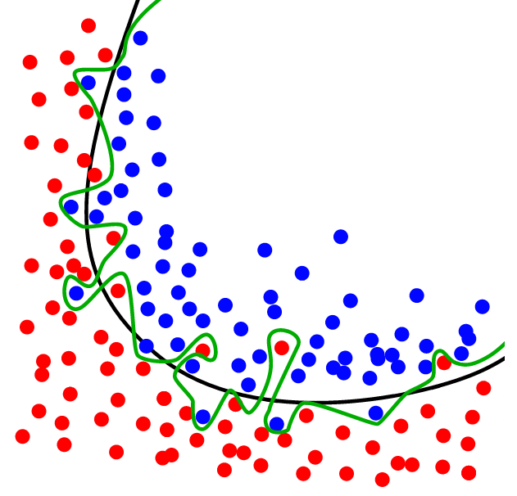
Overfitting example (classification)
source: http://upload.wikimedia.org/wikipedia/commons/1/19/Overfitting.svg

Slide 48
overfitting
The same thing can happen in regression.
It’s possible to design a regression model that matches the noise in the data instead of the signal.
This happens when our model becomes too complex for the data to support.

Slide 49
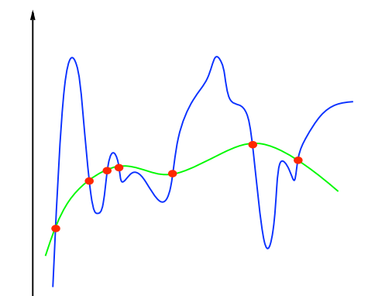
Overfitting example (regression)
source: http://www.mit.edu/~9.520/spring12/slides/class02/class02.pdf
Notes:
note: the blue curve is more “complex” than the green curve

Slide 50
Model complexity
Q: How do we define the complexity of a regression model?

Slide 51
Model complexity
Q: How do we define the complexity of a regression model?
A: One method is to define complexity as a function of the size of the
coefficients.
Notes:
Alternative: degree of polynomial (less general, can’t use for non-poly cases)

Slide 52
Model complexity
Q: How do we define the complexity of a regression model?
A: One method is to define complexity as a function of the size of the
coefficients.
Ex 1: Σ |β_{i}|
Ex 2: Σ β_{i}²

Slide 53
Model complexity
Q: How do we define the complexity of a regression model?
A: One method is to define complexity as a function of the size of the
coefficients.
Ex 1: Σ |β_{i}| this is called the L1-norm
Ex 2: Σ β_{i}² this is called the L2-norm

Slide 54
regularization
These measures of complexity lead to the following regularization techniques:

Slide 55
regularization
These measures of complexity lead to the following regularization techniques:
L1 regularization: y = Σ β_{i}x_{i} + ε st. Σ |β_{i}| < s

Slide 56
regularization
These measures of complexity lead to the following regularization techniques:
L1 regularization: y = Σ β_{i}x_{i} + ε st. Σ |β_{i}| < s
L2 regularization: y = Σ β_{i}x_{i} + ε st. Σ β_{i}² < s
Notes:
L1 – lasso method
L2 – ridge regression, tikhonov regularization

Slide 57
regularization
These measures of complexity lead to the following regularization techniques:
L1 regularization: y = Σ β_{i}x_{i} + ε st. Σ |β_{i}| < s
L2 regularization: y = Σ β_{i}x_{i} + ε st. Σ β_{i}² < s
Regularization refers to the method of preventing overfitting by explicitly controlling model complexity.
Notes:
Important sentence

Slide 58
Regularization
These regularization problems can also be expressed as:
L1 regularization: min(||y – xβ||² + λ||x||)
L2 regularization: min(||y – xβ||² + λ||x||²)

Slide 59
Regularization
These regularization problems can also be expressed as:
L1 regularization: min(||y – xβ||² + λ||x||)
L2 regularization: min(||y – xβ||² + λ||x||²)
This (Lagrangian) formulation reflects the fact that there is a cost associated with regularization.

Slide 60
Regularization
These regularization problems can also be expressed as:
L1 regularization: min(||y – xβ||² + λ||x||)
L2 regularization: min(||y – xβ||² + λ||x||²)
This (Lagrangian) formulation reflects the fact that there is a cost associated with regularization.
Q: Can anyone see what it is?

Slide 61
Bias and variance
Q: What are bias and variance?

Slide 62
Bias and variance
Q: What are bias and variance?
A: Bias refers to predictions that are systematically inaccurate.

Slide 63
Bias and variance
Q: What are bias and variance?
A: Bias refers to predictions that are systematically inaccurate.
Variance refers to predictions that are generally inaccurate.

Slide 64
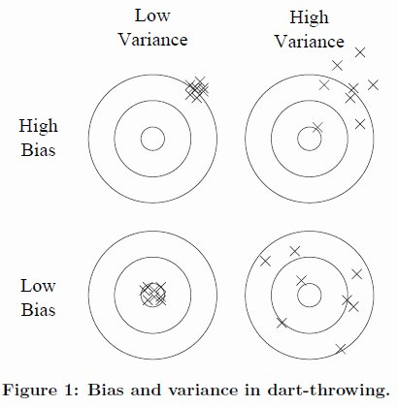
Bias and variance
source: http://homes.cs.washington.edu/~pedrod/papers/cacm12.pdf
Notes:
Low bias – on target
Low variance – tight grouping

Slide 65
Bias and variance
Q: What are bias and variance?
A: Bias refers to predictions that are systematically inaccurate.
Variance refers to predictions that are generally inaccurate.
It turns out (after some math) that the generalization error in our model can be decomposed into a bias component and variance component.

Slide 66
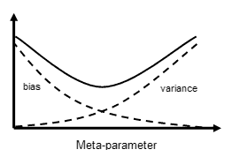
Bias-variance tradeoff
This is another example of the bias-variance tradeoff.
source: http://www.isu.edu/chem/images/kalivasmeta.gif

Slide 67
Bias-variance tradeoff
This is another example of the bias-variance tradeoff.
NOTE
The “meta-parameter” here is the lambda we saw above.
A more typical term is “hyperparameter”.
source: http://www.isu.edu/chem/images/kalivasmeta.gif

Slide 68
Bias-variance tradeoff
L1 regularization: y = Σ β_{i}x_{i} + ε st. Σ |β_{i}| < λ
L2 regularization: y = Σ β_{i}x_{i} + ε st. Σ β_{i}² < λ
So regularization represents a method to trade away some variance for a little bias in our model, thus achieving a better overall fit.
This tradeoff is regulated by a hyperparameter λ, which we’ve already seen:

Slide 69
Ex: polynomial regression & regularization
INTRO TO DATA SCIENCE

Slide 70
Exercise – polynomial regression & regularization
Key objectives
tools
- observe multicollinearity in naïve polynomial fit - lm
- perform polynomial fit using orthogonal basis functions - poly
- observe overfitting in polynomial fit of high degree - poly
- perform regularized fit to control overfitting - glmnet
Notes:
First, show ESM graphs to motivate sinusoidal data

