Slide 1
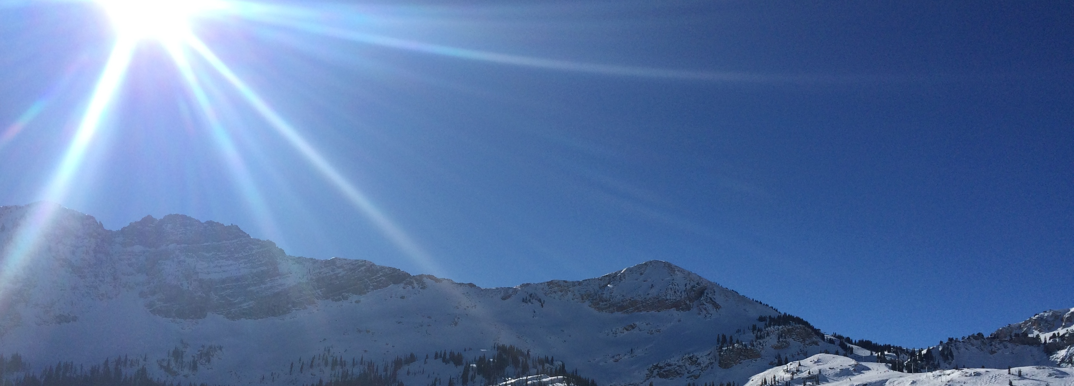

Blue Sky Energy
proposal
April, 10 2015

Slide 2


Problem Statement
Blue Sky Energy Corp would like to deploy their sign up teams to high traffic areas across New York City to maximize new subscriptions to their green energy supply service. Among other areas, they are interested in placing teams near the busiest subway stations.
MTA data obtained from the NYC Data Portal provides rich information about the travel patterns of New Yorkers -- using this information, can we create a street team deployment plan that will optimize Blue Sky Energy Corp resources toward achieving their goals?

Slide 3
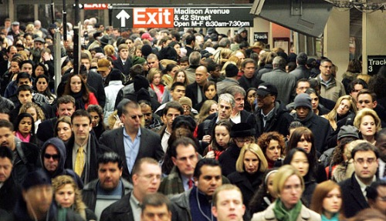
Where to start from?

Slide 4
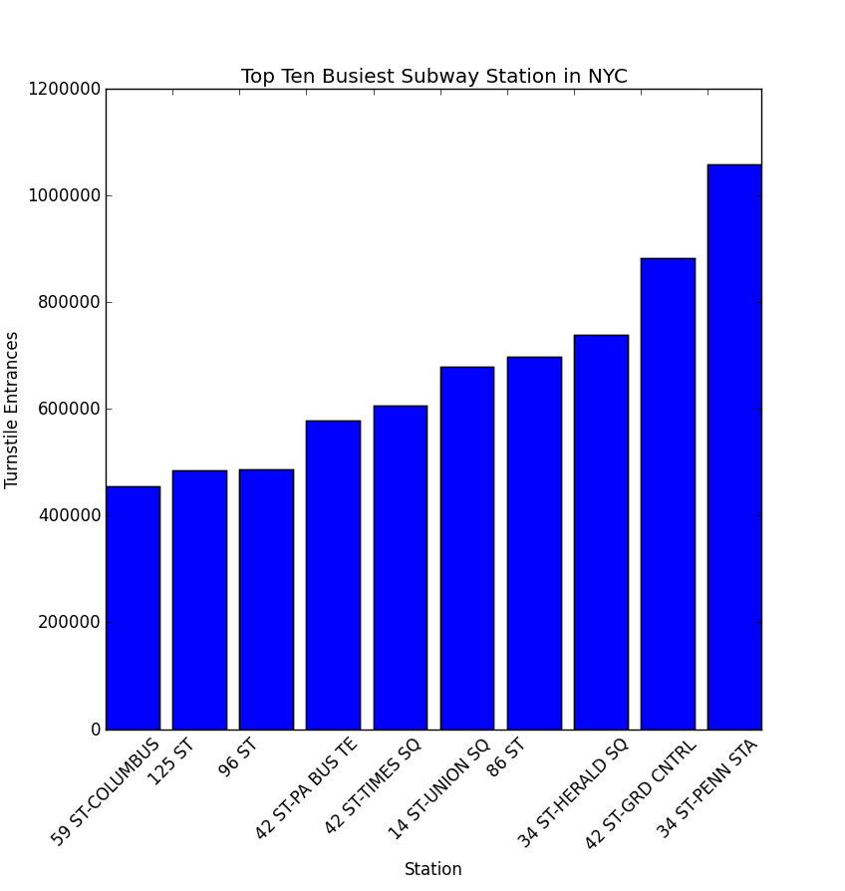
Top 10 busiest stations

Slide 5
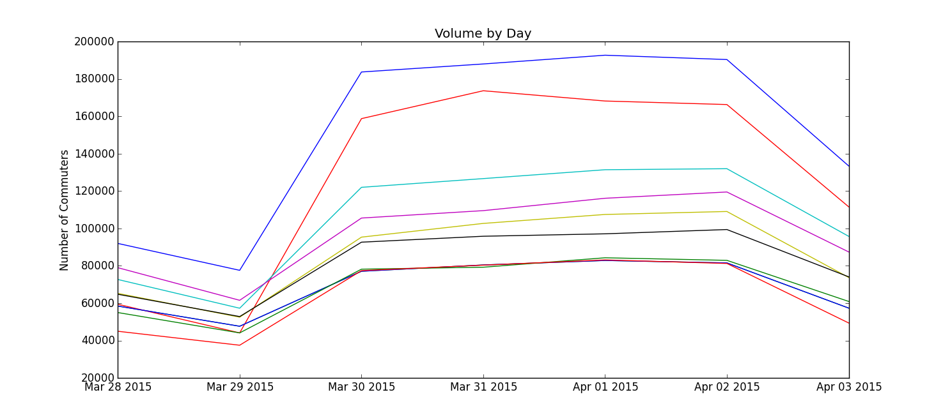
Which days are busiest?

Slide 6


Selecting your best target!
The top 10 stations are less crowded on weekends.
So we can reasonably assume that most of the people using these stations are not tourists but commuters: your best target!
Most of the top 10 stations are included into a relatively small “rectangle” in Manhattan. Targeting them should not be too expensive, and people using them should have a similar profile.

Slide 7
Further steps
So far, we have assumed that any subway rider is equally likely to sign up for green energy. Of course, this is not the case. There are a number of ways to narrow down stations to better target people aligned with the ideals of Blue Sky Energy, for example by involving external data sources.
At this point we just wanted to see what we could do with the MTA data alone.

Slide 8
Possible refinements of MTA data analysis
Use time of day component of MTA data.
Identify stations with low tourist usage.
Analyze the data seasonally to adjust deployment strategy to changes in energy demand between winter and summer.
For the largest subway stations, refine the analysis in terms of which entrances channel the largest crowds.

Slide 9
Other possible sources of data
Green market attendance
Large outdoor events (marathon, bike tour, Central Park events,…)
Street fairs
Large retail stores, popular restaurants and bustling nightlife
Demographic data about neighborhoods in the city

Slide 10
Additional analysis possibilities
Bring on an ethnographer or marketing specialist to profile people most likely to switch to clean energy.
Design experiments to gather data-informed feedback on sign-ups.

Slide 11

Conclusions
We had a lot of fun wrangling the MTA data and coming up with these simple plots.
Based on your interests and scope, we can go ahead with anything discussed above, or meet to iterate on these themes. We’re really looking forward to working with you!
Clean energy is an issue we love to support.

