Slide 1



Slide 2
Domain & Questions
Scenario:
Academy Awards Season (mid January to end of February): how to wisely use any additional budget available to exploit awards effects on movies audience?
Have we to wait for actual awards, or nominations are already a good hint enough?
Is there any relationship between box offices revenues and number of Nominations/actual Awards?

Slide 3
The Data
Source: Boxoffice Mojo Website (www.boxofficemojo.com).
Timespan: 15 years, since 1999 to 2013 (2014 and 2015 excluded to get only definitive Revenues data).
Domain: the 543 Movies with at least one Academy Nomination; 162 out of them awarded with at least one Oscar.
Used variables: Worldwide gross Box Office Revenues, Number of Nominations, Number of Oscars, Number of theaters on widest release, Year of Release.

Slide 4
Data - 2: metrics and some cleaning
Revenues evaluation for each movie = box office worldwide Revenues divided by the widest number of Theaters (more Theaters actually favour higher revenues)
Outliers removing (in case of clear errors into data)

Slide 5
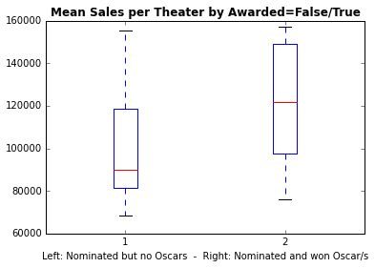
Should we decide upon Nominations, or is it worth waiting for the Awards?
The awarded movies produce more revenues, in average.
=> Maybe waiting doesn’t harm.

Slide 6
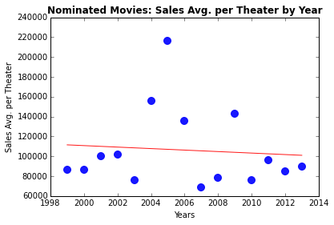
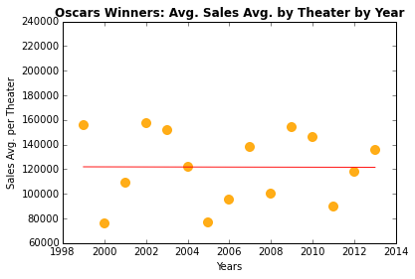
And going through the years…
Nominated movies with no Oscars (left) look like losing steam, while Nominated and Awarded movies (right) stay steady.
=> So, no elements to change the impression from previous slide.

Slide 7
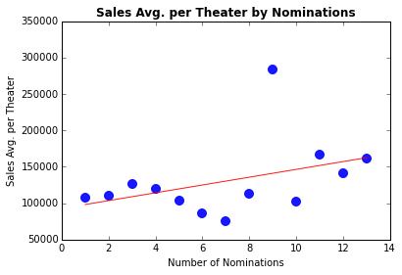
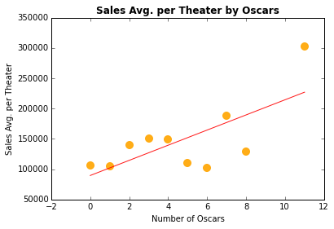
Are the numbers of Nominations/Oscars correlated with revenues at Box Offices?
The linear model that predicts revenues using number of Nominations and number of Oscars as predictor is quite weak (R² = 0.25).
=> No clear correlation between these variables and the average revenues per movie.

Slide 8
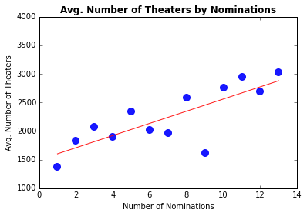
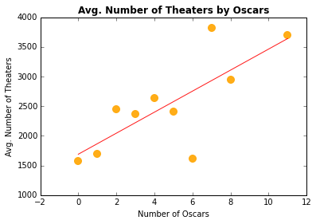
Unexpected finding: the number of Nominations/Oscars has more influence on theaters companies
The linear model that predicts the number of Theaters upon the number of Nominations/Awards is quite reliable (R² = 0.64)
=> Theaters Chains are more influenced by number of awards than the audience.

Slide 9
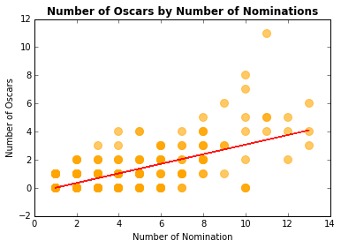
Somehow a hint: number of Oscars by number of Nominations
The linear model that predicts the number of Oscars given the number of Nominations is not so bad (R² = 0.51)
=> Could be somehow obvious, but maybe not as much as shown by the plot.

Slide 10
Finally: some Actionables
Allocate a little portion of the Budget (say 20%) on movies with a high number of Nominations.
It’s better waiting for the actual Awards to allocate the most of any available “Academy Awards Season” Budget.
Adopt a more even distribution in number of theaters for Nominated/Awarded movies, regardless of the number of Nominations/Oscars.

