Slide 1
Project Luther
Dara Elass
September 19th, 2014

Slide 2


The Client
Goal:
Opening Weekend Domestic Gross
Notes:
The client is a film studio specializing in action films.
My target is opening weekend domestic gross (i.e. I’m predicting how well a movie will do opening weekend).

Slide 3
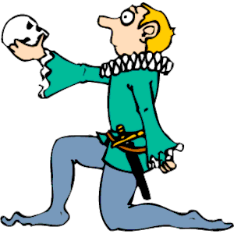


The Factors
Top 3 Actors
Director
Budget
Notes:
My features are:
The budget
The Director’s success (the average of their movies’ domestic gross on opening weekend)
The top 3 actors successes (the average of the averages of their movies’ domestic gross on opening weekend)

Slide 4
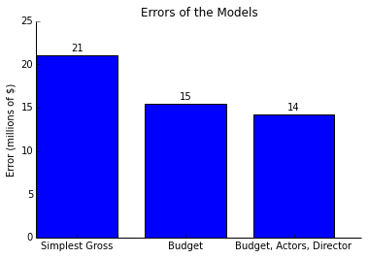
Errors of Models
Notes:
If I based my prediction on how well movies in the past did opening weekend, I’d be looking at an error margin of ±$42m. If I add budget as a feature, my error margin goes down to ±$30m, and adding the director and top 3 actors histories brings the error margin down to ±$28m.

Slide 5
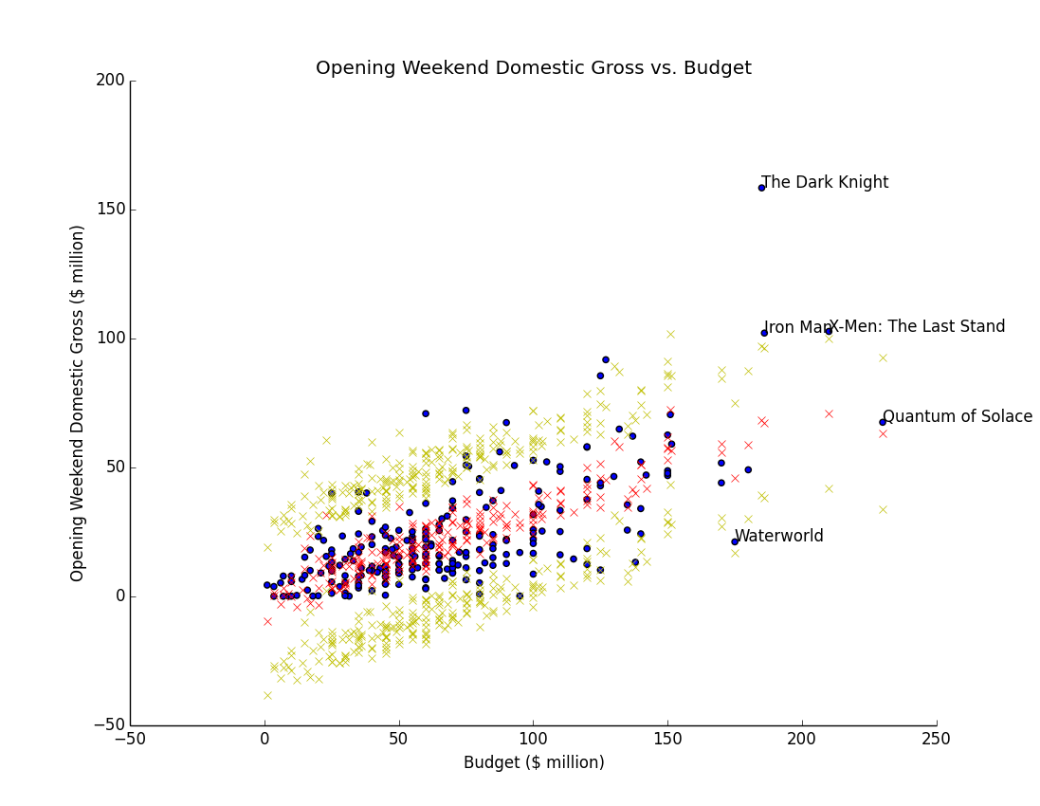
Results: Budget
Notes:
In the next few graphs, the blue dots represent my actual values in the data used, the red x’s represent my predictions for the same data points, and the yellow x’s represent my margin of error. So I’d expect my predictions to fall inside the yellow regions 95% of the time.
Looking at the budgets in this case, we can see that some movies did exceptionally well opening weekend in with respect to their budgets. The Dark Knight for example, is very high above the model.

Slide 6
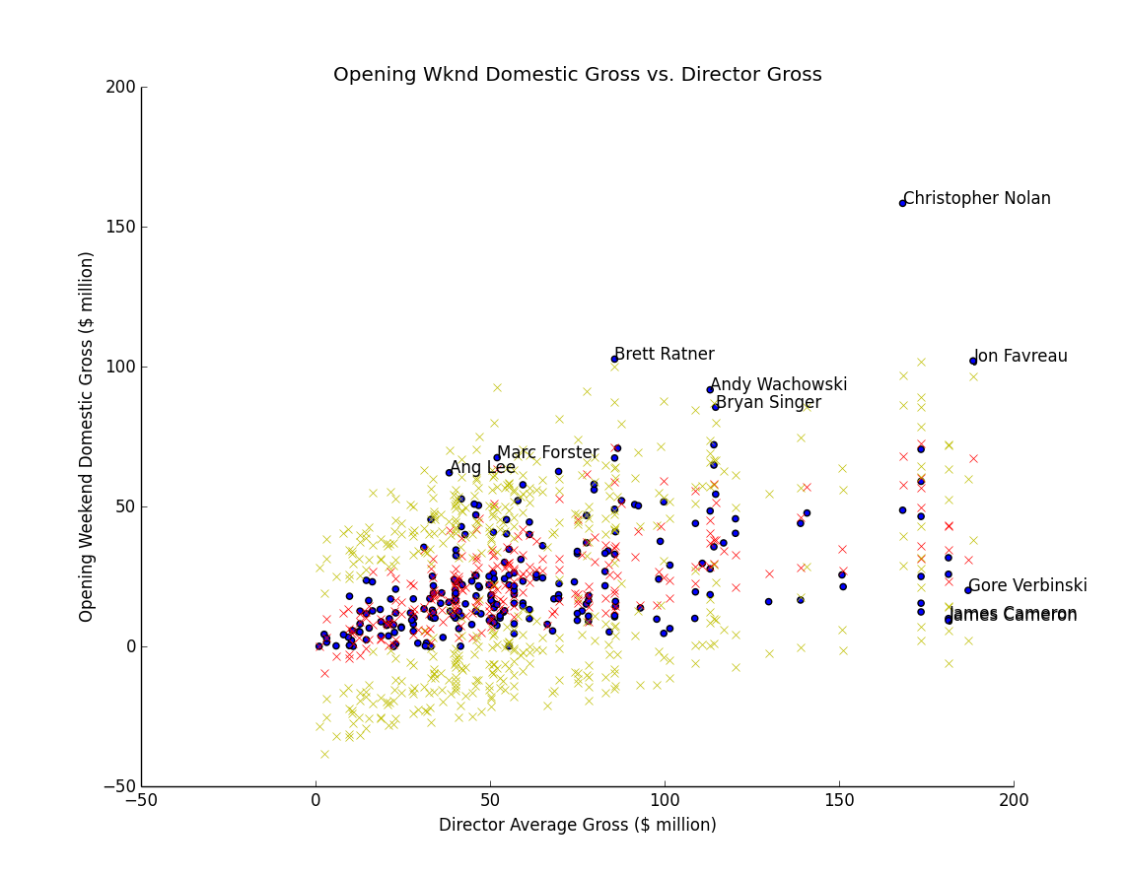
Results: Director Gross ( by Dir.)
Notes:
Looking at the movie director’s history/success from past movies, it is evident that most movies lie in the range we would expect, with the exception of Christopher Nolan, who did exceptionally well in his movie The Dark Knight.

Slide 7
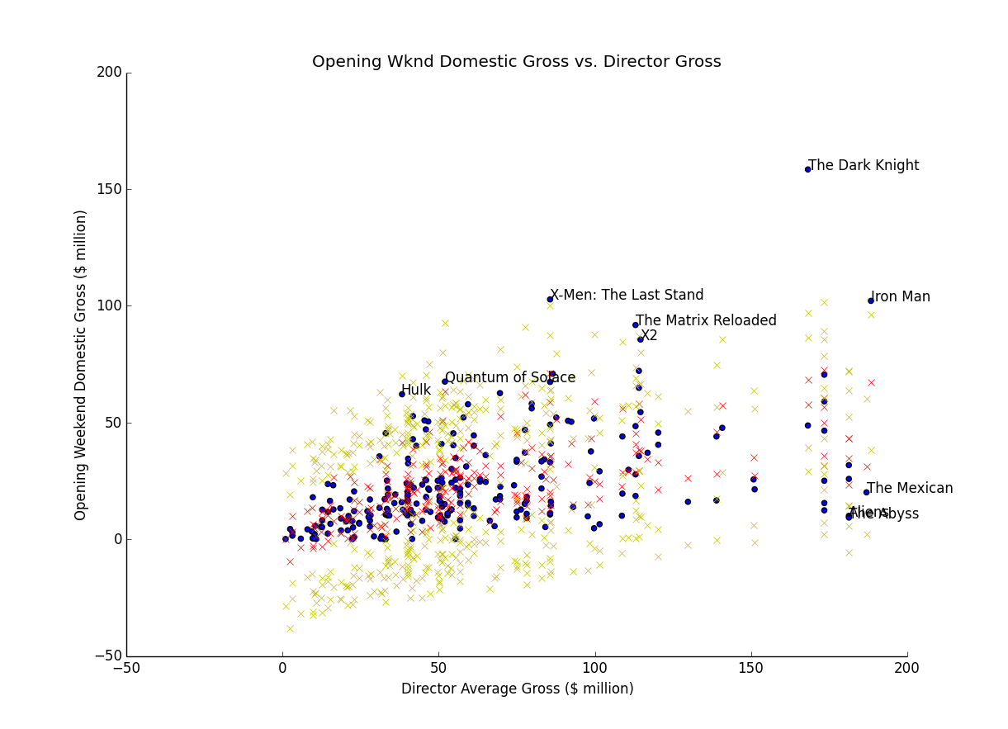
Results: Director Gross (Movie)
Notes:
This is the same graph as the previous one but shows the movies instead of the directors.

Slide 8
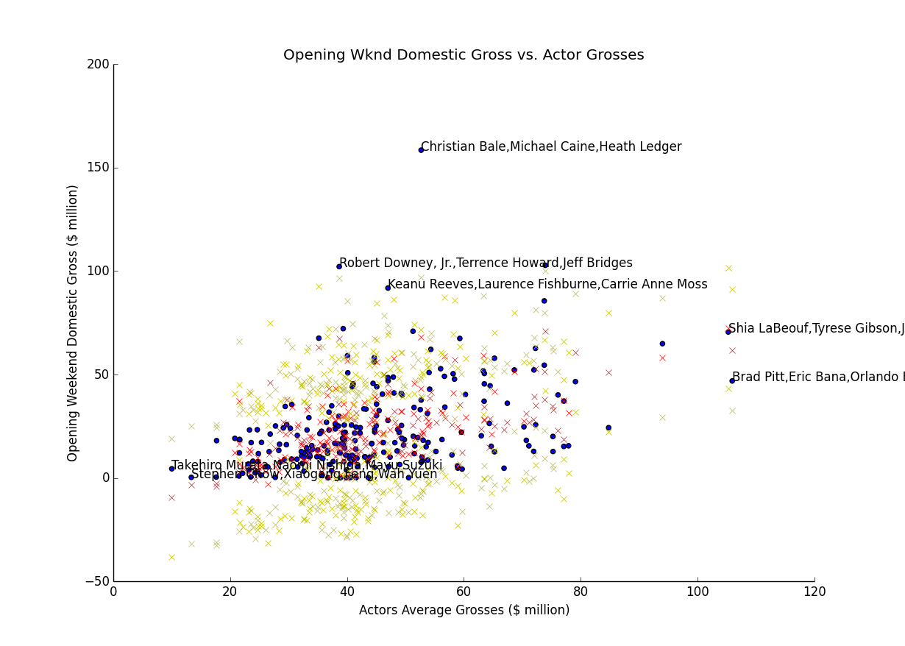
Results: Actor Grosses (Actors)
Notes:
If we look at the top 3 actors’ histories (in terms of their past movies successes on opening weekend), it is evident that once again there’s a movie far from the model – the actors are Christian Bale, Michael Caine, Heath Ledger (The Dark Knight). This movie also did better than expected when looking at the actors.

Slide 9
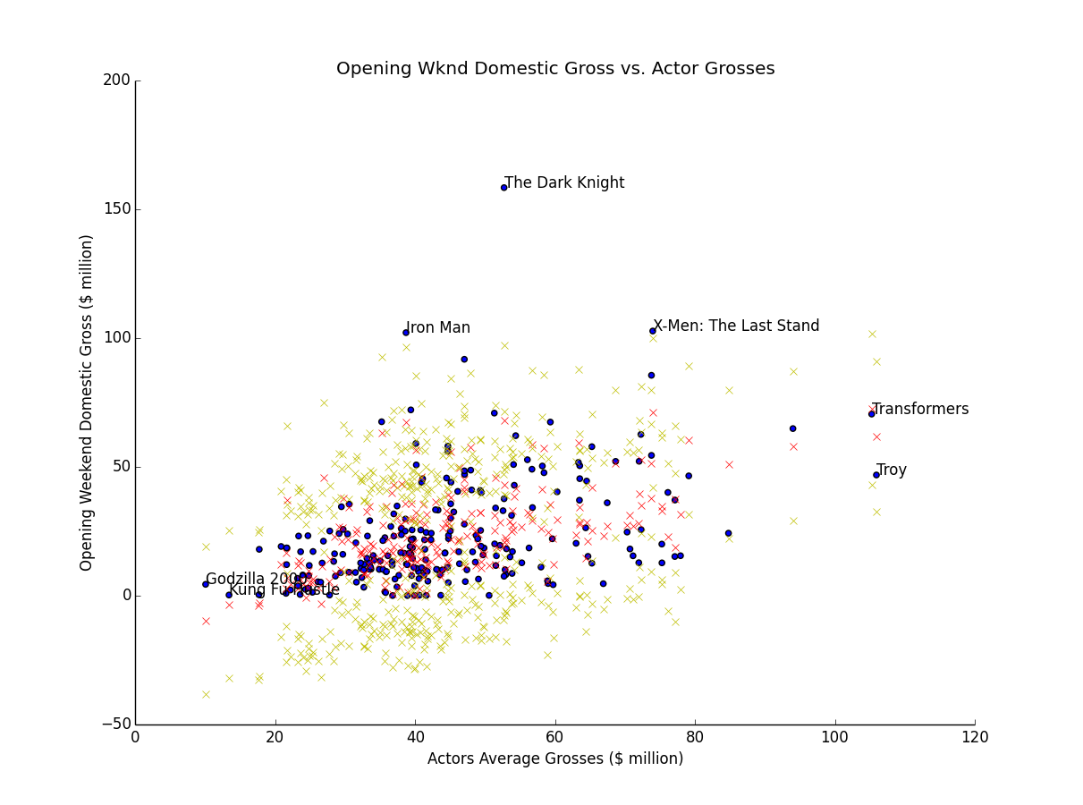
Results: Actor Grosses (Movie)
Notes:
This is the same graph as the previous slide, but with the movie names instead of the actors.

Slide 10
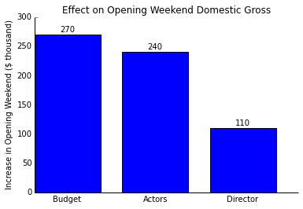
Effects of Factors
Notes:
I’d like to talk about the relative impacts of the different features on the opening weekend domestic gross. For every $1m spent on the budget, according to my model, we can expect a $270k increase in opening weekend domestic gross. For every $1m increase in past success of the top 3 actors, we can expect a $240k increase in the opening weekend domestic gross. Finally, for every $1m increase in the average success of the director, we can expect a $110k increase in the opening weekend domestic gross. From these numbers, we can conclude that the success of the actors has more than twice the impact than the director’s success. As a result, if a studio is trying to weigh their options and figure out which director or actors to choose, they should put more emphasis on the actors than the director.

