Slide 1
Software System Architectures (NSWI130) Architectural Views
Martin Nečaský, Ph.D.
Department of Software Engineering
Faculty of Mathematics and Physics
Charles University in Prague

Slide 2
Component-and-Connector (C&C) Viewpoint Definition
Shows elements that have some run-time presence and run-time relationships between them.
elements = run-time components and connectors
Components and connectors are principal units of computation
Components : processes, objects, clients, servers, data stores, etc.
Connectors : communication links and protocols, information flows, service buses, access to shared storage, message queues, pipes, etc.
relationships = attachment of a component to a connector

Slide 3
Concerns Covered by C&C Viewpoint
What are the major executing components and how do they interact?
What are the major shared data stores?
Which parts of the system are replicated?
How does data progress through the system?
What parts of the system can run in parallel?
How can the system’s structure change as it executes?

Slide 4
Importance of C&C Viewpoint
Shows how the system works and behaves in runtime.
Guides development by specifying structure and behavior of runtime elements.
Helps reason about runtime system quality attributes, such as performance and availability.

Slide 5
More about Components
Components have ports
A point of potential interaction of a component with its environment
It is similar to an interface of a module but not the same (e.g., there can be many ports of the same type, providing same services/operations but under different SLAs)
A component can represent a complex sub-system and, therefore, can be itself described with a C&C architecture.

Slide 6
More about Connectors
Connectors have roles
The way in which the connector may be used by components to carry out interaction.
invokes-services and provides-services roles for client-server connector
writer and reader roles for pipe connector
Roles can be replicated.
Complex connectors may be decomposed into another C&C architecture.
Connectors may have more than 2 roles.
Connectors embody a protocol of interaction which should be documented.

Slide 7
More about Attachments
A component port is attached to a compatible connector role.
Creates a graph with components and connectors as nodes and attachments as edges.

Slide 8
C&C properties
Reliability
What is a likelihood of failure for a given component or connector?
Helps determine overall system availability.
Performance
What response time will the component provide under what loads?
What kind of bandwidth, latency, transaction volume, throughput, etc. can be expected?
Helps determine system-wide properties like response time or buffering needs.

Slide 9
C&C properties
Resource requirements
What are the processing and storage needs of a component or a connector?
Helps determine whether a proposed hardware will be adequate.
Security
Does a component or connector enforce or provide security features? E.g., encryption, audit trails, authentication.

Slide 10
C&C properties
Concurrency
Does a component execute as a separate process or thread?
Helps to analyze and simulate performance of concurrent components and identify possible deadlocks.
Modifiability
Does the messaging structure support evolving data exchanges? Can the component or connector be adapted to process new kinds of messages?

Slide 11
Specific Kinds of Component-and-Connector Viewpoint
Component-and-Connector
Process
Data Flow

Slide 12
Specific Kinds of CaC Viewpoints Process Viewpoint
helps to engineer a system’s execution performance and availability
components are processes related to each other by run-time connectors
communicates with, synchronizes with, runs concurrently with, may run concurrently with, excludes, precedes, orchestrates, ...
process = process in an operation system, thread, distributed process, ...

Slide 13
Sample Process View
ETL
Data Extraction
<<preceeds>>
Data Transformation
<<may-run-concurrently-with>>
Data Cleansing
Data Linking
<<preceeds>>
Data Load
<<runs-concurrently-with>>
Data Provision

Slide 14
Sample Process View (Driven by Decomposition View)
Data Extraction
Extraction Performer Comp.
Extraction Scheduler Comp.
Extractor Configuration Com.
Extraction History Comp.
Extractor
Comp.
getPlan(id)
getConfiguration(id)
Configuration c [c.id = id]
LOOP [foreach d in c.data_sources]
getHistory(d.id)
History h [h.sid = d.id]
ExtractionPlan p
LOOP [foreach e in p.components]
e.run()
RDF data
Notes:
Extraction Performer asks for a plan for a given extraction task identified by an ID.
Extraction Scheduler asks for the configuration of the extraction task to be executed.
Extraction Scheduler asks for the history of accessing related data sources.
Extraction Scheduler builds a plan and returns it to the perfomer.
Extraction Performer runs each extractor according to the plan and receives the data.

Slide 15
Specific Kinds of CaC Viewpoints Data Flow Viewpoint
shows how data is produced and consumed by runtime software elements
it can be used to ensure good performance and data integrity
components produce, consume or store data
connectors enable sharing data
sharing = one component consumes data produced by another component through a connector

Slide 16
Data Flow View
Data Extraction Comp.
Data Cleansing Comp.
Data Linking Comp.
RDF Storage Comp.

Slide 17
More Complex Kinds
Previous examples showed only binary connectors with simple roles which can be visualized as lines.
However, more complex connectors which are hard to visualize as binary connectors exist.
For example: Enterprise Service Bus, Publish Subscribe Mediator.

Slide 18
Deployment View
element = software components and hardware + communication components
relationship = deployment of software components to hardware + communication components
Special kinds: Implementation view, Work assignment view

Slide 19
Implementation View
element = software components and system components (file system, configuration files, ...)
relationship = implemented by

Slide 20
Work Assignment View
element = software components and work teams
relationship = work assignment

Slide 21
How to document architecture?

Slide 22
Section 1: Documentation roadmap
tells the reader what information is in the documentation and where to find it
should include overview of the views (name, type, short description, ...)
how stakeholders can use the documentation
which stakeholders and concerns are addressed by the views
should be a table

Slide 23
Section 2 : System overview
short description of the system’s context, functions, stakeholders, constraints and other important background information

Slide 24
Section 3 : Views documentation
Section 3.1 : How a view is documented
Describe a template for documenting the views
Explain modeling notation(s)
E.g., what does each graphical modeling construct mean
Section 3.2+ : A documentation for each designed view

Slide 25
Section 3.*.1 : Primary representation
shows elements and relationships
should contain all important elements and relationships of the view
not necessarily all minor elements/relationships
graphical informal or semi-formal notation
if the number of elements/relationship is too big, you can separate it to several pictures
e.g., element/relationships which come to play in a normal operation vs. some exceptional operation

Slide 26
Section 3.*.2 : Catalog
List of elements and relationships
At least those from the primary representation
Details for each element and relationship
Name, description, rationale (why it is here?)
Interface, behavior description in different situations
SLA

Slide 27
Kruchten’s 4+1 View

Slide 28
Kruchten’s 4+1 View
Scenarios
Logical View
(end user)
Development View
(programmer)
Process View
(integrator)
Physical View
(system engineer)

Slide 29
Logical View (end user)
system functionality in terms of structural elements
decomposition of system to key functional modules (classes, services) and their attributes and methods
UML package diagrams, UML class diagrams
UML component diagrams
key internal behavior of functional modules
UML state machine diagrams

Slide 30
Process View (integrator)
system functionality in terms of runtime processes
software system partitioned to processes
process = group of related tasks
task is an executable unit which is performed by some functional unit (from logical view)
UML sequence diagrams
UML activity diagrams for more detailed view
allows for parallelization forks and joins, cycles, ...
UML timing diagrams for more detailed specification of performance

Slide 31
Development View (programmer, manager)
decomposition to software components developed and tested by development teams
libraries, sub-systems
each component provides well-defined interface to other components
it is specified what other components a component can use
layered structure recommended
UML component diagrams
work assignment, development cost and time planning, project progress monitoring
reasoning about software reuse, security and portability

Slide 32
Physical View (system engineer)
assignment of functional components, processes and tasks to physical configurations
should be flexible, assignment to another configuration should have minimal impact on development view
development and test physical configuration
deployment configurations for different customers
UML deployment diagrams

Slide 33
Scenarios
encompasses instances of use cases that describe system behavior as seen by stakeholders
use case = some very important requirement expressed as concrete interaction with the system
discussed as last but created as first
UML use case diagrams

Slide 34
Organization Architecture + Information Architecture

Slide 35
Organization
Hospital
Reception
Investigation
Hospitalization
Surgery
Control
“
Organization is a group of people who work together to create a common added value for organization’s clients.
Economy
Material
Reports
Utility
Accommodation
Sanitary
Food
”

Slide 36
Organization
we will distinguish two parts of organization (i.e. two subsets of people in organization):
business
performs various business activities to satisfy clients
represents the needs and requirements
IT
creates, runs and maintains IT infrastructure to support the activities of business

Slide 37
Business Process
business activities are organized into business processes
activities may be automated
activities within a single business process may be performed by different business people
business process can span the whole organization
“Business process is a chain of (business) activities whose output has some added value for the target (customer, people in organization, partner organization, ...).”

Slide 38
Business Process
three kinds of business processes
management processes
management of the organization, strategic planning
operational processes
create the added value of the organization
also called core processes
supporting processes
supplementary processes which support the operational processes

Slide 39
Business Document
business people exchange information among each other and with partner organizations
information exchange in the real world means exchanging business documents
within organization or with external partners

Slide 40
Organization needs to ...
build IT infrastructure which supports business activities and document exchange
automate, control, monitor, optimize, etc.
integrate IT infrastructure with its partners
flexibly, quickly and cheaply change IT infrastructure
according to ever-changing business requirements
reuse its existing capabilities and buy capabilities of third-parties
monitor and optimize the infrastructure and business processes

Slide 41
Organization Architecture + Information Model
basic building block of business-driven development
organization architecture
model of added value created by organization
model of business goals of organization
model of business processes
as use cases on a more abstract level
as connected activities on a more concrete level
information model of organization
model data domain
model documents

Slide 42
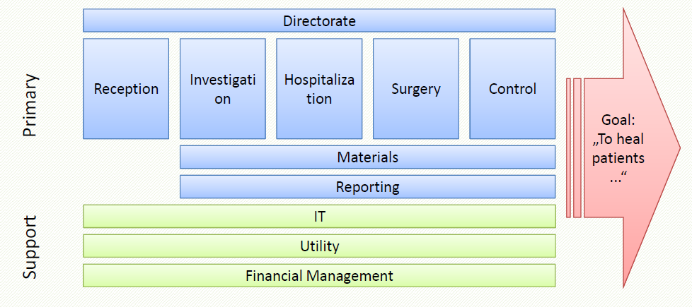
Organization Architecture Value-Added Diagram

Slide 43
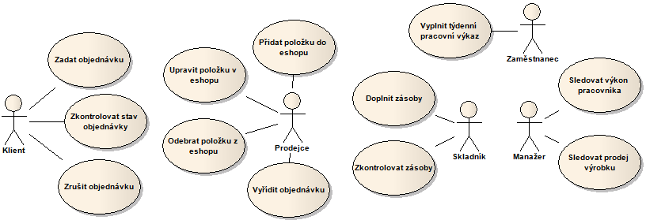
Organization Architecture Business Processes
exploit use-case diagrams to identify business processes in organization
use-case for each identified business process

Slide 44
Organization Architecture Business Processes
actor represents a key role in organization which performs some actions or whole business processes

Slide 45
Organization Architecture Business Processes
use case represents a particular business process
roles participate on use cases

Slide 46
Organization Architecture Business Processes
use case is further specified by use case scenario
use case scenario consists of sequence of steps
one main flow
zero or more alternative flows
use case scenario is formally expressed by Business Process Model
usually: 1 use case = 1 business process
sometimes: N use cases = 1 business process

Slide 47
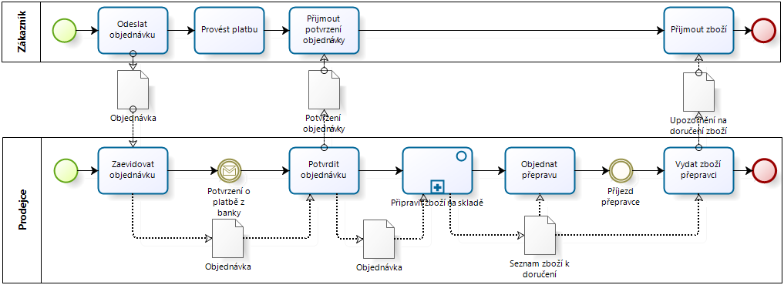
Organization Architecture Business Processes

Slide 48
Organization Architecture Business Processes

Slide 49
Organization Architecture Business Processes

Slide 50
Information Model
domain model specifies information in documents exchanged among business process activities
sometimes also called semantic model
two parts
conceptual domain model
specification of domain independently of particular documents
document models
specification of how parts of domain are represented in particular kinds of documents

Slide 51
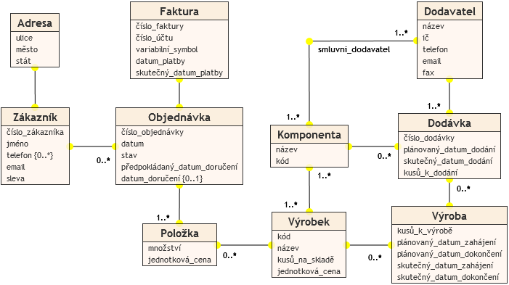
Information Model
conceptual domain model
UML class diagrams on high level of abstraction
no or only very generic data types, no keys, no class methods, ...

Slide 52
Information Model
document model
describes particular kind of documents from business process models
real-world documents have hierarchical structure
contains main information item which nests some additional information
e.g. purchase order with customer and purchase items details, procurement tender with tenderer details and offered price, patient record with examination details, etc.
different kinds of documents can share the same part of domain but represent it in different way

Slide 53
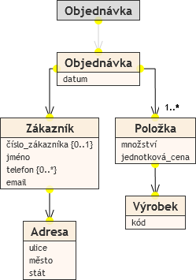
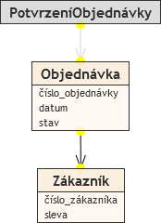
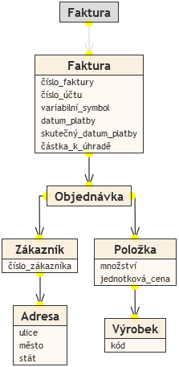
Information Model
document model

Slide 54
The End

