Slide 1
Virtualization and Cloud Computing
Virtualization
David Bednárek, Jakub Yaghob, Filip Zavoral

Slide 2
Resources
Using freely available VMware courseware
https://labs.vmware.com/academic/courseware-post

Slide 3
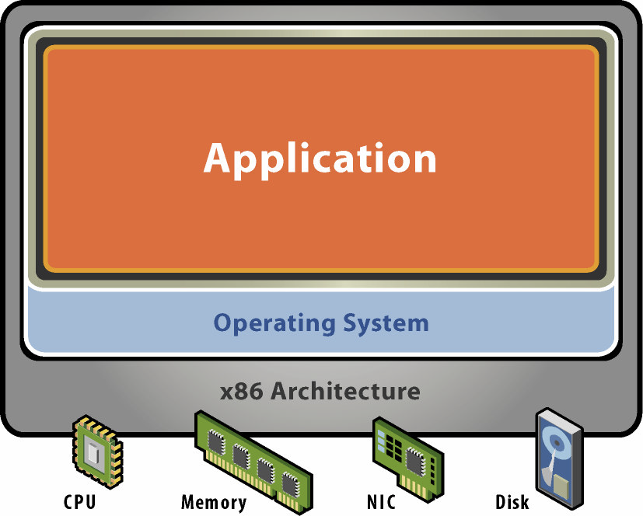
Physical machine
Physical HW
CPU, RAM, disks, I/O
Underutilized HW
SW
Single active OS
OS controls HW

Slide 4
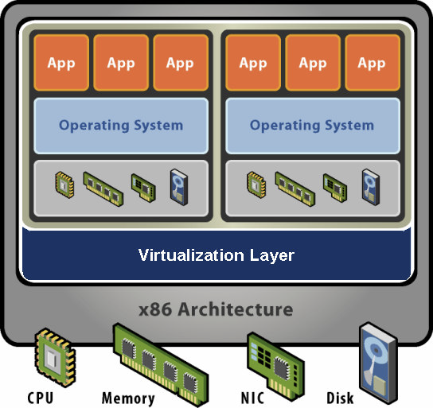
Virtual machine
HW-level abstraction
Virtual HW: CPU, RAM, disks, I/O
Virtualization SW
Decouples HW and OS
Multiplexes physical HW across multiple guest VMs
Strong isolation between VMs
Manages physical resources, improves utilization

Slide 5
Virtual machine – isolation
Secure multiplexing
Multiple VMs on a single physical host
CPU HW isolates VMs (MMU)
Strong guarantees
SW bugs, crashes within one VM cannot affect other VMs
Performance isolation
Partition system resources

Slide 6
Virtual machine – encapsulation
Entire VM is a file
OS, applications, data
Memory and device state
Snapshots and clones
Capture VM state on the fly and restore to point-in-time
System provisioning, backup, mirroring
Easy content distribution
Preconfigured apps
Virtual appliances

Slide 7
Virtual machine – compatibility
HW-independent
Physical HW hidden by virtualization layer
Standard virtual HW exposed to VM
Create once, run everywhere
No configuration issues
Migrate VMs between hosts
Legacy VMs
Run ancient OS on new platform

Slide 8
Resource controls
Shares
Specify relative importance
Entitlement directly proportional to shares
Abstract relative units, only ratios matter
Reservation
Minimum guarantee, even when system overloaded
Concrete absolute units
Admission control: sum of reservations ≤ capacity
Limit
Upper bound of consumption, even if underloaded
Concrete absolute units

Slide 9
Resource controls – demo
Proportional-share scheduling
Simple virtual-time algorithm
Virtual time = usage / share
Schedule VM with smallest virtual time
Example: 3 VM A, B, C with 3:2:1 share ratio
A
2
4
4
6
8
8
8
10
10
B
3
3
6
6
6
9
9
9
12
C
6
6
6
6
6
6
12
12
12

Slide 10
Distributed systems
Features
Choose initial host when VM powers on
Migrate running VM across physical hosts
Dynamic load balancing
Distributed power management
Distributed I/O management
Support cloud computing, multi-tenancy

Slide 11
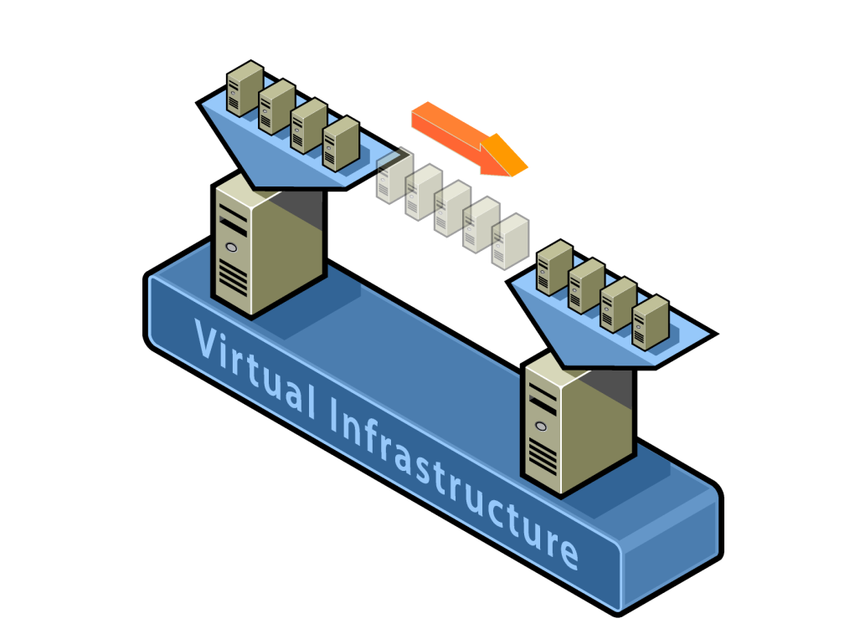
Live VM migration
Hot migrate across hosts
Transparent to guest OS, apps
Minimal downtime (≤1s)
Requirements
Shared storage
Same subnet
Compatible CPUs (EVC)

Slide 12
Load balancing
4GHz
4GHz
VM1
VM2
VM3
VM4
3GHz
2GHz
1GHz
1GHz
Host normalized
entitlement = 1.25 (5/4)
Host normalized
entitlement = 0.5 (2/4)

Slide 13
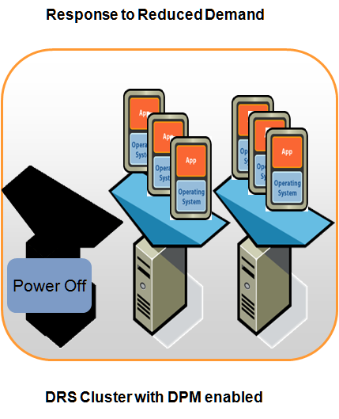
Distributed power management
Consolidate VMs onto fewer hosts and power off hosts when demand is low
Power hosts back on when needed to meet workload demands or to satisfy constraints
Works in concert with DRS

Slide 14
Distributed high availability
Features
Specify resources to reserve to restart VMs upon failures of their hosts in a cluster
Number of host failures to tolerate
Percentage of cluster capacity
Specify hosts to set aside for failover
Failover reservation strict or best-effort
Decentralized host failure detection and quick VM restart
Cluster hosts send each other heartbeats; when a host fails to do so for some period, failover response action is launched
Works in concert with DRS and DPM
Resources for each VM to failover on 1 powered on host
DRS/DPM/HA proactively maintain appropriate spare resources

Slide 15
Fault tolerance
High speed availability
Modern CPUs can replicate stream of instructions
Cluster creates secondary VM and moves it to another host, they share resources on SAN
Primary VM works as usual, secondary VM makes only reads
When host for primary VM fails, secondary VM becomes primary and continues without interruption
Small lag (≈ 5ms)

Slide 16
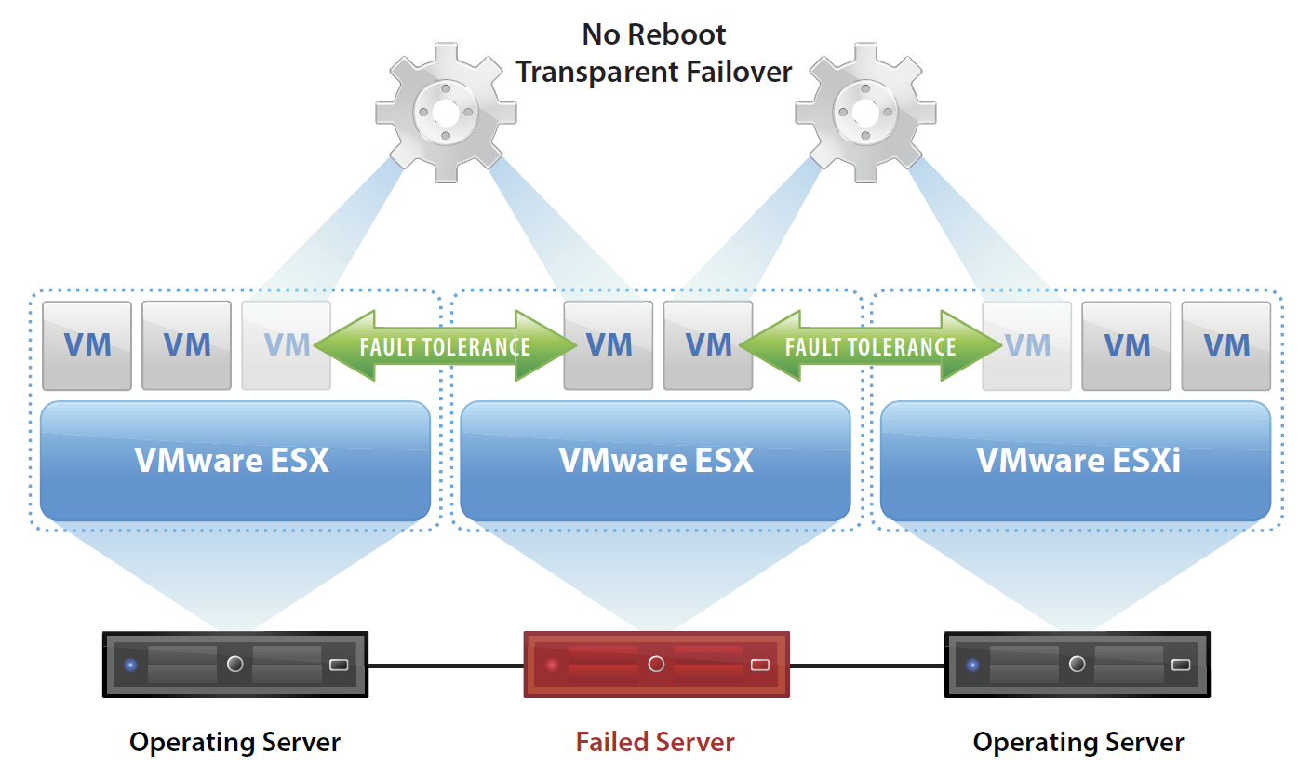
Fault tolerance – demo

