Slide 1

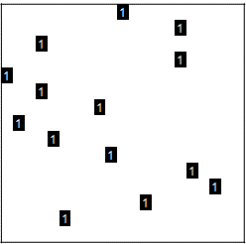
CNNs
Input: MSESAEKCFLTWPG …
21 amino acids
 | A | C | D | E | F | G | H | I | K | L | M | N | P | Q | R | S | T | V | W | X | Y
M |  |  |  |  |  |  |  |  |  |  | 1
S |  |  |  |  |  |  |  |  |  |  |  |  |  |  |  | 1
E |  |  |  | 1
S |  |  |  |  |  |  |  |  |  |  |  |  |  |  |  | 1
A | 1
E |  |  |  | 1
K |  |  |  |  |  |  |  |  | 1
C |  | 1
F |  |  |  |  | 1
L |  |  |  |  |  |  |  |  |  | 1
T |  |  |  |  |  |  |  |  |  |  |  |  |  |  |  |  | 1
W |  |  |  |  |  |  |  |  |  |  |  |  |  |  |  |  |  |  | 1
P |  |  |  |  |  |  |  |  |  |  |  |  | 1
G |  |  |  |  |  | 1
⋮
CNN
Concatenation
Output: TF/non-TF
Embedding matrix

