Slide 1

INT 400 Internship
Final Review
Certain Investigation of Malicious and Normal Traffic Interpretation
Team Members
1. S.DHARSON RAM(E0222025)
2. AKISH RAJ(E0222047)
Project Guide
Dr. ANAND J V
Assistant Professor

Slide 2
INTRODUCTION
In today’s digital landscape, distinguishing between malicious and normal network traffic is critical for ensuring cybersecurity. Malicious traffic poses serious threats to systems, while normal traffic follows routine communication patterns. This investigation aims to explore the key methods for detecting malicious traffic and the challenges involved in differentiating it from legitimate activity, ultimately contributing to stronger network defense strategies.

Slide 3
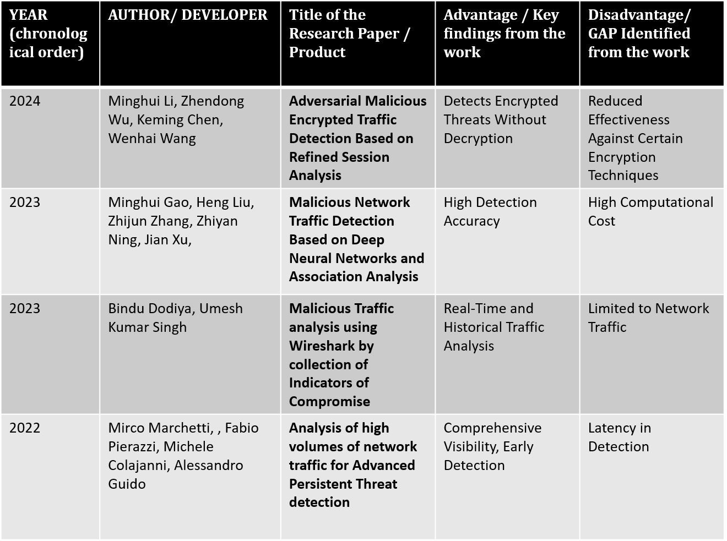
LITERATURE SURVEY

Slide 4
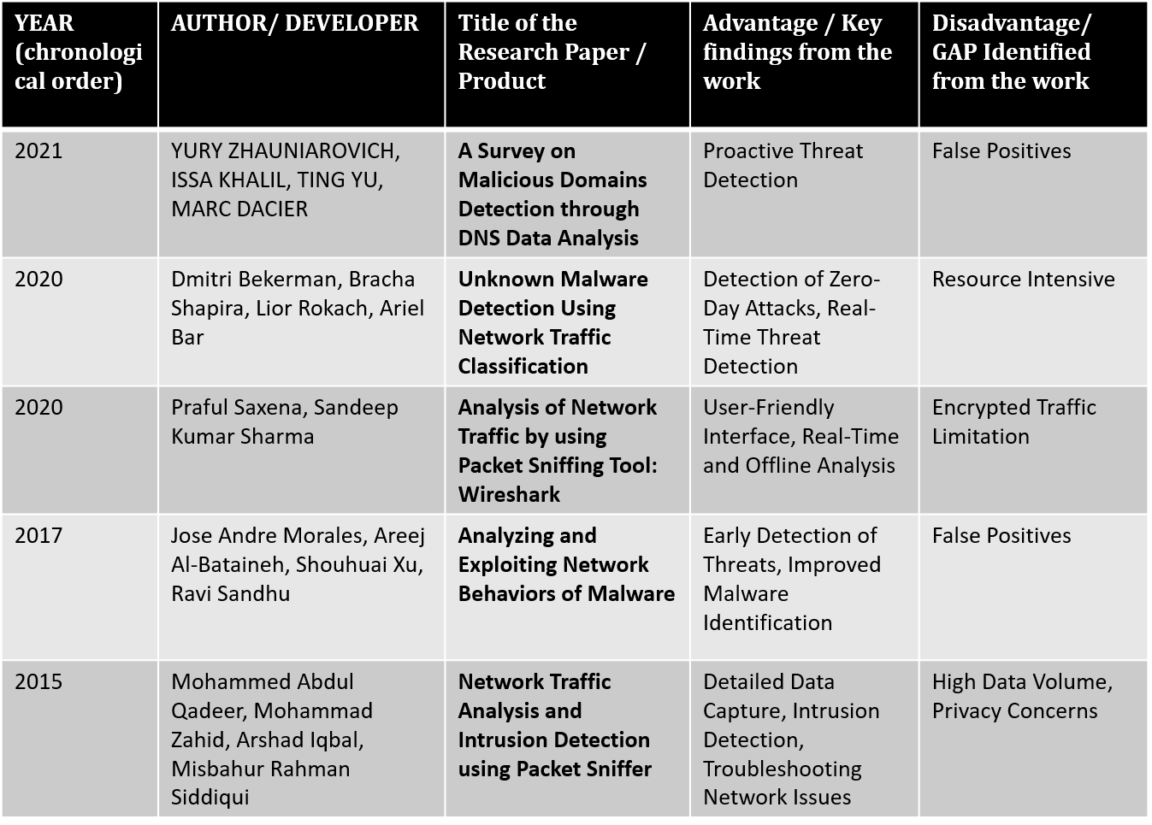

Slide 5
PROBLEM STATEMENT
In this modern Era Distinguishing between malicious and normal traffic is critical for maintaining security and operational integrity. The increasing volume and complexity of network traffic make it challenging to accurately identify and interpret malicious activities without generating excessive false positives or impacting legitimate operations.

Slide 6
OBJECTIVES
Employ tools like Wireshark to capture and inspect network traffic for forensic purposes.
Use Wireshark to detect and categorize different types of attack signatures and network anomalies. Enable administrators to monitor network activity at a granular level, gaining insights into real-time events.

Slide 7
WORKFLOW DIAGRAM
Raw data network packets
ingress traffic
TSHARK Py File
NO
YES
Malicious
traffic
Normal traffic
Identify Patterns
Denial of the packet
Log Suspicious Activity

Slide 8
Methodology
Data Collection: Capture real-time network traffic using Wireshark, storing it in PCAP files. This traffic will contain both normal and potentially harmful packets.
Data Filtering: Leverage Wireshark’s advanced filtering capabilities to detect anomalies in the network, such as malware, suspicious behaviors, or slow connections. Automated Traffic Capture: Use TShark to automate the traffic capture process, enabling continuous monitoring of network activity.
Geolocation Mapping: Utilize Python, along with libraries like Pyshark and Geopy, to analyze the PCAP data and visually map the destination IP addresses.
Testing and Validation: Perform testing across different network environments to assess the effectiveness of the methodology in detecting network issues and malicious activities.

Slide 9
IMPLEMENTATION
1. Setup Environment: Install Wireshark and Tshark on your Linux machine, ensuring you have the necessary permissions to capture network traffic.
2. Monitoring network traffic: it provides detailed information such as timestamps, frame numbers, and packet sizes. At the network layer, it reveals source and destination MAC addresses, IP addresses, and protocols (like TCP, UDP, or ICMP). You can also see transport layer details like port numbers, packet flags, sequence numbers, and payload data, helping analyze network communication and detect issues like latency, dropped packets, or security threats
3. Running Malware: DDoS and ARP Poisoning: When malware initiates a DDoS (Distributed Denial of Service) attack, Wireshark captures high volumes of traffic targeting specific IP addresses, often overwhelming a server with numerous requests. In ARP poisoning, Wireshark detects manipulated ARP packets where the malware alters MAC-to-IP mappings, redirecting network traffic.

Slide 10
4. Capturing malware traffic: When running malware in a controlled environment and capturing the network traffic with Wireshark, you can observe malicious activities like unusual connections, abnormal traffic patterns, or data exfiltration attempts.
5. Automating Network Analysis with Tshark: By automating Tshark, you can efficiently scan live network traffic and analyze PCAP files. Tshark's filters allow you to capture specific packets or protocols in real-time, and automation scripts can quickly process and extract key information, such as IP addresses or unusual traffic patterns, from stored capture files. This makes network monitoring and malware detection more streamlined and less reliant on manual analysis.

Slide 11
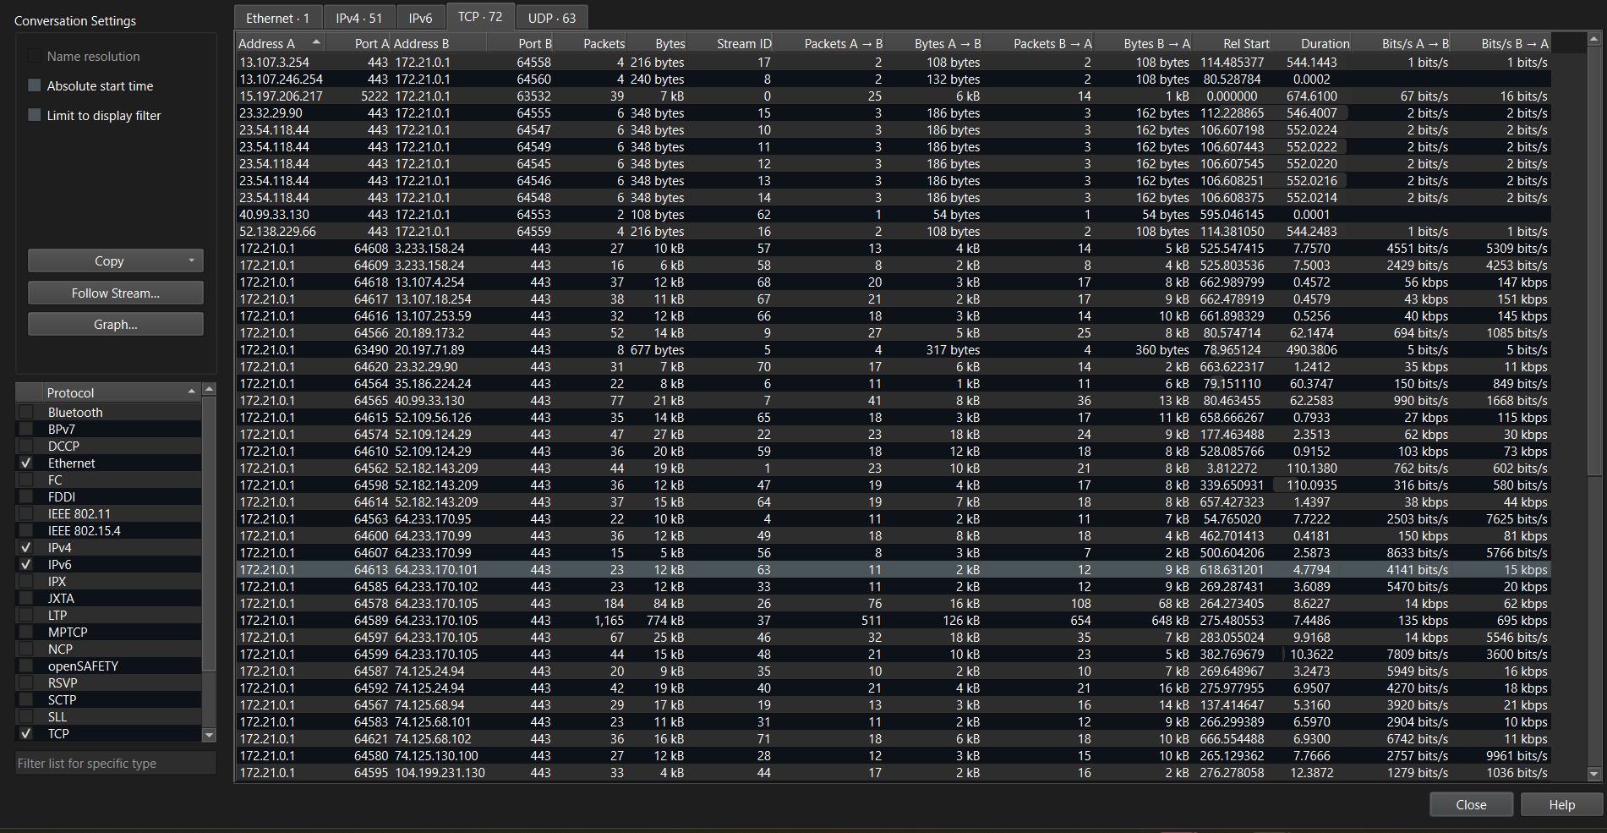
RESULT AND OUTPUT
1.PCAP File

Slide 12
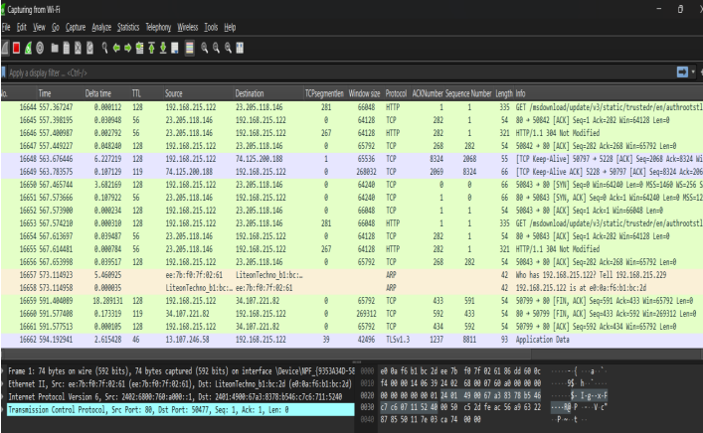
2.Normal Traffic Capture

Slide 13
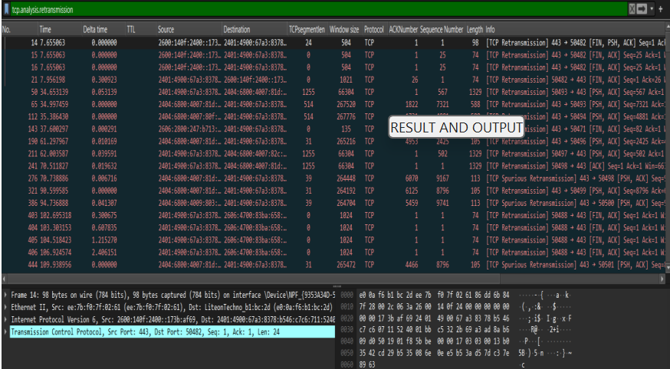
3.Retransmission Issue

Slide 14
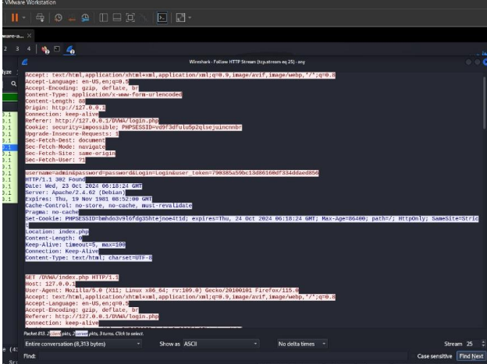
4. Analyzing HTTP Traffic

Slide 15
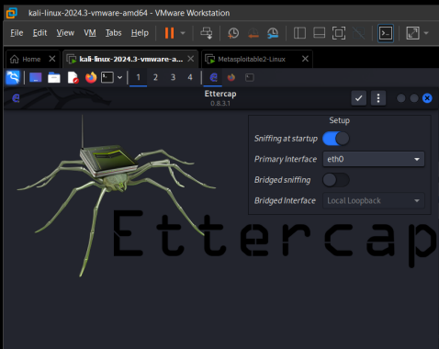
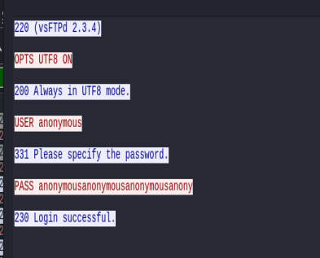
5. ARP Poisoning
6. Scanning ARP

Slide 16
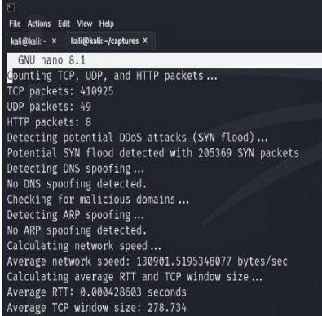
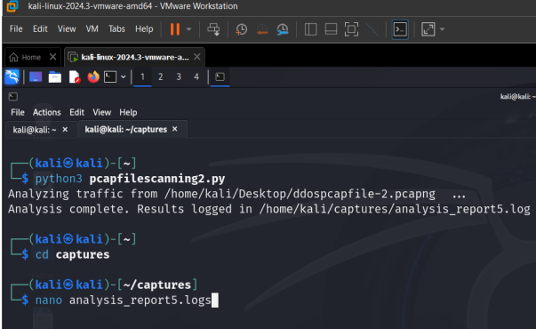
7. Tshark Automation

Slide 17
Conclusion:
The project proved that it is possible to capture, analyze, and visual network traffic with Wireshark, Python, and TShark. By assisting the automated process of traffic capture while mapping geolocation information, a clear approach is provided that assists in identifying what is normal traffic and what is suspected to be malicious in nature. Since this system also incorporates the analysis of data in real-time, it helps in the monitoring of networks and quicker resolution of cybersecurity issues.
Future Scope:
Machine learning models could be incorporated for real-time anomaly detection as well as automating the entire process for larger amount of data and more complex traffic patterns. Also, embedding more recent threat-detection methods could also supplement the system’s capabilities in recognizing modern era cyberattacks.

Slide 18
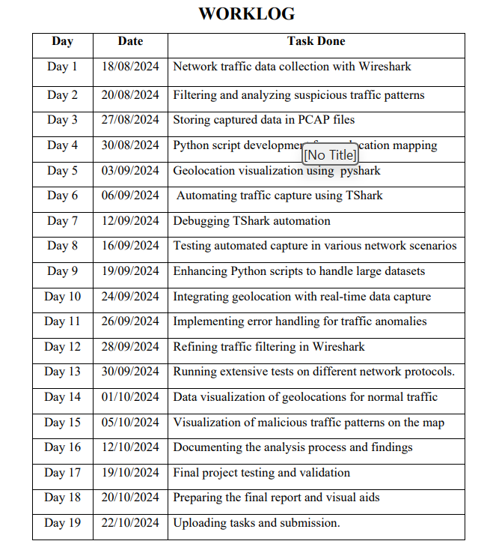
WORK LOG

Slide 19
REFERNCES
JOURNAL REFERENCE:
Dodiya, Bindu, and Umesh Kumar Singh. "Malicious Traffic analysis using Wireshark by collection of Indicators of Compromise." International Journal of Computer Applications 183.53 (2022): 1-6.
Saxena, Praful, and Sandeep Kumar Sharma. "Analysis of network traffic by using packet sniffing tool: Wireshark." International Journal of Advance Research, Ideas and Innovations in Technology 3.6 (2023): 804-808.

Slide 20
Thank you

