Slide 1


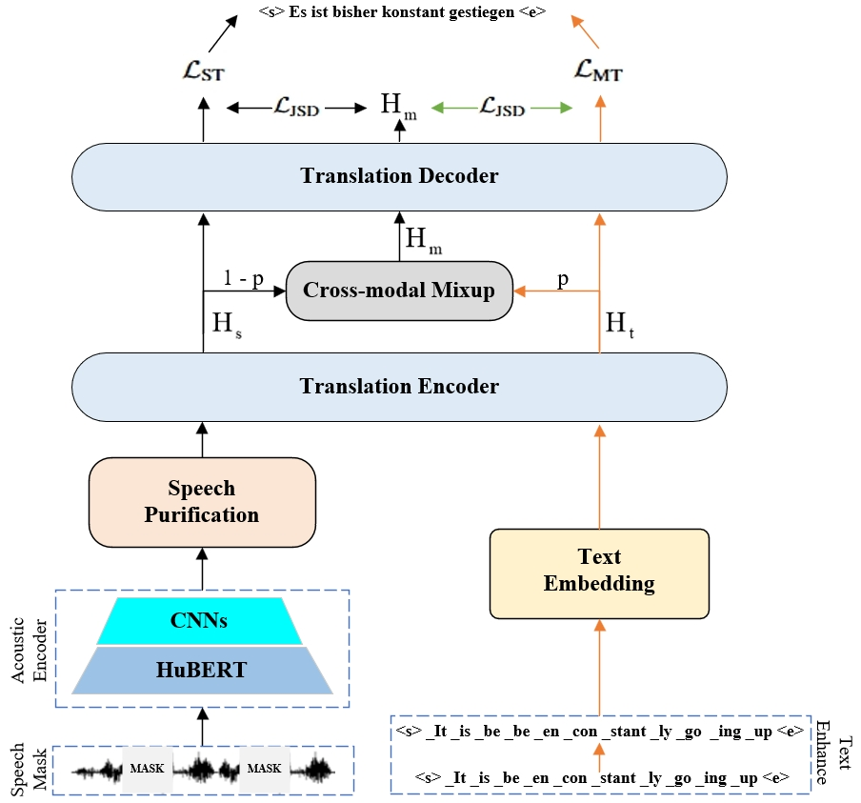
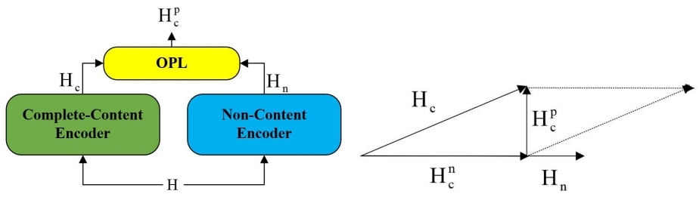
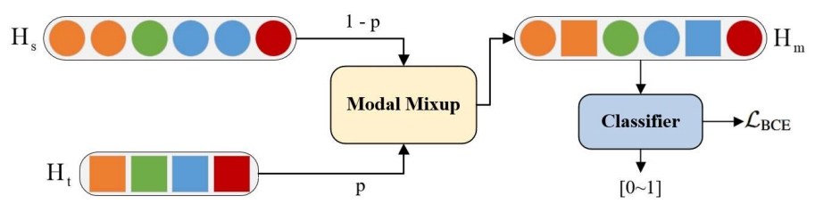
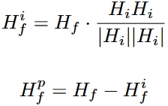
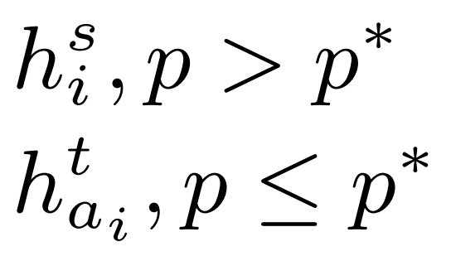
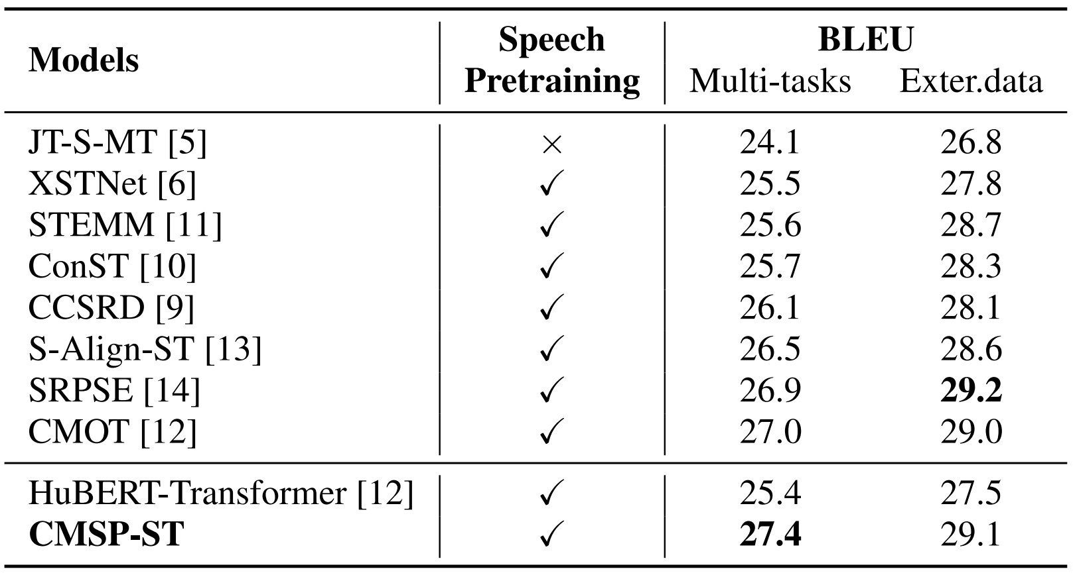
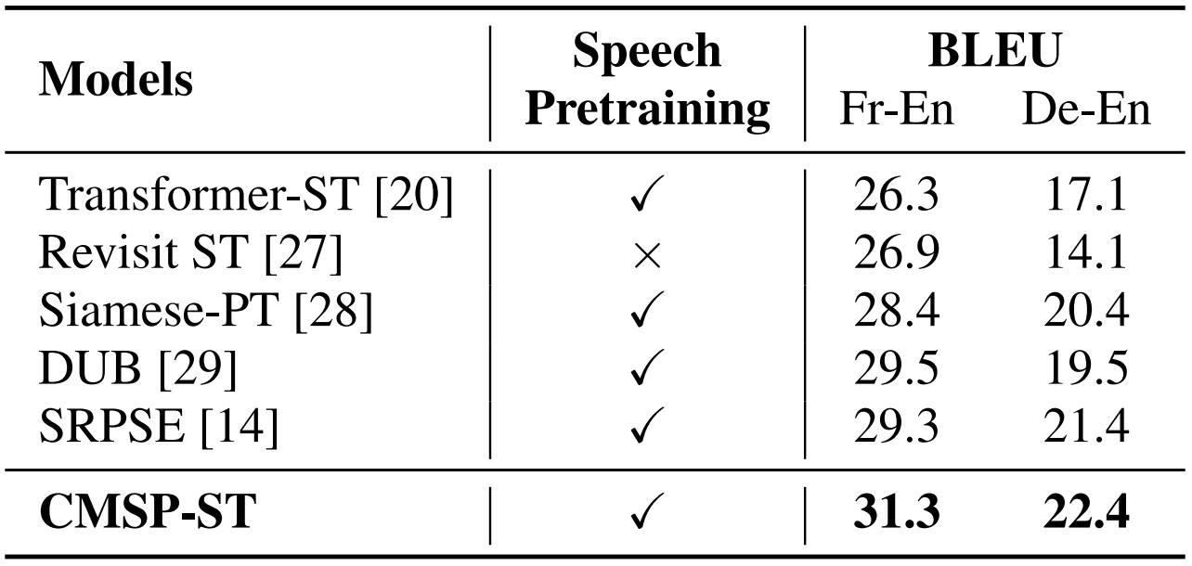
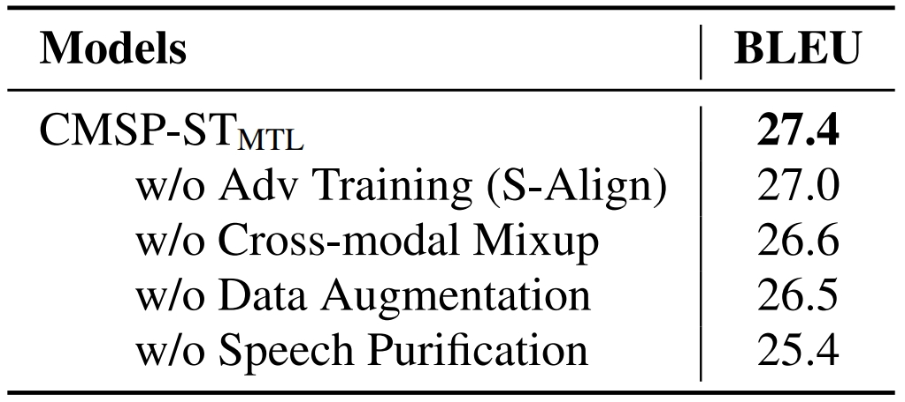
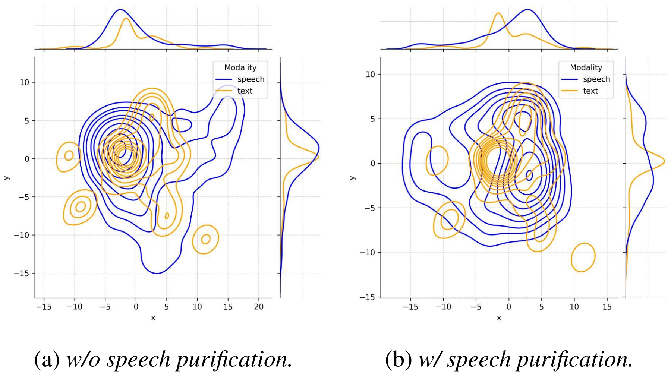
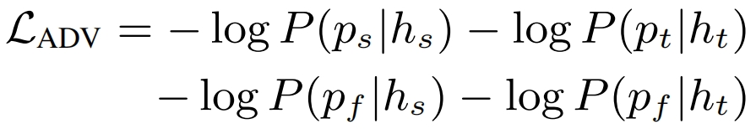
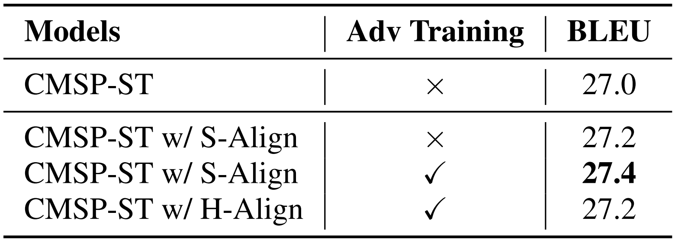

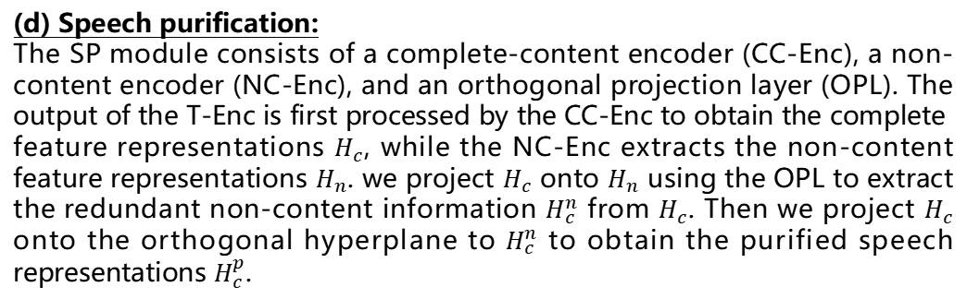
CMSP-ST: Cross-modal Mixup with Speech Purification for End-to-End Speech Translation
Jiale Ou, Hongying Zan
Fair and Inclusive Speech Science and Technology
School of Computer and Artificial Intelligence
Zhengzhou University
1791088334@qq.com, iehyzan@zzu.edu.cn
Introduction
End-to-end speech translation (E2E ST) aims to directly convert speech in a source language into text in a target lan-guage, and its performance is constrained by the inherent modality gap. Existing methods attempt to align speech and text representations to perform cross-modal mixup at the token level, which overlooks the impact of redundant speech information. In this paper, we propose cross-modal mixup with speech purification for speech translation (CMSP-ST) to address this issue. Specifcally, we remove the non-content features from speech through orthogonal projection and extract the purifed speech features for cross-modal mixup. Additionally, we employ adversarial training under the Soft Alignment (S-Align) to relax the alignment granularity and improve robustness. Experimental results on the MuST-C En-De, CoVoST-2 Fr-En, and CoVST-2 De-En benchmarks demonstrate that CMSP-ST effectively improves the speech translation performance of existing cross-modal mixup methods.
We open-source the model for future research at https://github.com/Akito-Go/CMSP-ST.
Framework of CMSP-ST
Main contributions:
E2E ST Training Framework. We propose Cross-modal Mixup with Speech Purification for End-to-end Speech Translation (CMSP-ST).
Speech Purification. We introduce two additional encoders, one for extracting non-content information from speech and the other for extracting complete speech features, and obtain content-focused purified speech features by removing non-content information from complete speech features through an orthogonal projection strategy.
Adversarial Training with Soft Alignment. We use Soft Alignment (S-Align) to relax alignment granularity by aligning the representation spaces of speech and text, and further improve the robustness of the model through adversarial training. Based on this, we implement token-level mixup of text and purified speech.
Significant improvements. Experimental results on the MuST-C En-De, CoVoST-2 Fr-En, and CoVoST-2 De-En datasets show that the CMSP-ST method can enhance the knowledge transfer of existing cross-modal mixup methods and effectively alleviate the modality gap in ST tasks.
(b) CMSP-ST: SP
(c) CMSP-ST: CM
SP
Main Results
(a) CMSP-ST: model
CM
Evaluation Metrics:
BLEU: An automatic metric used to evaluate the quality of machine-generated text, especially in translation tasks. It measures how closely a candidate translation matches one or more reference translations based on overlapping n-grams. Scores range from 0 to 1 (often shown as 0–100), with higher scores indicating better translation quality.
Methods
(a) Model architecture:
Our model adopts an encoder-decoder architecture, comprising six main modules: the acoustic encoder (A-Enc), text embedding (T-Emb) module, translation encoder (T-Enc), speech purification (SP) module, cross-modal mixup (CMM) module, and translation decoder (T-Dec).
In the multi-task setting, CMSP-ST outperforms HuBERT-Transformer by 2.0 BLEU and surpasses CMOT, which also uses OT and cross-modal mixup, by 0.4 BLEU. With the introduction of external MT data, CMSP-ST also slightly outperforms CMOT and achieves performance comparable to SRPSE.
(b) Masking strategy:
We implement a masking strategy for the input of the A-Enc to enhance speech purification, following the configuration of CCSRD. Furthermore, we randomly insert repeated elements or padding into the input of the T-Emb with a predefined probability to simulate the characteristics of speech content information.
(c) Classifier network:
In the CMM module, we introduce a classifier network consisting of three feed-forward layers and an output layer followed by sigmoid activation for
modality classification.
The experimental results demonstrate that, despite some baseline models leveraging large-scale external ASR and MT data in the pre-training stage to train encoder/decoder modules, or employing back-translation techniques, the CMSP-ST model still achieves performance that is comparable.
(d) Speech purification:
The SP module consists of a complete-content encoder (CC-Enc), a non-content encoder (NC-Enc), and an orthogonal projection layer (OPL). The output of the T-Enc is first processed by the CC-Enc to obtain the complete feature representations $H_{c}$, while the NC-Enc extracts the non-content feature representations $H_{n}$. we project $H_{c}$ onto $H_{n}$ using the OPL to extract the redundant non-content information $H_{c}^{n}$ from $H_{c}$. Then we project $H_{c}$ onto the orthogonal hyperplane to $H_{c}^{n}$ to obtain the purified speech representations $H_{c}^{p}$.
Ext. Main Results: comparison with baselines && multilingual verification
Ablation Study
(e) Cross-modal mixup:
Considering that achieving the ideal H-Align is difficult and may conflict with cross-modal mixup, we introduce S-Align to relax the alignment granularity. The classifier adjusts the classification target from the modality ID (0 or 1) to p, achieving a shift from S-Align to H-Align, aiming to learn a unified representation space by identifying the modality spaces of the input representations. To further enhance its effectiveness, we use a pseudo-label with a fixed mixup probability of 0.5 for adversarial training and employ binary cross-entropy (BCE) loss for modality classification. The overall adversarial training objective can be described as follows.
(f) Training objective:
The overall training objectives for both the multi-task and external data settings are as follows.
Ext. Methods Evaluation: ablation studies && visualization

