Slide 1


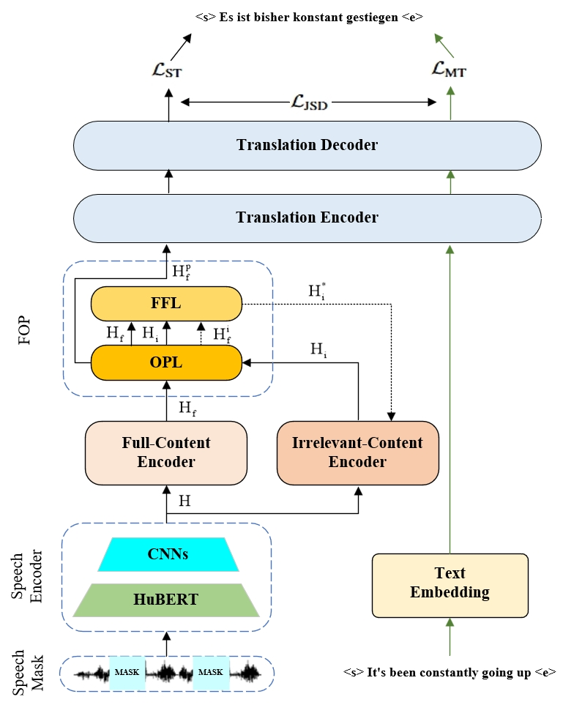
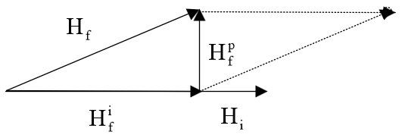
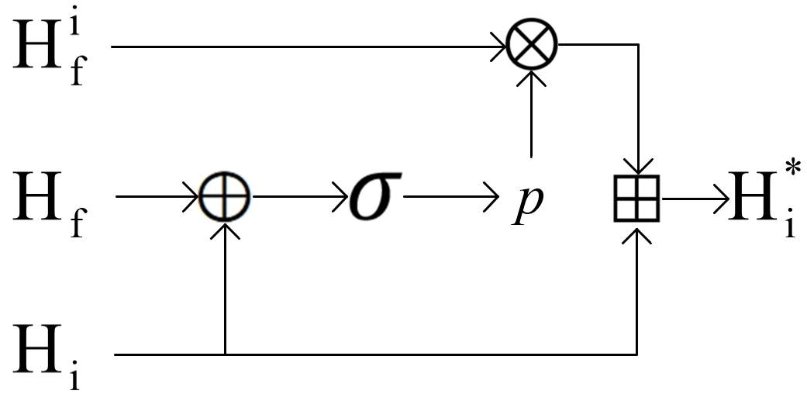
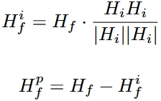
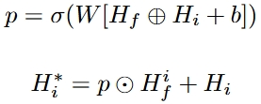
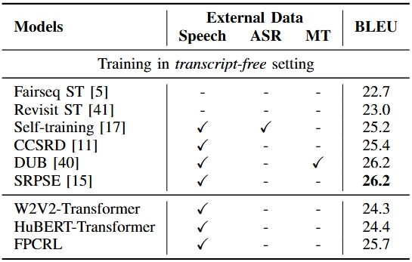
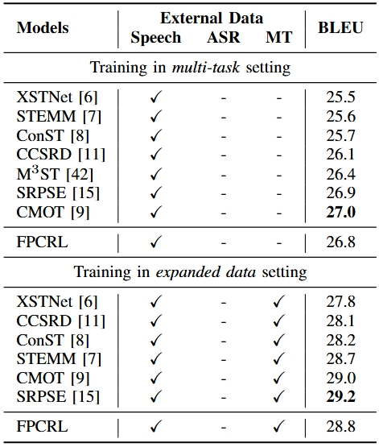
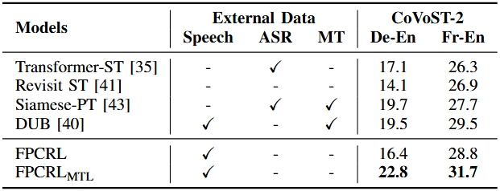
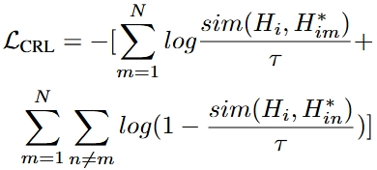
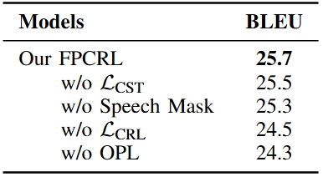
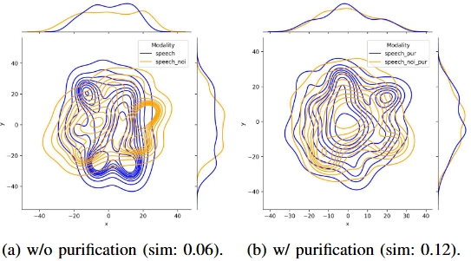

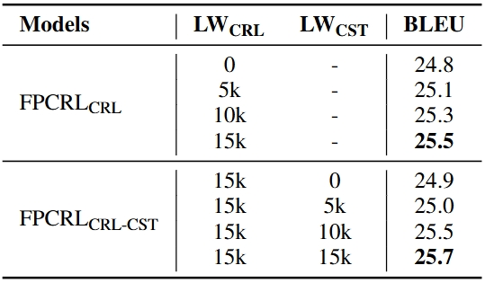
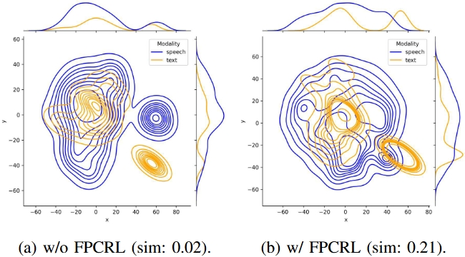
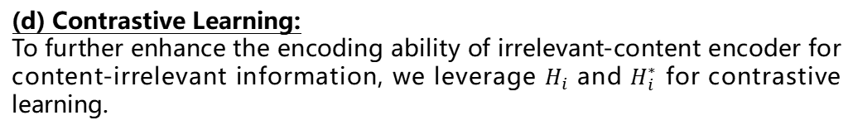
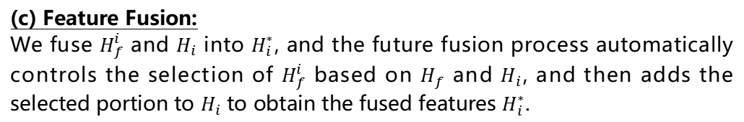
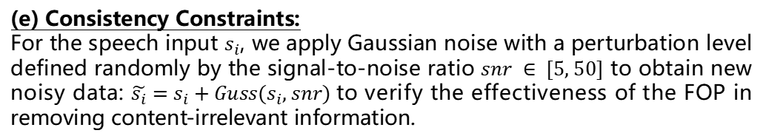
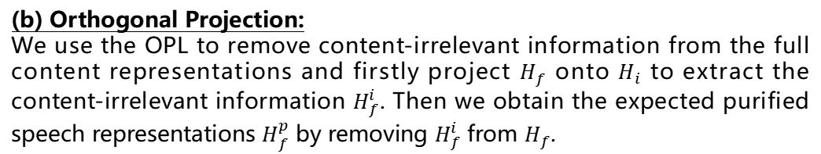
FPCRL: Feature Projection and Contrastive Representation Learning for End-to-End Speech Translation
Jiale Ou, Hongying Zan
All Neural Network roads lead to
Rome
School of Computer and Artificial Intelligence
Zhengzhou University
1791088334@qq.com, iehyzan@zzu.edu.cn
Introduction
Speech-to-text translation is a cross-modal and multilingual translation task. To alleviate the modality gap and data scarcity of this task, recent research has primarily focused on aligning speech and text representations to unify cross-modal features and incorporating external knowledge via multi-task learning. Although significant progress has been achieved, there remains potential for improvement, particularly in enhancing translation performance by purifying speech representations to extract more content-relevant information. In this paper, we propose a framework based on feature projection and contrastive representation learning for speech translation, FPCRL, which is adaptable to various training settings. FPCRL introduces additional full-content and irrelevant-content encoders, which separately extract full and irrelevant information from speech. Through a feature projection module, irrelevant components are removed from the full content representations, yielding purified speech representations. Furthermore, the extracted content-irrelevant information is utilized to guide the training of the irrelevant-content encoder via contrastive representation learning. Experiments on the MuST-C En-De, CoVoST-2 De-En, and CoVoST-2 Fr-En benchmarks demonstrate that FPCRL achieves significant improvements across all datasets.
We open-source the model for future research at https://github.com/Akito-Go/FPCRL.
Framework of FPCRL
Main contributions:
E2E ST Training Framework. We propose a training framework FPCRL for E2E ST, which can be applied in various settings. This framework purifies speech representations by introducing additional full-content and irrelevant-content encoders and employing a feature orthogonal projection method.
Speech Purification and Feature Fusion. By leveraging the redundant content-irrelevant information extracted during the purification process, we introduce a feature fusion method to combine it with the output from the irrelevant-content encoder. This fusion further guides the encoder to effectively capture and learn the content-irrelevant information.
Significant improvements. Experiments on the MuST-C En-De, CoVoST-2 De-En, and CoVoST-2 Fr-En benchmarks show that the methods we proposed can lead to significant improvements over strong E2E ST baselines across three settings: transcript-free, multi-task, and expanded data.
(b) FPCRL: OPL
(c) FPCRL: FFL
OPL
Main Results
FFL
Evaluation Metrics:
(a) FPCRL: model
BLEU: An automatic metric used to evaluate the quality of machine-generated text, especially in translation tasks. It measures how closely a candidate translation matches one or more reference translations based on overlapping n-grams. Scores range from 0 to 1 (often shown as 0–100), with higher scores indicating better translation quality.
Methods
(a) Speech Mask:
We modify the speech input s to mask continuous segments and obtain the masked waveform s', which is utilized as the input of the model. Then we mask with a probability of 0.75 for each speech input. The selected speech input is then masked for at least 2 spans, each containing at least 3600 consecutive frames.
(b) Orthogonal Projection:
We use the OPL to remove content-irrelevant information from the full content representations and firstly project $H_{f}$ onto $H_{i}$ to extract the content-irrelevant information $H_{f}^{i}$. Then we obtain the expected purified speech representations $H_{f}^{p}$ by removing $H_{f}^{i}$ from $H_{f}$.
(c) Feature Fusion:
We fuse $H_{f}^{i}$ and $H_{i}$ into $H_{i}^{∗}$, and the future fusion process automatically controls the selection of $H_{f}^{i}$ based on $H_{f}$ and $H_{i}$, and then adds the selected portion to $H_{i}$ to obtain the fused features $H_{i}^{∗}$.
(d) Contrastive Learning:
To further enhance the encoding ability of irrelevant-content encoder for content-irrelevant information, we leverage $H_{i}$ and $H_{i}^{∗}$ for contrastive learning.
Ext. Main Results: comparison with baselines && multilingual verification
Ablation Study
(e) Consistency Constraints:
For the speech input $s_{i}$, we apply Gaussian noise with a perturbation level defined randomly by the signal-to-noise ratio $snr ∈ [5, 50]$ to obtain new noisy data: $\tilde{s_{i}}=s_{i}+Guss(s_{i}, snr)$to verify the effectiveness of the FOP in removing content-irrelevant information.
(f) Loss Warm-up:
We propose a loss warm-up method, where the loss coefficient is initialized to a small value of 1e-8 at the beginning of training. As the number of training steps increases, the coefficient gradually increases to 1, allowing the loss to fully contribute to optimization.
Ext. Methods Evaluation: ablation studies && visualization

