Slide 1
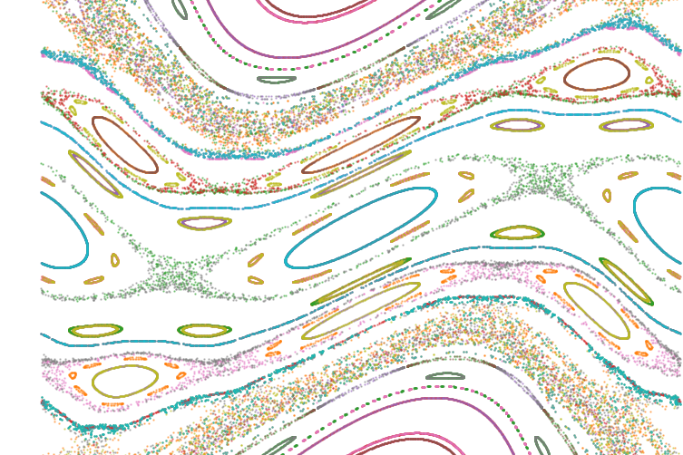
Using Meiss’s action principle to quantify stochasticity in the stellarator edge
Ecole Polytechnique Fédérale de Lausanne
June 2024
Ludovic Rais

Slide 2
W7X

