Slide 1
Weather Station Project

Slide 2
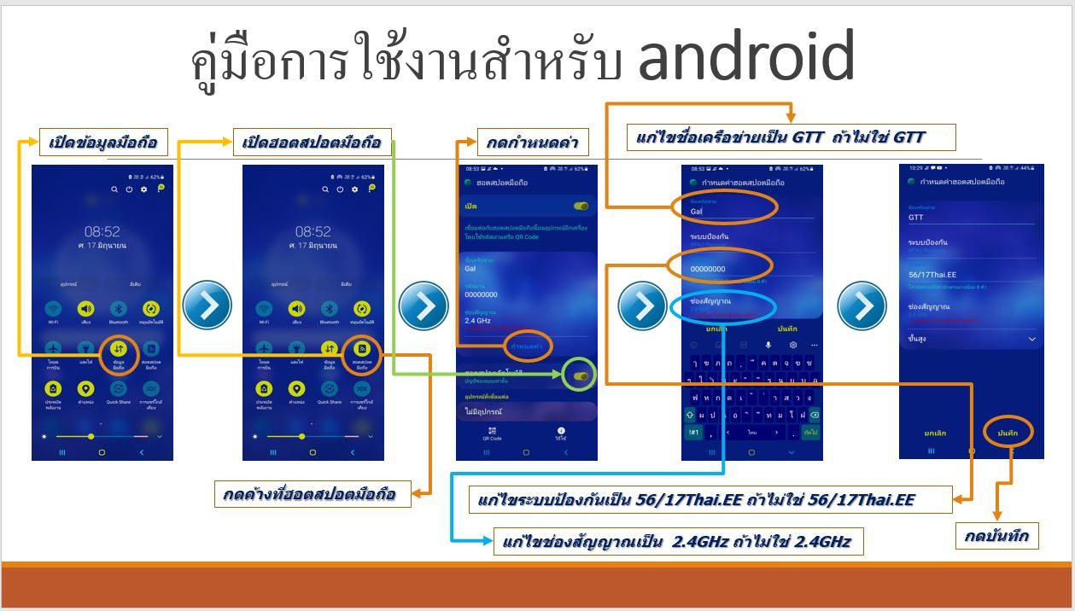

Slide 3
