Slide 1
Weekly Time table and remainder

Slide 2
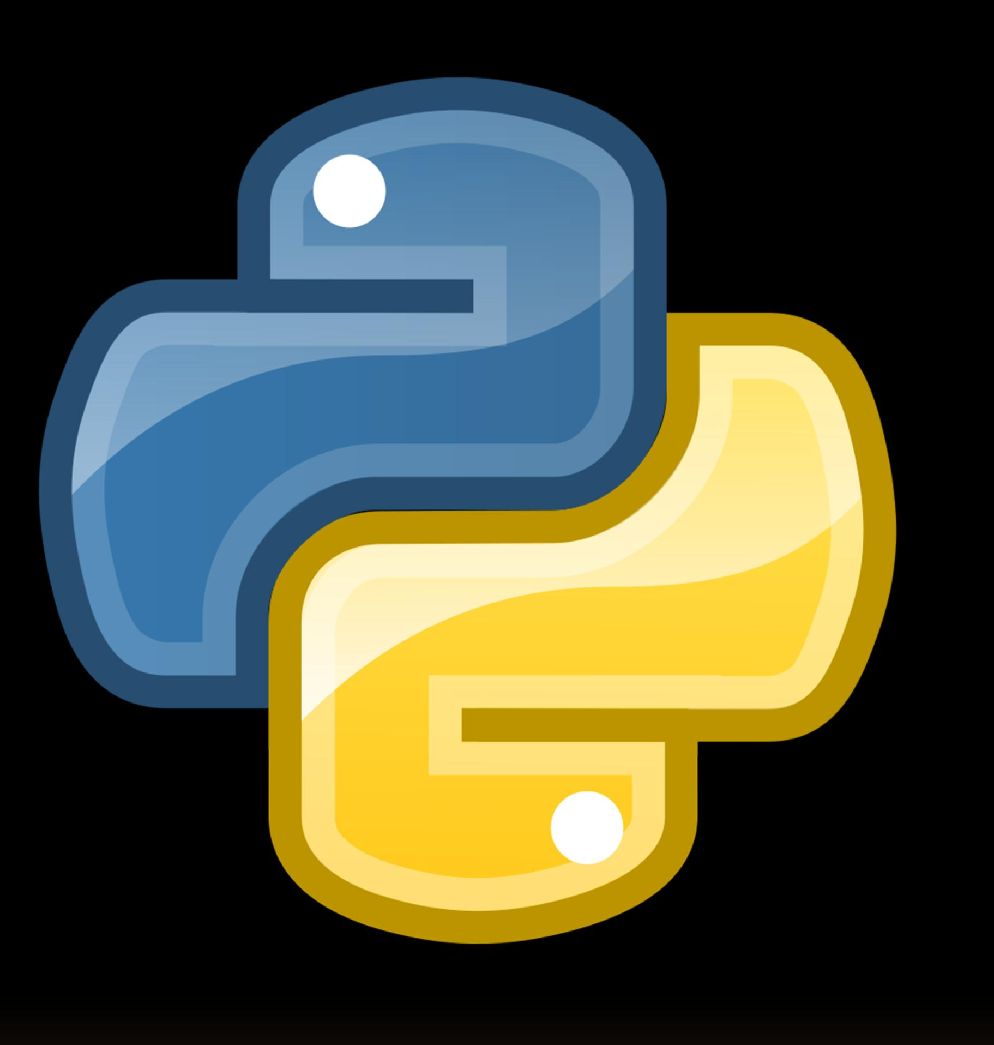
INTRODUCTION
The python project is about the weekly timetable and the remainder in which we can:
Add timetable entries
View timetable
Add reminder
View reminder
Reminder service

Slide 3
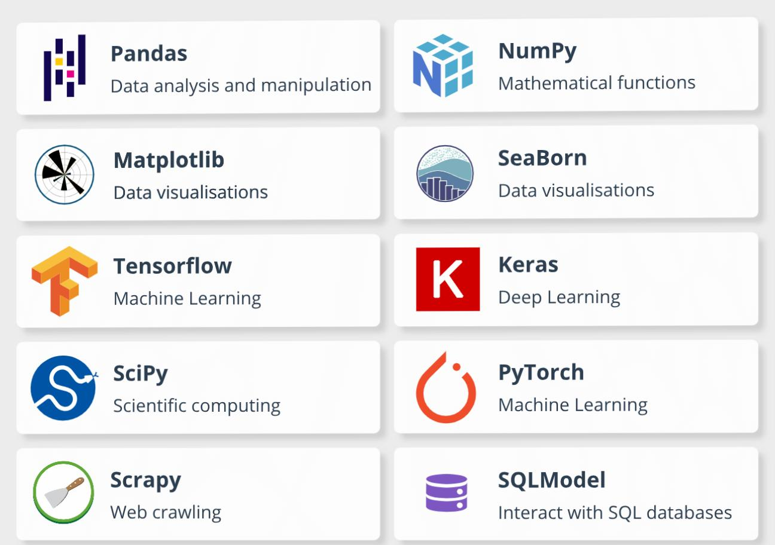
Libraries:
Here we are using
the following libraries:
Import datetime
Import time
Import json
Import os

Slide 4
File setup:
1. `timetable_file = "timetable.json"`: This line sets the filename for the timetable data file.
2. `reminder_file = "reminders.json"`: This line sets the filename for the reminders data file.
The `if` statements check if the files exist, and if they do, load the data from them. If not, they initialize the data structures (a dictionary for the timetable and a list for reminders).

Slide 5
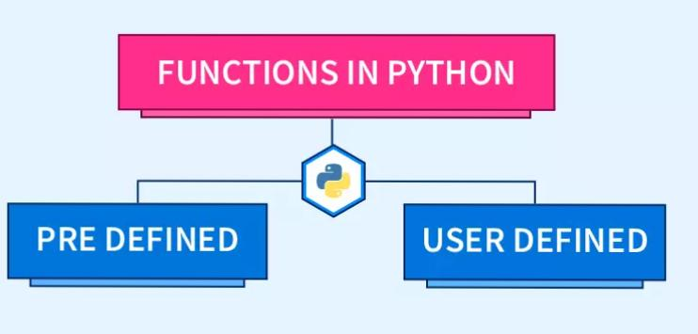
Functions:
1. save_data()
2. add_timetable()
3. view_timetable()
4.add_ reminder()
5. view_reminder()
6. check_reminders()

Slide 6
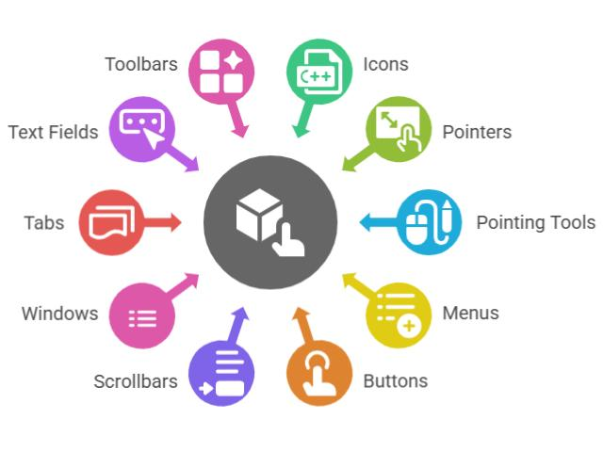
GUI Interface
In order to integrate the GUI with code you have to :
Import tkinter as tk
from tkinter import message box
import threading
from win10toast import ToastNotifier
import pyttsx3

Slide 7

Conclusion
This program simply provides the
weekly timetable and
reminder service so you can
schedule your tasks and use reminder
service to remember the most important
Tasks.

