Slide 1
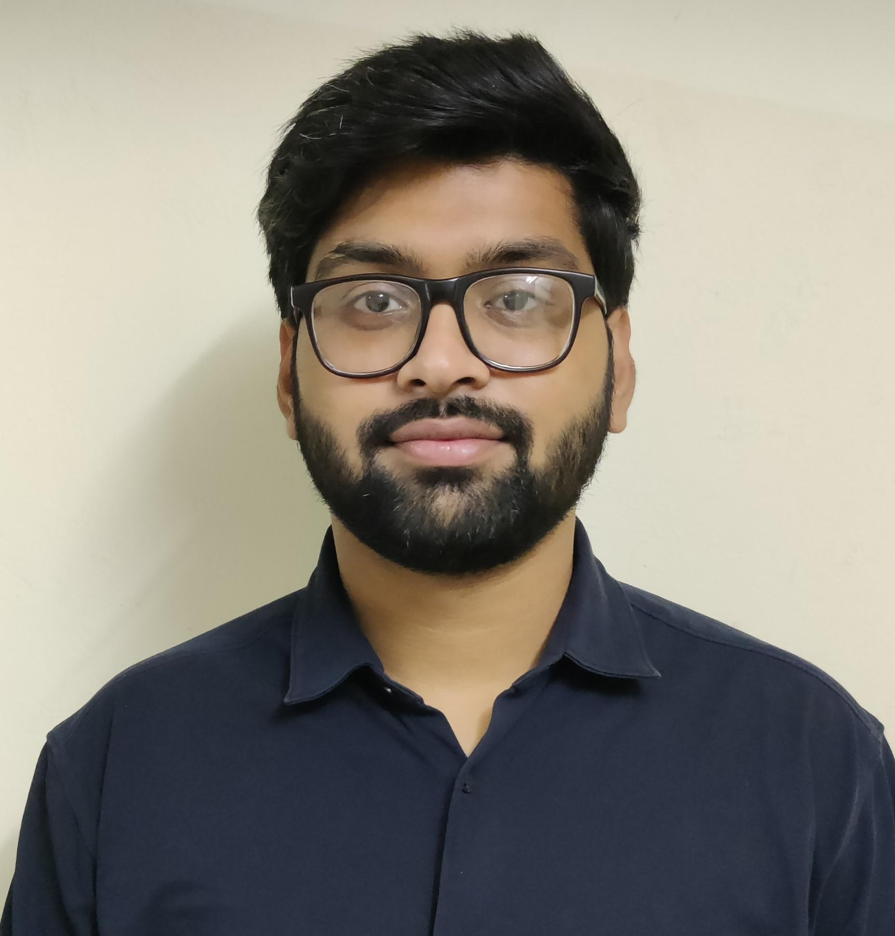


SUGRIVU AKKHIL
Analyst/Software Engineer
Bachelor of Technology
Electronics & Comm : 2018 - 2022
Skills Java 8
Spring Boot
Spring MVC
JPA CRUD
Bootstrap
Backend
Spring Boot
MongoDB
REST-API
Database
SQL database –Postgres
No SQL database –MongoDB
Web Technologies
HTML5
CSS3
JavaScript
Add-ons
GitHub
Maven
Postman
Additional Details
Communication skills
Time management
Leadership skills
BANGALORE
sugrivu.akkhil@capgemini.com
+91 8008679629
A4
Full Stack Developer
Hands on experience in creating microservices with Springboot, Spring Security, Spring Cloud API Gateway, Eureka server.
Hands on experience in implementing polyglot architecture with spring boot
Hands on experience in creating documentation with swagger and in unit testing using Junit.
Experience in using Postgres Database,Postman,MongoDB.
E-Commerce Shopping Cart Application
Completed end to end case study of Shopping Cart Application along with JWT authentication, Swagger API , MySQL, Email service and responsive UI with ReactJs.
Flight Management System
Developed Flight Management System using Spring Boot, MySQL and testing all API through postman along with responsive UI with HTML, CSS.
Check out my work on GitHub

