Slide 1

WT Exercise 1
2041103 Akshat Jain
Euphoria

Slide 2
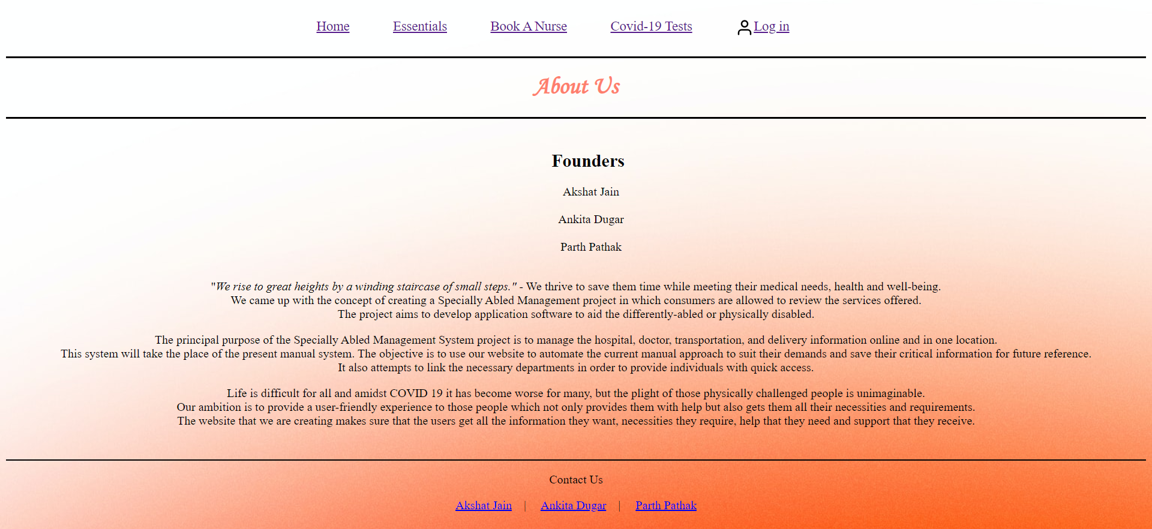
2041103 Akshat Jain

Slide 3
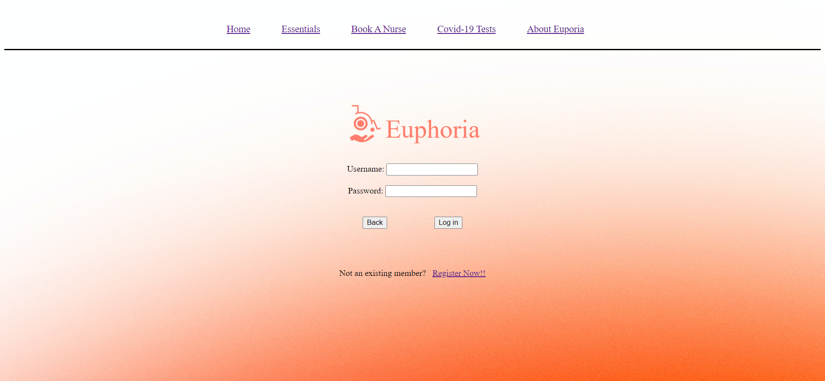
2041103 Akshat Jain

Slide 4
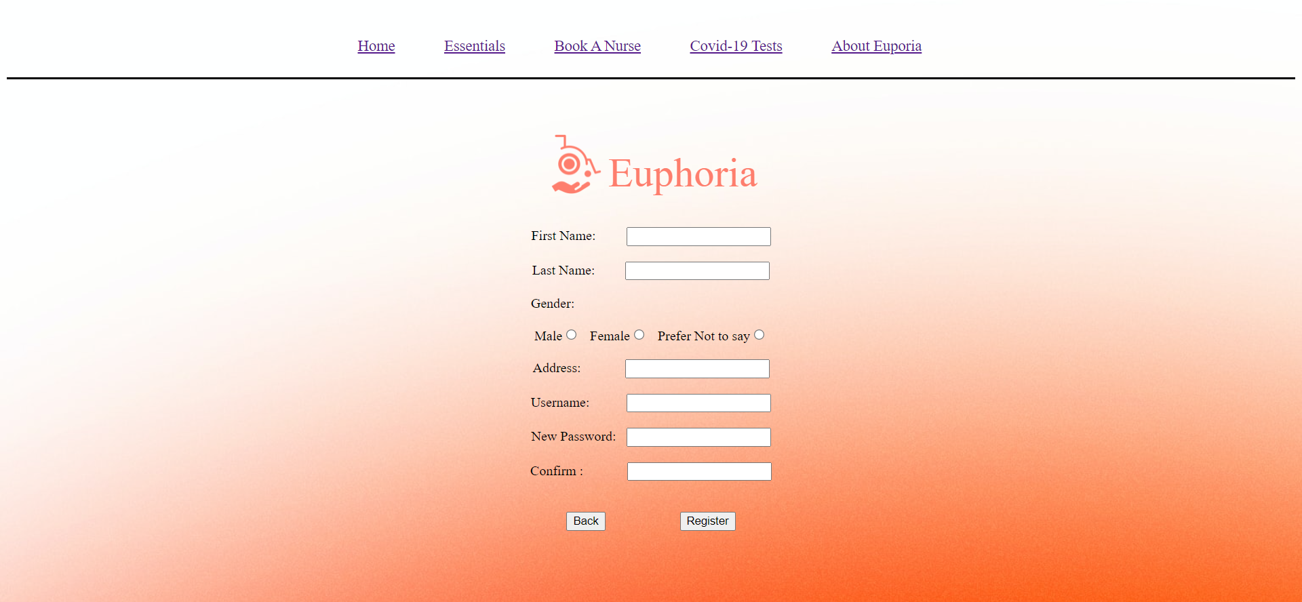
2041103 Akshat Jain

