Slide 1


Optimal parking spot
allocation
Presented by:
Diya Khandelwal, R2142210293, 500090939 DevOps
Akshay Mohpal R2142210078, 500088177 DevOps
Gaurav Bhandari, R21422210311, 500090993,DevOps
Under the guidance of:
Mr Sandeep Pratap Singh
School of Computer Science

Slide 2

1.Introduction
In the evolving urban landscape, efficient parking allocation is a pressing challenge. As cities grow and vehicles multiply, finding parking spots becomes increasingly time-consuming.The project addresses this issue by integrating advanced algorithms, real-time updates, and user-friendly interaction
This projects helps the users to save their time by finding the spot faster
Central to the project is its intelligent interplay of data structures, algorithmic principles, and user interface design.

Slide 3
2.Motivation
The parking system offers real-time information about available parking spots.
Users can access this information through a user-friendly interface, which provides them with up-to-the-minute data on which parking spots are currently vacant
Designing this system enables users to create a solution that streamlines the process of finding available parking spots.
It could significantly reduce the time users spend circling around parking lots searching for empty slots

Slide 4
3.Related Work
Smart Parking Solutions: Numerous smart parking systems have emerged, integrating real-time data from sensors and mobile apps to guide drivers to available parking spots. These systems utilize occupancy sensors, data analytics, and user interfaces to streamline parking allocation.
Path-finding Algorithms in Navigation: Path-finding algorithms, such as Dijkstra's, and Bellman-Ford and A* have been extensively used in navigation and robotics. These algorithms efficiently compute routes from point A to B, a concept directly applicable to guiding drivers to optimal parking spots.
Sustainable Urban Planning: Urban planning research addresses the need for sustainable transportation solutions. Integrating efficient parking allocation with urban planning strategies contributes to reduced traffic congestion and improved environmental outcomes.

Slide 5
4.Problem Statement
Develop an "Optimal Parking Spot Allocation System" that employs advanced algorithms to efficiently guide vehicles to suitable parking spots, reducing search times and enhancing urban mobility, user experience, and environmental sustainability.

Slide 6
5. Objectives
Efficient Path-finding: Implement a combination of shortest path algorithms, such as Dijkstra's to calculate the most efficient routes from entry points to vacant parking spots within the parking lot.
Size-based Allocation: Create an allocation system that considers the size of the user's vehicle and suggests spots that match the vehicle's dimensions.
Real-time Updates: Design the system to handle real-time updates to the parking lot's occupancy status and dynamically adjust path-finding and allocation recommendations accordingly to calculate the most efficient routes from entry points to vacant parking spots within the parking lot.
Reduced Congestion: Contribute to reduced traffic congestion by efficiently guiding vehicles to available parking spots, minimizing unnecessary circling and traffic buildup.

Slide 7
8.Problems in Model
Grid Complexity: As the parking lot grid grows in size, the graph representation and path-finding algorithms become more complex. This can result in longer preprocessing times and slower path calculations.
Dynamic Update: If the parking lot occupancy changes frequently, there will be need to handle real-time updates to the graph representation and shortest path data structures. This can be challenging to maintain efficiently.
Implementation Complexity: Integrating different algorithms (Dijkstra's, binary search) and managing their interactions can lead to complex code and potential bugs.

Slide 8
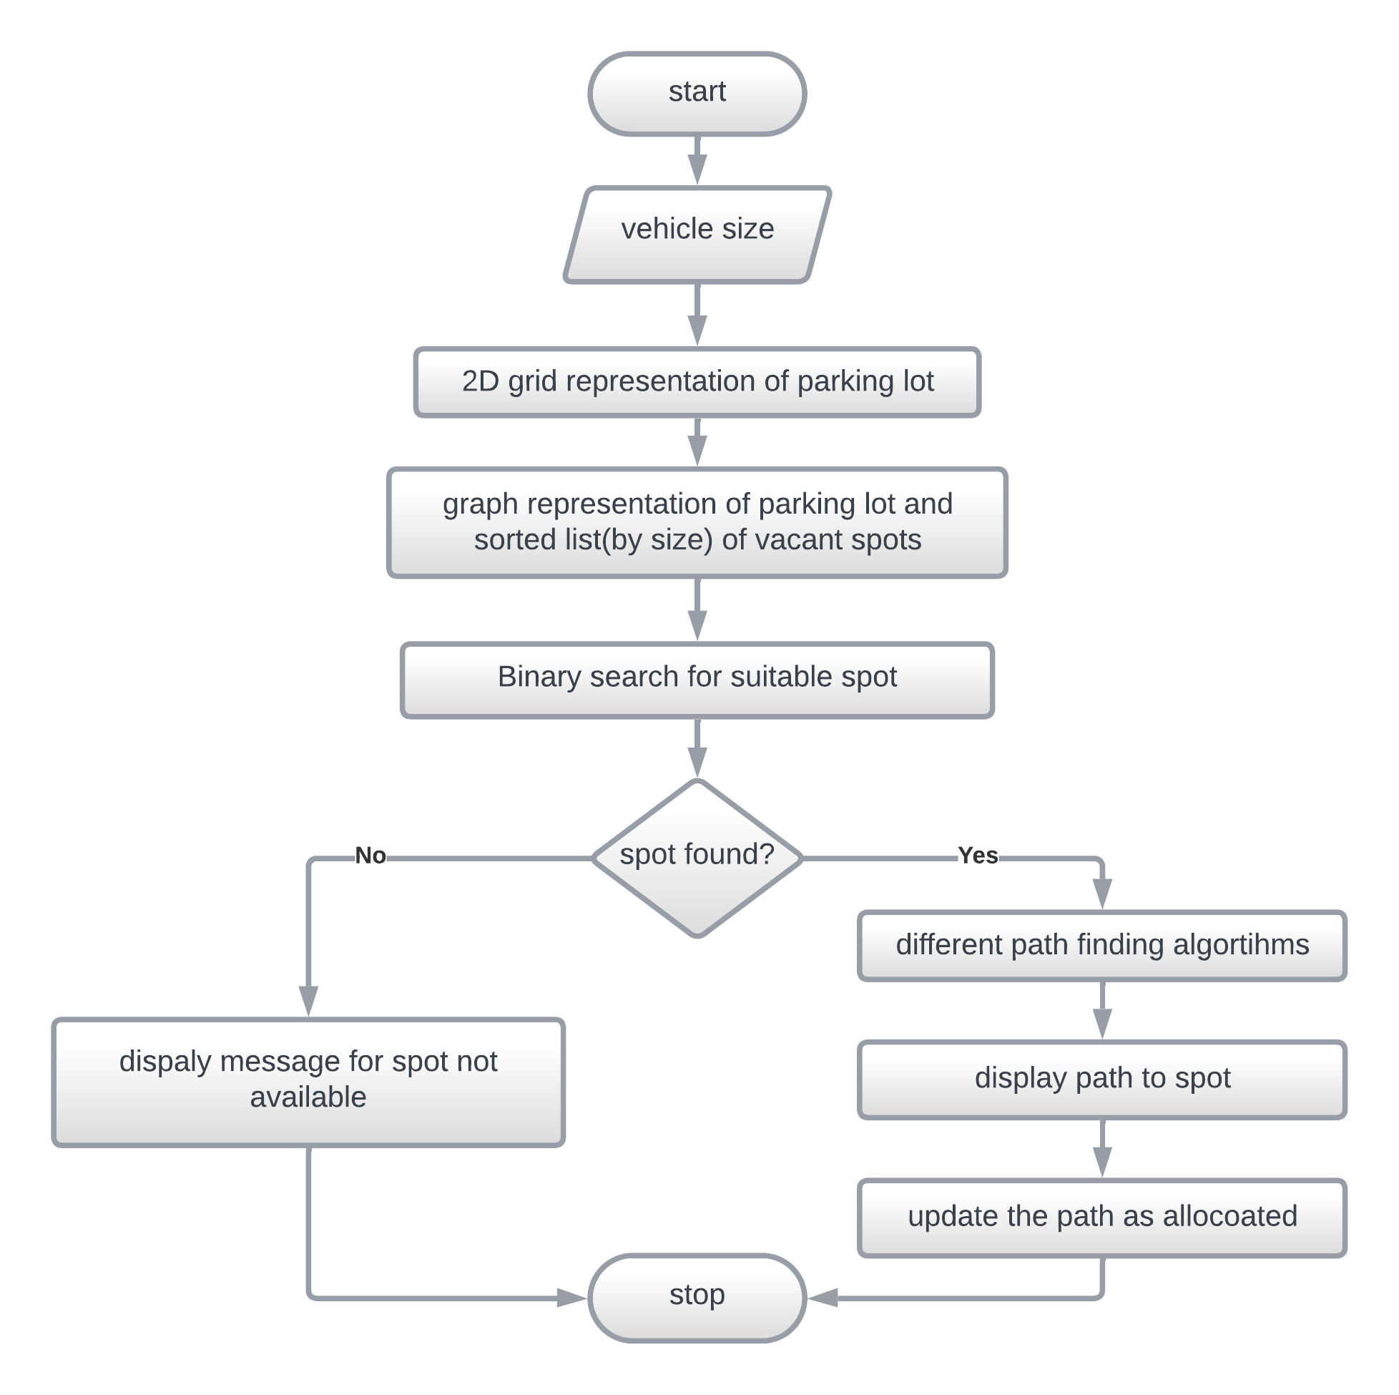
6.Proposed methodology

Slide 9
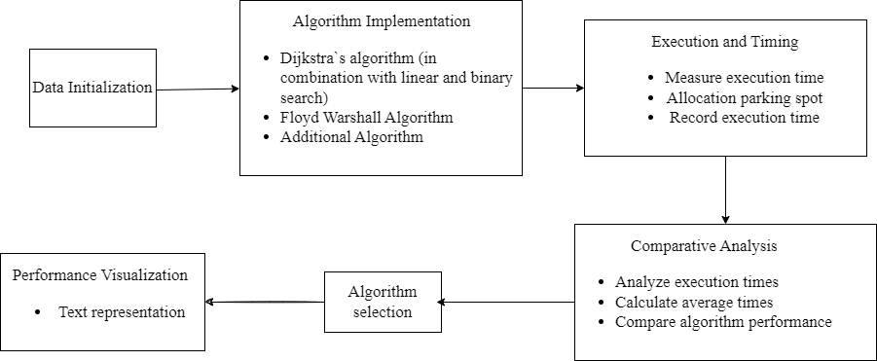
7.Work that has to be done
Users input the size of their vehicle (2 or 4 wheeler) into the parking system. This information is crucial for allocating the appropriate parking spot, ensuring that the vehicle fits comfortably and doesn't cause any congestion.
Both linear and binary search are used in combination with diff path finding algorithms and their time and results are analyzed and compared in order to determine the optimal one.

Slide 10
9.SWOT
Strengths:
Efficiency Enhancement: The project addresses a common urban challenge by significantly reducing search times and enhancing the overall efficiency of parking allocation.
Weaknesses:
Dependence on Data: Accurate and up-to-date data about parking lot occupancy is crucial for the system's effectiveness. Lack of reliable data may impact results.
Opportunities
Sensor Integration: Collaborating with sensor technology providers can enhance real-time data accuracy, further improving parking spot availability information.
Threats
Technical Glitches: System malfunctions or bugs could lead to inaccurate spot suggestions or navigation instructions, potentially frustrating user

Slide 11
10.Application
Urban Parking Management: The primary application is in urban parking management. The system can be integrated with existing parking facilities, helping users quickly find suitable parking spots and reducing congestion caused by aimless searching.
Smart Cities: The project aligns with the goals of smart city initiatives, contributing to efficient resource utilization and enhanced urban mobility. It can be integrated into broader smart city platforms for holistic transportation solutions.
Commercial Complexes and Malls: Shopping centers and malls can benefit from this system by providing visitors with a hassle-free parking experience, leading to increased footfall and customer satisfaction.

Slide 12

Thank You

