Slide 1
Doremon Explorer Hub by Ankit
This Project is all about the displaying of different components of Dormeon , Like in each component we will display the character of doremon, its gagdets and also we will display the gallery of doremon . Then we will display the details of characters and its gagdets.After that we will apply different methods in it to perform add,delete,update,save of the characters and the gagdets.Basically we will perform the CRUD operations here.

Slide 2
Project Data Flow
App Component(Navbar)
Character Component
Gadget Component
Gallery Component
Character-Detail Component
Gadget-Detail Component
Character Search Component
Gadget Search Component
DataServices
InMemeoryWebApi
Message Service
Message Component

Slide 3
Functionalities
Components
Character Component-Here we will display list of characters of doremon.
Gadget Component-Here we will display list gadgets of doremon.
Gallery Component-Here we will display the images of doremon characters
Character Detail Component- Now in this section we will display the details of each character whether it is the id,name,etc of the character.
Gadget Detail Component- Now in this section we will display the details of each gadget whether it is the id,name of gadget,etc of the character.
Search Component- Here we will make the search bar to search the things which we want to get.
Message Component and Message Services- Here we will give the messages which we want to display whenever we clicks on any component and then provide the services.
InMemoryWebApi- Here we will make the server and database which we want to use in the components of the project.
We will also define the add,delete,update,search functionalities.To add things we will use post method and to delete we will use delete method and to update we will use put method.

Slide 4
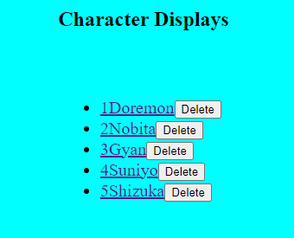
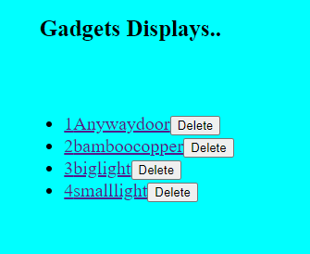
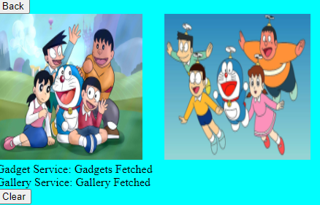
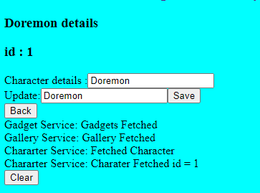
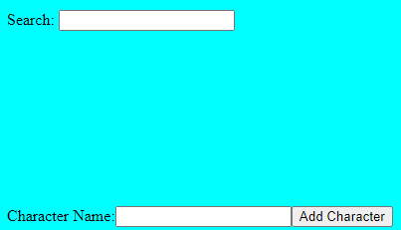
Character Component.
Gadgets Component
Gallery Component
Details Component
Search and Add Functionalities

Slide 5
Learning Outcomes:
1.Routing and Navigation
2.Dependency Injection
3.Bindings
4.Pipes
5.Http Clients
6.CRUD Operations(i.e add,delete,update,save methods)

Slide 6
Thank You

