Slide 1

Siddhivinayak Confidential
Checking FIXTURE CONCEPT
Checking Fixture Concept
Customer :- -
Project :-Atria
Part No.:- 264181910134
Part Name :- Bezel_Head_Lamp

Slide 2
BILL OF MATERIAL
Siddhivinayak Confidential
SR. NO. | DESCRIPTION | MATERIAL
1 | Base Plate | AL
2 | Resting Stand | AL
3 | Pin And Bush | SS
4 | Body | AL

Slide 3
ISOMETRIC VIEW OF PART
Siddhivinayak Confidential
SURFACE - A
SURFACE - B

Slide 4
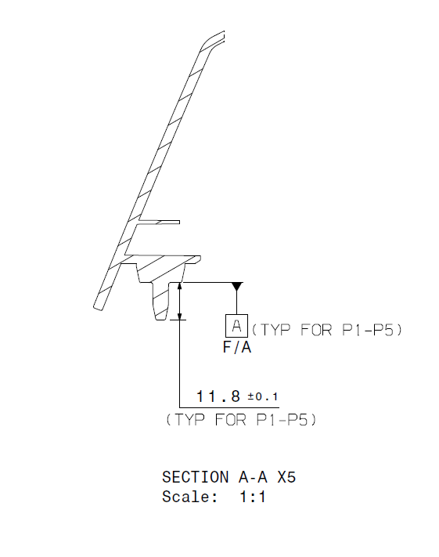
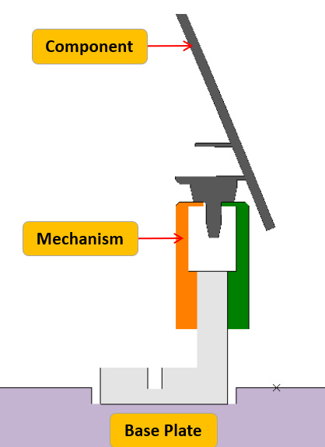
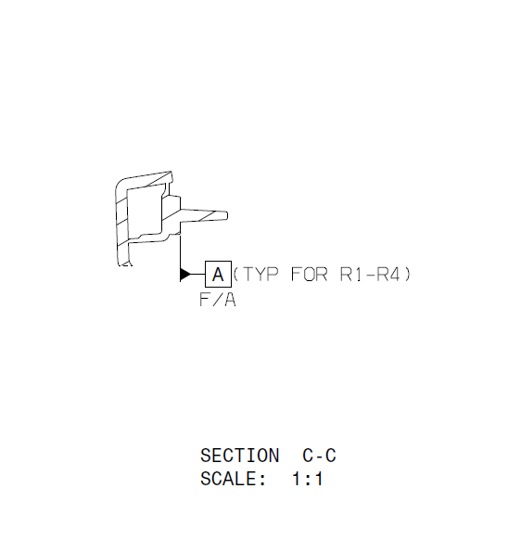
SECTION A-A
Mechanisms
SECTION CUT A-A
Siddhivinayak Confidential
2D DRAWING
Component
Mechanism
A
A
Base Plate
Mechanisms are provided as per surrounding at 9 places as shown above

Slide 5
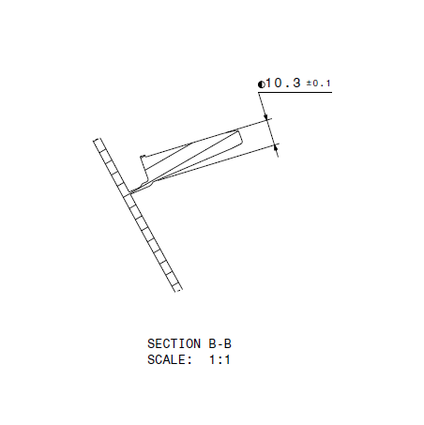
SECTION B-B
Locater
SECTION CUT B-B
Siddhivinayak Confidential
2D DRAWING
Component
Mechanism
B
B
Base Plate
Locators are provided as per surrounding at 2 places to locate the part as shown above

Slide 6
SECTION C-C
Thread_Pin
SECTION CUT C-C
Siddhivinayak Confidential
Thread_Pin
C
C
Component
Body
Thread Pin is provided at 01 place as shown above

Slide 7
SECTION D-D
Check_Pin
SECTION CUT D-D
Siddhivinayak Confidential
Check_Pin
D
D
Component
Check pins are provided at 2 places to check the position of the hole as shown above.

Slide 8
SECTION E-E
Gap_Flush_Body
SECTION CUT E-E
Siddhivinayak Confidential
E
Component
3
3
0
0
3
3
Body
0
Base_Plate
E
Body is provided with 3mm gap and 0mm flush all around the part as shown above

Slide 9
Siddhivinayak Confidential
CAR CONDITION OF HOLDING FIXTURE

Slide 10

Siddhivinayak Confidential
Thank You

