Slide 1

Siddhivinayak Confidential
Checking FIXTURE CONCEPT
Checking Fixture Concept
Customer :- -
Project :-Atria
Part No.:- 264188556301
Part Name :- Fog_Lamp_Bezal_Front_LH

Slide 2
BILL OF MATERIAL
Siddhivinayak Confidential
SR. NO. | DESCRIPTION | MATERIAL
1 | Base Plate | AL
2 | Resting Stand | AL
3 | Pin And Bush | SS
4 | Body | AL

Slide 3
ISOMETRIC VIEW OF PART
Siddhivinayak Confidential
SURFACE - A
SURFACE - B

Slide 4
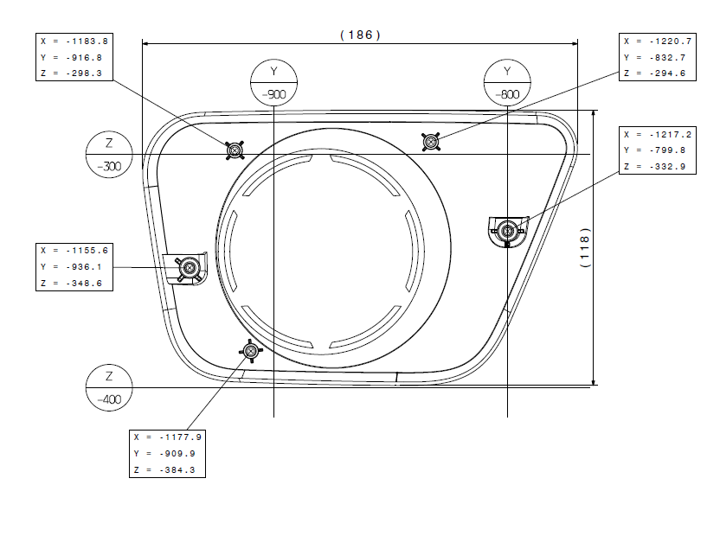
SECTION A-A
Locater
SECTION CUT A-A
Siddhivinayak Confidential
2D DRAWING
Component
Locator
A
A
Base Plate
Locators are provided as per surrounding at 2 places to rest and locate the part as shown above

Slide 5
SECTION B-B
Self_TappingPin
SECTION CUT B-B
Component
Siddhivinayak Confidential
2D DRAWING
Locator
Stand
Self_Tapping_Pin
Base Plate
B
B
Self Tapping pins are provided at 2 places to rest and lock the part as per surrounding as shown above

Slide 6
SECTION C-C
Gap_Flush_Body
SECTION CUT C-C
Siddhivinayak Confidential
2D DRAWING
Component
3
3
0
0
C
Body
Base Plate
C
Body is provided with 3mm gap and 0mm flush all around the part as shown above

Slide 7
Siddhivinayak Confidential
CAR CONDITION OF HOLDING FIXTURE

Slide 8

Siddhivinayak Confidential
Thank You

