Slide 1

Bhujbal Knowledge City
MET Institute of Engineering
Title of Project
CNG ONLINE SLOT BOOKING(COSB)
Presented By :-
AKSHAY BHUJBAL
KRITIKSHA GADIKAR
GANESH GITE
SAHIL GOHIL
Guided By :-
Prof. Javed Attar
Department of MCA
Met Institute of Engineering Bhujbal Knowledge City
Adgaon Nashik

Slide 2


Bhujbal Knowledge City
MET Institute of Engineering
CONTENT
 | 1 | Abstract
 | 2 | Introduction
 | 3 | Objective
 | 4 | Requirements
 | 5 | Diagrams
 | 6 | Screenshots
 | 7 | Future Enchancement
COSB

Slide 3
Bhujbal Knowledge City
MET Institute of Engineering
ABSTRACT
The project “COSB (CNG ONLINE SLOT BOOKING) '' is a real time system to book slots for CNG pumps. The purpose of this project is to develop and implement an CNG slot booking system for pumps, that will replace the traditional method(manual).
Nowadays we all are facing many problems regarding filling the CNG in the car. In Nashik, we were facing so many problems like huge numbers of queues on CNG pumps to fill the CNG, and waiting for 5-6 hours and this will cost our valuable time. This is a problem where we got motivated to do this project. The objects-oriented analysis and design methodology (OOADM) used to analyze the system in order to discover the various objects involved and how they interact with one another so that a new and improved system can be defined.
The main use of an online system to state the date and time wise available slot for filling CNG, using this system, customers can book their slots according to their availability .This system assists the pump owners to manage the availability of slots, they also reduce other problems like avoiding crowds of cars which leads to traffic on road/pump.
COSB

Slide 4
Bhujbal Knowledge City
MET Institute of Engineering
INTRODUCTION
COSB (CNG ONLINE SLOT BOOKING) Project aim to design and implementation of an CNG slot booking system which will provides customers a facility to reserve there slot without any hassle. It is web based system and it will save valuable time and efforts for CNG feeling. This project entitled design and implement of an CNG booking system can applicable to register CNG pumps. The features of this system will be similar as a common booking system. The customer can only book the slot on this website but by their convenient time.
The COSB system designed in this project was developed using PHP, JavaScript, CSS and HTML as the programming languages and MYSQL as the database management system. The methodology adopted for this project is Agile methods. This allows real time communication admin and user. This system allows to select or search cities( between Nashik, Mumbai, Pune) and CNG pumps. And after select cities then this system allows the user to book their slots with date and time, user can select slots available in systems. Then book their slots…
COSB

Slide 5
Bhujbal Knowledge City
MET Institute of Engineering
OBJECTIVES
To save time and effort of for CNG filling.
To reduce the hassle of the user.
To make CNG filling easier for user.
COSB

Slide 6
Bhujbal Knowledge City
MET Institute of Engineering
REQUIREMENTS
HARDWARE REQUIREMENT:-
Processor: Intel i3
RAM: 4GB or more
SOFTWARE REQUIREMENT:-
Operating System: Windows 7 or above.
Front end: HTML, CSS, JS, Bootstrap.
Back End: PHP.
Database: MySQL.
Browser: Chrome, Opera, Firefox, Microsoft Edge
COSB

Slide 7

Bhujbal Knowledge City
MET Institute of Engineering
PLATFORM REQUIREMENT:-
IDE: Adobe Dreamweaver CS 6.0 | VS Code.
Server: Apache Server XAMPP Application.
COSB

Slide 8
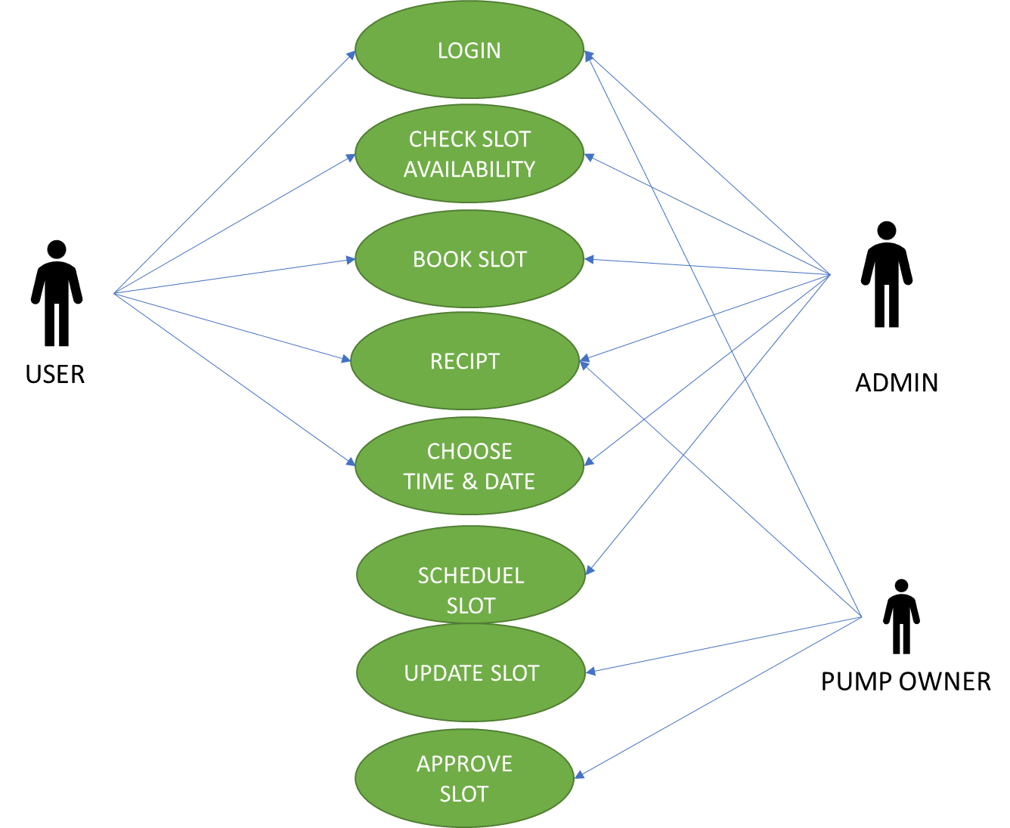
Bhujbal Knowledge City
MET Institute of Engineering
USE CASE DIAGRAM
COSB
CNG ONLINE SLOT BOOKING
COSB

Slide 9
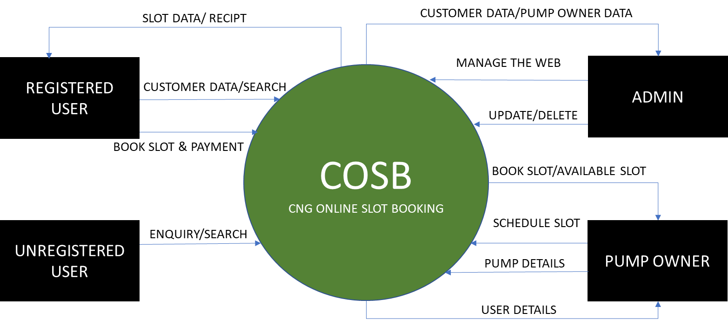
Bhujbal Knowledge City
MET Institute of Engineering
DATA FLOW DIAGRAM
COSB

Slide 10
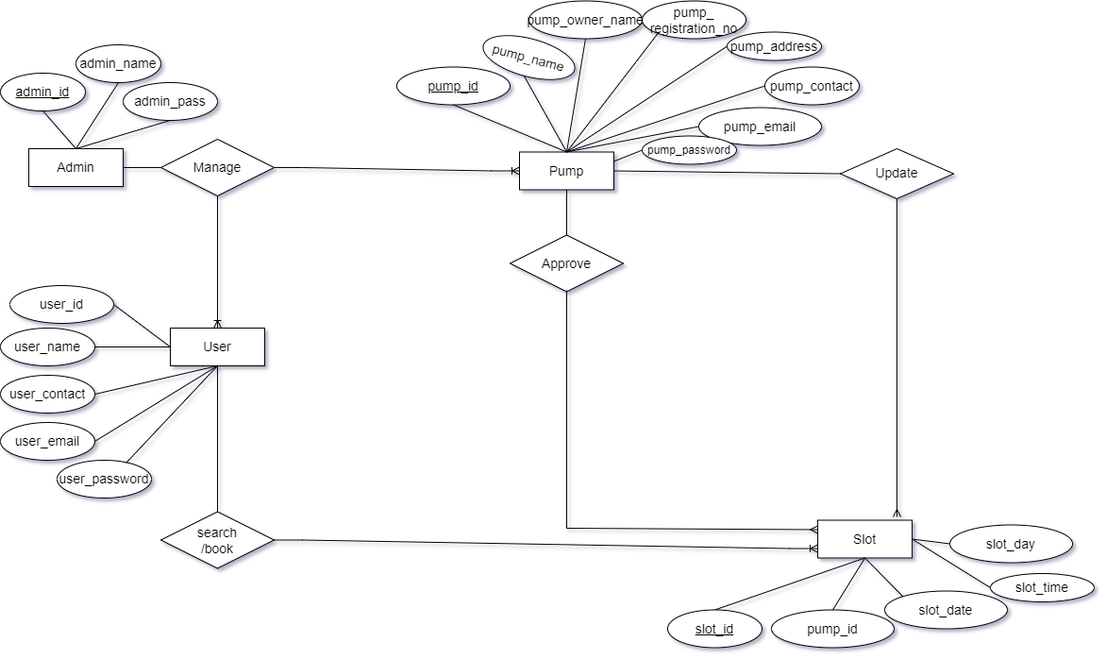
Bhujbal Knowledge City
MET Institute of Engineering
ER-DIAGRAM
COSB

Slide 11
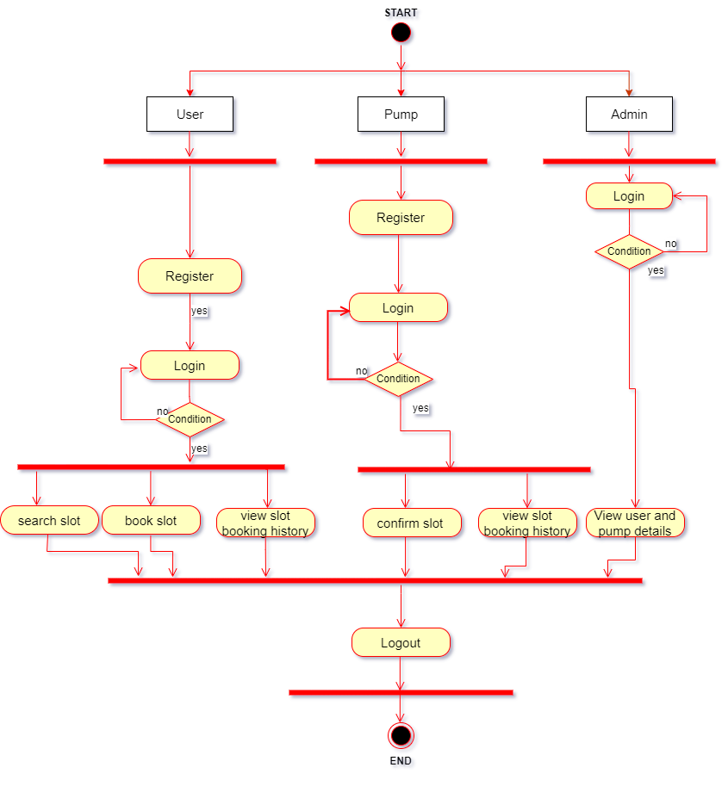
Bhujbal Knowledge City
MET Institute of Engineering
ACTIVITY DIAGRAM
COSB

Slide 12
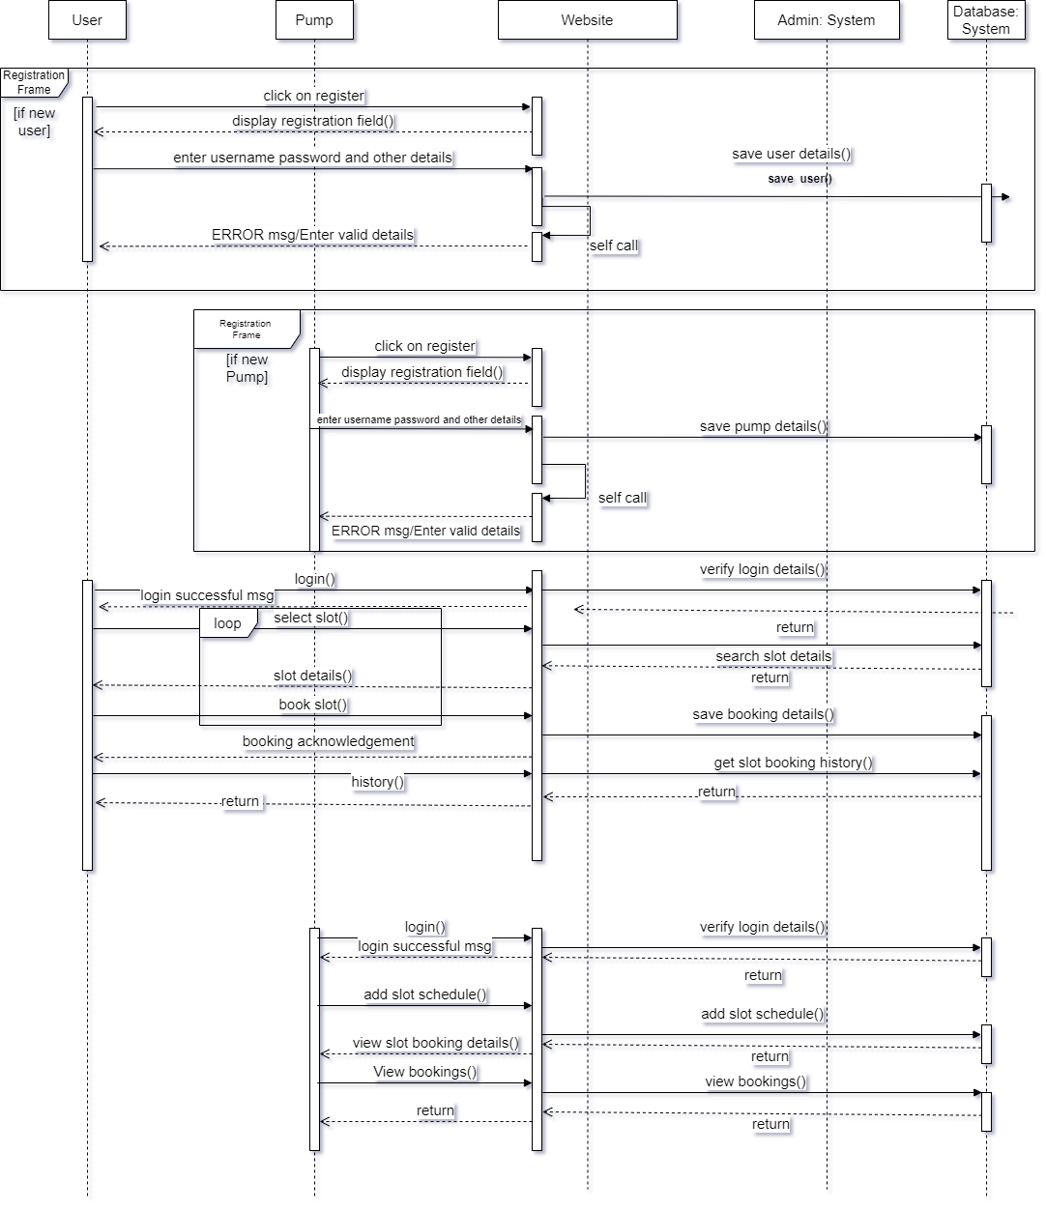
Bhujbal Knowledge City
MET Institute of Engineering
Sequence Diagram
COSB

Slide 13
Bhujbal Knowledge City
MET Institute of Engineering
LET’S SEE WEBSITE
COSB

Slide 14

Bhujbal Knowledge City
MET Institute of Engineering
Future Enhancement
In the future we can build Mobile applications for smartphones.
Introduce online payment system.
Add mobile no. & email id. verifications.
Currently the system supports desktop pc and in future we can make mobile browser compatible site.
COSB

Slide 15
Bhujbal Knowledge City
MET Institute of Engineering
THANK YOU…
COSB

