Slide 1





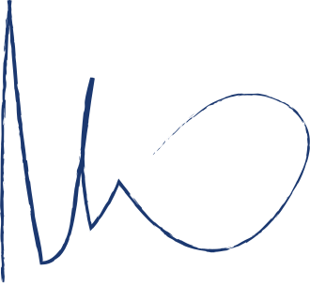
CERTIFICATE
OF PARTICIPATION
The following awards are given to
{name}
For participating in the seminar "Automation with Python" on 24 October 2023.
Akkil M G
Juliana Silva
SOSC - Python Lead
President
ref: {id}

