Slide 1

Java Microservices with Spring Boot
Notes:
Trainer Notes
This module gives a high level overview of Spring.
The slides make uses of ANIMATION and you need to use Presentation Mode (press F5)
Each slide will show the notes and sequence of the animation within the context of the slide
(*CLICK*) represents where you should do a mouse click to start the next animation

Slide 2
Content and objectives
Introduction
What is Spring Boot
Hello World application
Creating a Hello World application in Spring Boot
Dependency Injection
What is DI and what different types are there
RESTful API and Spring WEB
Multi-Tier Architecture and how to implement it
Spring Data
Connecting to a database
Testing and Monitoring
To check if the endpoints of the application work and the software performs as expected
2
Notes:
Trainer Notes:
Explain course content and objectives for each part and how they all come together when developing a spring application.
There aren’t many exercise labs as most of the exercises would be part of the build-along where the trainer demonstrates code live and get the learners to follow but also make their own tweaks.
That way there is a common project for the trainers and learners to discuss.
For reference, there is a sample todo-application on sharepoint.

Slide 3
INTRODUCTION
What you need to know:
Java
Maven
Database concepts and SQL
Basic JPA understanding
Notes:
Environment
mvn installed and added to PATH
Java 17
Intellij Comminity Edition
Not Covered in this module
Spring Security

Slide 4



What is Spring Boot?
Spring Boot is a Java-based framework used to build production-grade applications and services.
It is built on top of the Spring framework and is intended to make it easier to create stand-alone, production-grade Spring-based applications that you can ‘just run’.
It also has a build in WEB Server that, together with the Spring MVC framework, greatly eases the implementation of RESTful Micro-Services.
Spring Core
Spring MV
Web Server
Notes:
Trainer Notes:
Explain spring boot and the core dependencies used along with their functionality.
Can use this opportunity to give any additional resources the trainer may personally have.

Slide 5


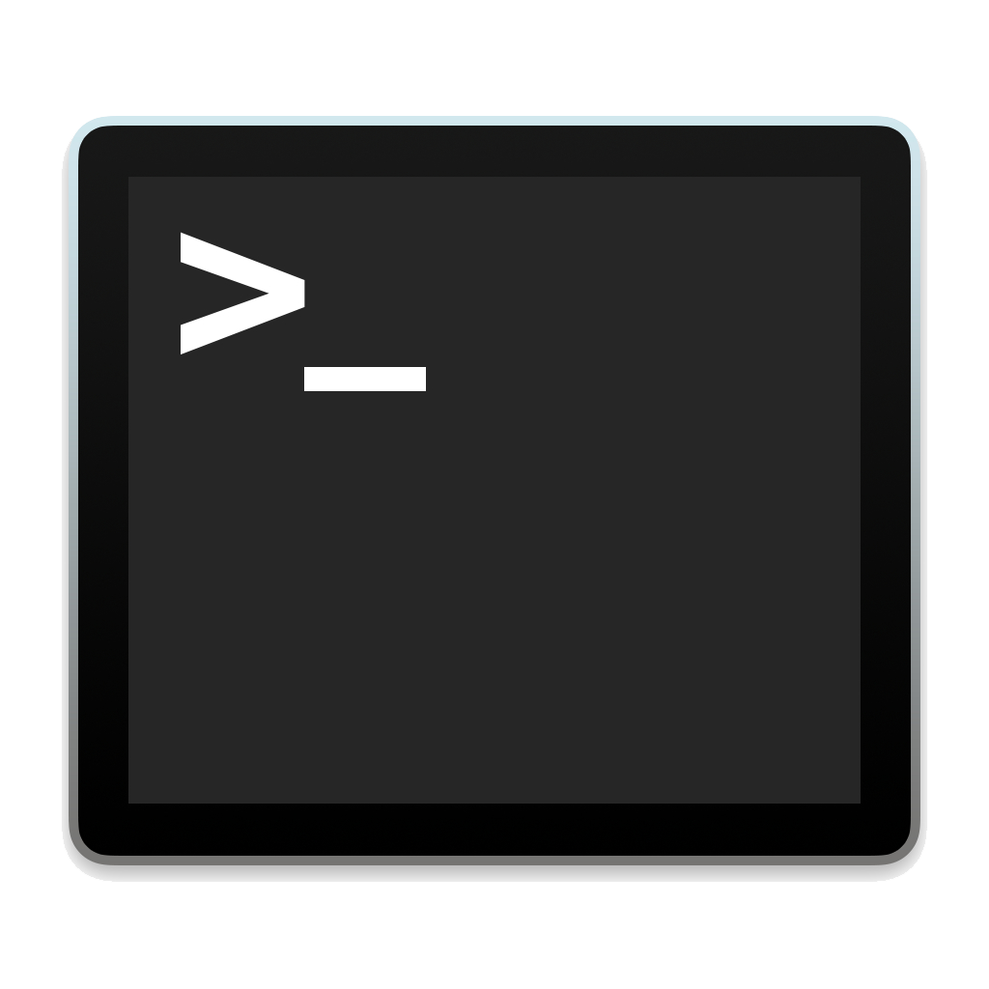
Generate Project using Spring Initialize
Spring Boot has a large number of components and dependencies which can be difficult to manage manually.
Spring Initializr is a web-based tool that can be used to set up a Spring Boot project.
Spring Initializr will do the following:
Create the build file with all the required dependencies, plugins.
Create the basic file structure for your project.
Creating a Spring Boot Hello World Application
https://start.spring.io
Unzip Project to Work Folder
Build and Run

Slide 6
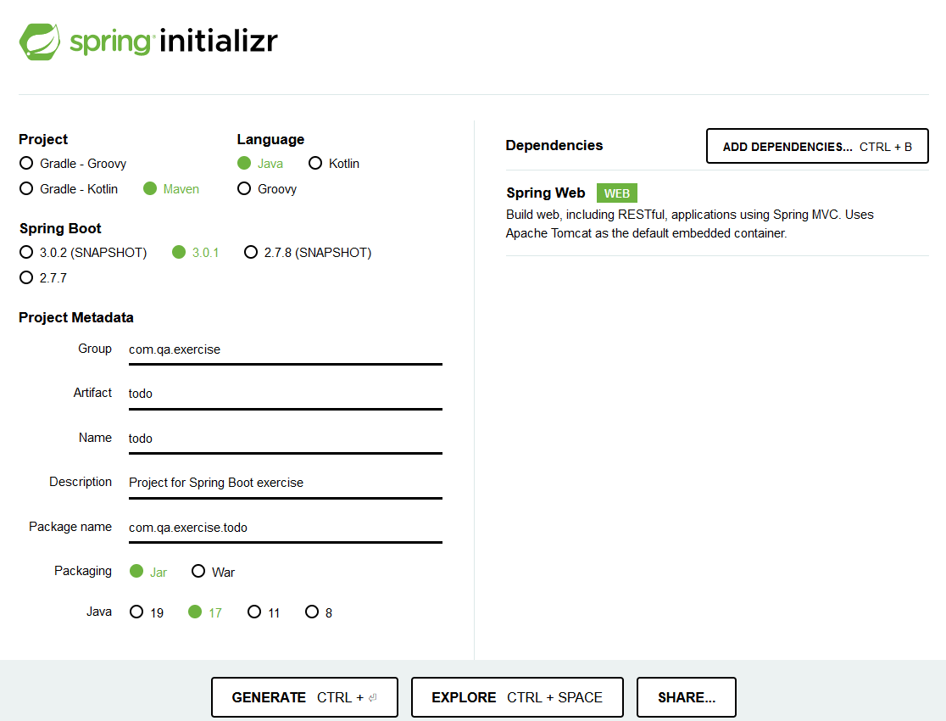
Using the Spring Initializr
Generate Project using Spring Initialize
https://start.spring.io
Navigate to https://start.spring.io and select the configuration as shown.
Maven
Spring Boot 3.0.1
Spring Web
Java 17
Add the Spring WEB dependency.
Generate and download the project.
Unzip Project to the work folder.

Slide 7
Building the Hello World Application
Instructor Demo
Lab 1
Notes:
Demonstrate how to use the Spring Initializr website to generate a basic Spring application and how to run a Spring app
If a new spring version has been released since the last time this content was updated then the version numbers might not match up with what’s in the slides/labs but it should be fine to just use whichever is the latest LTS version (usually the one without the word snapshot)
There are currently two versions of the first lab – one uses Spring Initilizr (free), the other requires IntelliJ Premium, use whichever is appropriate for the cohort

Slide 8
The project folder structure
│ pom.xml
├───.mvn
└───src
├───main
│ ├───java
│ │ └───com
│ │ └───qa
│ │ └───exercise
│ │ └───todo
│ │ TodoApplication.java
│ └───resources
│ │ application.properties
│ ├───static
│ └───templates
└───test
└───java
└───com
└───qa
└───exercise
└───todo
TodoApplicationTests.java
This is the Maven project file, where all the dependencies for the application are defined.
This is the entry point to Spring Boot. When the application is run, Spring Boot will handle all the initialization.
application.properties stores all the Spring Boot configuration for your application.
Generated test that loads the Spring Context. This is useful to see any errors that causes Spring Boot to fail to start.
Notes:
NOTE: Instructor should show this on their own machine
- Unzip Project File to work directory
- Examine the TODOApplicaiton and explain more on IOC, that is the Life Cycle and management of Objects is managed by Spring Boot

Slide 9
The POM file
<parent>
<groupId>org.springframework.boot</groupId>
<artifactId>spring-boot-starter-parent</artifactId>
<version>3.0.1</version>
<relativePath/> <!-- lookup parent from repository -->
</parent>
<groupId>com.qa.exercise</groupId>
<artifactId>todo</artifactId>
<version>0.0.1-SNAPSHOT</version>
<name>todo</name>
<description>Project for Spring Boot exercise</description>
<properties>
<java.version>17</java.version>
</properties>
<dependencies>
<dependency>
<groupId>org.springframework.boot</groupId>
<artifactId>spring-boot-starter-web</artifactId>
</dependency>
<dependency>
<groupId>org.springframework.boot</groupId>
<artifactId>spring-boot-starter-test</artifactId>
<scope>test</scope>
</dependency>
</dependencies>
<build>
<plugins>
<plugin>
<groupId>org.springframework.boot</groupId>
<artifactId>spring-boot-maven-plugin</artifactId>
</plugin>
</plugins>
</build>
This pulls in all the Core Spring Boot dependencies. In this case, Spring Boot 3.0.1
Specify that the Spring MVC to be used to handle HTTP request.
More dependencies will be added later on (e.g., Spring Data).
Notes:
Trainer Note:
Explain the purpose and importance of the pom file
Show maven repository website/spring documentation links – where we get the dependencies for the project from and/or to read up on what dependencies are available and what they do

Slide 10

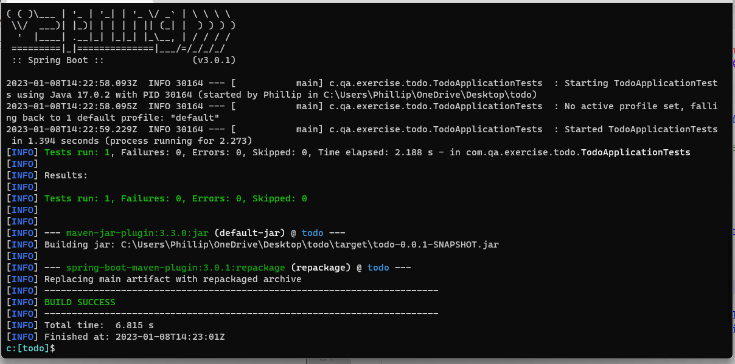
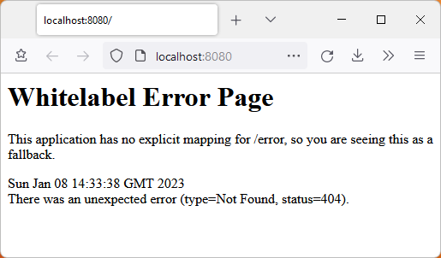
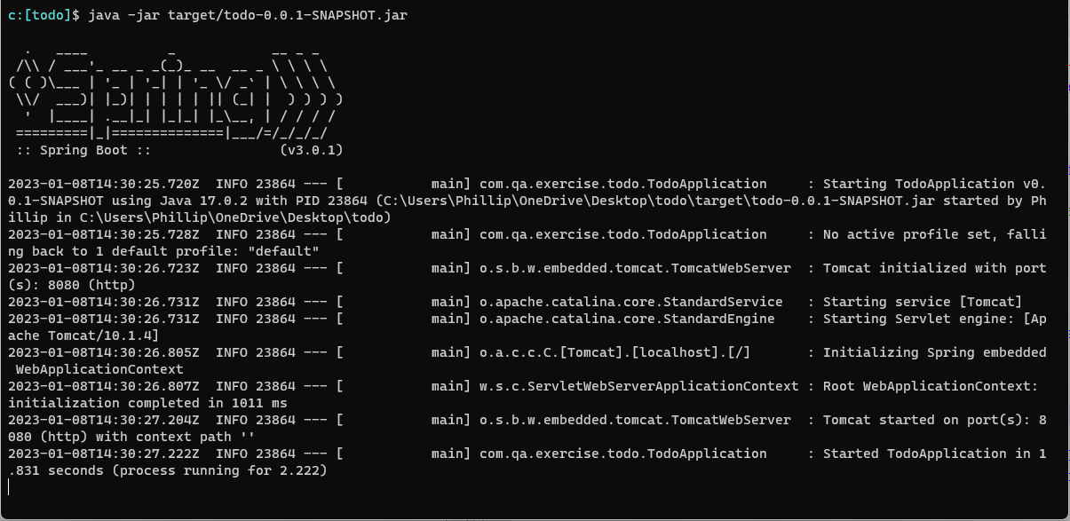

Running the Skeleton Application
> mvn clean package
Notes
Need to check in project directory
Notes
You can try to invoke the skeleton application in the browser (http://localhost:8080) and you should get a White Page Error as no Endpoint has been defined.
Spring Boot defaults to port 8080
> java -jar target/todo-0.0.1-SNAPSHOT.jar
Notes:
CD to the work directory

Slide 11

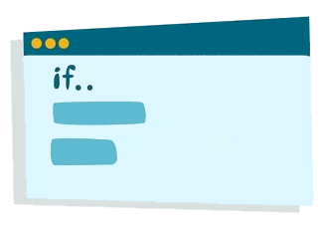
Dependency Injection is the ability of an object to supply dependencies of another object.
Dependency Injection is one of the main functionalities provided by Spring. It is the process in which Spring will take care of creating and assigning objects needed by another class.
Dependency injection
Service Class
(1) Create
(3) Use
Spring Injector
Client Class
(2) Inject
Notes:
This is the introduction. Illustration of how DI works in the next Slide

Slide 12
Spring DI
Manual Instantiation
Dependency Injection via Spring
Service Class
Service Class
class UserProfileService {
.....
}
@Service
class UserProfileService {
.....
}
(1) Instantiate
Depends on
Injector
Depends on
class Lesson {
private UserProfileService userProfileSvc;
public Lesson() {
userProfileSvc = new UserProfileService();
.....
}
}
class Lesson {
@Autowired
private UserProfileService userProfileSvc;
public Lesson() {
.....
}
}
(2) Injects
Explicit instantiation
Client Class
Client Class
Notes:
Client Class: This is the dependent class and is dependent on the Service class.
Service Class: This class provides a service to the client class.
Injector: This class is responsible for injecting the service class object into the client class
(**CLICK**) Lesson has a dependency on the UserProfileService class
(**CLICK**) Without DI, you would have to explicit instantiate the UserProfileService class yourself
(**CLICK**) Spring uses an Injector class to inject components into Client Classes.
(**CLICK**) Here @Service tells Spring that this is a component to be managed by Spring. In the Client Class, @Autowired tell spring that it wants Spring to manage the instantiation and assignment for that variable
We will discuss different Spring Component Types later
(**CLICK**) When Spring sees a Client Class using a Spring Component managed by Spring, it will automatically do the assignment behind the scene
** DEMONSTRATION / Hands On **

Slide 13
Spring Dependency Injection types
Field-based: Component are directly injected into a field. This makes it hard for testing as there is no easy way to set up mock. It would also hide mandatory fields from outside which would otherwise be assigned in the constructor. This would take away the advantage of properly initialized POJO.
class Lesson {
@Autowired
private UserProfileService userProfileSvc;
……
}
Notes:
Recap the @Autowired and @Service annotation
Demonstration, Hindson?

Slide 14
Spring Dependency Injection types
Constructor-based: should be used for mandatory dependencies. Components are injected via the class constructor.
class Lesson {
private UserProfileService userProfileSvc;
@Autowired
public Lesson() (UserProfileService userProfileSvc) {
this.userProfileSvc = userProfileSvc;
}
}
class Lesson {
@Autowired
private UserProfileService userProfileSvc;
……
}
Notes:
Recap the @Autowired and @Service annotation
Demonstration, Hindson?

Slide 15
Spring Dependency Injection types
Setter-based (aka Property-based): Components are injected via a property’s Setter method.
class Lesson {
private UserProfileService userProfileSvc;
@Autowired
public setUserProfileService(UserProfileService userProfileSvc) {
this.userProfileSvc = userProfileSvc;
}
}
class Lesson {
@Autowired
private UserProfileService userProfileSvc;
……
}
Notes:
Recap the @Autowired and @Service annotation
Demonstration, Hindson?

Slide 16
Spring Boot stereotypes
REST Request
@Controller indicates a component is a front controller and is responsible to handling requests and returning appropriate responses. The controller layer is a WEB facing layer.
@RestController is used at the class level for the implementation of RESTful APIs. It combines @Controller with @ResponseBody so that the data returned by mapped methods is automatically placed into the body of the response.
Controller
@Controller
@RestController
Business
@Component
@Service
Data
@Repository
Data Source
Notes:
For this course we will be Focusing the on the REST API

Slide 17
Spring Boot stereotypes
REST Request
Controller
@Controller
@RestController
@Service specifies that a class is holding the business logic. Besides being used in the service layer, there isn’t any other special use for this annotation. @Service is just an alias for @Component and there is no real difference between them.
Business
@Component
@Service
Data
@Repository
Data Source
Notes:
For this course we will be Focusing the on the REST API

Slide 18
Spring Boot stereotypes
REST Request
Controller
@Controller
@RestController
Business
@Component
@Service
Data
@Repository to indicate that they’re dealing with CRUD operations, usually, it’s used with DAO (Data Access Object) or Repository implementations that deal with database tables.
@Repository
Data Source
Notes:
For this course we will be Focusing the on the REST API

Slide 19
End of session

