Slide 1

Java Microservices with Spring Boot
Notes:
Trainer Notes
This module gives a high level overview of Spring Web and Data.
The slides make uses of ANIMATION and you need to use Presentation Mode (press F5)
Each slide will show the notes and sequence of the animation within the context of the slide
(*CLICK*) represents where you should do a mouse click to start the next animation

Slide 2
Content and objectives
Introduction
What is Microservices and Spring Boot
Hello World application
Creating a Hello World application in Spring Boot
Dependency Injection
What is DI and what different types are there
RESTful API and Spring WEB
Multi-Tier Architecture and how to implement it
Spring Data
Connecting to a database
Testing and Monitoring
To check if the endpoints of the application work and the software performs as expected
2
Notes:
Trainer Notes:
Explain course content and objectives for each part and how they all come together when developing a spring application.
There aren’t many exercise labs as most of the exercises would be part of the build-along where the trainer demonstrates code live and get the learners to follow but also make their own tweaks.
That way there is a common project for the trainers and learners to discuss.
For reference, there is a sample todo-application on sharepoint.

Slide 3
What is an API?
An application programming interface, or API, is the part of an application that communicates with other applications.
RESTful API?
REST, or Representational State Transfer, is a framework for developing APIs; APIs that conform to REST are called REST APIs. These are the most common API for cross-platform integrations and are also used in microservices.
RESTful API
Microservice
Microservice
REST API
REST API
Microservice
REST API
Microservice
REST API
Notes:
Learners needs an understanding of REST API first

Slide 4

RESTful API (OVER HTTP)
Uniform Resource Locator
the id of the resources
protocol
domain
path
URL e.g., http://somewhere.com/picture/firstcatphoto
HTTP Methods | CRUD Operation (SQL)
GET | READ (SELECT)
POST | CREATE (INSERT)
PUT | UPDATE (UPDATE)
PATCH | UPDATE (UPDATE)
DELETE | DELETE(DELETE)
HTTP REQUEST
Status code
100-199 | Informational responses
200-299 | Successful responses
300-399 | Redirection messages
400-499 | Client Error responses
500-599 | Server error responses
HTTP RESPONSE
Client
Server
Resource: e.g., image, html text file
Common resource media types
application/json
application/javascript
text/html
image/jpeg
image/png
4
Notes:
REST does not have to be over HTTP
PUT – replaces existing data
PATCH – updates existing data

Slide 5
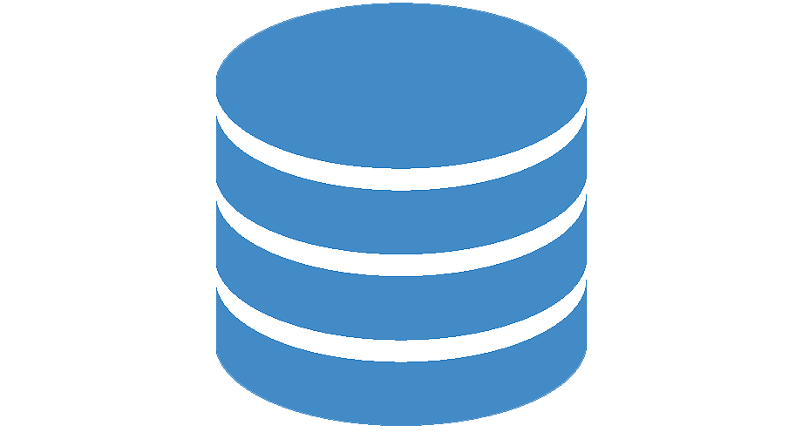
Guiding principles of RESTful architectures
REQUEST
Client-Server Decoupling
Client (e.g., browser, microservice) and server (e.g., Backend Server) are separate.
RESPONSE
Client
Server
Order
REQUEST
Stock
RESPONSE
Microservice
Microservice
5
Notes:
Client-server decoupling
In REST API design, client and server applications must be completely independent of each other.
The only information the client application should know is the URI of the requested resource; it can't interact with the server application in any other ways.
Similarly, a server application shouldn't modify the client application other than passing it to the requested data via HTTP.

Slide 6

Guiding principles of RESTful architectures
Task | Method | Path
Create a new customer | POST | /customers
Get customer by customer ID | GET | /customers /{ID}
Search for customers | GET | /customers
Update an existing customer by customer ID | PUT | /customers /{ID}
Delete an existing customer by customer ID | DELETE | /customers /{ID}
Uniform Interface
All devices access services via a single consistent interface.
Microservice
API
Microservice
API
6

Slide 7


Guiding principles of RESTful architectures
Client
STATEFUL
Server
REQUEST Next Page
Stateless
State is contained within the request.
No states is held on server. The server is stateless.
RESPONSE Page 1 Content
on page 1
REQUEST Next Page
RESPONSE Page 2 Content
on page 2
STATELESS
REQUEST Page 1
RESPONSE Page 1 Content
REQUEST Page 2
RESPONSE Page 2 Content
7

Slide 8

Guiding principles of RESTful architectures
Cacheable
Client
Server
Cat Photo not in local cache.
Get Cat Photo
Cacheable
Each response message must explicitly state if it can be cached or not.
cache
REQUEST Cat Photo
RESPONSE - Cacheable
cache
Cat Photo IS in local cache.
Get Cat Photo
cache
Get Cat Photo from Cache
8
Notes:
Cache-Control: no-cache

Slide 9

Guiding principles of RESTful architectures
Not Cacheable (no-cache)
Client
Server
Get Dog Photo
Dog Photo not in local cache.
Cacheable
Each response message must explicitly state if it can be cached or not
cache
REQUEST Dog Photo
RESPONSE – Not Cacheable
Get Dog Photo
Dog Photo not in local cache.
cache
REQUEST Dog Photo
RESPONSE – Not Cacheable
9

Slide 10


Guiding principles of RESTful architectures
Client
Proxy
Load Balancer
Server
REQUEST
Layered
Each layer is transparent to the Client and Server. The client and server should not be aware of any intermediates servers.
RESPONSE
REQUEST
RESPONSE
REQUEST
RESPONSE
10
Notes:
A RESTful API should be designed as a layered system, with each layer performing a specific function. This allows for greater flexibility and modularity, as each layer can be developed and maintained independently of the others.

Slide 11
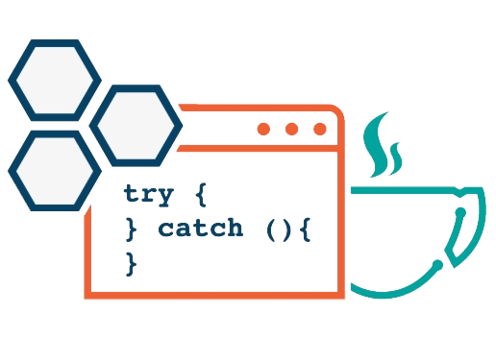
Guiding principles of RESTful architectures
Code-On-Demand
Allow the server to extend an application functionality by sending code to client
REQUEST
RESPONSE
Browser
Server
Optional
e.g., Applet, JavaScript
11
Notes:
Code-On-Demand
The code-on-demand style concerns client components having access to a set of resources, but no knowledge of how to process such resources.
The client can request the code to process resources from the server, which can then be executed locally on the client. This provides improved application extensibility, performance and efficiency as code execution has been deferred from the server to the client

Slide 12
RESTful services is exposed via the @RestController and HTTP method mappings, as shown below:
Exposing RESTful API with Spring WEB
@RestController
class
{
@PutMapping
method() {}
@GetMapping
method() {}
@PostMapping
method() {}
@DeleteMapping
method() {}
}
Microservice
REST API
@RestController
Notes:
Trainer Notes:
Explain the different types of mapping and what they do
Why the annotations are important

Slide 13
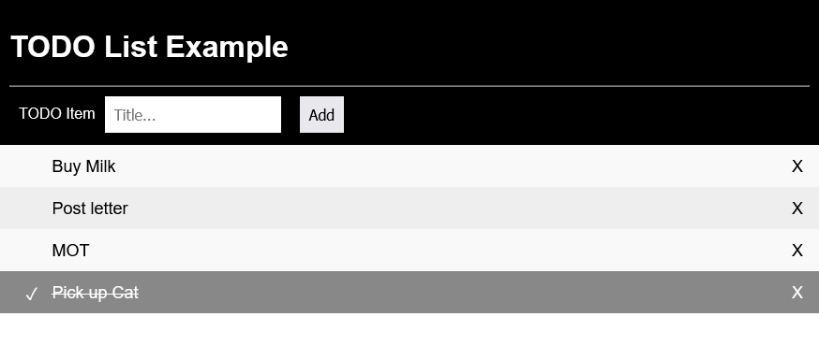
Test Application UI
TODOITEM Structure
{
"type": "object",
"$schema": "http://json-schema.org/draft-06/schema#",
"description": "JSON schema for TODO ITEM",
"properties": {
"description": {
"type": "string"
},
"id": {
"type": "integer"
},
"status": {
"type": "string"
}
}
}
Example
{
"id":-1,
"description":"hello",
"status":"NEW“
}
@PostMapping("/todo")
Add a TODO item
@GetMapping("/todo")
Get all the TODO items as a list
@PutMapping("/todo")
Update a TODO item.
@DeleteMapping("/todo/{todoItemID}")
Delete a TODO Item by ID
Notes:
The TODO UI is a standalone HTML/JAVA script application (in the WEBUI folder)
If run standalone then @CrossOrigin(origins = "*") is required due to page serving from a “different “ server and browser security
You can embed the TODO html in the SpringBoot application by moving it to main/resources/static (http://localhost:8080/todo.html)
NOTE
F12 on the Browser will bring up the development console.
You can see and explore the content of the REST NETWORK traffics under the Network Tab (for example see the method and body content)
This is followed by Hands On Exercises (Reference: Sprint Boot (1) Basic)

Slide 14
The Test Application Structure
|-- src
| |-- main
| | |-- java
| | | `-- com
| | | `-- qa
| | | `-- exercise
| | | `-- todo
| | | |-- TodoApplication.java
| | | |-- controller
| | | | `-- TodoController.java
| | | |-- data
| | | | |-- entity
| | | | | `-- TodoItem.java
| | | | `-- repository
| | | `-- service
| | | `-- TodoService.java
| | `-- resources
| | |-- application.properties
Controller
@RestController
Business
@Service
The @RestController
Data
Data Entity
@Repository
@Entity
Repository (for Data Access)
Business Logic
H2 Database
Notes:
Repository will be introduced in the Data Access module

Slide 15

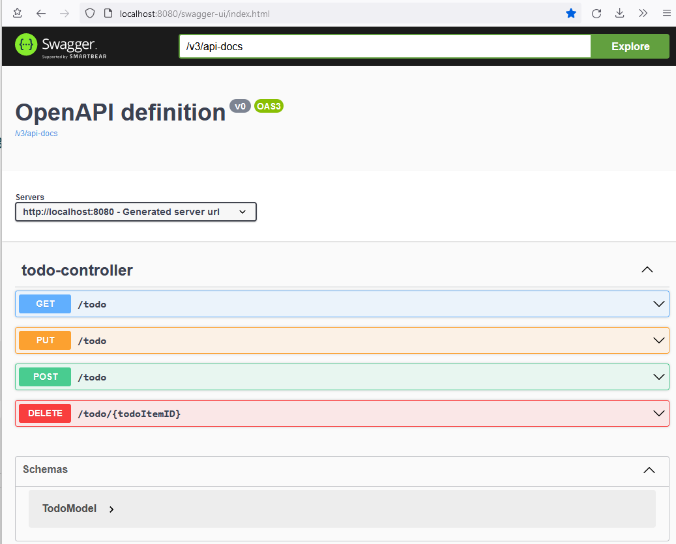
Adding Swagger to your project
Add the following dependency to your project POM:
<dependency>
<groupId>org.springdoc</groupId>
<artifactId>
springdoc-openapi-starter-webmvc-ui
</artifactId>
<version>2.0.0</version>
</dependency>
Rebuild application:
mvn clean package
Run application:
java -jar .\target\todo-0.0.1-SNAPSHOT.jar
Browse to the following URL: http://localhost:8080/swagger-ui/index.html
Notes:
Demonstrate Swagger
Hands on exercise

Slide 16
Building the controller
Instructor Demo
Lab 2 – Creating the Controller

Slide 17

Traditionally, Java data access involves a lot of boilerplate code and configuration.
Spring Data makes it possible to remove the DAO implementations entirely.
The interface of the DAO is now the only artifact that developers need to explicitly define.
Spring Data unify and ease the access to different kinds of persistence stores, both relational database systems and NoSQL data stores.
ACCESSING DATA WITH SPRING DATA
Spring Data Repository
JPA
Hibernate
JDBC
Managed by Spring Data (no code)

Slide 18
Spring Data dependencies for our test project
pom.xml
<!-- Data -->
<dependency>
<groupId>org.springframework.boot</groupId>
<artifactId>spring-boot-starter-data-jpa</artifactId>
</dependency>
<!– H2 Database Driver →
<dependency>
<groupId>com.h2database</groupId>
<artifactId>h2</artifactId>
<scope>runtime</scope>
</dependency>
Spring Data
H2 Database Driver. The test project will use an in-memory database. No permanent data is held.
src/main/resources/application.properties
H2 UI Console URL: http://localhost:8080/h2
# Enabling H2 Console
spring.h2.console.enabled=true
spring.h2.console.path=/h2
# Disable Hibernate from automatically creating tables
spring.jpa.hibernate.ddl-auto=none
spring.datasource.url=jdbc:h2:mem:qa-springboot
Instruct Spring Data not to automatically create the tables.
Explicitly name the schema, otherwise a different one is created each time the application starts.
Notes:
H2 in memory DB will not hold permanent data
Database table will be created via src/main/resources/schema.sql when Spring Boot starts

Slide 19
Methods | Description
<S extends T> S save(S entity) | Saves a given entity.
<S extends T> Iterable<S> saveAll(Iterable<S> entities) | Saves all given entities.
Optional<T> findById(ID id) | Retrieves an entity by its id.
boolean existsById(ID id) | Returns whether an entity with the given id exists.
Iterable<T> findAll() | Returns all instances of the type.
Iterable<T> findAllById(Iterable<ID> ids) | Returns all instances of the type T with the given IDs.
long count() | Returns the number of entities available.
void deleteById(ID id) | Deletes the entity with the given id.
void delete(T entity) | Deletes a given entity.
void deleteAllById(Iterable<? extends ID> ids) | Deletes all instances of the type T with the given IDs.
void deleteAll(Iterable<? extends T> entities) | Deletes the given entities.
void deleteAll() | Deletes all entities managed by the repository.
Spring Data Repository
@Repository
@JpaRepository
@ListCrudRepository
@ListPagingAndSortingRepository
@PagingAndSortingRepository
Spring Data provides four types of repository with different functionalities.
For this module, we will focus on the @JpaRepository.
See https://docs.spring.io/spring-data/commons/docs/current/api/org/springframework/data/repository/package-summary.html
Notes:
JPA Repository: https://docs.spring.io/spring-data/jpa/docs/current/reference/html/

Slide 20
Sample SQL files to setup and populate a database
schema.sql
drop table if exists `chocolate` CASCADE;
CREATE TABLE chocolate (
id BIGINT AUTO_INCREMENT,
brand VARCHAR(255),
name VARCHAR(255),
sugar_content INTEGER NOT NULL,
tastiness INTEGER NOT NULL,
texture VARCHAR(255),
type VARCHAR(255),
PRIMARY KEY (id)
);
The schema.sql file sets up the structure of the database table for your project to interact with and make CRUD requests to.
data.sql
The data.sql file populates the database with a record but you can also populate the database with multiple records by duplicating this line and changing the values for each one.
INSERT INTO `chocolate`(`name`,`brand`,`type`,`tastiness`,`texture`,`sugar_content`) VALUES('Twirl', 'Cadbury', 'Milk', 103, 'Crumbly', 20);
Notes:
Spring will automatically run data.sql and schema.sql files on startup if they’re in the resources folder

Slide 21
Implementing a JpaRepository
Client Class
@Autowired TodoItemRepository todoItemRepository;
todoItemRepository.save(todoItem);
todoItemRepository.delete(todoItem);
call
No implementation required. Spring Data will automatically implement the class. You DO NOT need to do this manually.
TodoItemRespository
TodoItem
public interface TodoItemRepository
extends JpaRepository<TodoItem, Long> {
List<TodoItem> findAll();
}
@Entity
public class TodoItem {
...
}
This tells Sping Data to work with the TodoItem
With the exception of findXXX() methods, other methods such as save() and delete() do not need to be declared. It is automatically available.
Notes:
Sample code shown on the slides can be found on sharepoint

Slide 22
Persistence
Instructor Demo
Lab 3 – Creating the Service
Lab 4 - Persistence

Slide 23
End of session

