Slide 1
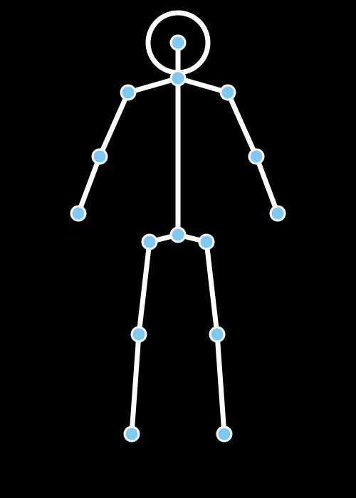

MCA FINAL YEAR PROJECT • ARTIFICIAL INTELLIGENCE & MACHINE LEARNING
Human Activity
Recognition System
Watching Movement. Understanding Action. Enabling Real-Time Insight.
AI / MACHINE LEARNING
PRESENTED BY
Akkisetti Ganesh
REGISTRATION NO.
12524619
DEGREE
Master of Computer Applications (MCA)
MediaPipe Pose • 33 Landmarks • Stacked LSTM
Deployed using Streamlit

Slide 2








MOTIVATION
Problem Statement & Proposed Solution
THE PROBLEM
THE PROPOSED SOLUTION
Manual video monitoring is inefficient
Real-time pose detection using MediaPipe
Continuous human supervision does not scale and is error-prone.
Tracks 33 body landmarks per frame instantly.
Falls require instant detection
Activity recognition using stacked LSTM
Delayed response during emergencies can be critical.
Learns temporal motion patterns across frame sequences.
Wearable sensors are uncomfortable
Webcam and uploaded video support
Body-worn devices affect user comfort and daily routine.
Flexible input from live camera or recorded files.
Lack of integrated lightweight AI solutions
Unified Streamlit web application
Few systems combine pose, sequence and prediction end-to-end.
One dashboard for capture, prediction and analytics.
02 / 10

Slide 3









TECHNOLOGY STACK
Tools & Frameworks Powering the System
Python
OpenCV
MediaPipe
TensorFlow / Keras
NumPy
Core programming language
Video capture & frame processing
Real-time pose landmark detection
LSTM model building & training
Numerical array operations
Pandas
Scikit-learn
Matplotlib
Seaborn
Streamlit
Dataset handling & structuring
Metrics & train/test splitting
Training curve visualization
Confusion matrix heatmaps
Interactive web dashboard
03 / 10

Slide 4







ARCHITECTURE
System Architecture
Video / Webcam
OpenCV
MediaPipe Pose
33 Landmarks
Live or uploaded input
Frame capture & preprocessing
Pose landmark model
Per-frame body keypoints
30-Frame Sequence
Stacked LSTM Model
Activity Prediction
Streamlit Dashboard
Fixed-length window
Temporal pattern learning
Softmax classification
Live result display
04 / 10

Slide 5









PROCESSING PIPELINE
AI & Data Pipeline
1
2
3
Frame Extraction
RGB Conversion
Pose Detection
Read frames from video stream
BGR to RGB color transform
MediaPipe locates body pose
4
5
6
Landmark Extraction
Sequence Generation
Normalization
33 keypoints (x, y, z, visibility)
Group into 30-frame windows
Scale landmark coordinates
7
8
9
LSTM Prediction
Softmax Classification
Live Prediction
Stacked LSTM reads sequence
Probability per activity class
Result streamed to dashboard
05 / 10

Slide 6

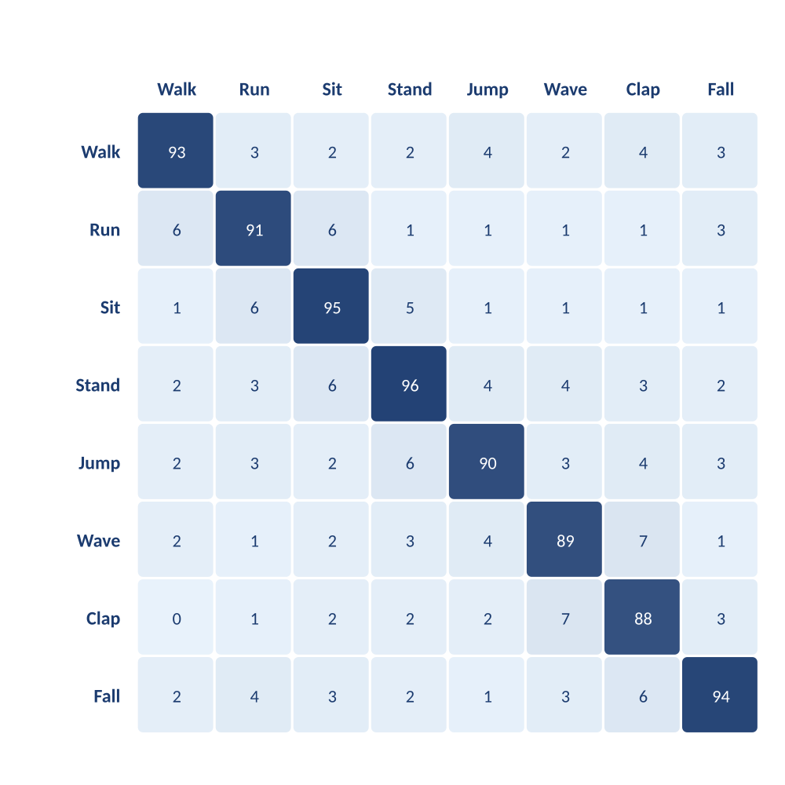

EVALUATION
Model Performance
92.5%
OVERALL ACCURACY
91.8%
92.1%
91.9%
Precision
Recall
F1-Score
CONFUSION MATRIX
TRAINING CURVE
06 / 10

Slide 7













CAPABILITIES
Recognized Activities & Project Features
RECOGNIZED ACTIVITIES
Walking
Running
Sitting
Standing
Jumping
Waving
Clapping
Falling
PROJECT FEATURES
Real-Time Webcam Prediction
Video Prediction
Interactive Dashboard
Instant activity recognition from live camera feed
Upload and analyze pre-recorded video files
Unified Streamlit interface for all functions
Confidence Score
Analytics View
Training Curves
Displays prediction probability per activity
Session-level activity insights and summaries
Visualizes model accuracy and loss over epochs
07 / 10

Slide 8




ENGINEERING CHALLENGES
Challenges & Solutions
Variable Video Length
SOLUTION
Inputs range from a few seconds to several minutes.
Frames are padded or truncated into fixed 30-frame sequences before inference.
Missed Pose Detection
SOLUTION
Occlusion or poor lighting can drop landmark tracking.
Confidence thresholds and frame interpolation handle missing keypoints gracefully.
Similar-Looking Activities
SOLUTION
Actions like standing and waving share overlapping poses.
A deeper stacked LSTM captures temporal motion patterns, not just single poses.
Webcam Latency
SOLUTION
Live inference can lag behind real-time video feed.
Optimized preprocessing and a lightweight model architecture enable real-time speed.
08 / 10

Slide 9









OUTCOMES & ROADMAP
Results & Future Scope
RESULTS
FUTURE SCOPE
Multiple Person Detection
Recognize activities for more than one individual at once
92.5%
Fast
Mobile Application
Overall Accuracy
Prediction Speed
Extend the system to Android / iOS platforms
CCTV Integration
Connect with existing surveillance camera networks
Fall Alert System
Lightweight
Real-Time
Automated notifications for emergency response
Model Footprint
Live Inference
Healthcare Monitoring
Track patient movement and elderly care activity
Smart Surveillance
Anomaly and suspicious-behavior detection
09 / 10

Slide 10

REFERENCES
References
MediaPipe Documentation — Google AI Edge
TensorFlow / Keras Documentation
Thank You
Streamlit Documentation
OpenCV Documentation
Questions & Answers
Scikit-learn Documentation
NumPy & Pandas Documentation
Akkisetti Ganesh
Reg. No. 12524619 • MCA
Hochreiter & Schmidhuber (1997) — Long Short-Term Memory, Neural Computation
Human Activity Recognition System
10 / 10

