Slide 1
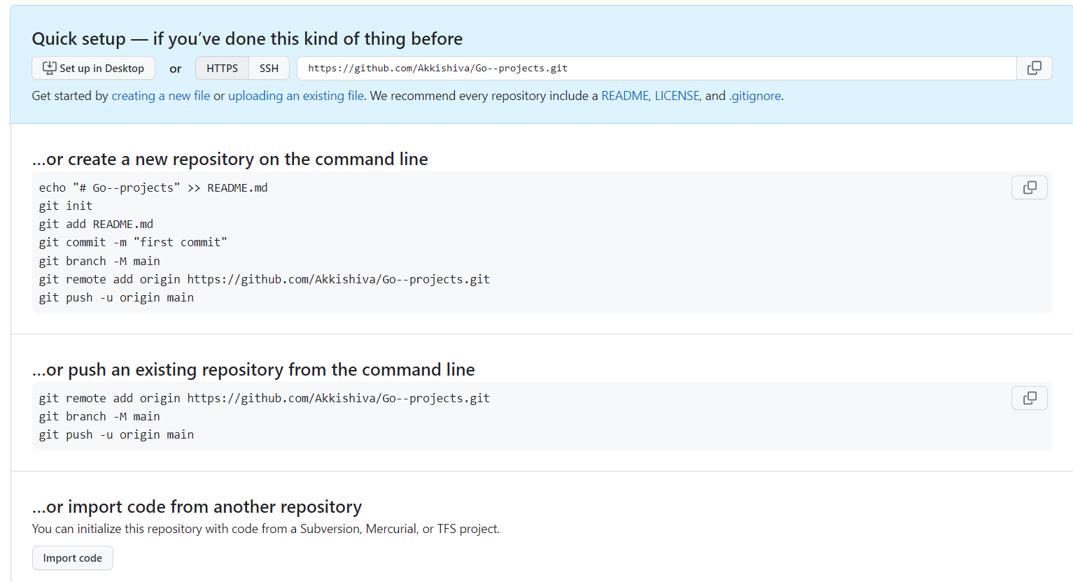

Slide 2
Project 1- Email Verifier

