Slide 1

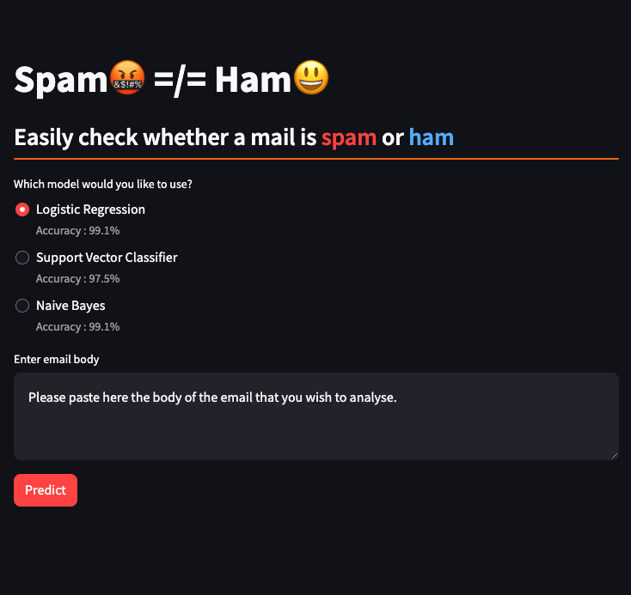
Spam🤬 =/= Ham😃
Email Classification using NLP and ML
Akshat Sharma
500097291, R2142211317
AIML Hons. B2

Slide 2
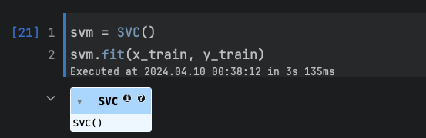
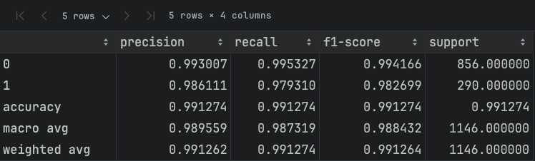
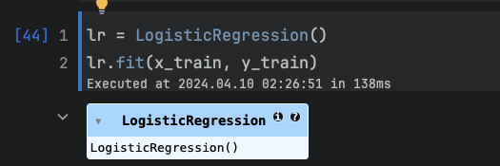
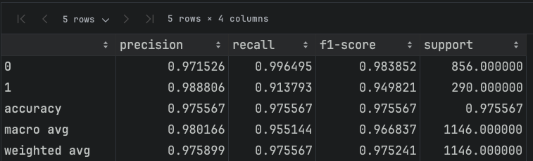
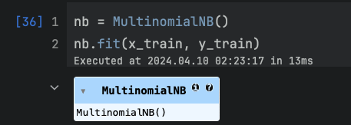
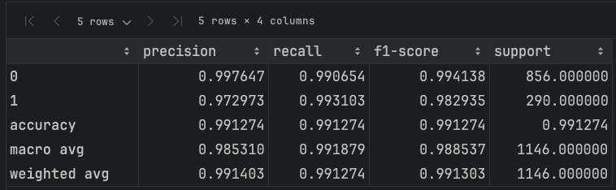
Models Used
Logistic Regression
Support Vector Classifier
Naive Bayes Classifier

Slide 3
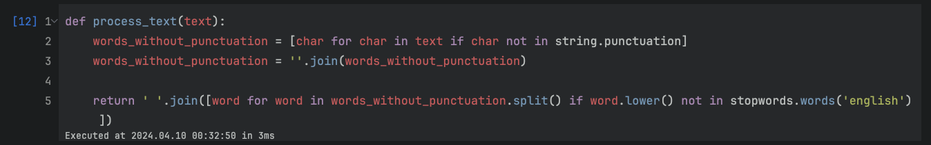
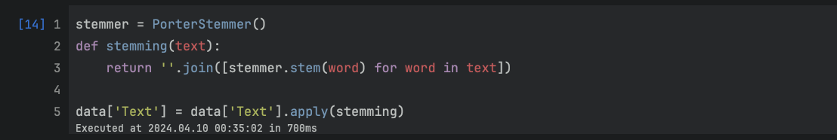
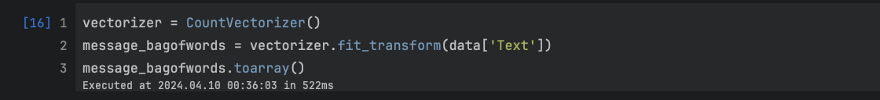
Methodology
Text Processing
Punctuation removal
Stopwords removal
Stemming
PorterStemmer
Vectorisation
Count Vectorizer
Model Training

Slide 4
Thank You

