Slide 1
Movie Ticket Booking System
Mentor name:
Prof. Shakila Shaikh
Presentation By :
Priyal Kadam(N051) Akshay Patil(N052)
Atharva Kolhe(N054)

Slide 2
Presentation Agenda
Introduction
Project Overview
Project Workflow (EER)
Technologies Used
Schema Diagram
Query
Self Learning
Lessons Learned
Challenges Faced
References

Slide 3
Introduction
Movie Ticket Booking Systems are used all around the world for booking and reserving movies online. These applications and websites provide customers with facilities to view movie availability online and make reservations with just a few steps.

Slide 4
Project Overview
Our movie ticket management system, implemented in allows users to easily make movie reservations. When a user first visits the website they are redirected to a home dashboard where all the different movies that are currently in the database are listed along with some key information regarding the movie including a brief description, PG rating, duration, genre etc.

Slide 5
In order to make a booking all users must first login to their personal account. If the user does not have an account, they must make one before they can proceed to make a booking.
The users also have the option of providing a feedback on the website experience through a feedback forum. This project replicates the working of a real life movie ticket booking system

Slide 6

Project Workflow (EER)

Slide 7

Technologies Used
MySQL Workbench 8.0 CE

Slide 8
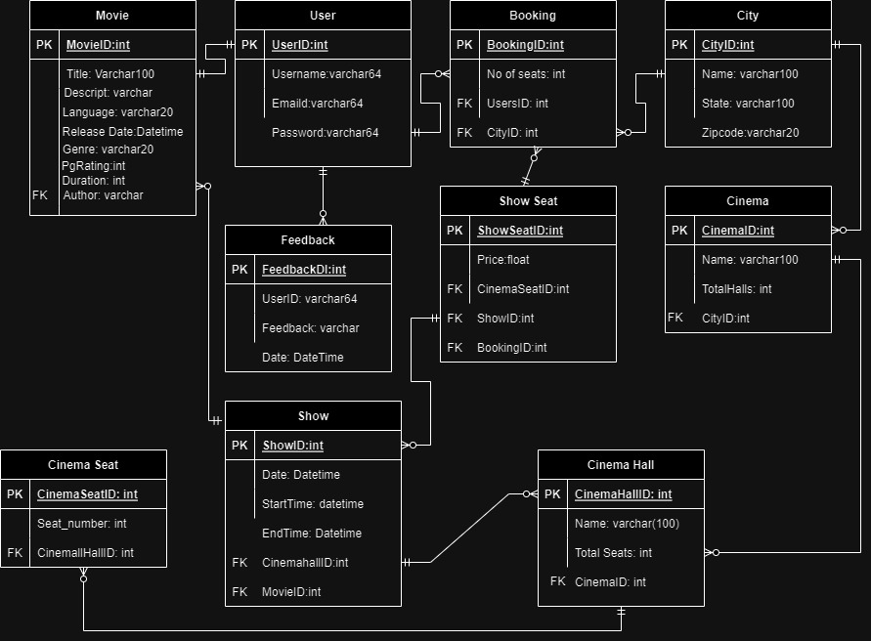
Schema Diagram

Slide 9
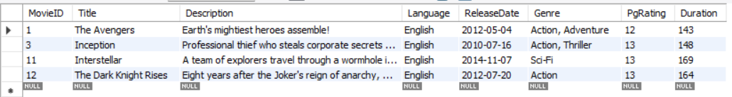
Queries
1) Retrieve all movies released after 2010
CODE:
SELECT * FROM Movie WHERE ReleaseDate > '2010-01-01’;
OUTPUT:

Slide 10
2) Retrieve all movies in the Drama genre
CODE:
SELECT * FROM Movie WHERE Genre = 'Drama’;
OUTPUT:

Slide 11
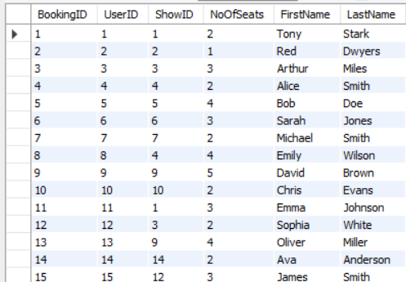
3) Retrieve all bookings with corresponding user details
CODE:
SELECT Booking.*, User.FirstName, User.LastName FROM Booking INNER JOIN User ON Booking.UserID = User.UserID;
OUTPUT:

Slide 12
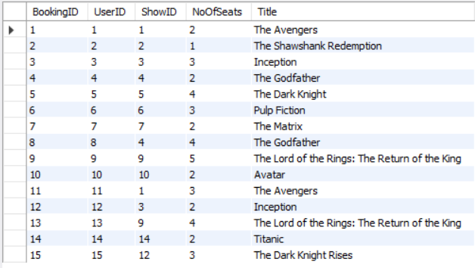
4) Retrieve all bookings with corresponding movie details
CODE:
SELECT Booking.*, Movie.Title FROM Booking INNER JOIN Show_ ON Booking.ShowID = Show_.ShowID INNER JOIN Movie ON Show_.MovieID = Movie.MovieID;
OUTPUT:

Slide 13
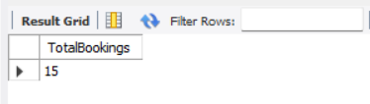
5) Count the total number of bookings made
CODE:
SELECT COUNT(*) AS TotalBookings FROM Booking;
OUTPUT:

Slide 14
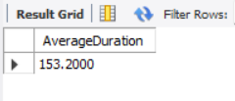
6) Calculate the average duration of movies
CODE:
SELECT AVG(Duration) AS AverageDuration FROM Movie;
OUTPUT:

Slide 15
7) Retrieve all users who made a booking for a movie with a PgRating of 13.
CODE:
SELECT * FROM User WHERE UserID IN (
SELECT DISTINCT Booking.UserID
FROM Booking
INNER JOIN Show_ ON Booking.ShowID = Show_.ShowID
INNER JOIN Movie ON Show_.MovieID = Movie.MovieID
WHERE Movie.PgRating = 13);

Slide 16
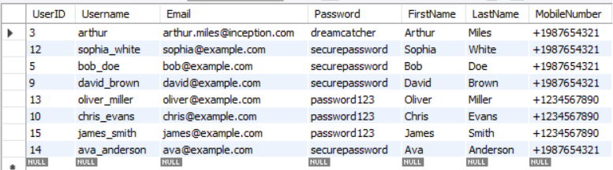
OUTPUT:

Slide 17
8) Retrieve all movies with more than 1 feedbacks
CODE:
SELECT * FROM Movie WHERE MovieID IN (
SELECT DISTINCT Show_.MovieID
FROM Show_
INNER JOIN Feedback ON Show_.ShowID = Feedback.ShowID
GROUP BY Show_.MovieID
HAVING COUNT(*) > 1);

Slide 18
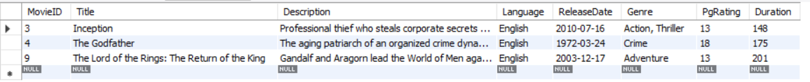
OUTPUT:

Slide 19
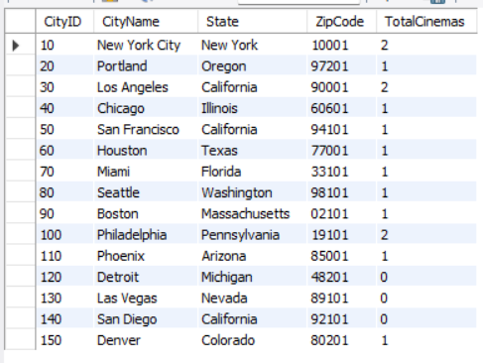
9) Retrieve all cities with their respective cinemas
CODE:
SELECT City.*, COUNT(Cinema.CinemaID) AS TotalCinemas FROM City LEFT JOIN Cinema ON City.CityID = Cinema.CityID GROUP BY City.CityID;
OUTPUT:

Slide 20
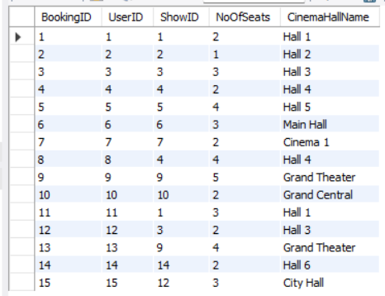
10) Retrieve all bookings with corresponding cinema hall details
CODE:
SELECT Booking.*, CinemaHall.CinemaHallName FROM Booking INNER JOIN Show_ ON Booking.ShowID = Show_.ShowID INNER JOIN CinemaHall ON Show_.CinemaHallID = CinemaHall.CinemaHallID;
OUTPUT:

Slide 21
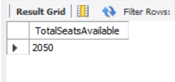
11) Calculate the total number of seats available in all cinema halls
CODE:
SELECT SUM(TotalSeats) AS TotalSeatsAvailable FROM CinemaHall;
OUTPUT:

Slide 22
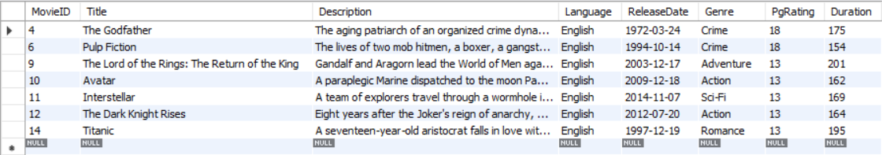
12) Retrieve all movies with a duration longer than the average duration of movies
CODE:
SELECT * FROM Movie WHERE Duration > (
SELECT AVG(Duration) FROM Movie);
OUTPUT:

Slide 23
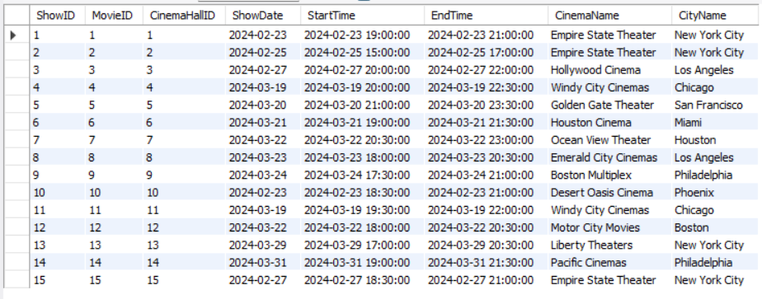
13) Retrieve all shows with corresponding cinema and city details
Code:
SELECT Show_.*, Cinema.CinemaName, City.CityName FROM Show_ INNER JOIN CinemaHall ON Show_.CinemaHallID = CinemaHall.CinemaHallID INNER JOIN Cinema ON CinemaHall.CinemaID = Cinema.CinemaID INNER JOIN City ON Cinema.CityID = City.CityID;
OUTPUT:

Slide 24

14) Find the maximum duration among all movies
CODE:
SELECT MAX(Duration) AS MaxDuration FROM Movie;
OUTPUT:

Slide 25
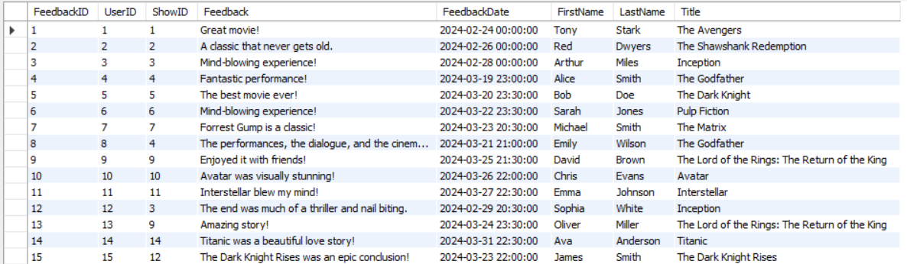
15) Retrieve all feedbacks with corresponding user and movie details
CODE:
SELECT Feedback.*, User.FirstName, User.LastName, Movie.Title FROM Feedback INNER JOIN User ON Feedback.UserID = User.UserID INNER JOIN Show_ ON Feedback.ShowID = Show_.ShowID INNER JOIN Movie ON Show_.MovieID = Movie.MovieID;
OUTPUT:

Slide 26
16) Retrieve all movies along with the corresponding city names where they are being screened
CODE:
SELECT Movie.Title, City.CityNameFROM MovieINNER JOIN Show_ ON Movie.MovieID = Show_.MovieIDINNER JOIN CinemaHall ON Show_.CinemaHallID = CinemaHall.CinemaHallIDINNER JOIN Cinema ON CinemaHall.CinemaID = Cinema.CinemaIDINNER JOIN City ON Cinema.CityID = City.CityID;

Slide 27
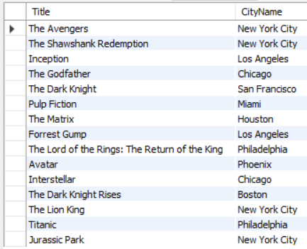
OUTPUT:

Slide 28

17) Calculate the average number of seats per cinema hall
CODE:
SELECT AVG(TotalSeats) AS AverageSeatsPerHall FROM CinemaHall;
OUTPUT:

Slide 29
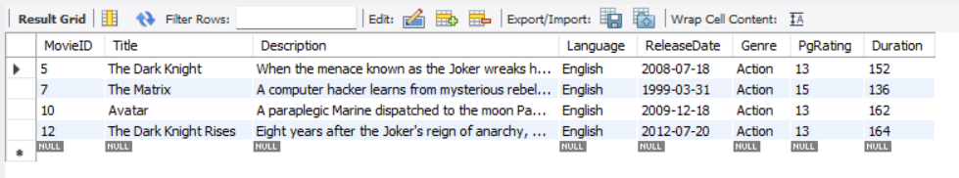
18) Retrieve all movies with a genre that matches the most common genre among movies
CODE:
SELECT *FROM MovieWHERE Genre = ( SELECT Genre FROM Movie GROUP BY Genre ORDER BY COUNT(*) DESC LIMIT 1);
OUTPUT:

Slide 30

19) Find the minimum PgRating among all movies
CODE:
SELECT MIN(PgRating) AS MinPgRating FROM Movie
OUTPUT:

Slide 31
Self Learning
Through this project, we enhanced understanding of database management and SQL. Key learnings included database design, SQL constraints, normalization techniques, data manipulation operations, transaction management, data integrity, and advanced SQL operations like joins and aggregates. These practical experiences equipped us with valuable skills for real-world database development and administration tasks.

Slide 32
Lessons Learned
A significant learning from the project was the practical application of normalization techniques in database design. Understanding how to structure databases efficiently to minimize data redundancy and maintain data integrity is crucial for optimizing database performance and ensuring scalability in real-world applications.

Slide 33
Challenges Faced
Writing SQL Queries: Constructing SQL queries to retrieve, update, or delete data from the database can be difficult, particularly if you're not familiar with the SQL language syntax and best practices.
Normalization: Ensuring that your database is normalized to eliminate redundancy and maintain data integrity can be tricky.
Data Modeling: Designing a simple yet effective database schema can be challenging, especially if you're not experienced with data modeling. You need to identify the entities, attributes, and relationships in your system accurately.
Understanding Requirements: Sometimes, the initial requirements for the project might be unclear or incomplete. It's essential to communicate effectively with stakeholders to ensure that you fully understand what is expected from the project.

Slide 34
References
https://github.com/AnirudhAchal/Movie_Management_System

Slide 35
Thank You!

