Slide 1
SpaceX Falcon 9 First Stage Landing Prediction
IBM Applied Data Science Capstone
Aklesso KPEGUIE
Université Aix-Marseille
https://github.com/Akla-20/IBM-Applied-Data-Science-Capstone

Slide 2
Executive Summary
Business problem: Predict successful Falcon 9 first-stage landings.
Data sources: SpaceX REST API and Wikipedia.
Techniques: SQL, EDA, Folium, Plotly Dash, Machine Learning.
Goal: Support launch cost estimation through landing prediction.

Slide 3
Introduction
Reusable boosters reduce launch costs.
Landing success determines whether boosters can be reused.
Predictive analytics helps estimate mission cost and operational risk.

Slide 4
Data Collection
Collected launch records from the SpaceX API.
Completed missing information using Wikipedia web scraping.
Built a structured dataset for analysis.

Slide 5
Data Wrangling
Handled missing values.
Created the target variable (Class).
Encoded categorical variables and standardized features.

Slide 6
EDA and SQL
Analyzed launch sites, payload mass, orbit types and outcomes.
Used SQL queries to summarize launches and landing results.

Slide 7
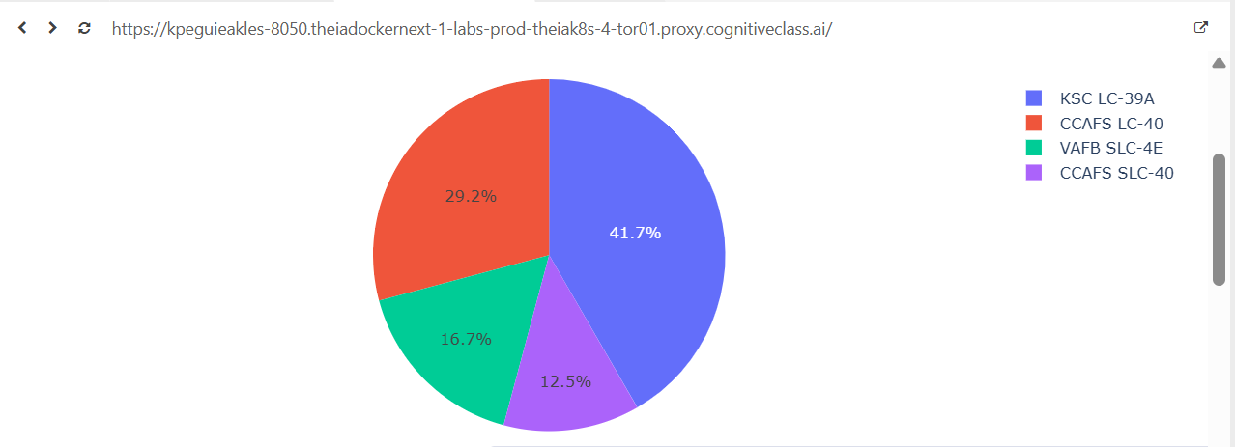
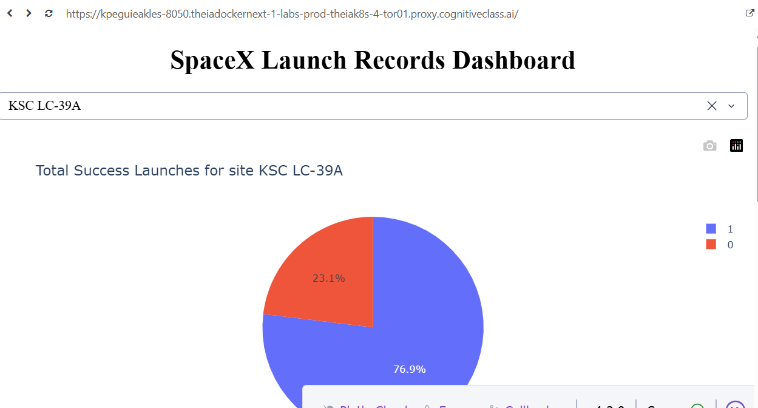
Plotly Dash Dashboard
All launch sites
KSC LC-39A filter

Slide 8
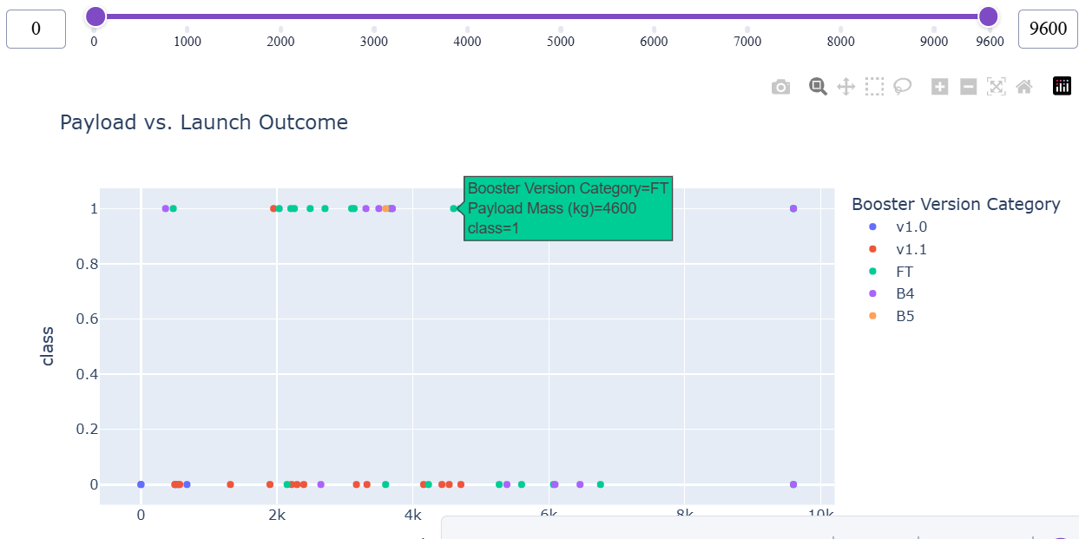
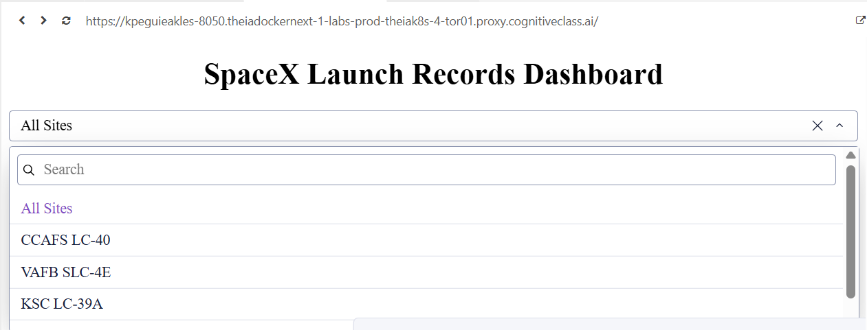
Interactive Analytics
Payload vs Outcome
Launch site selector

Slide 9
Interactive Map (Folium)
Launch sites visualized geographically.
Marker clusters used to display launch locations.
Interactive map helps explore spatial distribution.

Slide 10
Machine Learning
Algorithms: Logistic Regression, Decision Tree and Support Vector Machine.
GridSearchCV used for hyperparameter tuning.
Performance evaluated on an independent test set.

Slide 11
Results
SVM and Decision Tree achieved strong predictive performance.
Classification metrics and confusion matrix used for evaluation.
Machine learning can support decision-making for launch planning.

Slide 12
Conclusion
End-to-end data science workflow successfully implemented.
Interactive visualizations improved exploration.
Predictive models demonstrated the feasibility of landing prediction.

Slide 13
GitHub Repository
https://github.com/Akla-20/IBM-Applied-Data-Science-Capstone
Repository contains notebooks, dashboard application and project documentation.

