Slide 1
IBM DATA SCIENCE
CAPSTONE PROJECT
SpaceX Falcon 9
First-Stage Landing
Prediction
Methods · exploratory analysis · SQL · geospatial insights · machine learning
FINAL REPORT / 25 OCT 2026
HISTORICAL SPACE X LAUNCH DATA

Slide 2
01 / DECISION-READY OVERVIEW
Executive summary
90
60
83.3%
Modelling observations
Successful landings
Held-out test accuracy
66.7% in the 90-flight dataset
15 correct predictions / 18
What we learned
Decision implication
Landing success varies by launch site, payload range and booster generation in the historical data. KSC LC-39A leads the 56-launch dashboard subset.
Four classification algorithms tie at 83.3% test accuracy. Interpretation must include false positives, small sample size and dataset limitations.
Not a current SpaceX performance assessment: source datasets are course-provided historical snapshots.
Sources: Data Wrangling; Dashboard; Machine Learning notebooks.
IBM DATA SCIENCE CAPSTONE / SPACEX FALCON 9
02

Slide 3
02 / FRAMING
Research question and outcome definition
Can historical mission and booster characteristics predict whether the Falcon 9 first stage lands successfully?
Target label = 1
Target label = 0
Successful first-stage landing / accepted success categories under the IBM data-wrangling lab.
Failed landing, no landing attempt, or other outcome categorized as unsuccessful in the exercise.
Important distinction: mission success (payload delivered) and first-stage landing success are different outcomes.
Sources: Data Wrangling and Machine Learning notebooks.
IBM DATA SCIENCE CAPSTONE / SPACEX FALCON 9
03

Slide 4
03 / DATA LINEAGE
Study architecture: four different data views
121
Scraping
101
SQL
Web-derived historical launches · 11 columns
Historical launch-table records for SQL tasks
90
ML / EDA
56
Dash / Folium
Labelled observations · 18 test cases
Launch-site geographic/dashboard subset
These cohorts have different coverage and naming conventions; their percentages must not be pooled.
Sources: Web Scraping, SQL, Data Wrangling, Folium and Dash notebooks.
IBM DATA SCIENCE CAPSTONE / SPACEX FALCON 9
04

Slide 5
04 / COLLECTION METHODOLOGY
Acquisition: API workflow and web scraping
API collection (not verified)
Web scraping (verified)
Notebook documents the SpaceX REST API workflow (rockets, launchpads, payloads, cores). The uploaded API notebook has no saved executed outputs.
BeautifulSoup parses the archived Falcon 9/Falcon Heavy launch tables and saves an 11-column CSV. The notebook reports 121 extracted records.
121
11
—
Extracted web records
Scraped output columns
Executed API results
Sources: API notebook (unexecuted); Web Scraping notebook (executed).
IBM DATA SCIENCE CAPSTONE / SPACEX FALCON 9
05

Slide 6
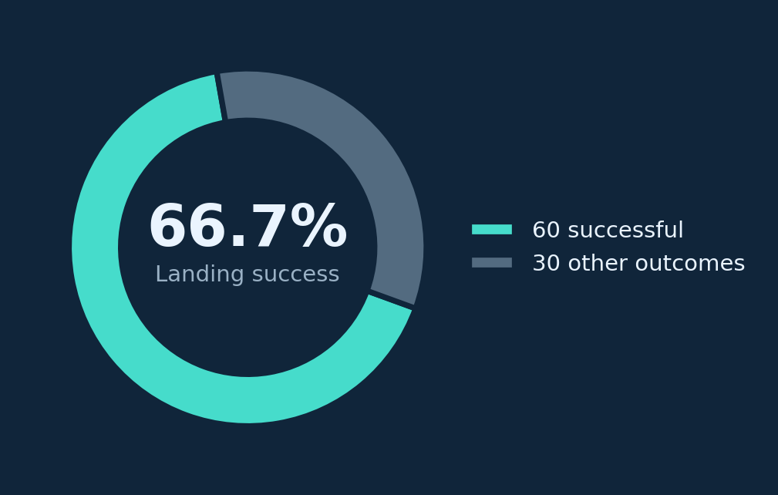
05 / PREPARATION
Data wrangling: define the learning target
Cleaning and labelling
Missing-value review, landing-outcome mapping, target Class∈{0,1}, and export of dataset_part_2.csv.
Observed missingness
LandingPad is missing in 28.89% of records; no missing values are reported for the other listed input variables.
The 66.7% figure is the labelled first-stage landing rate in the 90-record modelling cohort.
Source: Data Wrangling(1).ipynb, cells 19–50.
IBM DATA SCIENCE CAPSTONE / SPACEX FALCON 9
06

Slide 7
06 / SQL RESULTS
Exploratory analysis with SQL
101
45,596 kg
Launch records
NASA (CRS) payload mass
A separate IBM SQL exercise table.
Total recorded payload mass for this exact customer label.
2,928.4 kg
2015-12-22
Falcon 9 v1.1
First ground-pad landing
Average recorded payload mass in SQL dataset.
Earliest date of “Success (ground pad)” recorded.
These are values returned by the uploaded notebook queries; the original SQL cohort is not the 90-flight ML cohort.
Source: Complete the EDA with SQL.ipynb, executed query outputs.
IBM DATA SCIENCE CAPSTONE / SPACEX FALCON 9
07

Slide 8
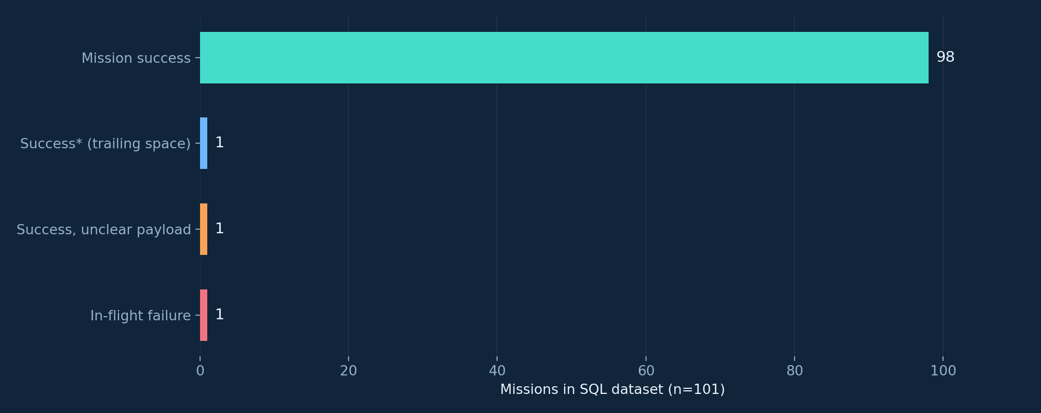
07 / SQL INTERPRETATION
Mission outcome is not landing outcome
Data quality insight
The SQL results include “Success” and a separate “Success ” value with a trailing space. Category normalization matters before aggregation.
98 exact “Success” records + 1 with trailing whitespace; 1 unclear payload; 1 in-flight failure.
Source: SQL notebook, query grouping Mission_Outcome (101 records).
IBM DATA SCIENCE CAPSTONE / SPACEX FALCON 9
08

Slide 9
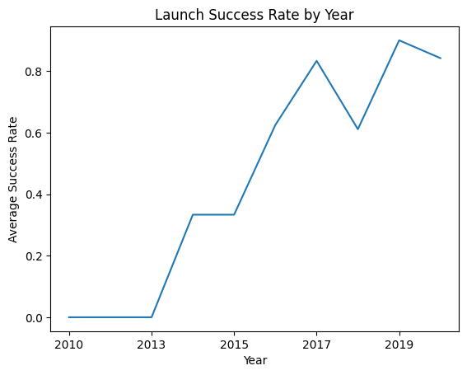
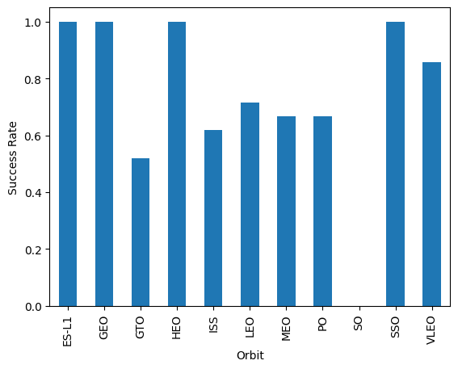
08 / EDA METHODOLOGY
Exploratory visual analysis: key patterns
Yearly first-stage landing rate in the historic sample
Landing rate varies across orbit categories
Descriptive associations only: time trends, orbit and payload patterns do not establish causal effects.
Source: EDA with Visualization Lab, executed plot outputs.
IBM DATA SCIENCE CAPSTONE / SPACEX FALCON 9
09

Slide 10
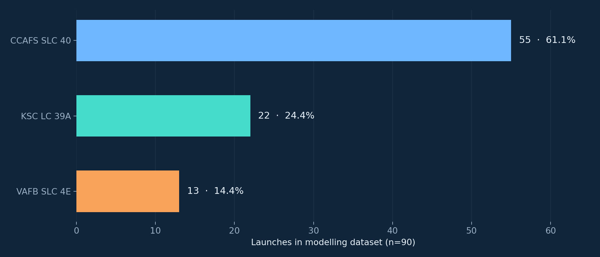
09 / EDA RESULTS
Launch-site distribution in the modelling sample
More observations come from Cape Canaveral than other locations; sample imbalance affects generalization.
Source: Data Wrangling(1).ipynb, LaunchSite.value_counts() (n=90).
IBM DATA SCIENCE CAPSTONE / SPACEX FALCON 9
10

Slide 11
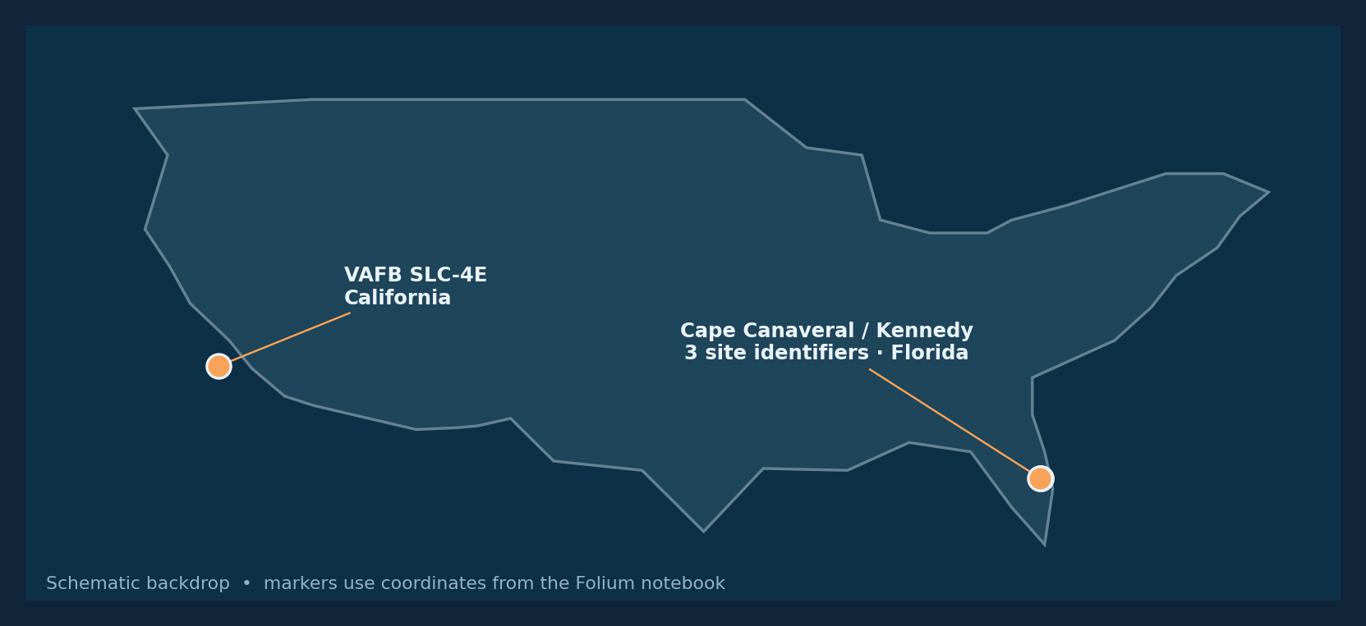
10 / INTERACTIVE VISUAL ANALYTICS
Folium: geographic context of the launch sites
MarkerCluster groups overlapping launch records; green/red markers distinguish landing outcomes in the interactive notebook.
Source: Folium notebook, launch_sites_df, cells 18–46. Illustration uses coordinates recorded in the notebook.
IBM DATA SCIENCE CAPSTONE / SPACEX FALCON 9
11

Slide 12
11 / GEOSPATIAL INTERPRETATION
Folium proximity analysis: what was measured?
4
1.01 km
MousePosition
Distinct launch-site IDs
Worked coastline example
Map extension
Manually chosen map point
Implementation
Interpretation boundary
Circle + text labels for each site, marker clustering for launches, a cursor-coordinate plugin, PolyLine overlays, and haversine distances.
Coastline/highway points were selected manually as approximate examples. These distances are illustrative, not verified nearest-neighbour distances.
Source: Folium notebook, cells 54–72.
IBM DATA SCIENCE CAPSTONE / SPACEX FALCON 9
12

Slide 13
12 / PLOTLY DASH ARCHITECTURE
The interactive dashboard: four completed tasks
TASK 1
Launch-site dropdown: ALL + four locations
TASK 2
Pie chart callback: success volume / site outcomes
TASK 3
Payload mass range slider: 0–10,000 kg
TASK 4
Scatter callback: payload, class and booster version
Verified 25 OCT 2026: notebook server-start output and interactive dashboard visible in Safari at 127.0.0.1:8050.
Sources: Dash notebook and IBM Dash laboratory PDF, pages 5–10.
IBM DATA SCIENCE CAPSTONE / SPACEX FALCON 9
13

Slide 14
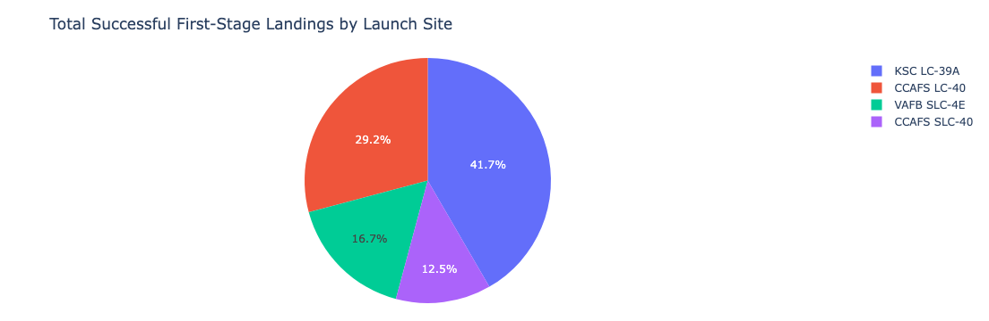
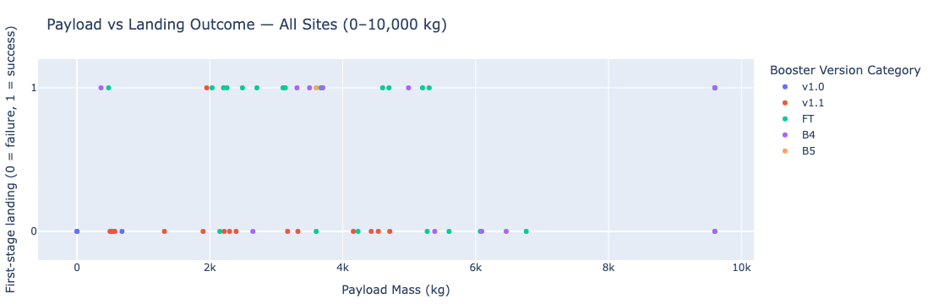
12A / DASHBOARD VISUAL EVIDENCE
Dashboard charts in the executed notebook
Launch site: ALL SITES
Payload slider: 0 — 10,000 kg
Pie chart: successful first-stage landings by site
Scatter: payload, outcome and booster category
These are notebook-generated figures; the following two slides document the live Safari session.
Source: Plotly Dash notebook, saved outputs from callbacks for ALL sites and payload range.
IBM DATA SCIENCE CAPSTONE / SPACEX FALCON 9
14

Slide 15
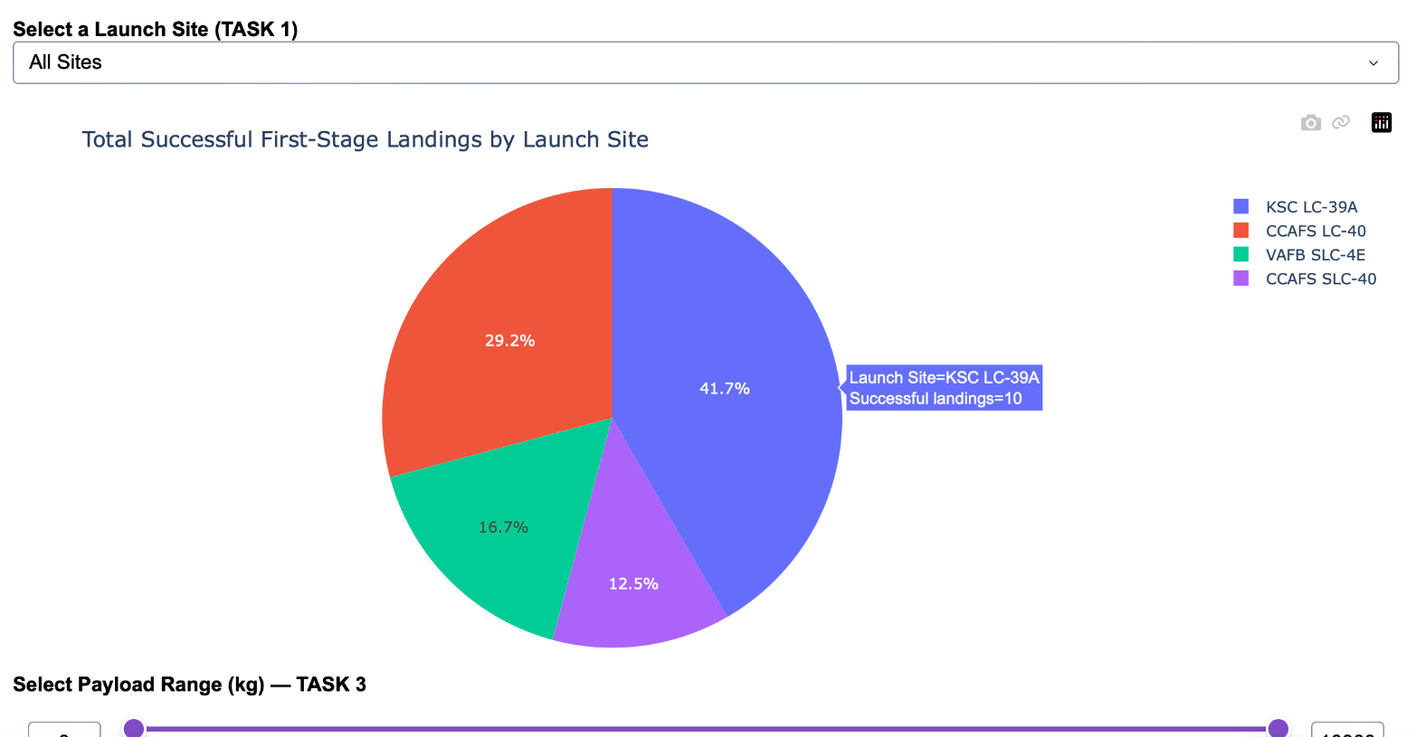
12B / LIVE DASHBOARD · SAFARI
Live dashboard: launch-site success overview
BROWSER EVIDENCE
Live application
25 October 2026 · Safari
127.0.0.1:8050
Local Dash server in notebook
ALL SITES
Four launch sites available
KSC LC-39A: 10 successful landings (41.7% of successful landings in dashboard subset).
Source: supplied Safari screenshot at 15:21; notebook 7, executed server-start cell.
IBM DATA SCIENCE CAPSTONE / SPACEX FALCON 9
15

Slide 16
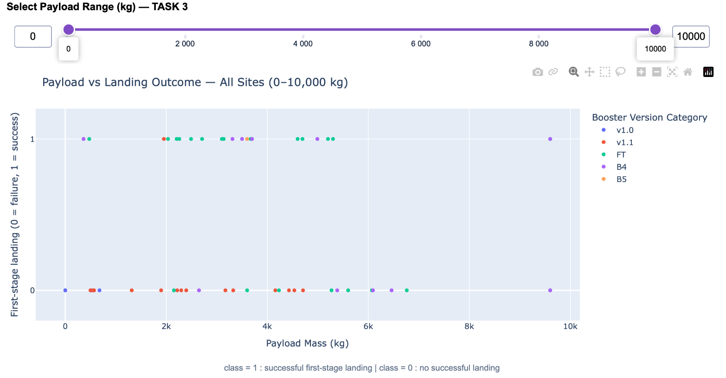
12C / LIVE DASHBOARD · SAFARI
Live dashboard: payload and landing outcomes
BROWSER EVIDENCE
Interactive filters
25 October 2026 · Safari
0–10,000 kg
Interactive payload range
Class 0 / 1
Outcome by payload and booster
Visible booster categories: v1.0, v1.1, FT, B4 and B5. Values are historical.
Source: supplied Safari screenshot at 15:21; notebook 7, verified Dash callbacks.
IBM DATA SCIENCE CAPSTONE / SPACEX FALCON 9
16

Slide 17
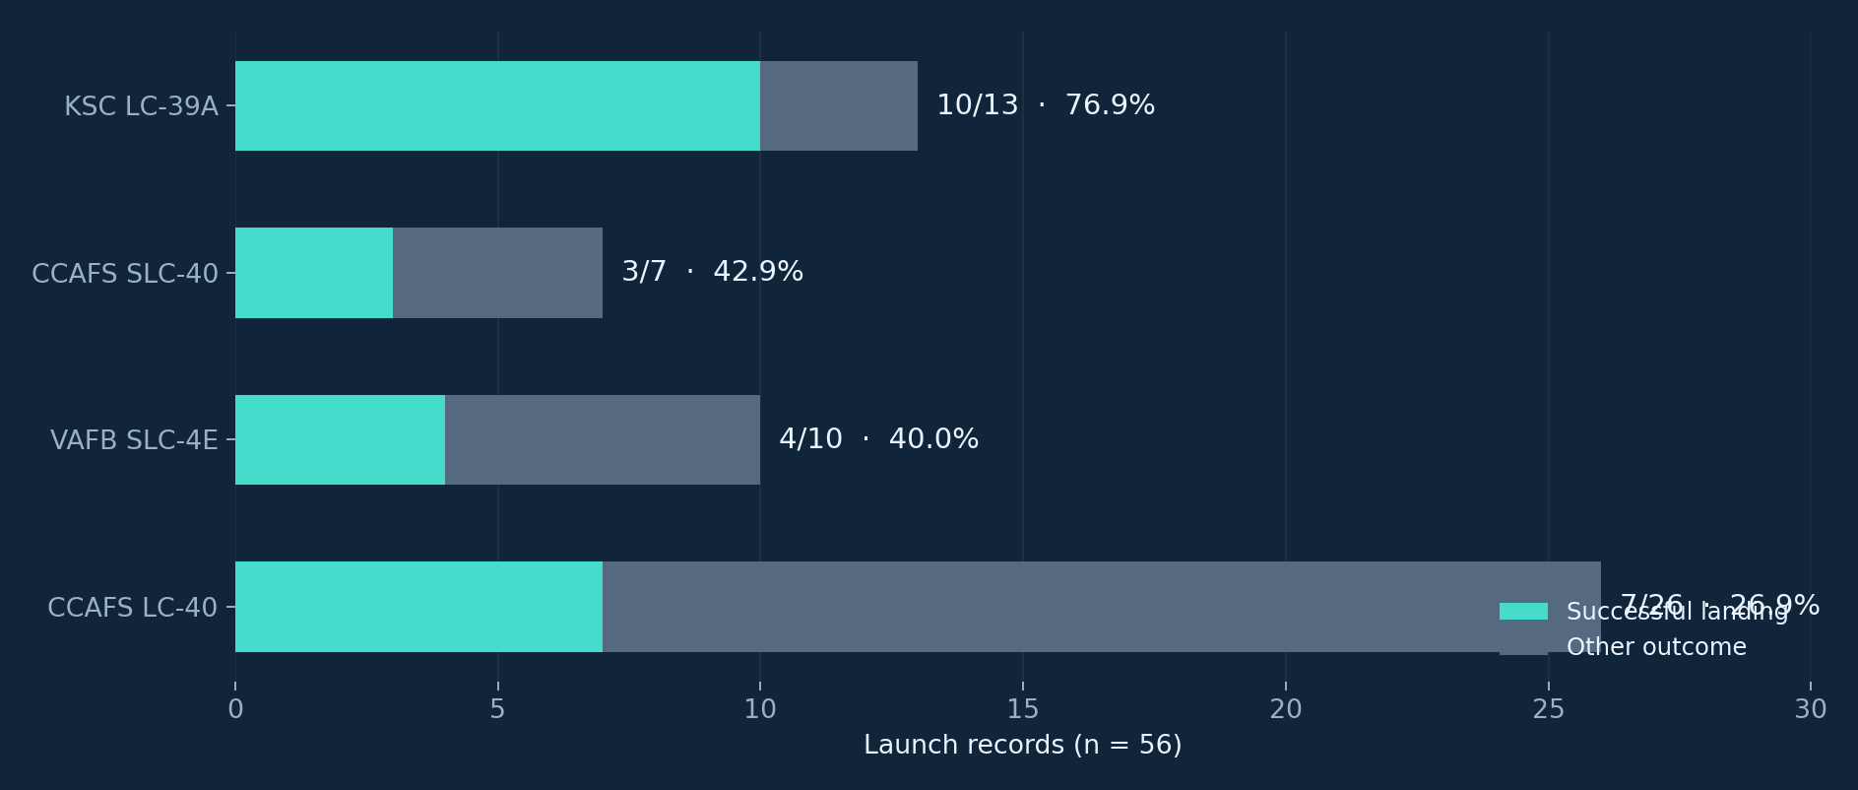
13 / DASHBOARD FINDINGS
Which launch site performs best?
KSC LC-39A: 10 successful first-stage landings out of 13 (76.92%) — most successes and highest site rate.
Source: Dashboard notebook, site_stats output (n=56).
IBM DATA SCIENCE CAPSTONE / SPACEX FALCON 9
17

Slide 18
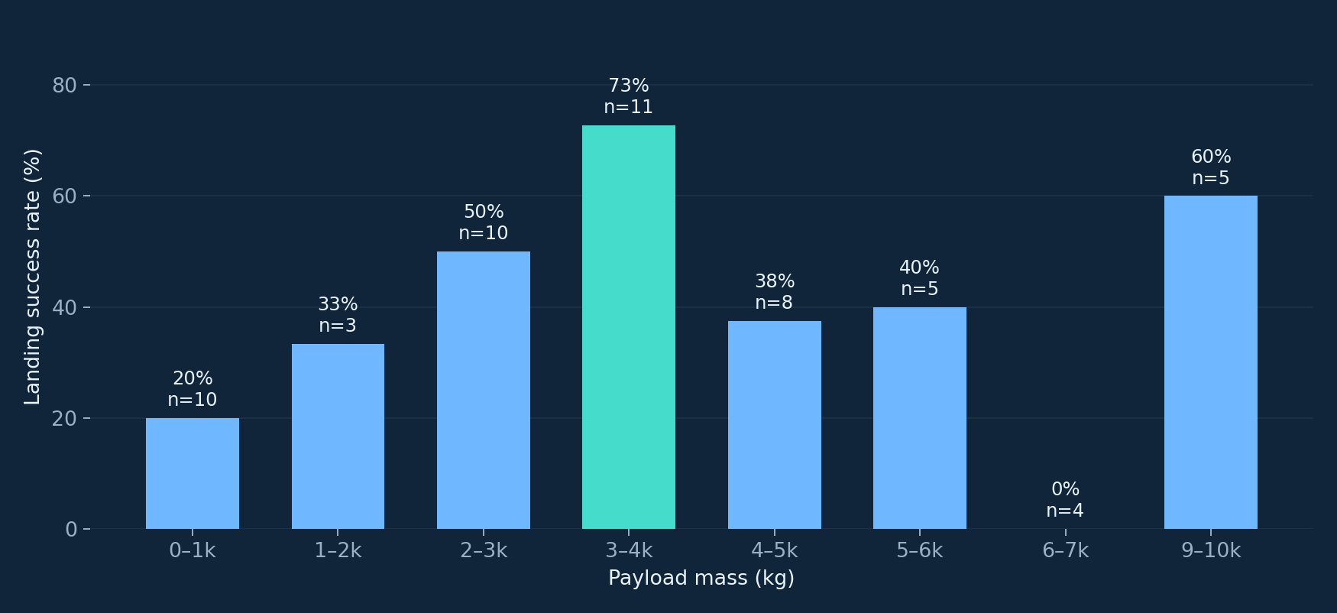
14 / DASHBOARD FINDINGS
Does payload mass correlate with landing success?
Highest observed: 3,000–4,000 kg (8/11 = 72.73%); lowest: 6,000–7,000 kg (0/4 = 0%).
Source: Dashboard notebook, payload_stats output (1,000 kg bins, n=56).
IBM DATA SCIENCE CAPSTONE / SPACEX FALCON 9
18

Slide 19
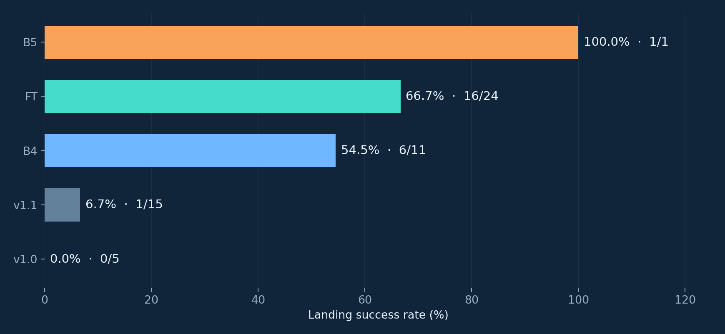
15 / DASHBOARD FINDINGS
Booster generations: rates need sample sizes
Top raw result
B5 shows 100%, but only one launch in this dataset (1/1). This is not evidence of a stable 100% population rate.
More informative comparison
FT records 16 successful landings in 24 launches (66.67%) — a materially larger sample.
Source: Dashboard notebook, booster_stats output (n=56).
IBM DATA SCIENCE CAPSTONE / SPACEX FALCON 9
19

Slide 20
16 / MODELLING METHODOLOGY
Predictive workflow and model selection
01 FEATURES
02 SPLIT
83 columns in the exported modelling feature table. Numeric and one-hot encoded inputs.
Train/test split: 80/20 with random_state=2. Test holdout: 18 records.
03 SEARCH
04 EVALUATE
10-fold GridSearchCV for Logistic Regression, SVM, Decision Tree and KNN.
Compare cross-validation scores with the held-out test accuracy and confusion matrix.
Methodological caution: the uploaded notebook fits StandardScaler before splitting; a pipeline would reduce leakage risk.
Source: Machine Learning Prediction notebook, cells 19–79.
IBM DATA SCIENCE CAPSTONE / SPACEX FALCON 9
20

Slide 21
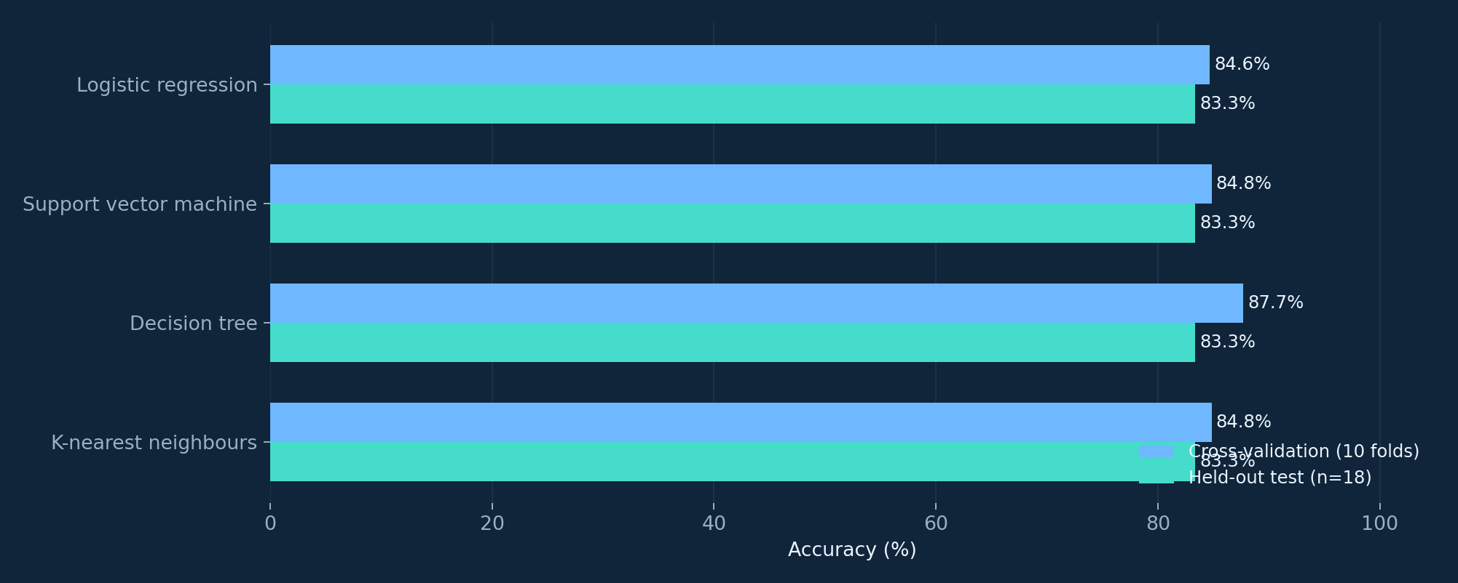
17 / PREDICTIVE RESULTS
All four models tie on the independent test
15/18 correct for each model, equivalent to 83.33% test accuracy. CV leader: Decision Tree (87.68%).
Source: Machine Learning Prediction notebook, recorded cross-validation and held-out scores.
IBM DATA SCIENCE CAPSTONE / SPACEX FALCON 9
21

Slide 22
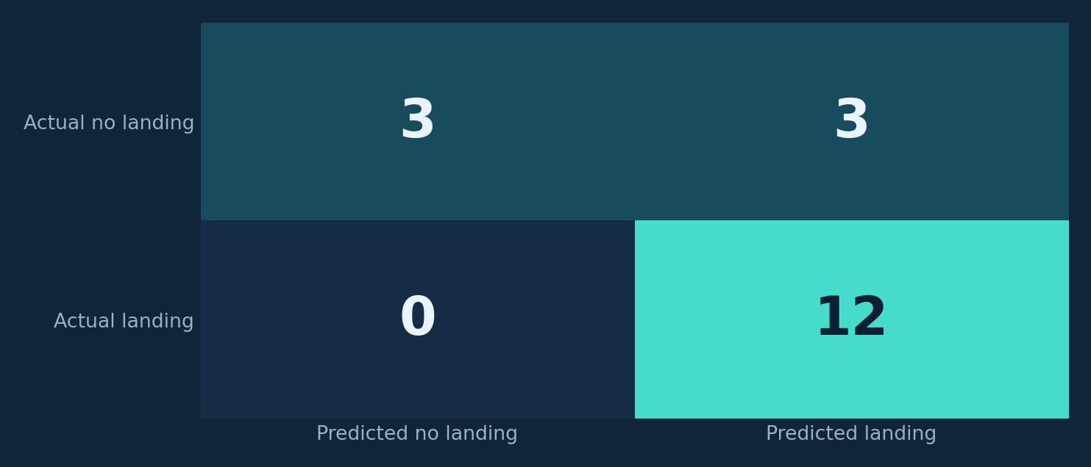
18 / ERROR ANALYSIS
What the confusion matrices reveal
Predictions across 18 test flights
True positives: 12 | True negatives: 3
False positives: 3 | False negatives: 0
How to interpret
Accuracy is 83.33%, but the model incorrectly predicts landing in 3 of the 6 actual unsuccessful cases; specificity is 50%.
All four saved confusion-matrix plots show the same test classification counts.
Source: Machine Learning Prediction notebook, confusion-matrix images (all four models).
IBM DATA SCIENCE CAPSTONE / SPACEX FALCON 9
22

Slide 23
19 / FINAL CONCLUSION
Conclusion: evidence, limits and next steps
Evidence
Predictive result
Historical landing results differ substantially by site and booster family. KSC LC-39A leads the dashboard subset.
Four algorithm families reach 83.33% on 18 holdout flights, with three false-positive landing calls each.
Limitations
Recommended improvements
Small and inconsistent cohorts; B5 has only one observation in Dash; scaling precedes split in the ML notebook.
Rebuild reproducible joined datasets, fit preprocessing within CV pipelines, test on newer out-of-time launches and report uncertainty.
Takeaway: a credible historical case study, not a production-grade predictive system.
Synthesis of submitted IBM SpaceX notebooks; historical datasets only.
IBM DATA SCIENCE CAPSTONE / SPACEX FALCON 9
23

Slide 24
20 / REPRODUCIBILITY
Submission checklist and source references
Final presentation (PDF + PPTX)
Project materials published on GitHub
This deck contains the business question, data lineage, acquisition, cleaning, SQL, EDA, Folium, Dash, classification and conclusions.
The public repository contains eight course notebooks, a Python Dash app, results, evidence screenshots, and the final PDF and PowerPoint presentations.
GitHub repository URL
https://github.com/AkmMalek/IBM-SpaceX-Falcon9-Capstone
Live Dash runtime confirmed by saved notebook output and Safari screenshots. API execution remains unverified.
IBM Capstone rubric: PDF deck + GitHub repository with completed notebooks/Python files.
IBM DATA SCIENCE CAPSTONE / SPACEX FALCON 9
24

Slide 25
APPENDIX / EVIDENCE LEDGER
Technical appendix: provenance and methods
Web scraping
121 × 11
BeautifulSoup / historical launch page
Data Wrangling + EDA
90 observations
Outcome-to-Class mapping · one-hot features
SQL EDA
101 rows
SQLite + SELECT / GROUP BY / filtering
Folium
4 sites
Maps / clusters / coordinates / illustrative distance
Plotly Dash
56 observations
Dropdown + two callbacks; live Safari session confirmed
Machine learning
90 total / 18 test
10-fold CV and test confusion matrices
API notebook
unexecuted
API functions present; results not verified
Evidence: executed notebooks, screenshots of Dash running locally, and reproduced figures.
IBM DATA SCIENCE CAPSTONE / SPACEX FALCON 9
25

