Slide 1

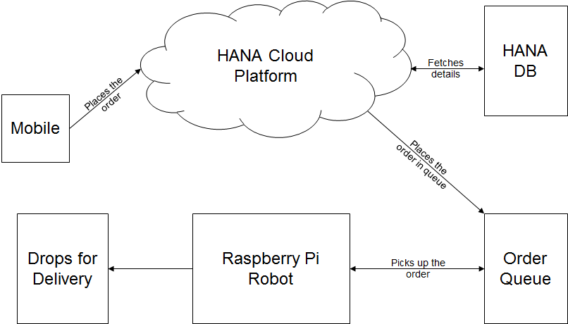
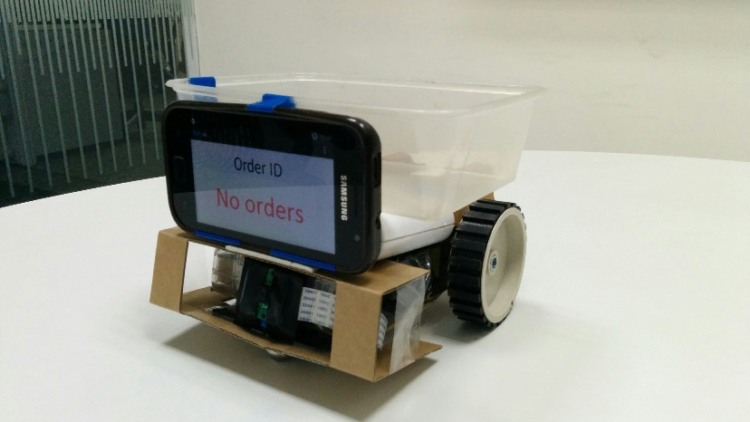
Internet of Things Warehouse Automation
Pain points
More time to ship the package out of warehouse during mass orders.
Lots of man power and money for handling goods in warehouse.
Human errors during shipment.
Solution Benefits
Speed & Efficient order processing
Automatic location and order pickup from the queue.
More orders processed in shorter time leads to faster shipping.
Prone to less errors.
Cost effective.
Detailed tracking of the order.
Happy customers as orders are processed fast.
Architecture
Picture
Faster shipping, Happy customers
Reduction in man power, faster processing of orders, detailed tracking of order, less errors.

