Slide 1



Online Voting System Using Biometric Facial Recognition
Akmal Ahmad
20COB525
Shubham Kumar Gaur
20COB309
Under the Guidance
Prof. Izharuddin Sir

Slide 2
List of Contents
Introduction
Aims And Objectives
Literature Review
Three Level of Security
Software and Hardware Requirements
Online Voting System Architecture
Face Recognition Flow Chart
Use Case Diagram
Advantages of Online voting system
Our Project Overview
Conclusion
References

Slide 3

INTRODUCTION
Election plays an important role in such a huge democratic country like India where the leader is elected by the people.
In today's digital age, our society is undergoing a transformative shift towards technology.
Online voting will increases participation of people in voting as they can cast their vote from any place.
https://www.istockphoto.com/vector/elections-voting-isometric-flowchart-gm1201407177-344526531

Slide 4
AIMS AND OBJECTIVES
The main goal of this project is to make a new and improved way for people to vote using the internet. We want to build a system that recognizes people's faces to make sure they are the right voters. Our project aims to do the following things:
Make sure voting is safe and protected.
Show exactly how voting works so that it is easy to use.
Follow the rules and laws about voting.
Make voting quicker and more accurate.

Slide 5
Literature Review
In 2021, Ganesh Prabhu and his team created a system for voting. Instead of a voter ID, they use RFID tags and face scanning to record each voter's face. People can vote from anywhere using a computer or phone with face recognition and an OTP.
In 2021, Shubham Gupta and Divanshu Jain created a system for elections. system first verify their voter ID, then go through a face check and then the data is sent to a server for monitoring, making sure everything is reliable.
In 2013, Abdul Hamid, & Abdul Malik, design a real time E-Voting system in Nigeria that included face recognition technology. People registered by taking pictures of their faces, creating unique templates for security. Only verified individuals could vote, making sure the election results were accurate.

Slide 6
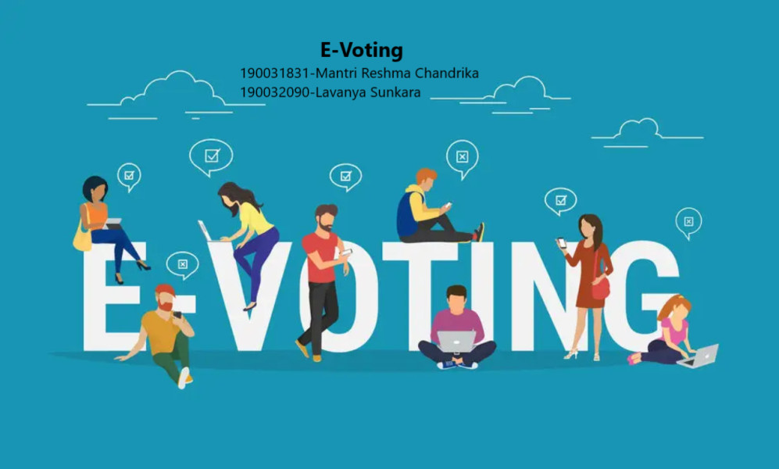
Three Level of Security
The first level involves the unique voter ID number.
The second level of security is OTP verification.
The third level is Voter face recognition.

Slide 7


Software and Hardware Requirements
Frontend Technologies: HTML, CSS, and JavaScript to design the user interface for voters.
Database Management System: PostgreSQL to store voter data, voting records.
Web Development Framework: Django.
Facial Recognition: Use cameras or webcams with good resolution and lighting to capture voter faces during authentication.

Slide 8
Online Voting System Architecture
Voter
Voter Registration
Voter details- Id No. Mobile No. & Image
Casting Vote Process
Data Base- PostgreSQL
Three Level of Security
Server
Voter Id No. Verification
Admin-Election Authority
Mobile OTP Verification
Display Election Result
Face Recognition
Caste Your Vote

Slide 9
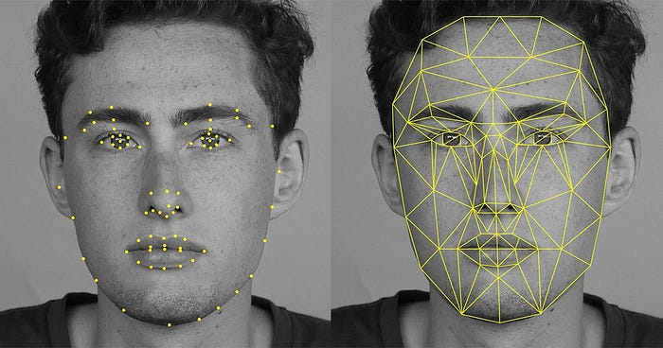
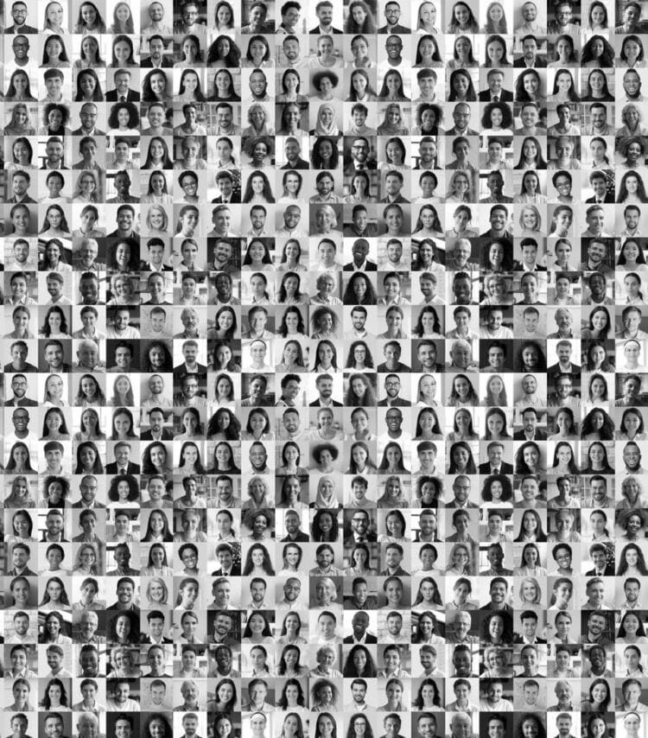
Face Recognition Flow Chart
Start
Input Face Image
Divide the face image into block
Calculate the histogram for each block LBPH
Face image processed
No
Yes
Recognition Result
End
Algorithm: LBPH
https://onlinelibrary.wiley.com/doi/10.1002/dac.4651

Slide 10
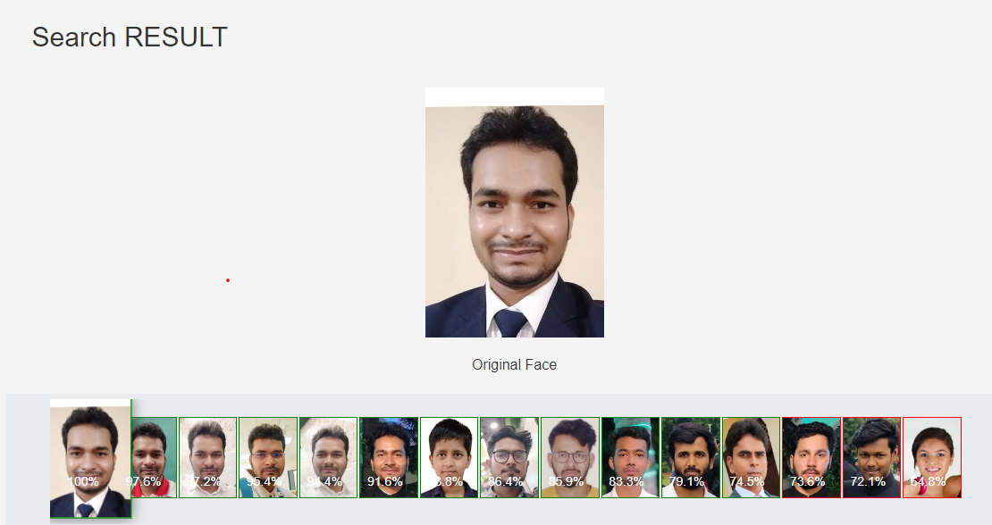
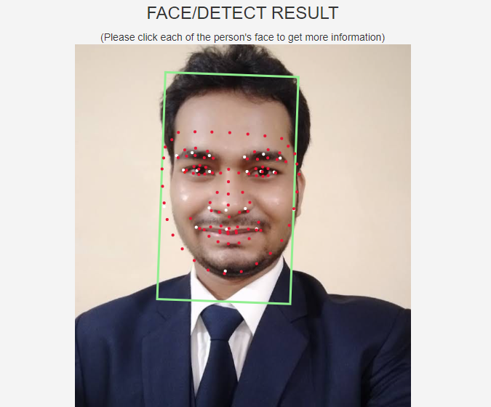
LBPH Face Recognition

Slide 11
Use Case Diagram
Login/
Logout
Voter Id No. Verification
<<include>>
Voter Registration
<<include>>
<<extend>>
System
Voter ID Number
Face Recognition
<<include>>
<<extend>>
View Candidates
Scan Face
Database Management
Cast Vote
Add Delete Candidate
Voter
Modify Voter’s Information
Admin
Vote Confirm
Display Election Result

Slide 12
Advantages of Online Voting system
Accuracy and Authenticity: Facial recognition technology accurately verifies a voter's identity, reducing the chances of fraudulent voting.
Increased Voter Participation: Online voting can potentially increase voter turnout by making the voting process more convenient and accessible.
Convenience: Voters can participate from anywhere with an internet connection, increasing accessibility and turnout.
Time Efficiency: The online process saves time for both voters and election officials, leading to quicker results.
Reduced Costs: Online voting reduces expenses associated with traditional paper-based methods.

Slide 13
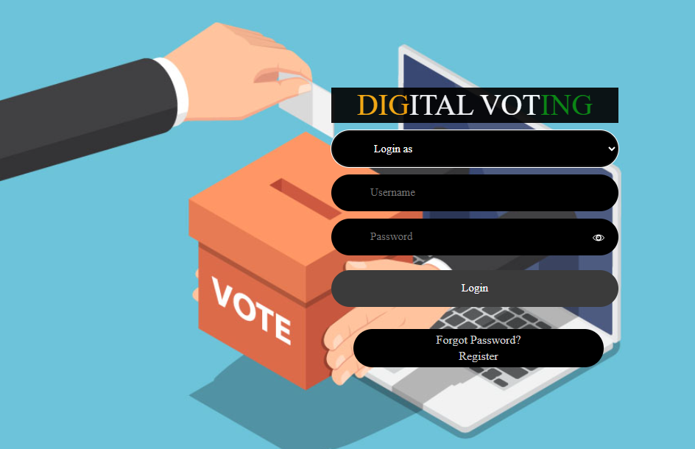
OUR PROJECT OVERVIEW
1. Login Page

Slide 14
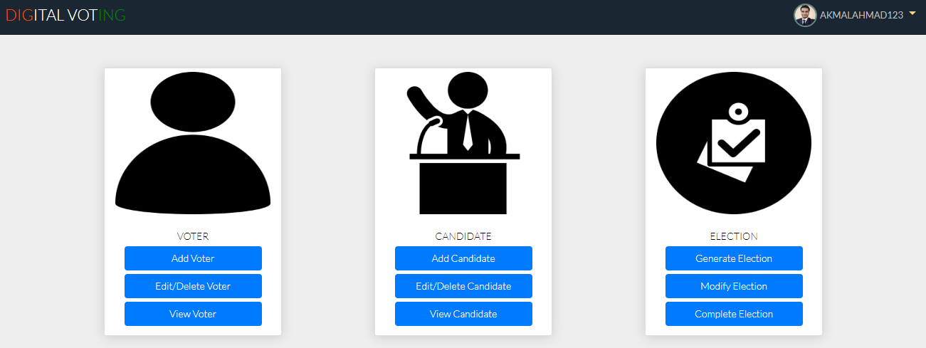
2.Admin Home Page

Slide 15
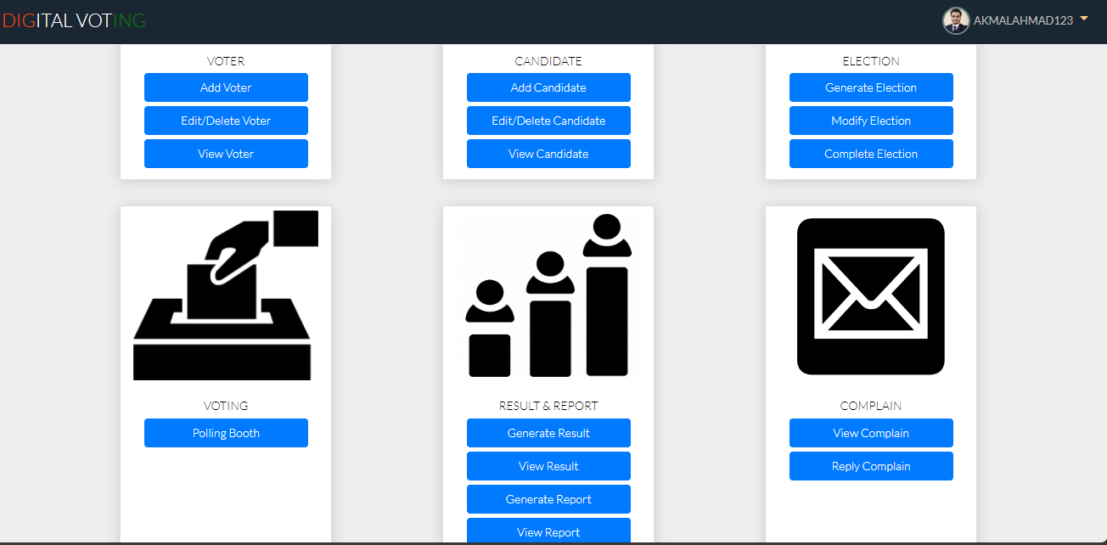
Admin Home Page

Slide 16
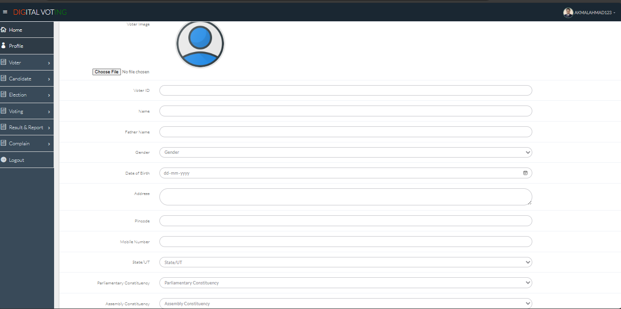
3. Voter Registration Page

Slide 17
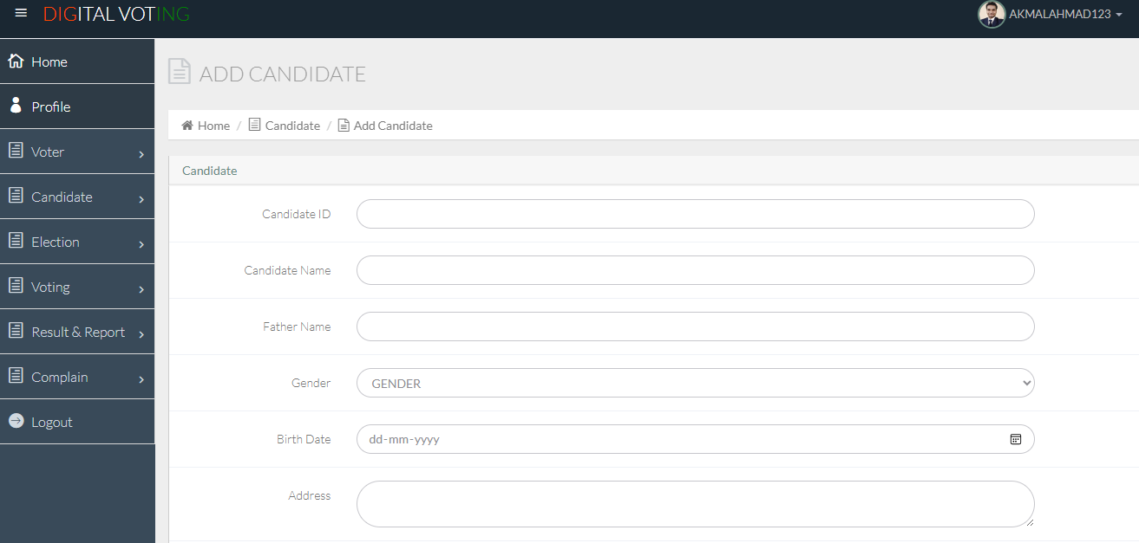
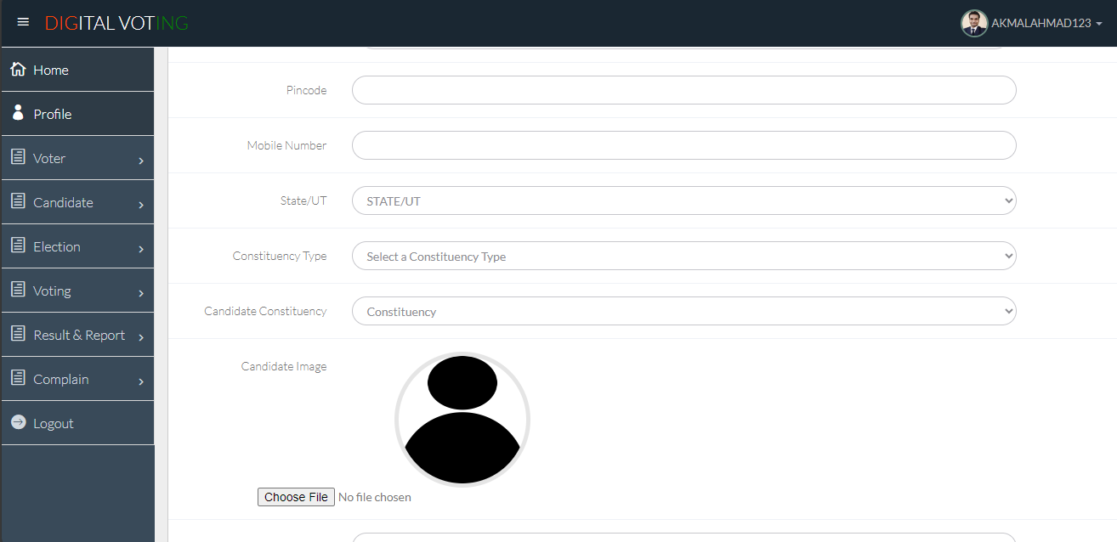
4. Candidate Registration Page

Slide 18
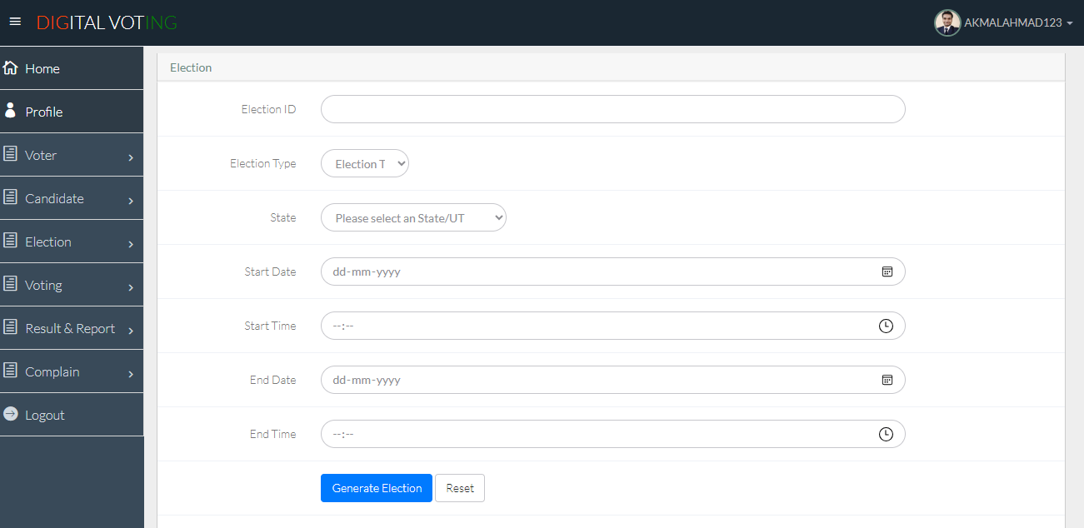
5. Generate Election Page

Slide 19
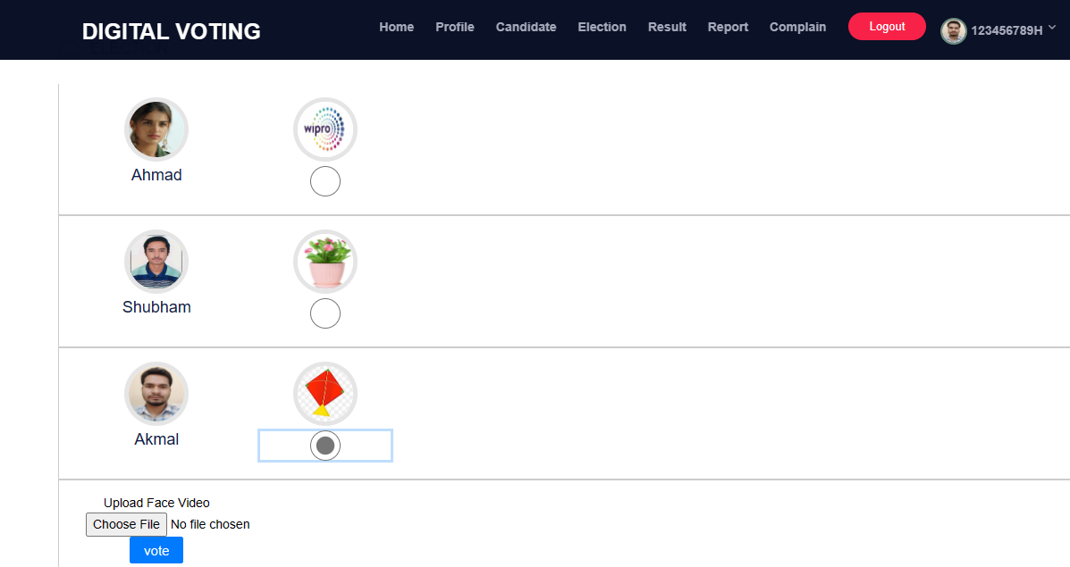
6.Voting Page

Slide 20

7. Mobile OTP Verification Page

Slide 21
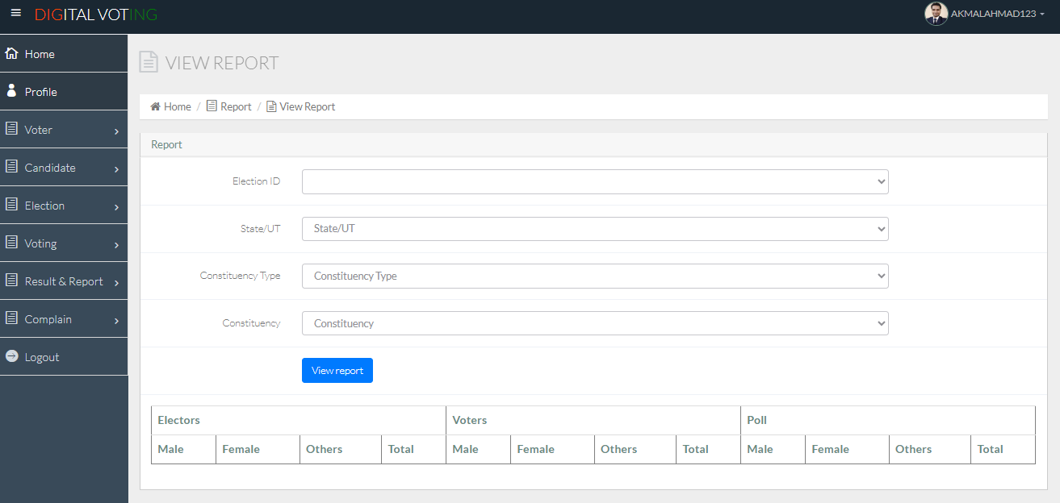
8.View Election Result

Slide 22
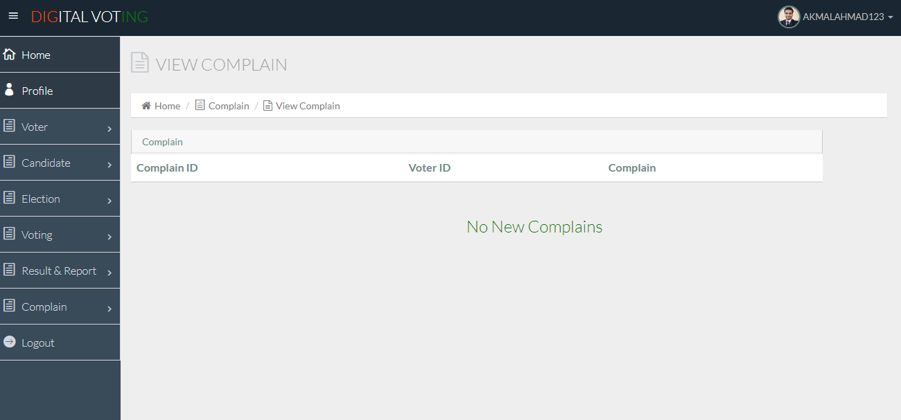
9.Election Complain Page

Slide 23
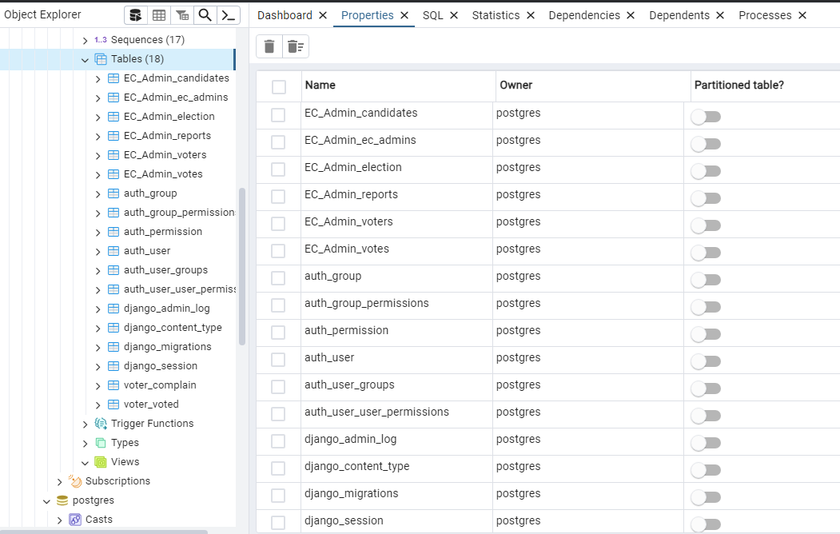
10.Database Tables

Slide 24
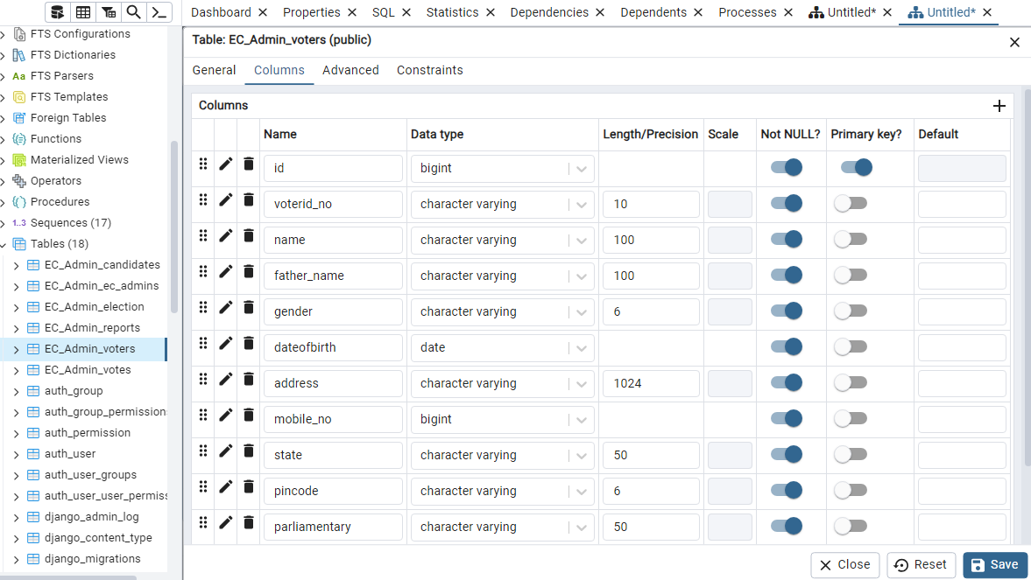
11.Schema of Voters

Slide 25
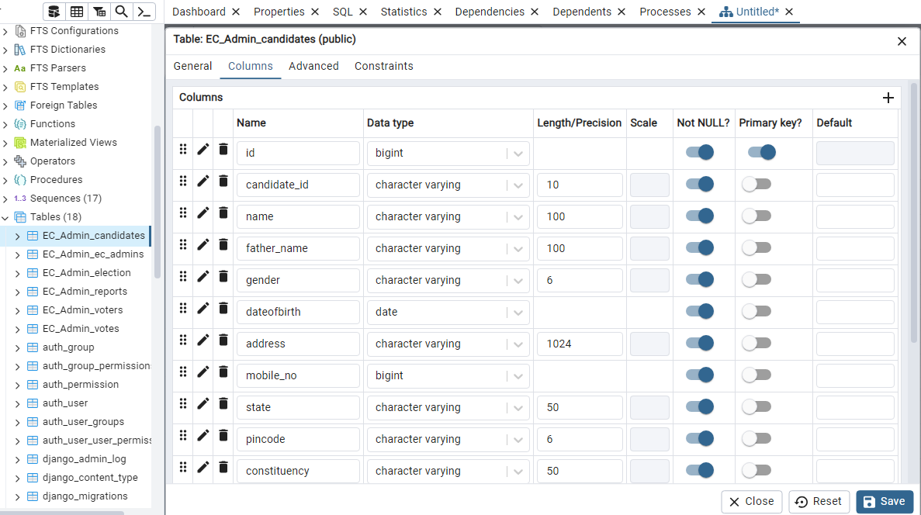
12.Schema of Candidates

Slide 26
CONCLUSION
We conclude that with the implementation of the online voting system we will able to help election authority and voters to save their time.
The online voting system with face recognition is like a big step in making voting better and safer.
People can easily vote from their computers or phones instead of going to a voting place.
Provide three level of security including OTP verification and face recognition.
Online voting will able to increase the voting percentage and make voting process easy.

Slide 27
References
[1] Ganesh Prabhu S, et.al., “Smart Online Voting System”, 7th International Conference on Advanced Computing and Communication Systems (ICACCS), pp. 632-634, 2021.
[2] Shubham Gupta, Divanshu Jain, Milind Thomas Themalil, “Electronic Voting Mechanism using Microcontroller ATmega328P with Face Recognition”, Proceedings of the Fifth International Conference on Computing Methodologies and Communication (ICCMC 2021), pp. 1471-147, 2021.
[3]Dr. Sanjay Sange, “Online Voting System Using Face Recognition and mobile no. OTP(One Time Password) verification” https://www.irjet.net/archives/V8/i6/IRJET-V8I6132.pdf
[4] Abdul hamid, S. M., Adebayo, O. S., Ugiomoh, D. O., & Abdul Malik, M. D. (2013). The Design and Development of Real-Time E-Voting System in Nigeria with Emphasis on Security and Result Veracity. International Journal of Computer Network and Information Security,5(5),9–18.
[5] M. Kandan, K. D. Devi, K. D. N. Sri, N. Ramya and N. K. Vamsi, "Smart Voting System using Face Detection and Recognition Algorithms," 2021 IEEE International Conference on Intelligent Systems, Smart and Green Technologies (ICISSGT), Visakhapatnam, India, 2021, pp. 202-206, doi: 10.1109/ICISSGT52025.2021.00050.
[6] S.G. Prabhu, A. Nizarahammed, S. Prabu, S. Raghul, R.R. Thirrunavukkarasu, P. Jayarajan, ‘Smart Online Voting System’, In 2021 7th International Conference on Advanced Computing and Communication Systems (ICACCS), Vol. 1, pp. 632-634, 2021.

Slide 28
THANK YOU !!!

