Slide 1
Spider silk
X-Ray Scattering Experiments
30.11.2025

Slide 2
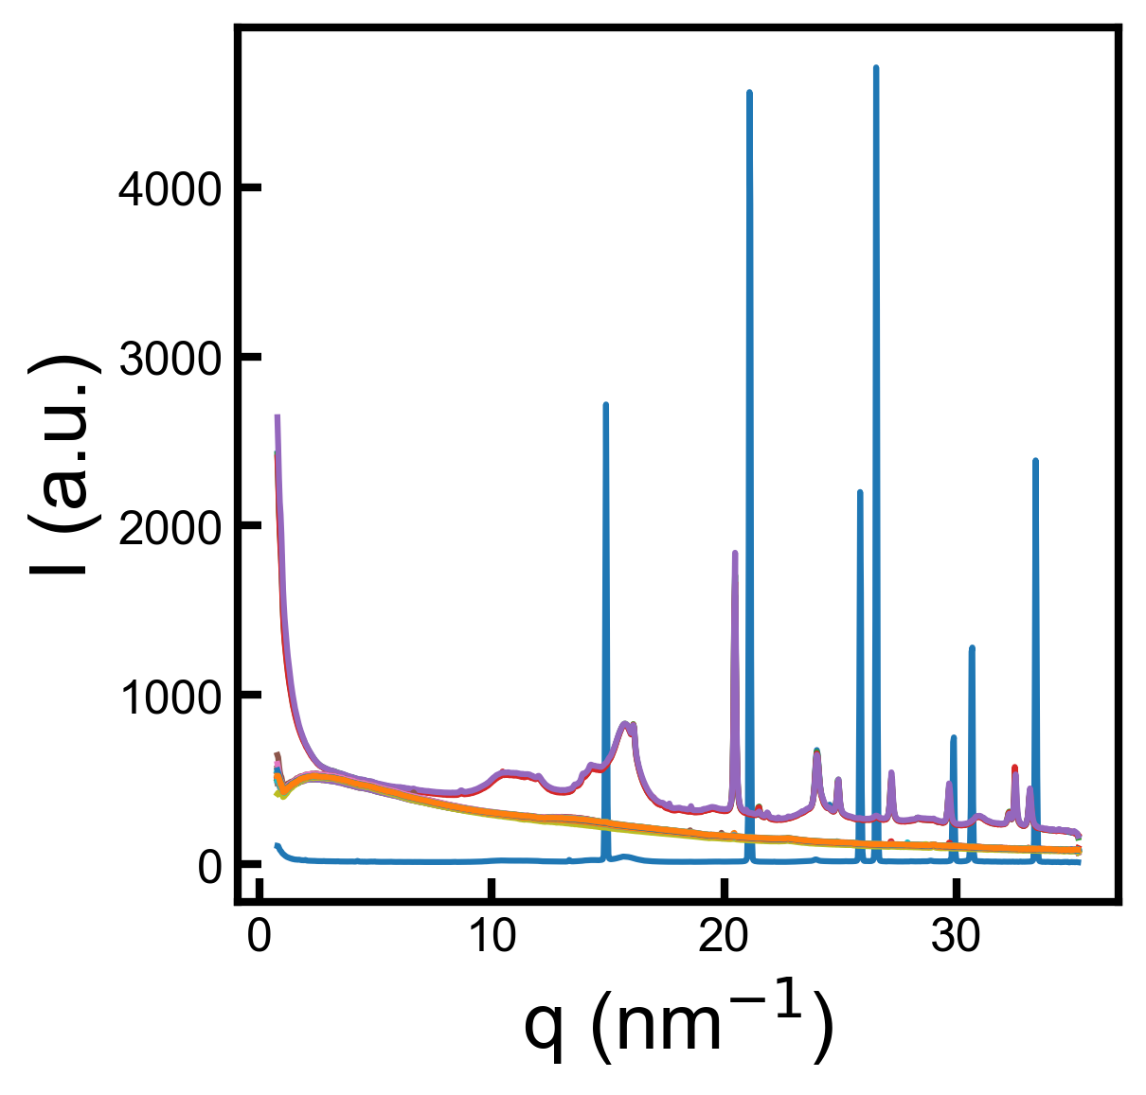
Stretching Experiments
All experiments in the folder
LAB6
Cellulose?
Silk?

Slide 3
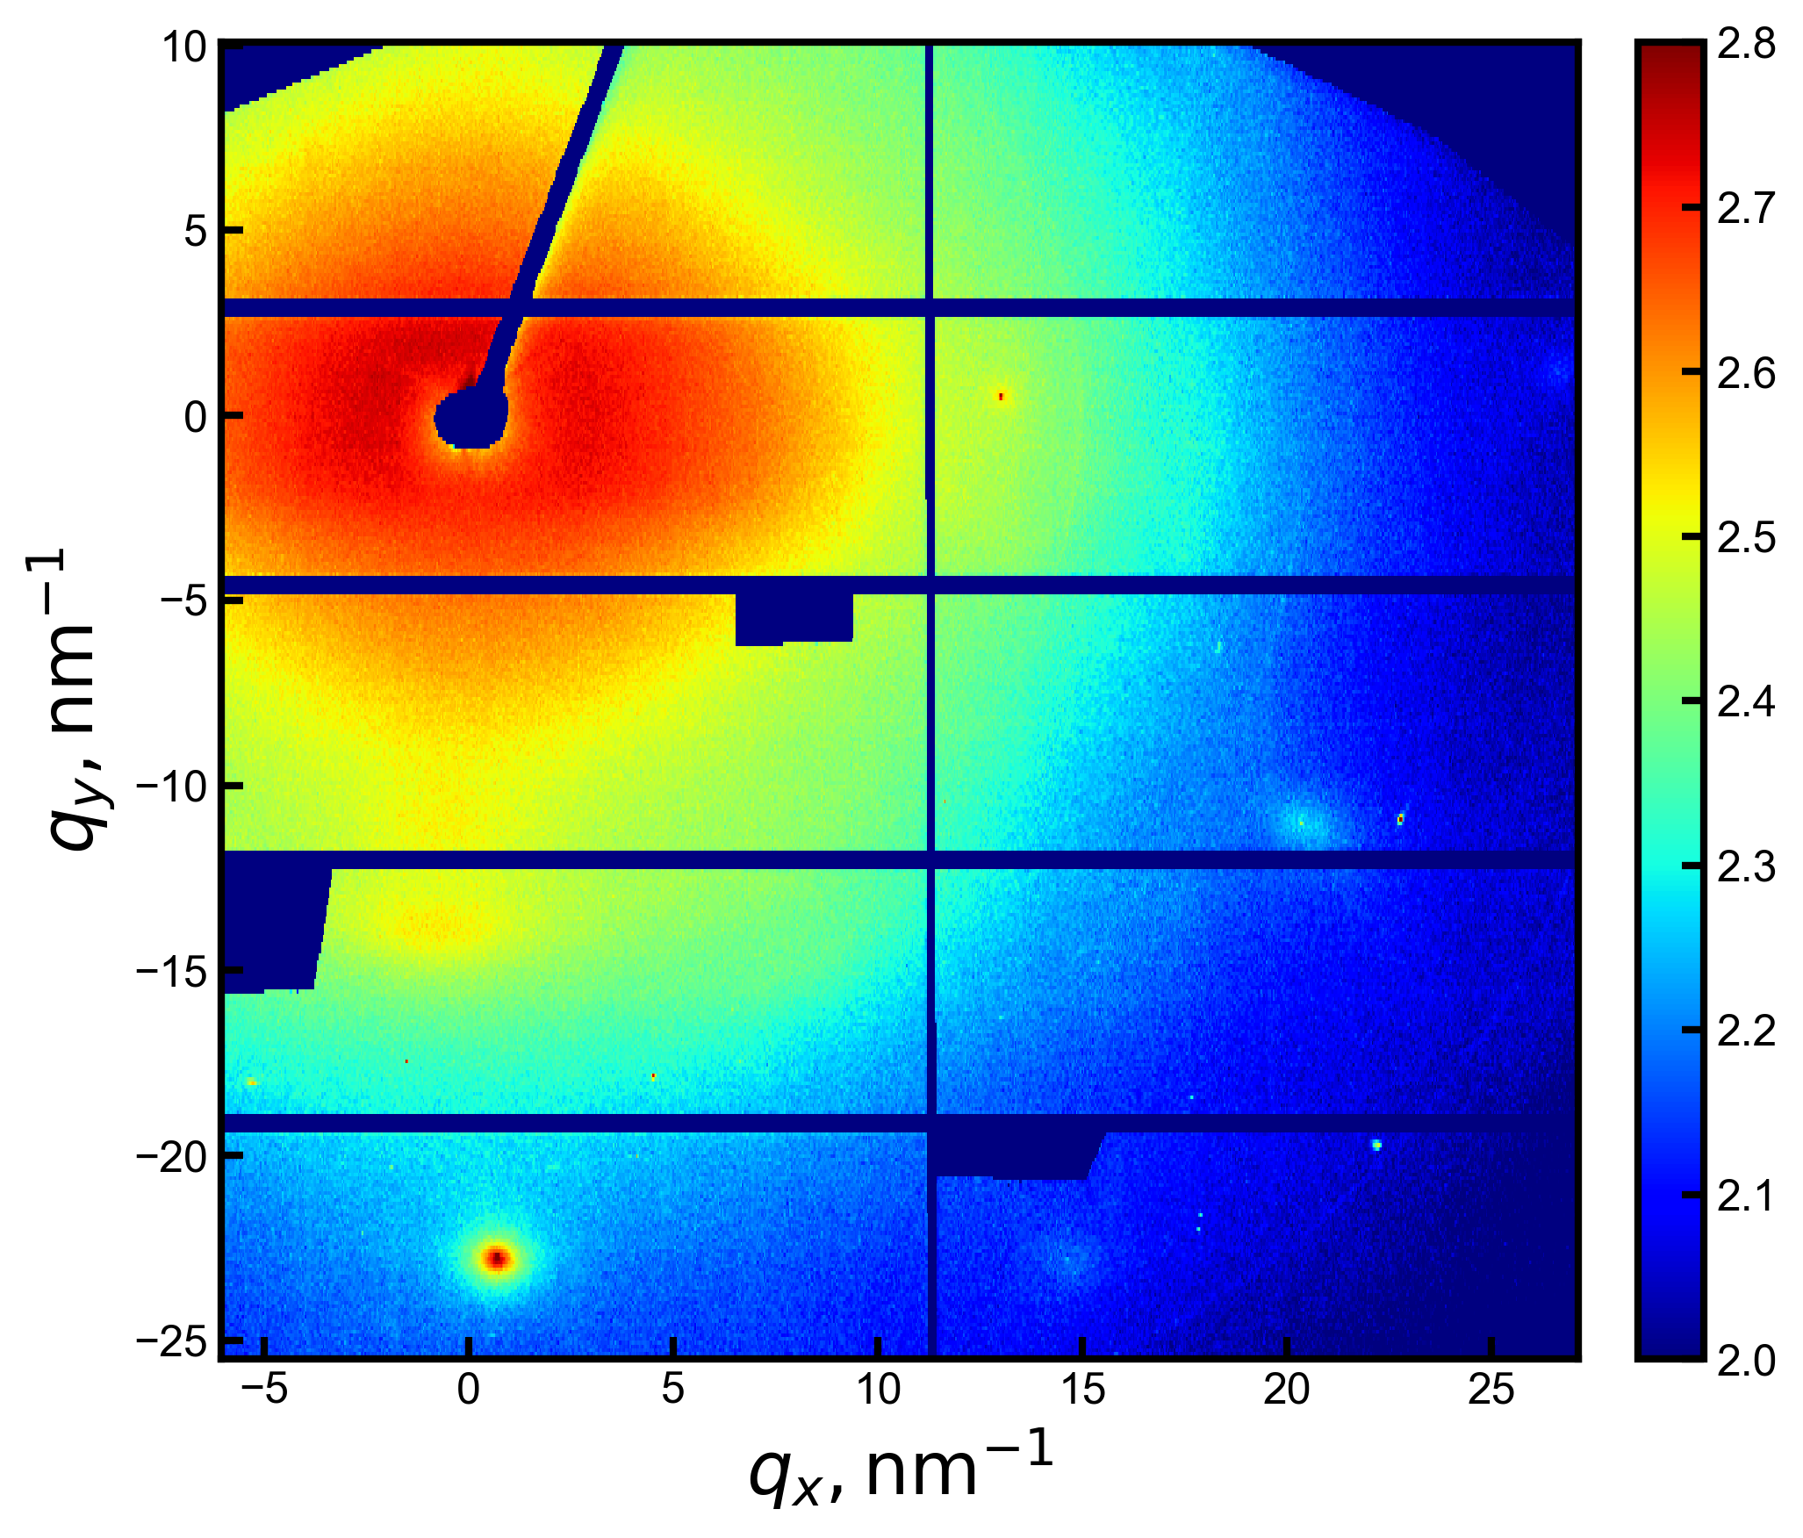
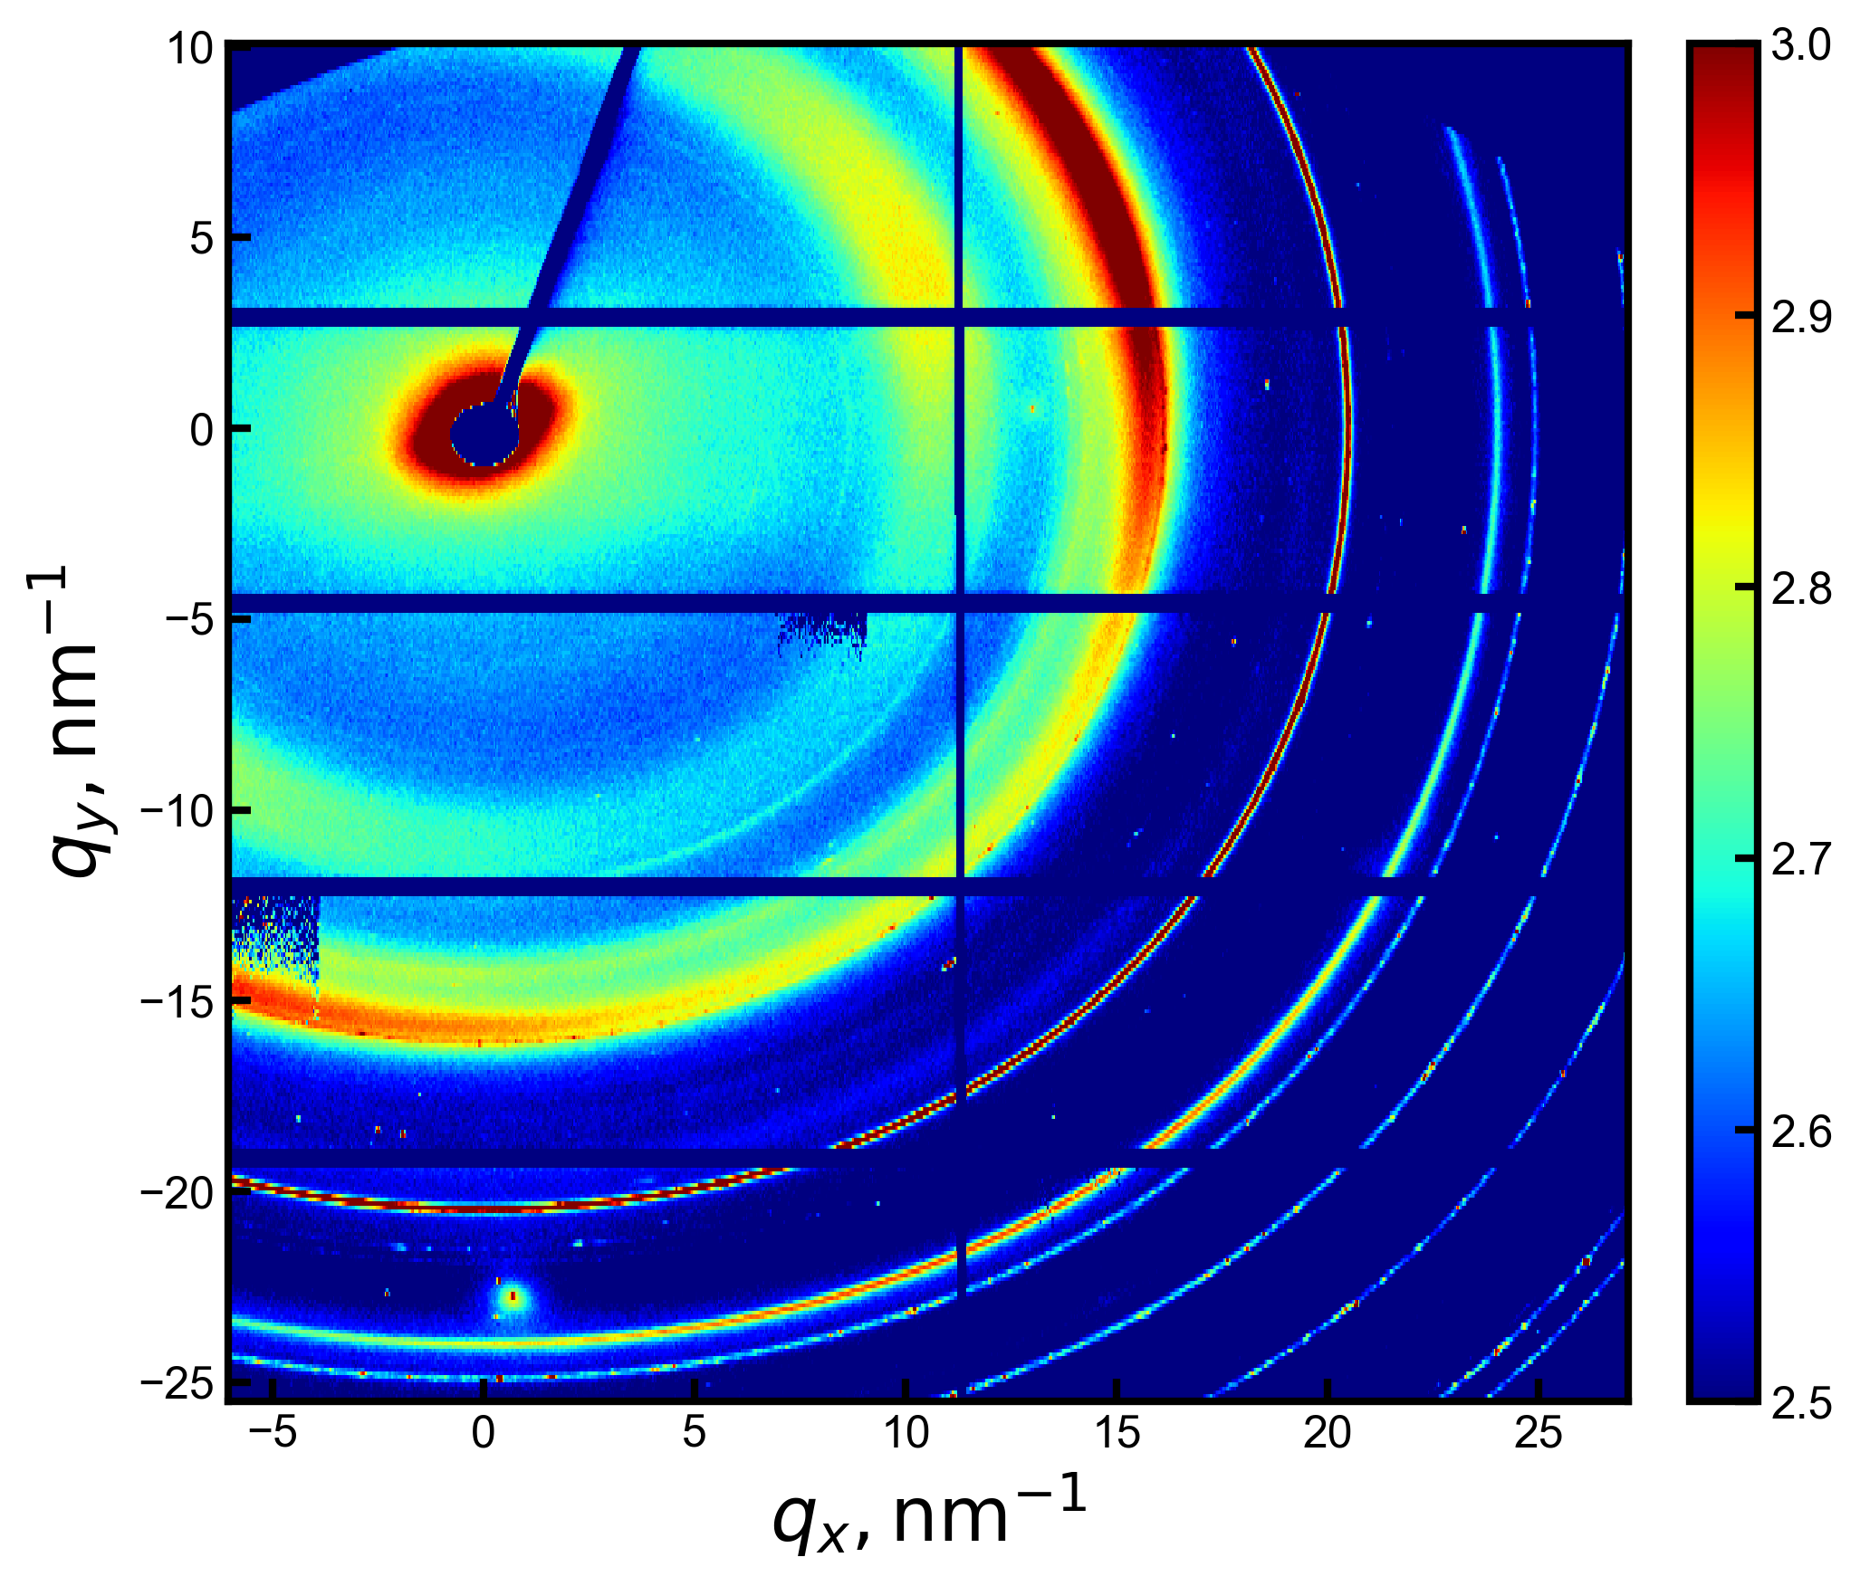
Stretching Experiments
Silk?
cellulose?

