Slide 1
PDF Table Extraction Tool - Hackathon Project
Presented by: Anju Kumari
MNNIT Allahabad

Slide 2
Introduction
Our project aims to develop a tool that efficiently detects and extracts tables from system-generated PDFs. Unlike existing tools, our solution does not use Tabula or Camelot and does not require converting PDFs into images. It is designed to handle tables with or without borders, as well as irregularly shaped tables. The extracted tables are stored in Excel format, ensuring structured and accessible data management.

Slide 3
Problem Statement
Extracting tables from PDFs is a common but challenging task, especially when dealing with diverse table structures. Existing tools often struggle with irregular tables, merged cells, and multi-line text. Additionally, many approaches rely on image processing, which can introduce errors. Our tool provides a text-based extraction solution that overcomes these limitations while maintaining high accuracy and efficiency.

Slide 4
Objectives
Develop a reliable PDF table extraction tool that works without image conversion.
Accurately detect tables with and without borders, handling complex structures.
Provide a user-friendly interface using Streamlit for easy interaction.
Enable bulk processing of multiple PDFs with a progress bar.
Store extracted tables in structured Excel sheets while maintaining integrity.
Implement a validation mechanism to compare extracted tables with the original content.

Slide 5
Technology Stack
Our project is built using:
Python: Core language for processing and extraction.
Streamlit: Provides an interactive and intuitive GUI.
pdfplumber & PyMuPDF (Fitz): Extracts table text from PDFs.
Pandas & OpenPyXL: Converts extracted tables into structured Excel files.
Heroku (Optional): Deployment for cloud accessibility.

Slide 6
Approach & Methodology
PDF Processing: The tool reads the uploaded PDF using PyMuPDF and pdfplumber.
Table Detection: Analyzes text positioning, whitespace, and alignment to identify tables.
Data Extraction: Extracted content is processed into structured tabular data.
Data Cleaning & Formatting: Handles irregularities, merged cells, and multi-line text.
Excel Storage: Writes structured tables into Excel while preserving integrity.
Validation: Compares extracted tables with the original PDF text to ensure accuracy.
GUI Interaction: Users can upload files, preview tables, and download the Excel output.

Slide 7
Features
Multi-PDF Support: Process multiple PDFs simultaneously.
Table Preview: Users can review extracted tables before exporting.
Progress Indicator: Shows extraction status for large PDFs.
Excel Export: Saves data in structured Excel format with multiple sheets.
Error Handling: Provides informative error messages and logs.

Slide 8
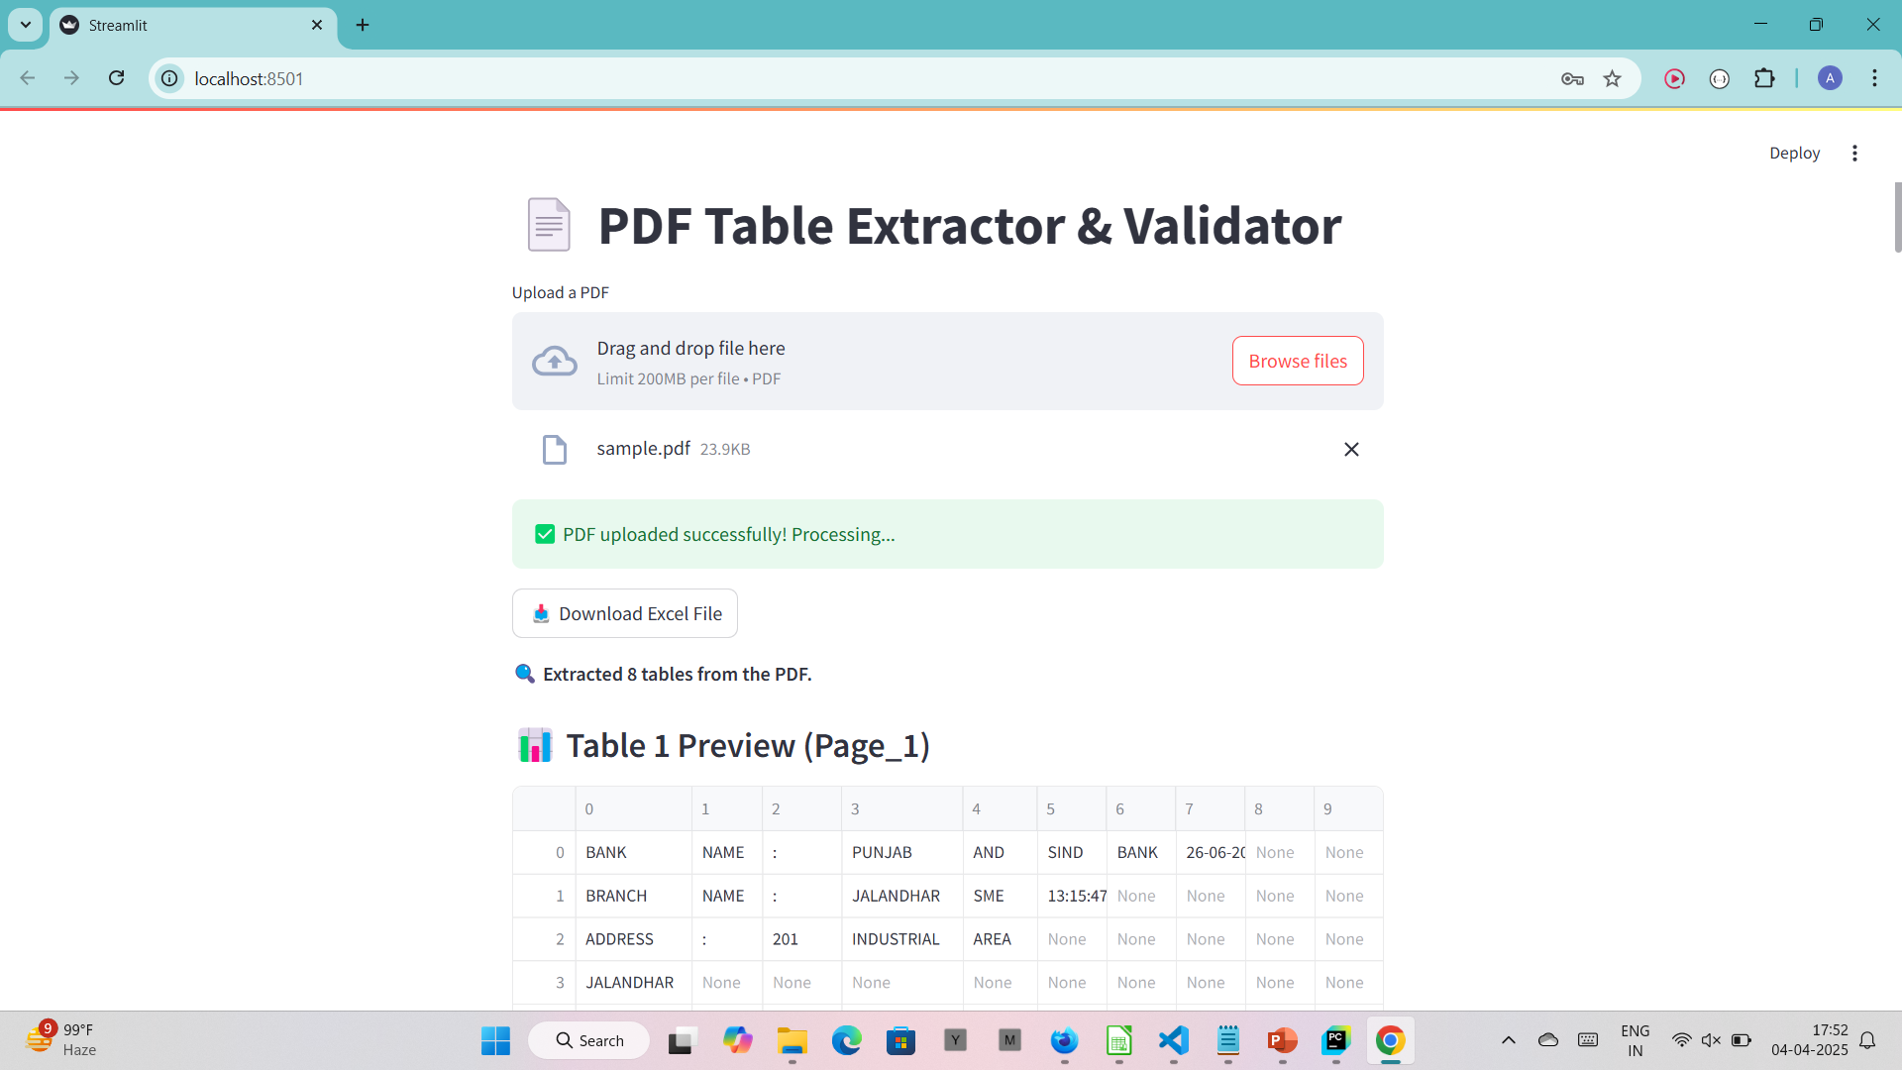
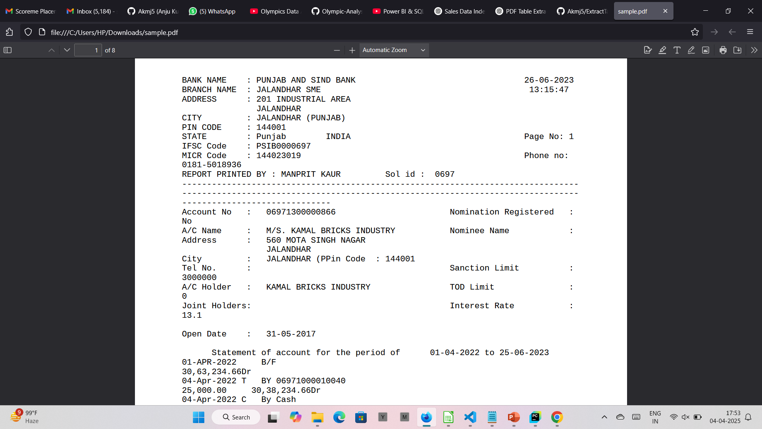
Demo Screenshots
Streamlit GUI
Sample Input

Slide 9
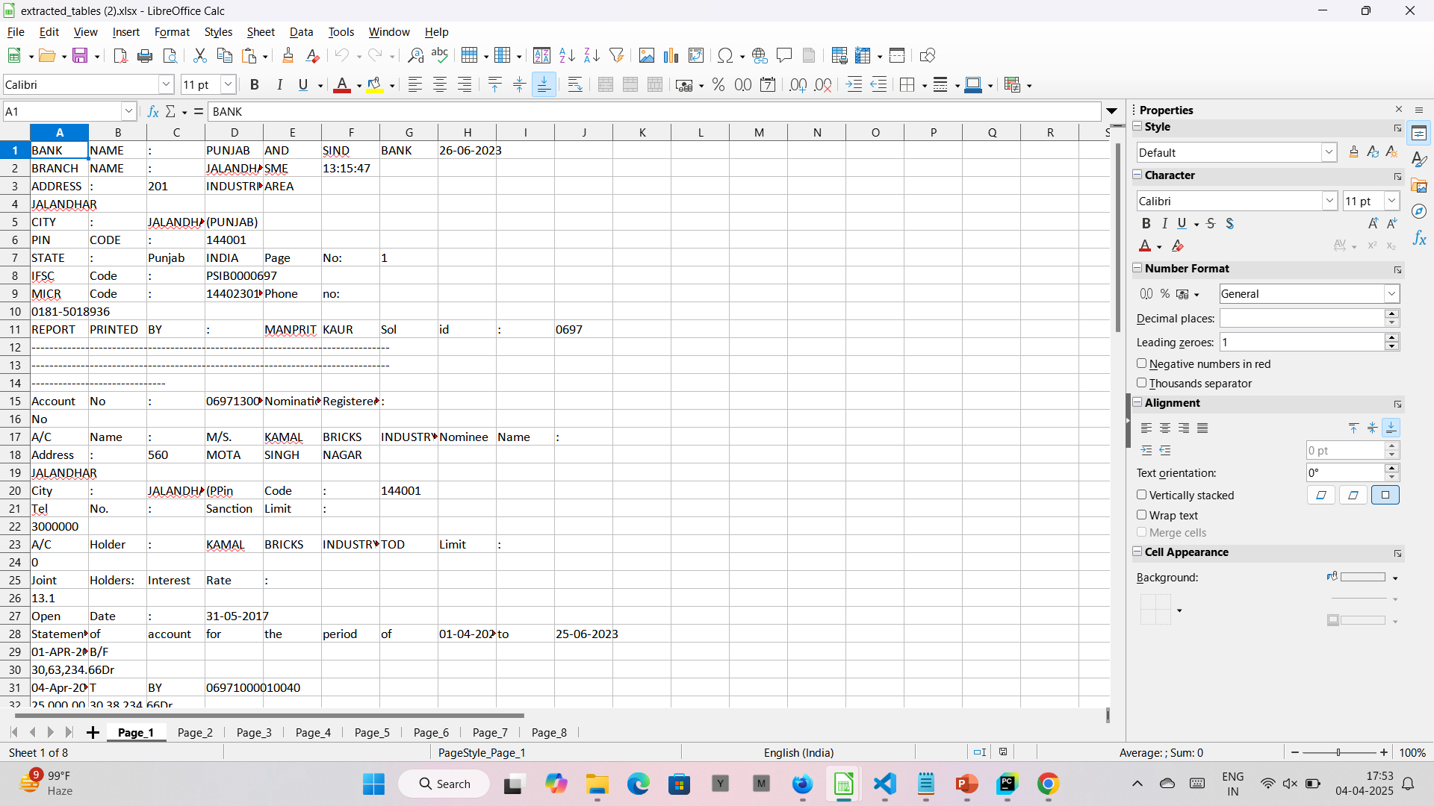
Sample Output

Slide 10
Conclusion
This project provides an efficient and reliable solution for extracting tables from PDFs. With its robust processing, user-friendly interface, and structured data storage, it stands out as an innovative tool. Future enhancements will further improve its capabilities, making it a valuable asset for data extraction needs.

Slide 11
Thank You!

