Slide 1
Feature Interaction Analysis
Machine Learning, 2025
Hassan Iftikhar
Ali Arshad
Yaroslav Degtyarev
Akmuhammet Gurbangeldiyev

Slide 2
Agenda
Conduct a literature review on feature interaction detection, focusing on neural interaction analysis
Experiments with synthetic and real datasets
Show: NO INTERACTION in Y=X1+X2 and the INTERACTION exists for Y=X1*X2, where X1, X2 i.i.d. ~ N(0, 1).
Investigate how multicollinearity affects
Compare the algorithm with other algos
Propose a method to estimate the power of interactions.

Slide 3
Feature Interaction
Feature interactions occur when the effect of one feature on the prediction depends on another feature.
Statistical interactions are more than just the sum of individual effects.
Understanding how models make decisions
Why Are They Important?
Enhance model interpretability: Understand how features work together.
Improve performance: Capture complex relationships.
Enable feature selection: Focus on significant combinations.

Slide 4
Literature Review
Method | Pros | Cons
Neural-based (e.g., NID) | Captures complex interactions, Flexible and adaptable | High computational cost, Requires large datasets
Tree-based (e.g., Random Forest, XGBoost) | Good for high-dimensional data, Handles feature interactions well | Can overfit, Limited interpretability of interactions
Statistical (e.g., ANOVA, Lasso) | Efficient for small datasets, Transparent and interpretable | Assumes linearity or specific interactions, May miss complex patterns
SHAP (Shapley Additive Explanations) | Provides feature-level interpretability, Can highlight interaction effects | Can be slow for complex models, Approximation needed for large models

Slide 5
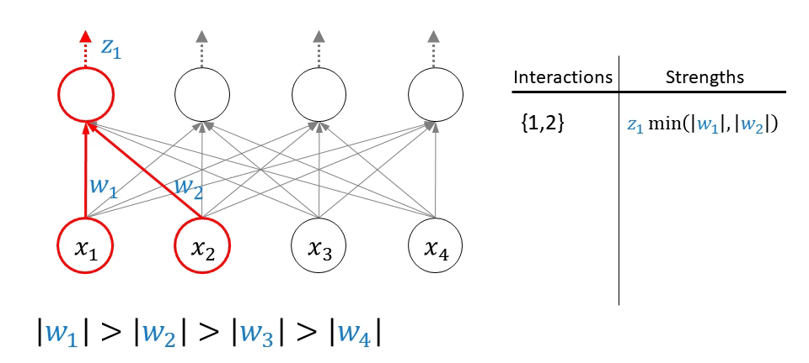
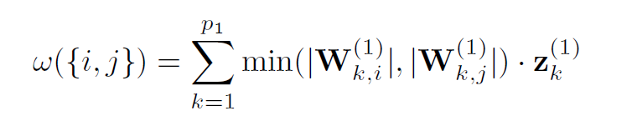
Methodology - Neural Interaction Detection
Approach:
jk
Train a Multilayer Perceptron (MLP) on the data.
Extract weights from the interaction MLP.
Compute interaction strengths from weights.
Evaluation:
m
Pairwise Interaction Strength
Any-Order Interaction Strength

Slide 6
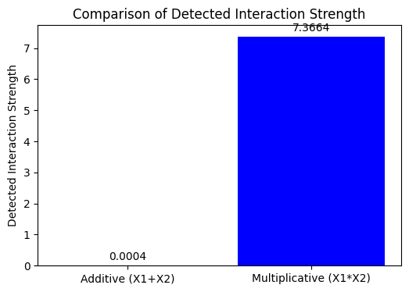
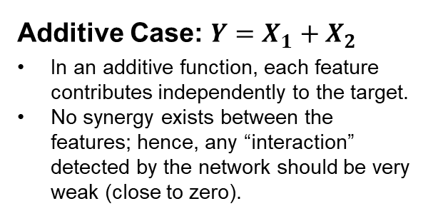
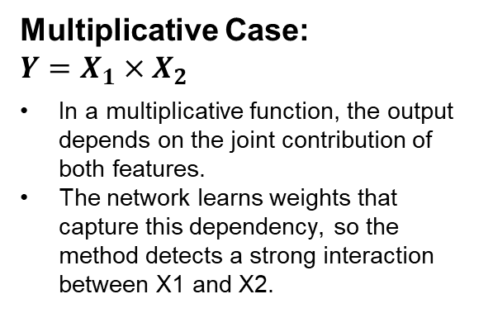
Experiments – 01:
Additive Case: $Y=X_{1}+X_{2}$
In an additive function, each feature contributes independently to the target.
No synergy exists between the features; hence, any “interaction” detected by the network should be very weak (close to zero).
Multiplicative Case:
$$Y=X_{1}×X_{2}$$
In a multiplicative function, the output depends on the joint contribution of both features.
The network learns weights that capture this dependency, so the method detects a strong interaction between X1 and X2.

Slide 7
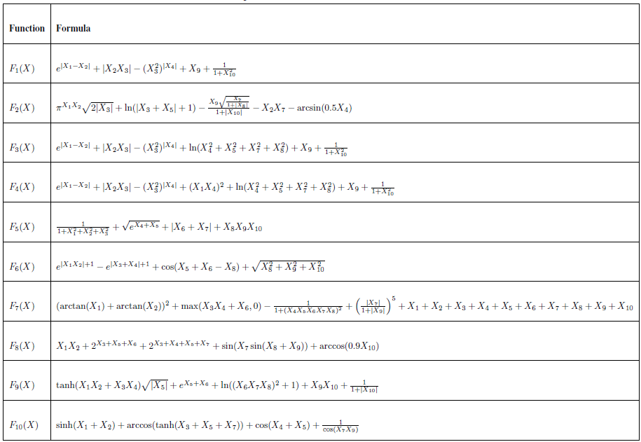
Experiments – 02: Synthetic Data
Generated data: 30,000 samples, 10 features,
X i.i.d. ~ N(0, 1).
Functions: Experiment with 10 functions including different complexity.

Slide 8
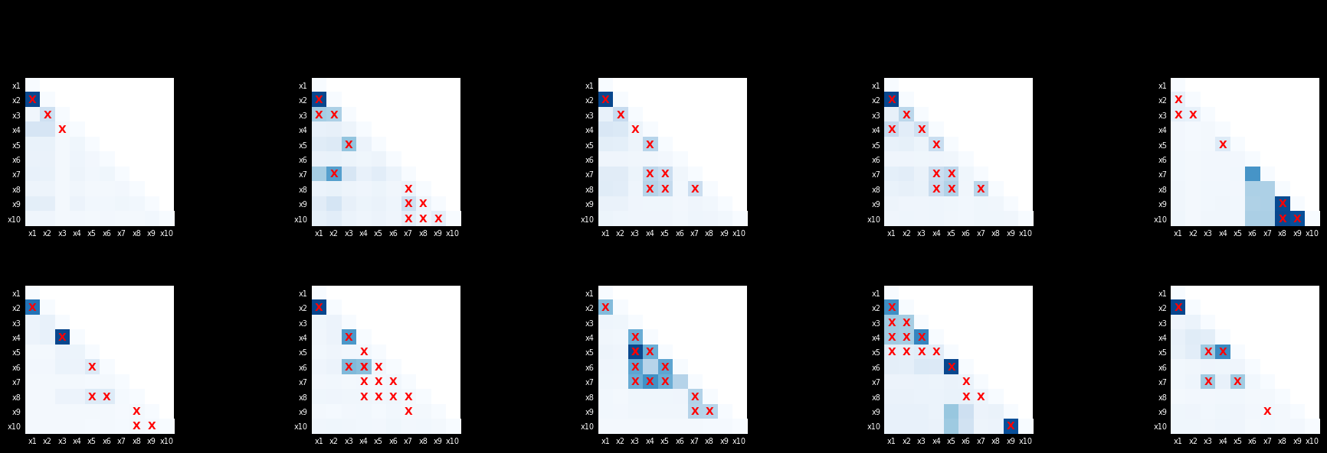
Experiments – 02: Synthetic Data

Slide 9
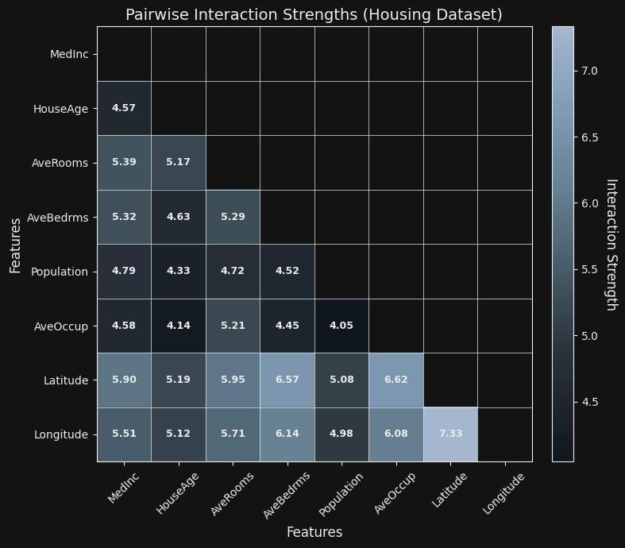
Experiments – 03: Real Data
California Housing Price Dataset:
Number of Features: 8
Number of Instances: 20640
Observation:
The strongest interaction occurs between Latitude and Longitude.

Slide 10
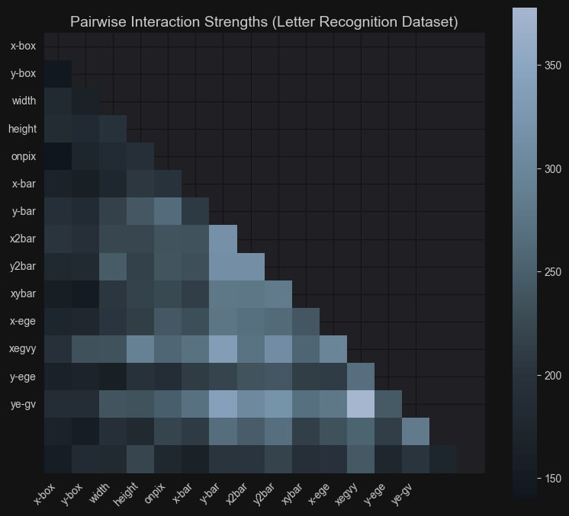
Experiments – 04: Real Data
Letter Recognition:
Number of Features: 16
Number of Instances: 20000
Discussion/Conclusion:
Strong interactions exist between features that are likely correlated (e.g., x-egy and y-egy)

Slide 11
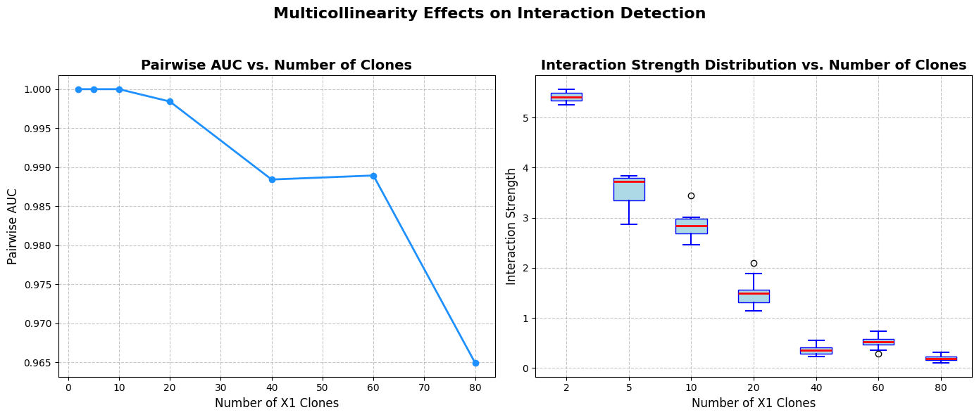
Experiment – 05: Multicollinearity
Study: Duplicate Clones
Base: Y = X1 * X2, X1, X2 ~ N(0,1).
Added clones: X11 = X12 = … = X1n = X1.
Tested if (X11, X2), …, (X1n, X2) are detected as n grows.

Slide 12
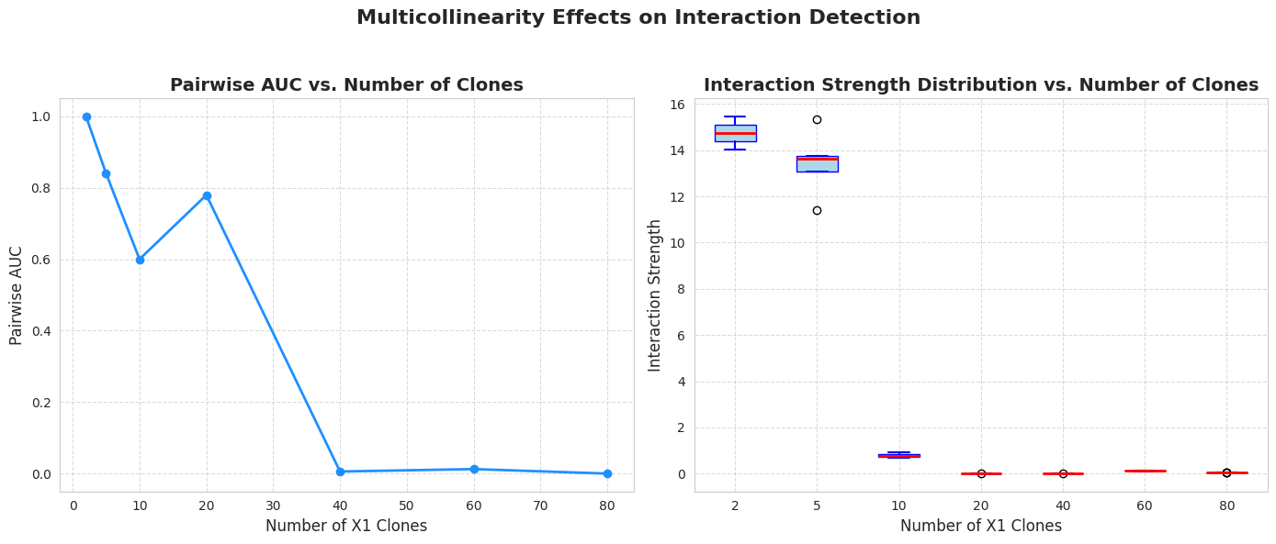
Experiment – 06: Multicollinearity
Study: Duplicate Clones
Base: Y = X1 * X11 * X12 * … *X1n * X2, X1, X2 ~ N(0,1).
Added clones: X11 = X12 = … = X1n = X1.
Tested if (X11, X2), …, (X1n, X2) are detected as n grows.

Slide 13
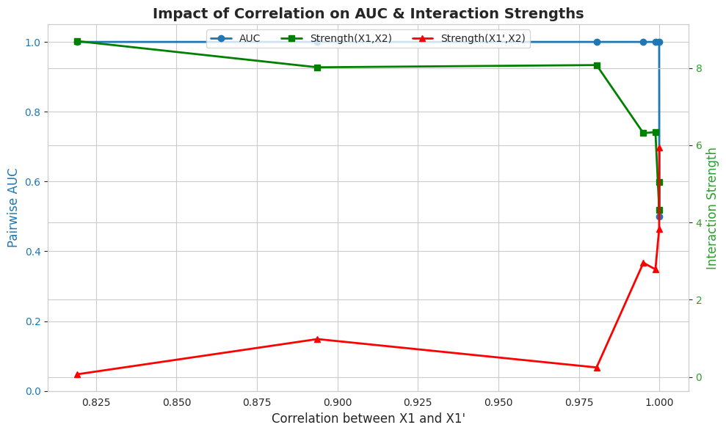
Experiment – 07: Multicollinearity
Study: Highly Correlated
Base: Y = X1 * X2, X1, X2 ~ N(0,1).
Added clones: X11 = X1 + ∈.

Slide 14
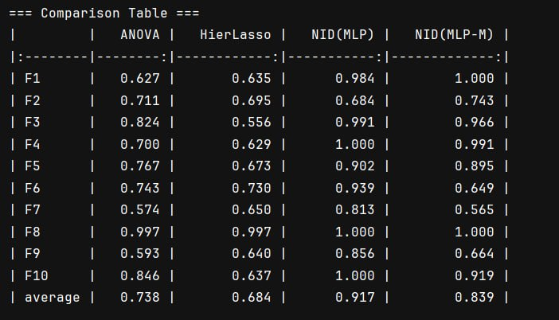
Experiment – 07: Comparison
NID: Does not explicitly model the main effects (individual contributions)
NID-M: Extends the NID framework by explicitly modeling both main effects and interactions between features.

Slide 15
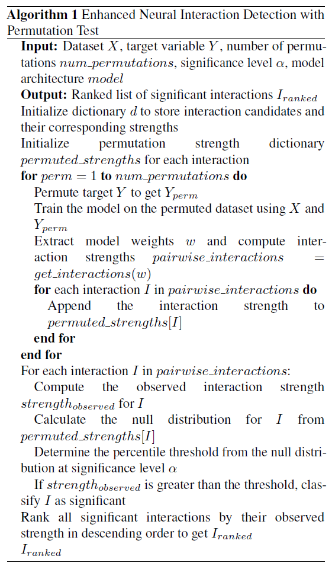
Proposed Algorithm

Slide 16
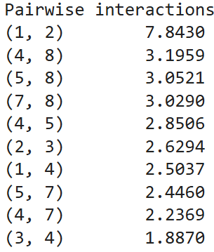
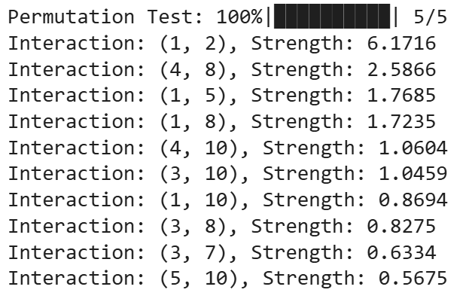
Proposed Algorithm – Experiment
NID
Permuted NID

Slide 17
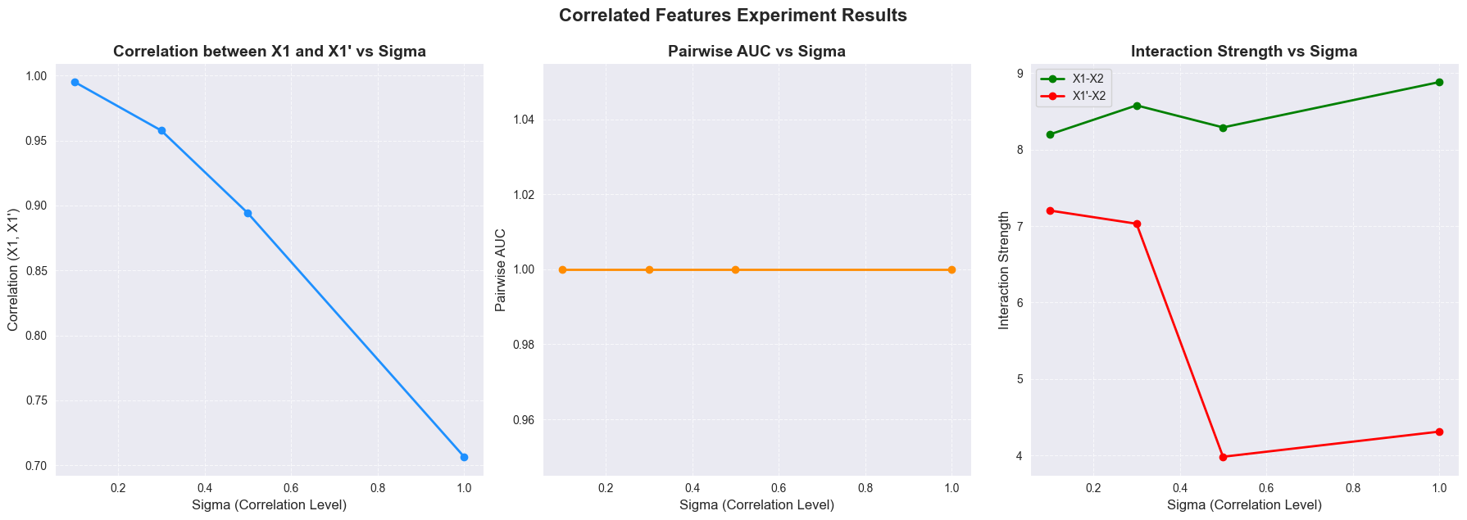
Proposed Algorithm – Experiment (Correlated)

Slide 18
Conclusion
Effective Interaction Detection:
NID framework successfully detects interactions in both synthetic and real-world datasets.
Example: Detected interactions between latitude and longitude in the California Housing dataset.
Impact of Multicollinearity:
Multicollinearity (duplicate or highly correlated features) reduces interaction strength.
Too many similar features confuse the model, making interaction detection more difficult.
Permutation Testing for Significance:
Introduced permutation testing to validate the significance of detected interactions.
Helps ensure that interactions are genuine and not due to random chance, especially with correlated features.

Slide 19
THANKS!

