Slide 1
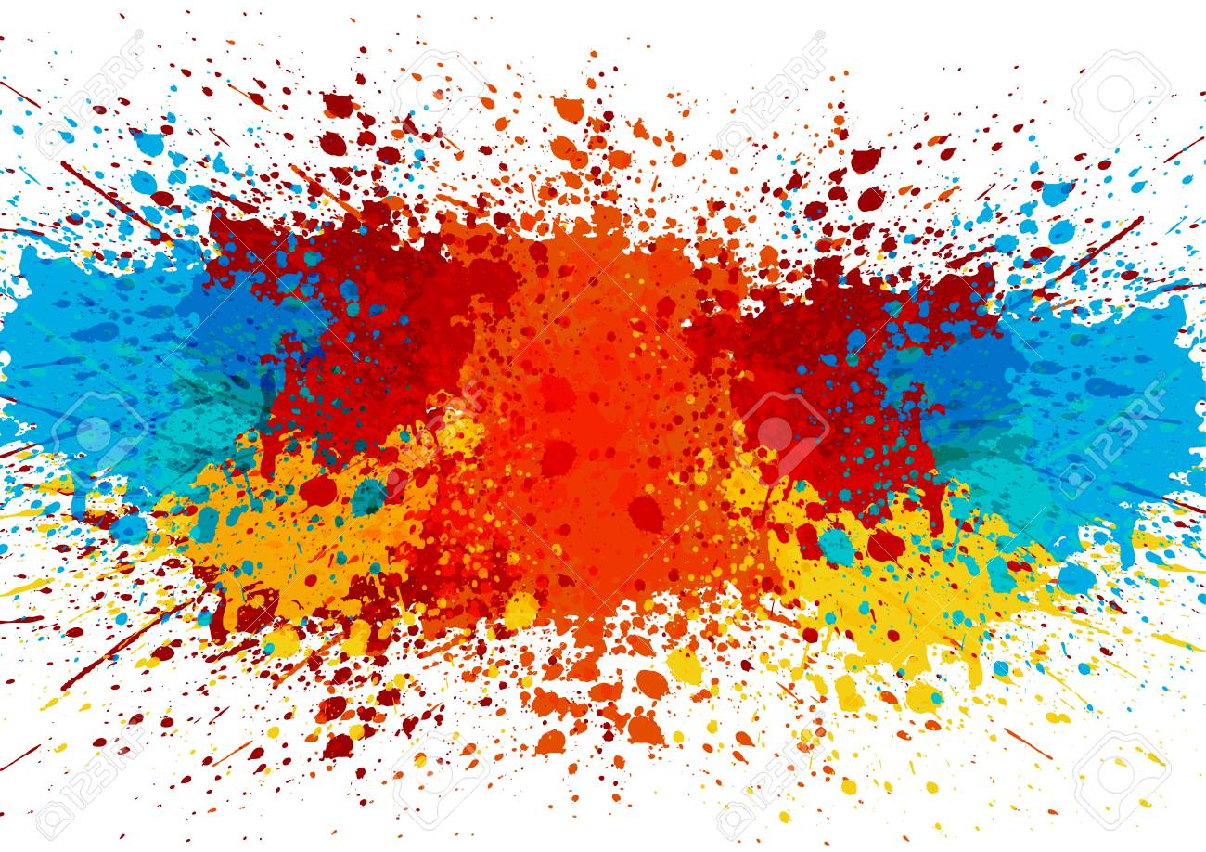
Colors detection
PROJECT AUTHOR:AKNIYET KOLIBAYEVA AND KASYMOVA DILNAZ
EXAMINATOR:ZHANGIR RAYEV

Slide 2
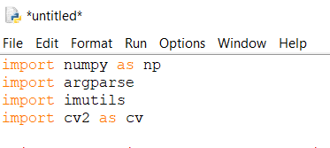
Project purpose-color detection application with which you can automatically get the name of the color through your webcam. So, for this we will have a data file containing the name of the color and its values.
1.Numpy- support for multidimensional arrays,support for high-level mathematical functions designed to work with multidimensional arrays.
2.Argparse - converting string arguments to program objects,
formatting and displaying informative prompts.
3. Imutils - a series of handy functions to simplify basic image processing functions such as rotation, resizing, display, edge sorting, edge detection and more.
4.OpenCV - is a cross-platform library using which we can develop real-time computer vision applications. It mainly focuses on image processing, video capture and analysis including features like face detection and object detection.

Slide 3
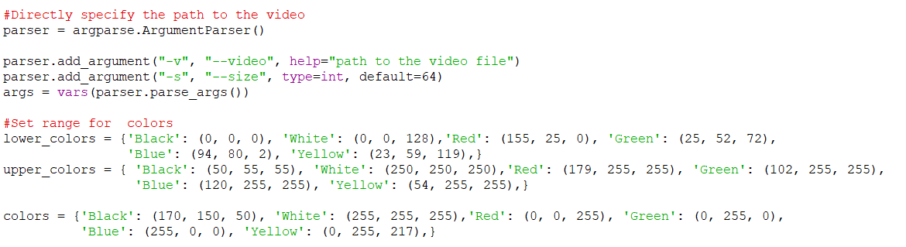
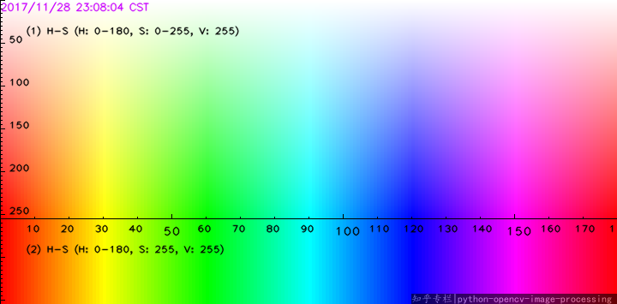
To get started with argparse, need to configure the parser
Next, the parser should indicate what objects we expect from it.
also we use color spaces
Next we find the upper and lower value of the color, (for this we used the internet to find the value of the colors)
upper and lower

Slide 4
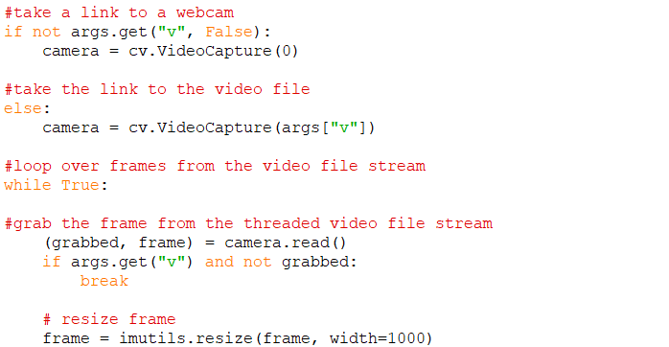
To record a video, we need to create a VideoCapture object
The device index is just a number indicating which camera
get a link to a video file
capture the current frame
if the frame was not grabbed, then we have reached the end of the video file
process the frame a bit by changing its size
frame : The actual video frame itself.
grabbed : A boolean indicating if the frame was successfully read or not.

Slide 5
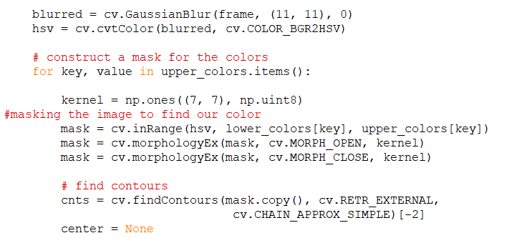
then we apply a Gaussian blur so that we can focus on the real “structures” in the frame, and then convert it to the HSV color space.
kernel - It represents the kernel.
cv2.morphologyEx() it is useful in removing noise
cv2.MORPH_CLOSE it is useful in closing small holes inside the foreground objects or small black points on the object
define the contours of the drop in the mask

Slide 6
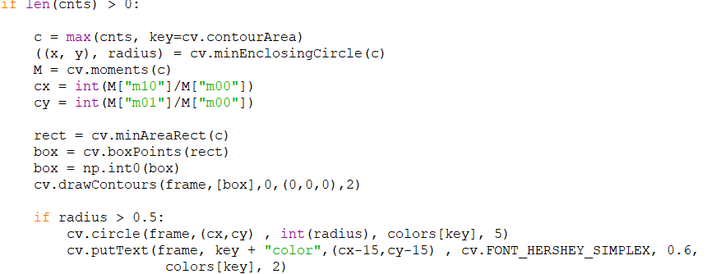
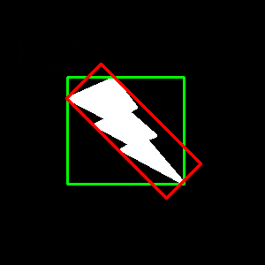
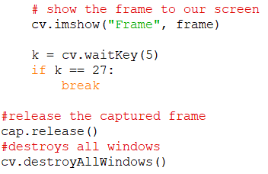
find the largest path in the mask, then use it to calculate
minimum enclosing circle and centroid
Rotated rectangle
we will have a rectangle like in pictures
draw the surrounding circle and text
method is used to display an image in a window
this is necessary to avoid using the Python kernel
release of software resource and release of hardware resources
closing all open windows

Slide 7
Thank you for your attention
sites that we used
https://docs.opencv.org/master/dd/d49/tutorial_py_contour_features.html
https://www.analyticsvidhya.com/blog/2019/03/opencv-functions-computer-vision-python/

