Slide 1
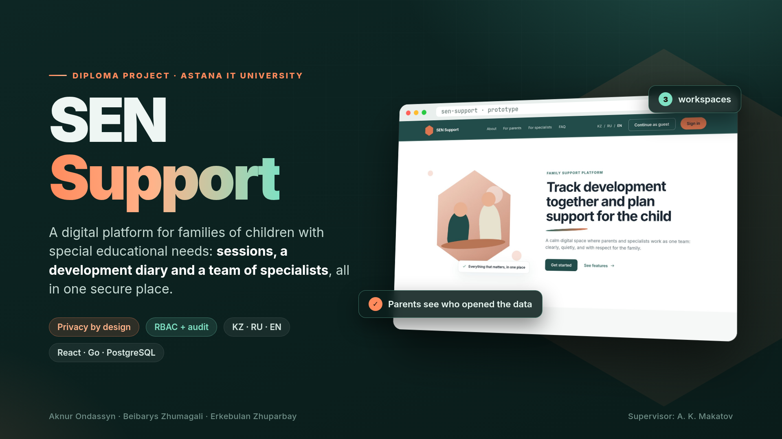
Notes:
Good afternoon! We are the SEN Support team. Imagine a family whose child has special educational needs: a speech therapist, a special education teacher, a tutor and the parents all work with the same child, but they have no shared space. Our project is a digital platform that brings them together as one team while carefully protecting the child's data.

Slide 2
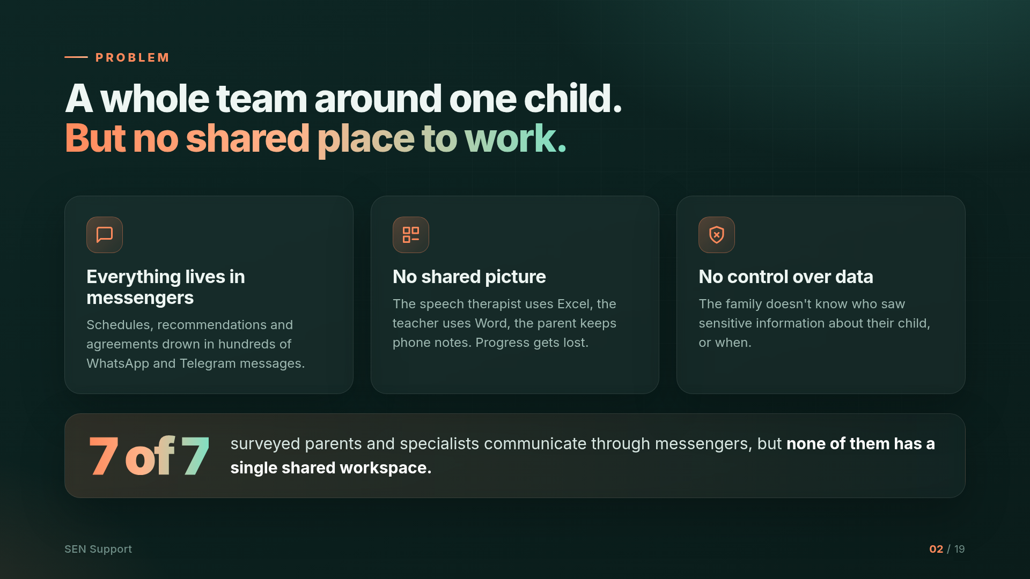
Notes:
Today, information about the child is scattered: the schedule lives in WhatsApp, specialists keep notes in Excel and Word, and parents keep notes on their phones. There is no shared picture of the child's progress, and the family doesn't know who has seen sensitive data. Our survey confirmed this: all 7 respondents communicate through messengers.

Slide 3
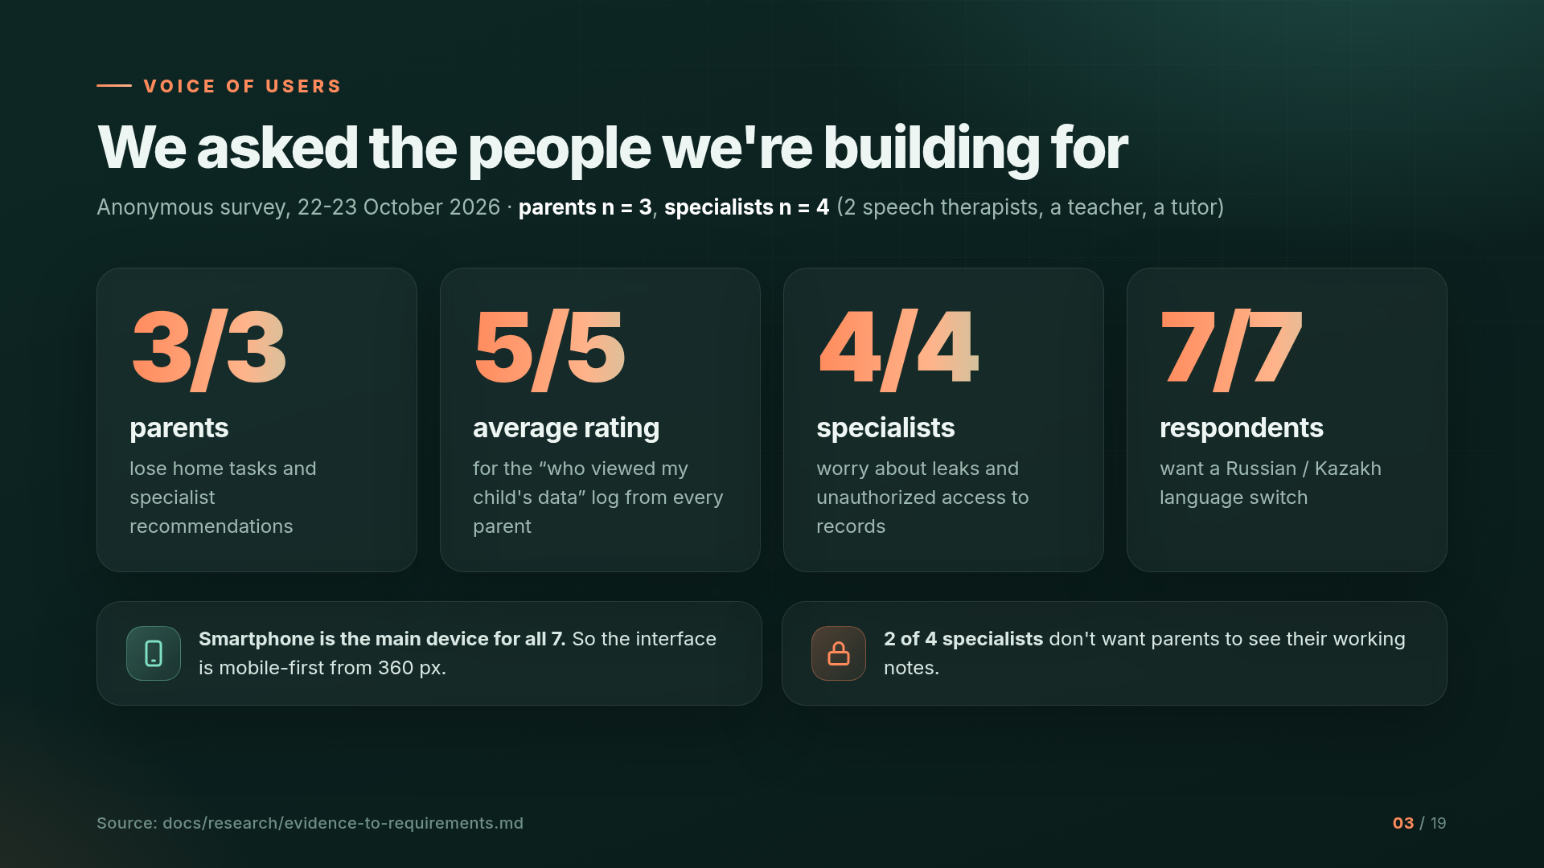
Notes:
We didn't build the product on guesses. We ran an anonymous survey with 3 parents and 4 specialists. Key numbers: all parents lose home recommendations; every parent rated the 'who viewed the data' log 5 out of 5; all specialists worry about leaks; all 7 want Kazakh and Russian. The sample is small, and we say so openly. The next stage will include interviews.

Slide 4
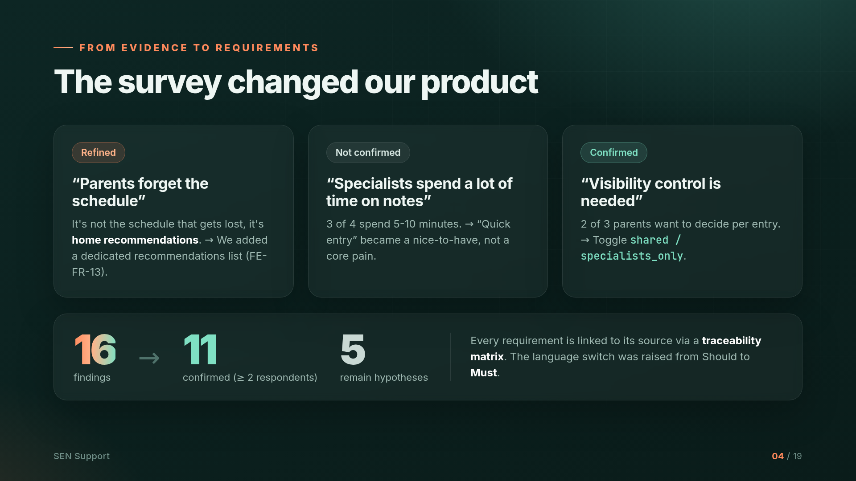
Notes:
The survey changed the product. The hypothesis 'parents forget the schedule' was refined: what actually gets lost is the recommendations, so we added a dedicated recommendations list. The hypothesis about time-consuming notes was not confirmed. Visibility control was confirmed. 11 of 16 findings are confirmed by at least two respondents, and every requirement is linked to its source through a traceability matrix.

Slide 5
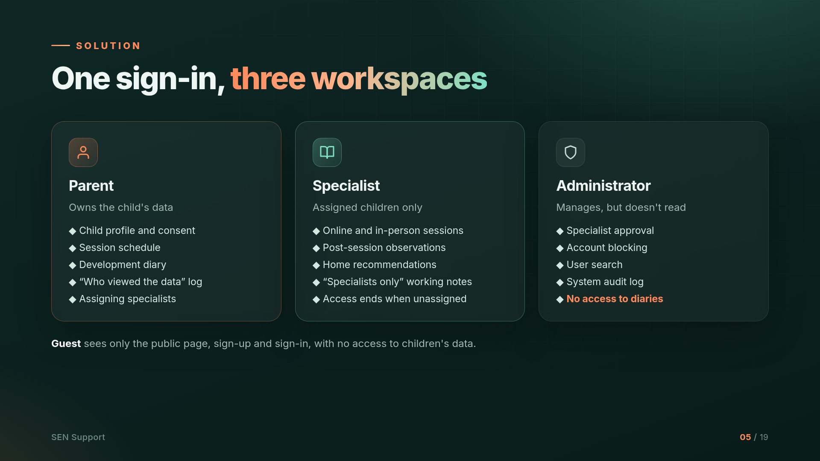
Notes:
The solution is one sign-in and three workspaces. The parent owns the data: profile, schedule, diary and access log. A specialist sees only assigned children and loses access as soon as the assignment ends. The administrator manages accounts but, by design, does not read diaries.

Slide 6
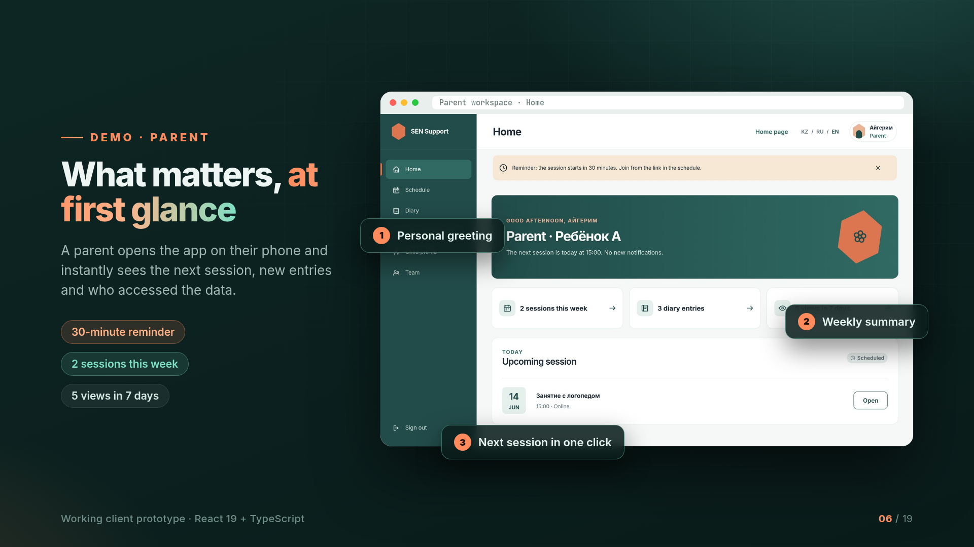
Notes:
This is a working client prototype built with React and TypeScript. The parent opens the workspace and immediately sees what matters: the next session, a weekly summary, a 30-minute reminder and how many times the child's data was viewed.

Slide 7
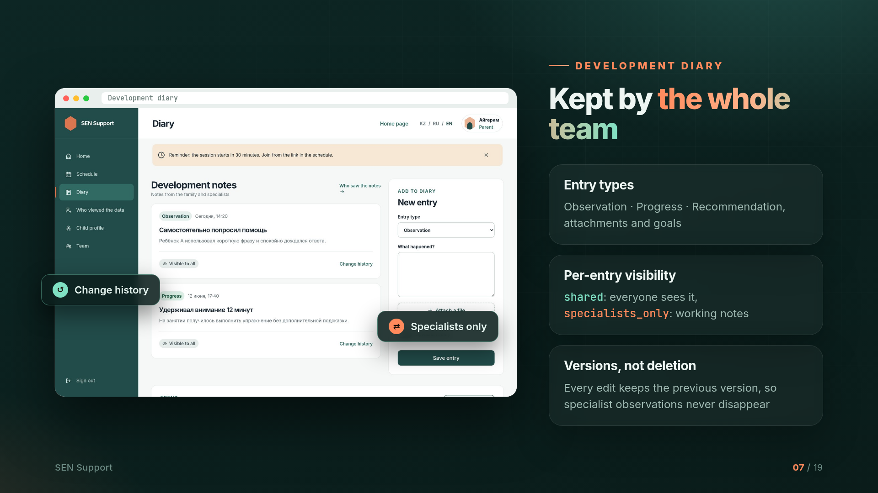
Notes:
The development diary is kept by the whole team. Entries have types: observation, progress and recommendation. Each entry has a visibility setting: shared means everyone sees it, specialists_only is for specialists' working notes. Edits keep previous versions, so observations are never lost.

Slide 8
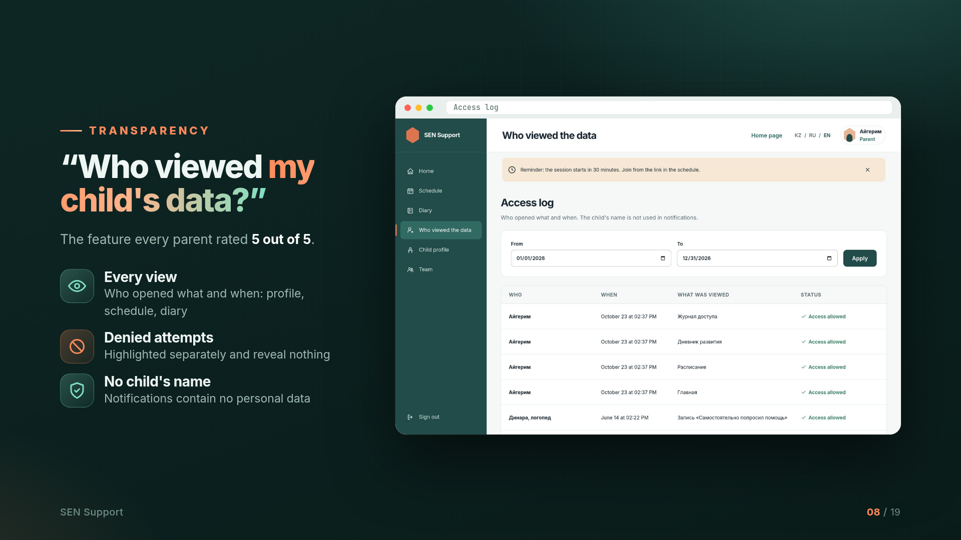
Notes:
The most requested feature is the access log. Parents see who opened what and when. Denied attempts are highlighted separately, and notifications never contain the child's name.

Slide 9
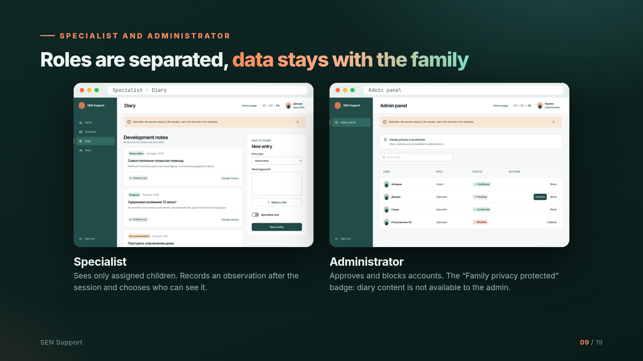
Notes:
A specialist works only with assigned children and chooses the visibility of each entry. The administrator approves and blocks accounts, but diary content is not available to them, and the interface makes this visible.

Slide 10
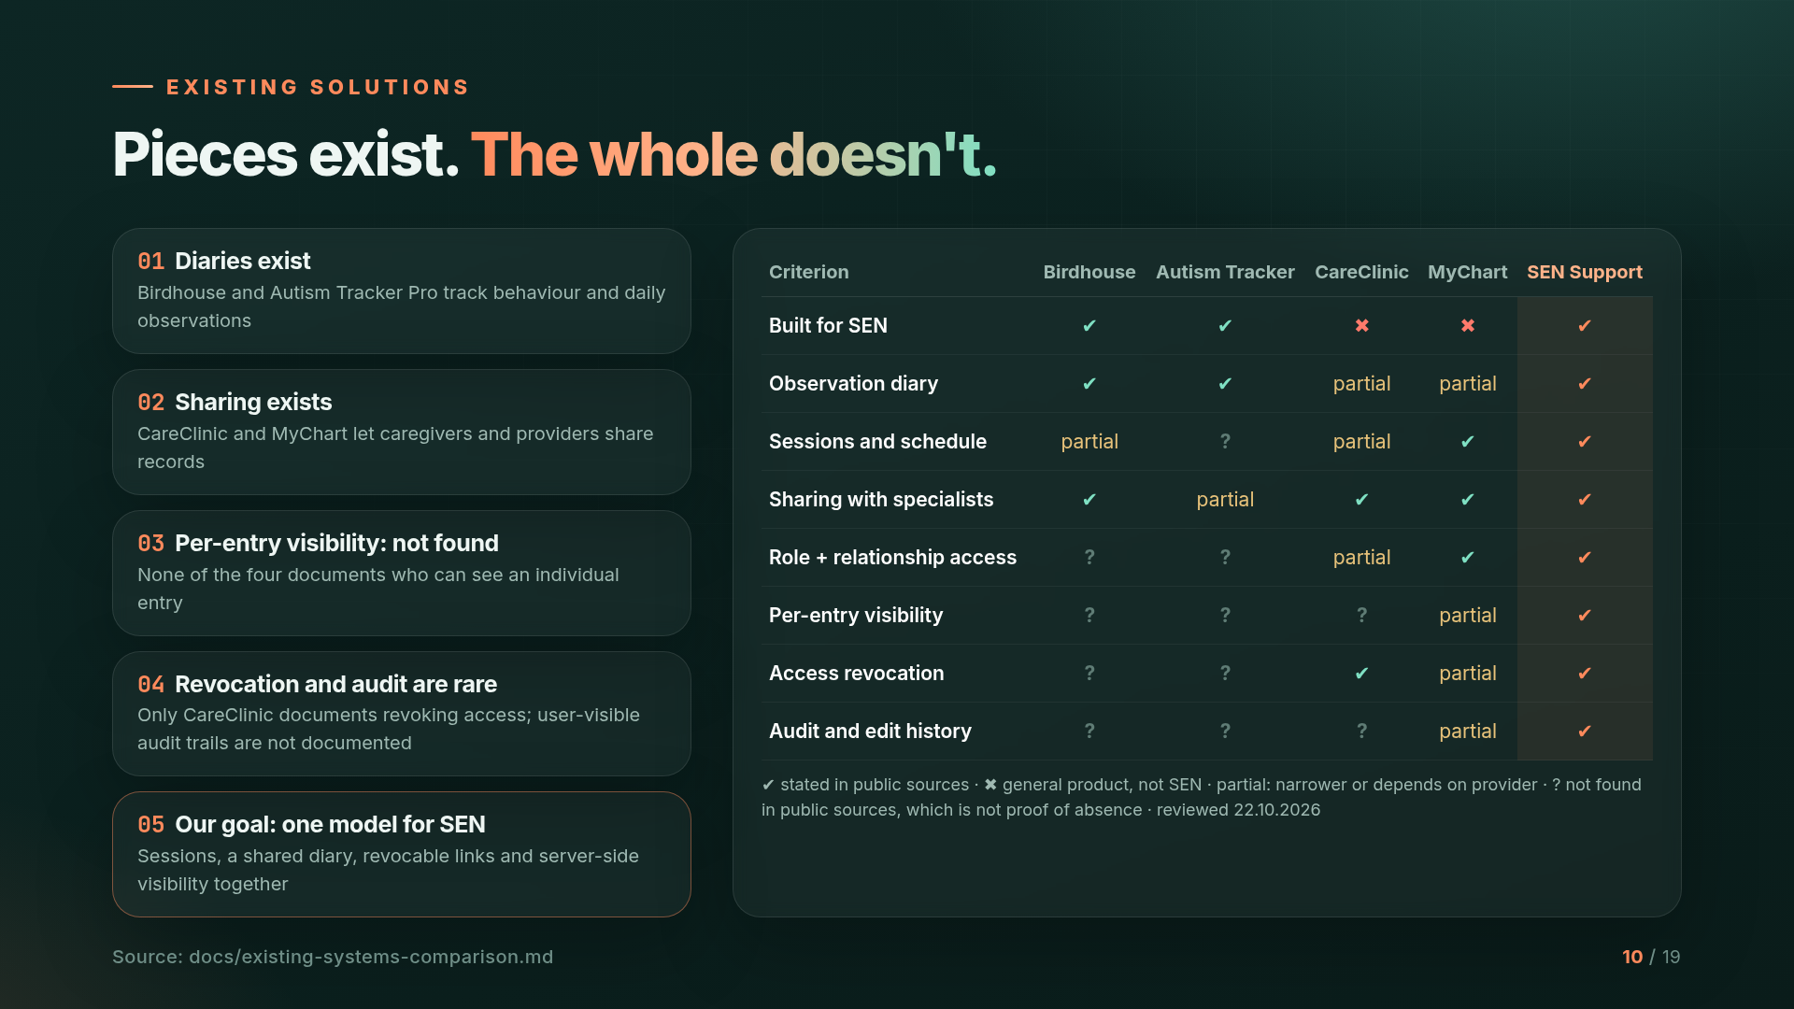
Notes:
We compared four existing solutions across ten criteria. Individual features exist: diaries, scheduling, sharing with doctors. But public descriptions don't confirm the combination of per-entry visibility, access revocation and auditing in one product for SEN. That is our engineering niche. Note that 'not confirmed' doesn't mean the feature is absent.

Slide 11
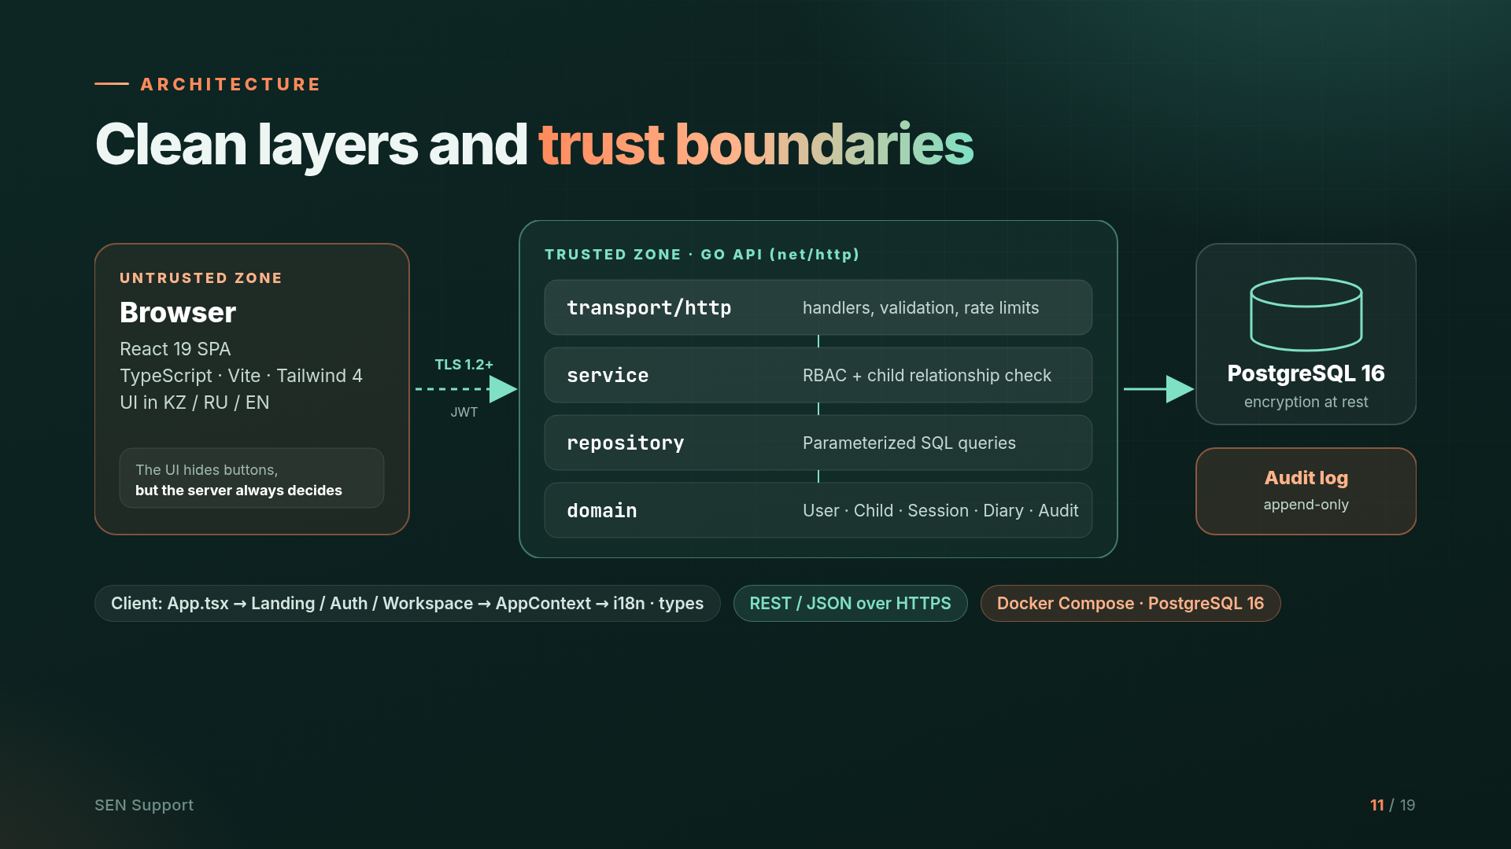
Notes:
Architecture: the browser is an untrusted zone. The interface may hide buttons, but the server always makes the decision. The Go API is built on the standard library and split into layers: transport, a service layer that checks roles and relationships, a repository with parameterized queries, and the domain. Data lives in PostgreSQL, with a separate append-only audit log.

Slide 12
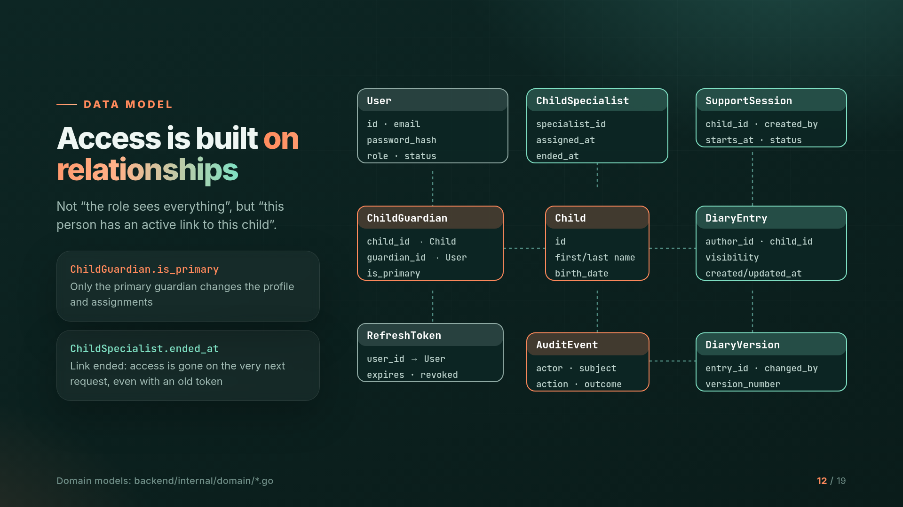
Notes:
The key idea of the data model is that access is built on relationships. Not 'a specialist sees everything', but 'this specialist has an active link to this child'. The is_primary field marks the primary guardian, and ended_at marks the end of an assignment: access disappears on the very next request, even with an old token.

Slide 13
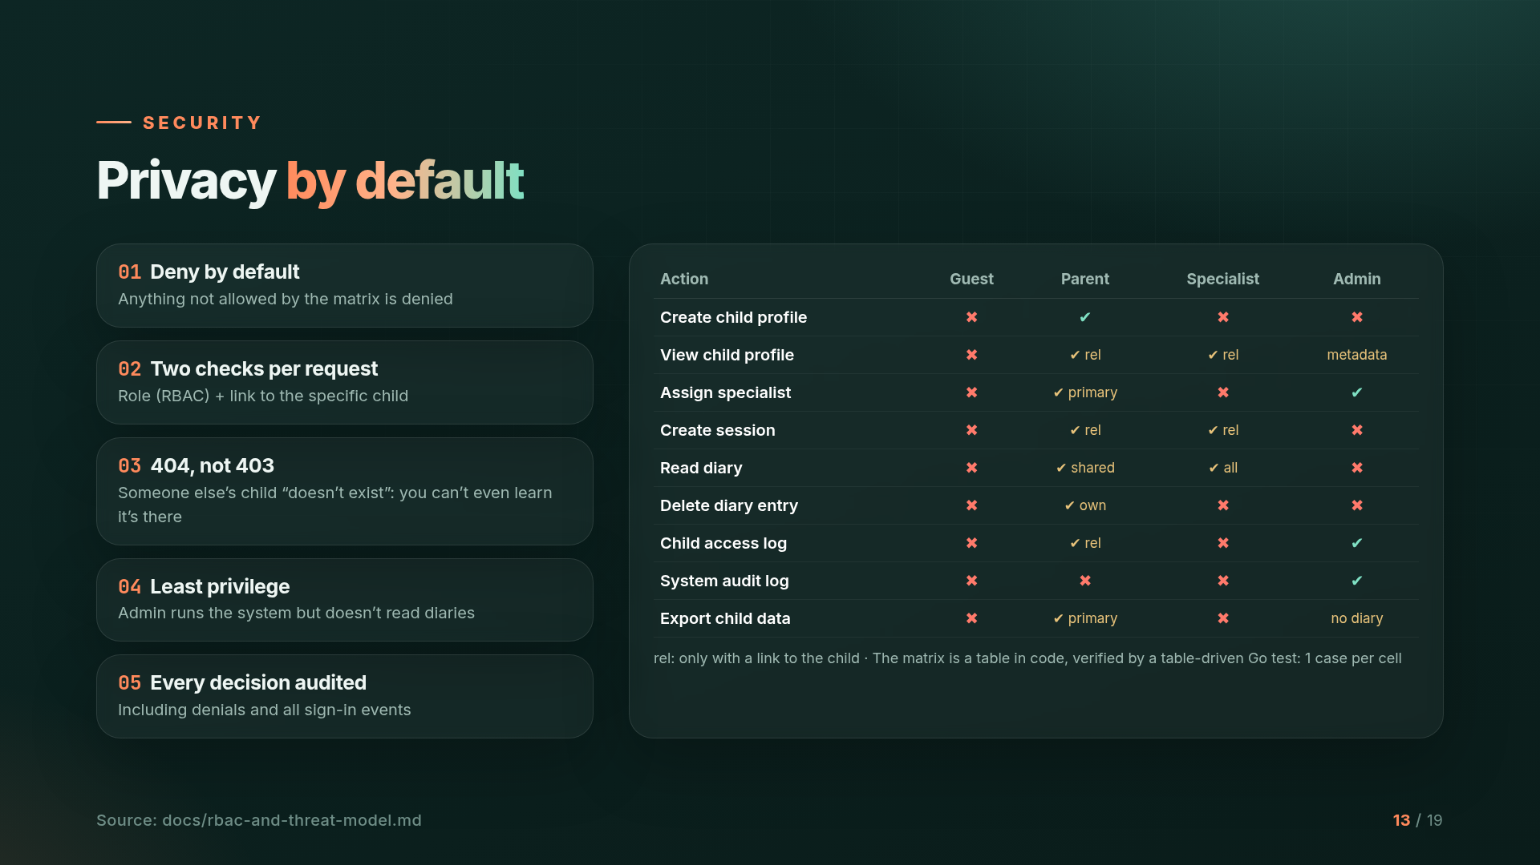
Notes:
Five security principles: deny by default, two checks on every request, 404 instead of 403 for other people's children, least privilege, and an audit of every decision. The access matrix is a table in code, verified by a test for every cell.

Slide 14
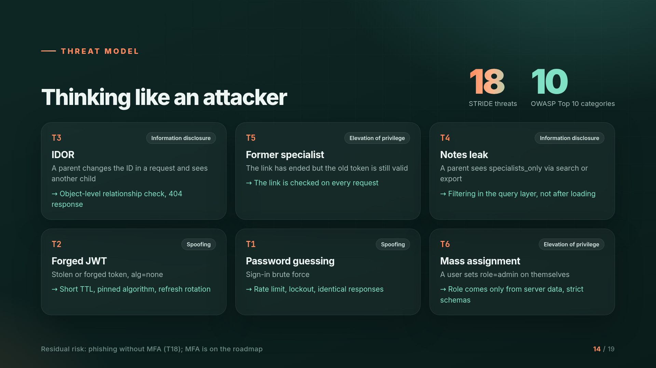
Notes:
We modeled 18 threats using STRIDE and mapped them to the OWASP Top 10. The main ones are IDOR, access by a former specialist, leakage of working notes, forged JWTs, password brute force and mass assignment. Each has a mitigation and a test. The residual risk is phishing without MFA, which is on the roadmap.

Slide 15
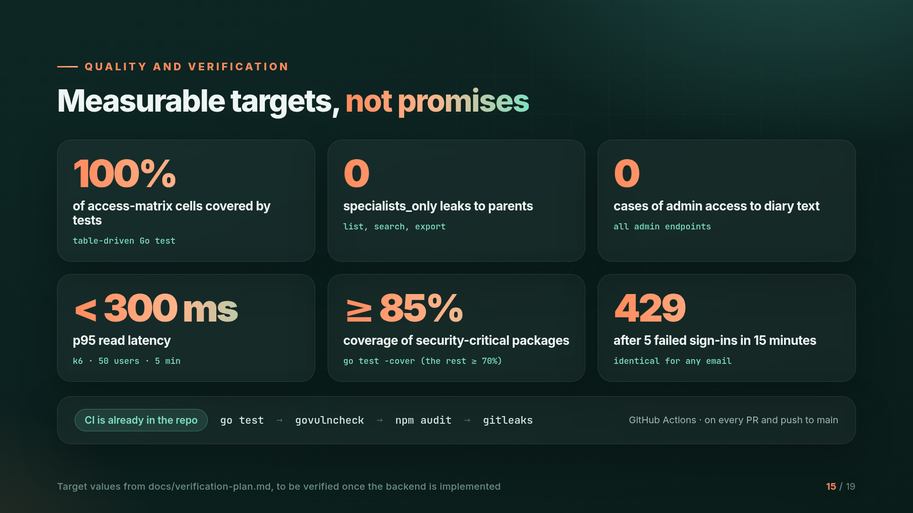
Notes:
We have measurable targets: 100% of matrix cells covered by tests, zero leaks of notes, zero admin access to diaries, and p95 under 300 ms under load. These are target values that we will verify once the backend is implemented. CI is already running go test, govulncheck, npm audit and gitleaks on every PR.

Slide 16
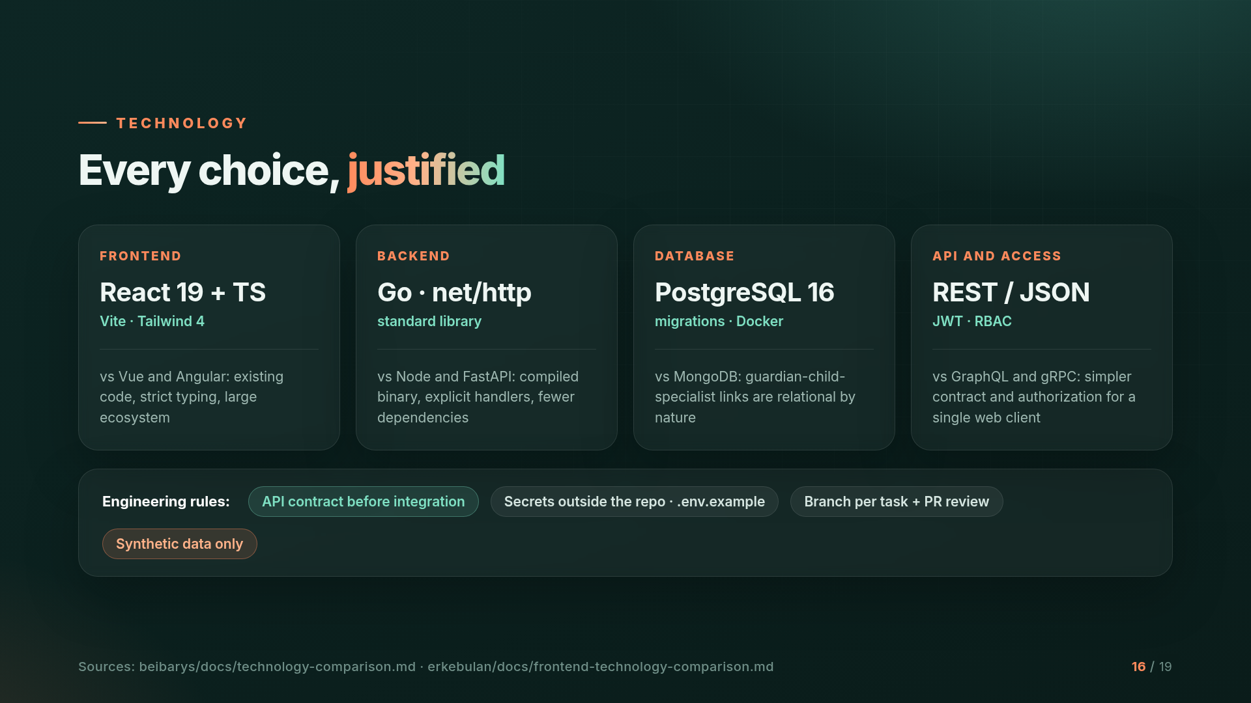
Notes:
Every technology was chosen by comparing alternatives: React vs Vue and Angular, Go vs Node and FastAPI, PostgreSQL vs MongoDB because our data is relational by nature, and REST vs GraphQL and gRPC.

Slide 17
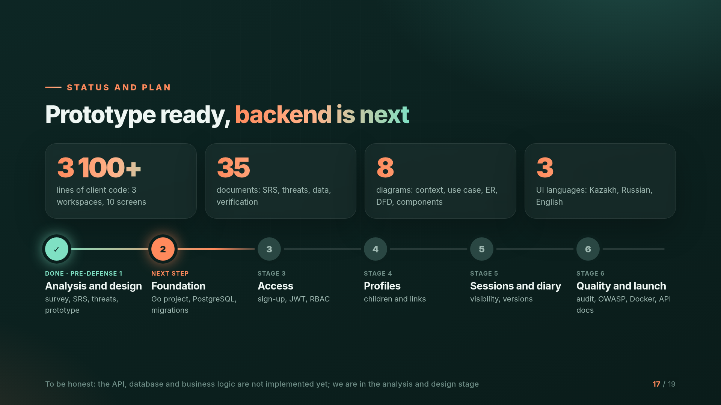
Notes:
Status: the analysis and design stage is complete, with a survey, SRS, threat model, 35 documents, 8 diagrams and a clickable prototype in three languages. To be honest, the API, database and business logic are not implemented yet. Next: foundation, access, profiles, sessions and the diary, and finally auditing, OWASP testing and Docker.

Slide 18
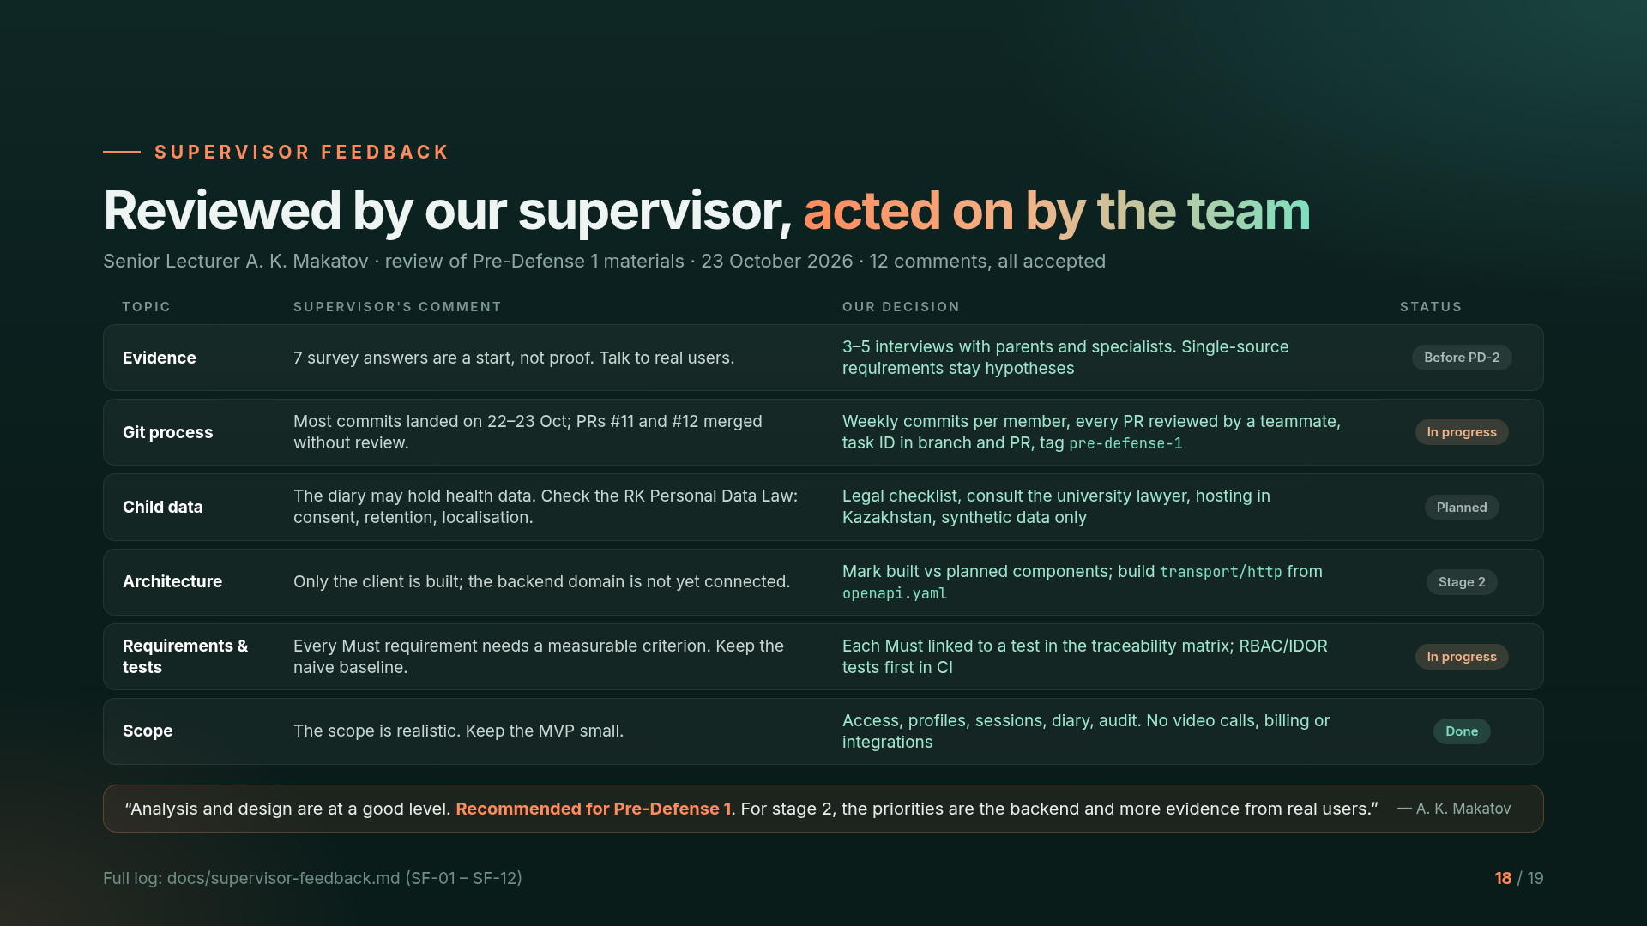
Notes:
Our supervisor, Senior Lecturer Arstan Makatov, reviewed the repository, YouTrack and this presentation on 23 October. He gave 12 comments and we accepted all of them. The most important ones: seven survey answers are only exploratory, so we will run 3 to 5 interviews before pre-defense 2. Most commits were made in the last two days, so from now on everyone commits weekly and every pull request is reviewed by a teammate. Children's data may include health information, so we will check the Kazakhstan personal data law with the university lawyer and use only synthetic data. His conclusion: analysis and design are at a good level and the project is recommended for pre-defense 1. The full log is in docs/supervisor-feedback.md.

Slide 19
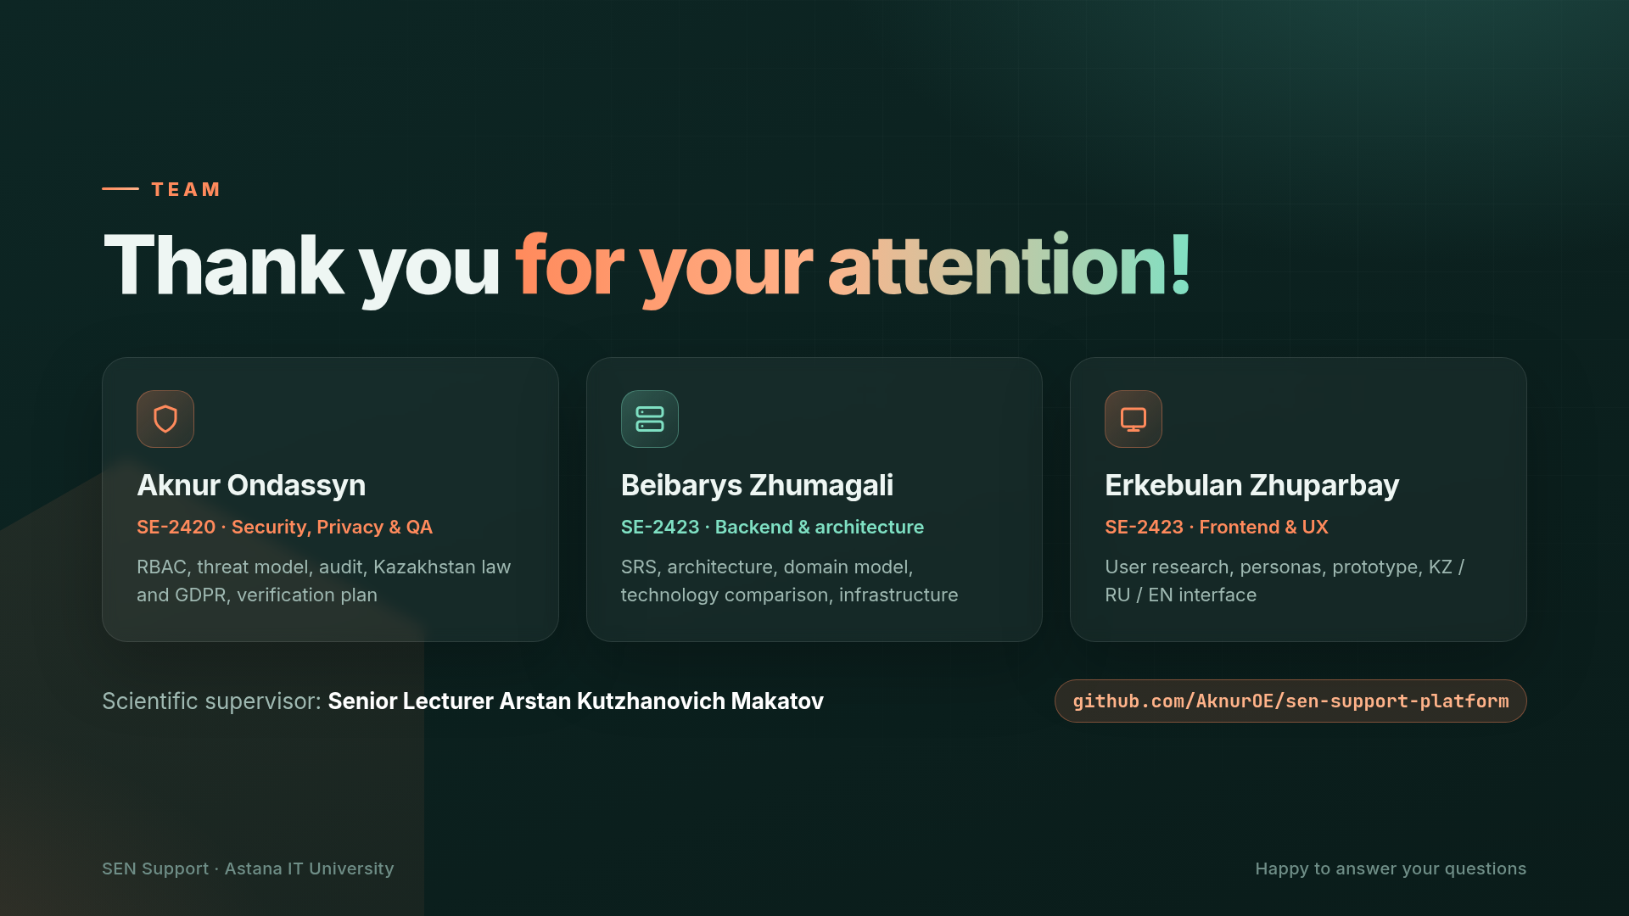
Notes:
Thank you for your attention! Aknur is responsible for security, privacy and quality, Beibarys for the backend and architecture, and Erkebulan for the frontend and UX. We are happy to answer your questions.

