Slide 1
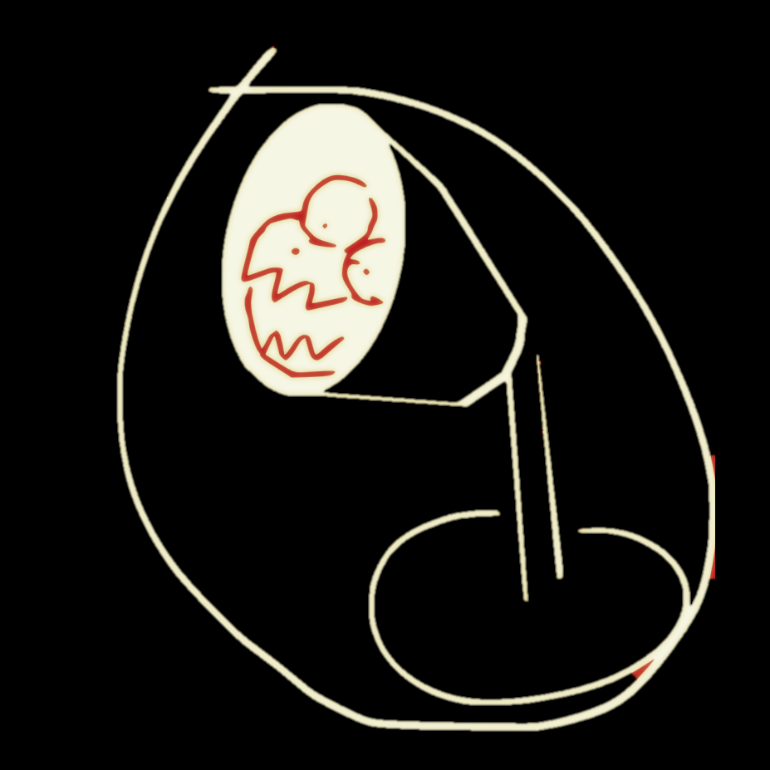
Results of sentiment analysis

