Slide 1
Crop Analysis and Prediction Using Machine Learning
- Team A
Akhilesh Akoju
Akhil Reddy Goli
Divya Balaji

Slide 2
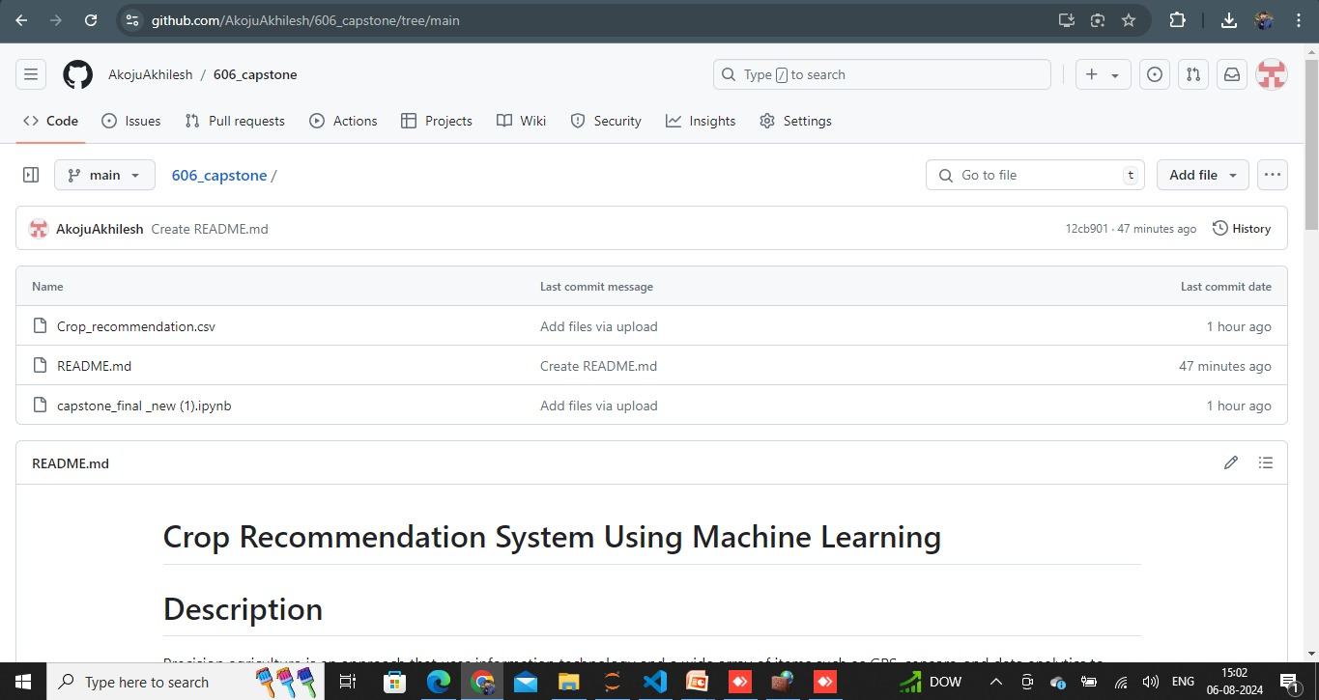
Kaggle ID: 7672689
GitHub Repository Link: https://github.com/AkojuAkhilesh/606_capstone
Snapshot of GitHub Page:

Slide 3
Introduction
Precision agriculture is an approach that uses information technology and a wide array of items such as GPS, sensors, and data analytics to enhance crop yields and optimize agricultural practices. By integrating machine learning, this project aims to analyze environmental and soil data to predict the optimal crops for specific conditions. This involves using historical data to train models that can understand and predict which crop varieties will thrive under various environmental factors such as soil type, climate conditions, and resource availability.
The primary motivation for this project is to enhance agricultural productivity by enabling farmers to make better-informed decisions about what crops to plant and when. This is increasingly important as agricultural industries face challenges from changing climate conditions, population growth, and the need for sustainable practices. By using data-driven decisions, farmers can optimize the use of resources like water, fertilizers, and pesticides, which in turn contributes to more sustainable agricultural practices. The project aims to minimize waste and maximize efficiency in crop production.

Slide 4
Research Question/Hypothesis
How accurately can machine learning models predict the optimal crop for given environmental and soil conditions?
- The accuracy of machine learning models in predicting the optimal crop for given environmental and soil conditions depends on the quality and quantity of data, the features used, and the algorithms applied. For the given data we have got an accuracy of 99% for the Random forest machine learning algorithm.
What are the most significant environmental and soil factors that influence crop recommendation?
- After performing feature importance we have considered the top most environmental and soil factors as Humidity, Rainfall and K (Potassium) value.
What are the potential economic benefits for farmers using a machine learning-based crop recommendation system?
- A machine learning-based crop recommendation system helps farmers optimize crop selection and resource use, increasing yield and profitability while reducing costs and risks. It also aids in market analysis and sustainable practices, ensuring long-term economic benefits.

Slide 5
What are the environmental impacts of implementing data-driven crop recommendations on a large scale?
- Implementing data-driven crop recommendations on a large scale reduces resource waste and promotes sustainable farming practices, leading to lower environmental impact and improved soil health. It also minimizes the use of harmful chemicals, protecting ecosystems and biodiversity.
What extra difference did we introduce comparing to the existing models?
- When farmers give the necessary environmental and soil conditions, we have developed an algorithm that suggests them the top 5 crops that can be grown in those given conditions giving their probability too.

Slide 6
State of the Art and Literature Review
Current Approaches :
Traditional farming relies on farmers' experience and general practices without considering specific soil and climate variations. Modern agriculture uses some automation, like machinery for planting and harvesting, but often relies on broad data rather than detailed, plot-specific information.
Gaps Identified:
Despite advances, current agricultural tools still have major gaps. They lack real-time prediction and adaptive models, making it hard to respond quickly to weather changes, pests, and other environmental shifts. Most technologies use generic models, which aren't tailored to local conditions, leading to inefficiencies and lower crop yields.

Slide 7
Introduction to the Dataset
Source: The dataset is hosted on Kaggle, a popular platform for data science projects and competitions.
Data Size and Structure
Number of Instances/Samples: 2,200 Number of Attributes: 8 raw attributes
Features: 7 ( That we are interested in)
Soil Nutrients: Nitrogen (N), Phosphorus (P), Potassium (K)
Weather Conditions: Temperature, Humidity, Rainfall
Soil pH: pH level of the soil
Target Variable: Crop type recommended (categorical variable) – 22 categories.
The target variable, 'label', represents the type of crop recommended based on the input features. The dataset contains multiple crop categories such as rice, wheat, maize, etc.

Slide 8
Link to the Dataset
Kaggle Dataset Link: https://www.kaggle.com/code/theeyeschico/crop-analysis-and-prediction/input
Types of Machine Learning or Data Analysis
Type of Task: Classification (multi)
Goal: The primary goal is to classify which crops are best suited for cultivation based on specific environmental conditions and soil characteristics.
Machine Learning Techniques:
Decision Trees, Random Forest, Gradient Boosting,
Logistic Regression (multi), Linear Discriminant Analysis (LDA)
Support Vector Machines (SVM), K-Nearest Neighbors (KNN)
Naïve Bayes
Neural Networks, Adaboost

Slide 9
Summary of the before works:
Predicting a single or few classes.
Only the soil conditions.
Only the environmental conditions.
Fewer models (knn/decision tress etc.)
Less accuracy. (Around 90 %)
No recommendation page in some of them.
How our model will be different:
We are trying to overcome all of the above issues in our single project.
We are predicting 5 crops instead of one and also their probabilities and might add additional data/ features for better real time performance.
Also trying better model evaluation techniques like accuracy, precision, recall, and F1-score. Techniques like cross-validation will be used to ensure that the model generalizes well on unseen data.
Proposed method:
Data preprocessing, Model Training, Model Deployment.

Slide 10
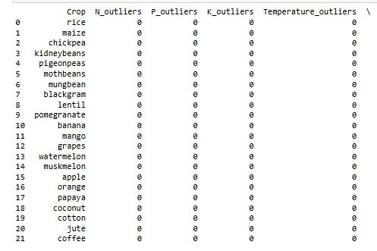
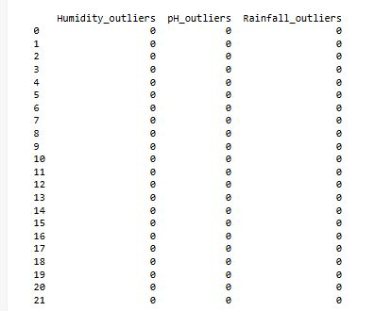
Outlliers
We have used z score for detecting outliers.
(z-score > 3 or z-score < -3)

Slide 11
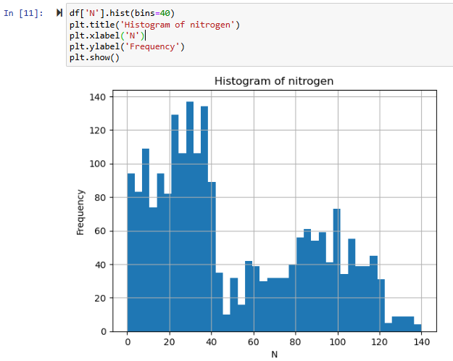
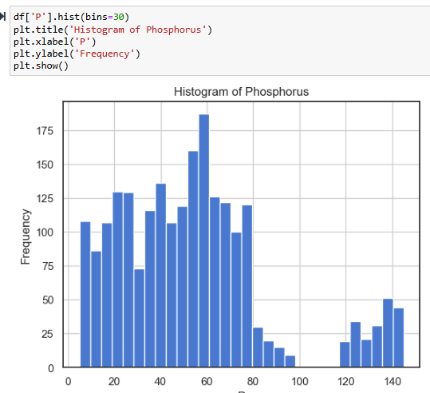
Exploratory Data Analysis
Histogram of Nitrogen
Key Insights:
Highest frequency around 30-35 nitrogen level.
Other peaks around 10, 20-25, 85, and 100-110 nitrogen levels.
Wide range of nitrogen levels from 0 to about 140, indicating diverse nitrogen content.
Histogram of Phosphorus (P)
Distribution: Shows the frequency distribution of phosphorus levels in the dataset.
Key Insights:
  Most common phosphorus levels fall within the 0-50 range.
  A noticeable decline in frequency beyond 50 phosphorus level.

Slide 12
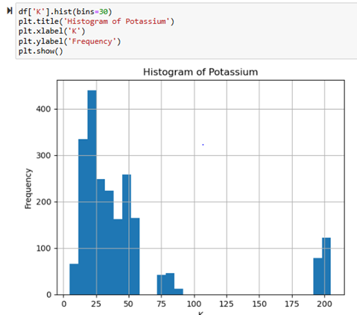
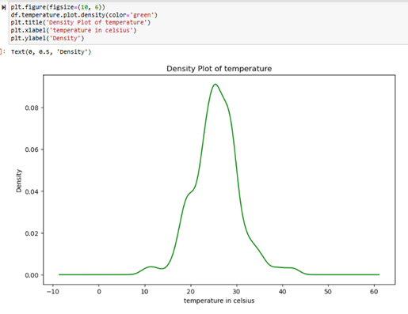

Histogram of Potassium (K)
Distribution: Displays the frequency distribution of potassium levels.
Key Insights:
  Peaks around 0-50 potassium levels, indicating these are the most common.
  Few occurrences of potassium levels beyond 100.

Slide 13
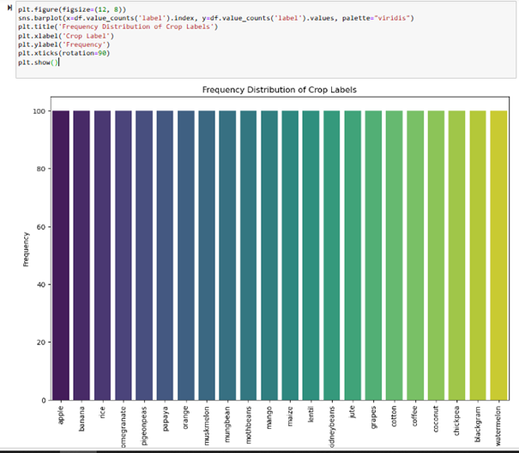
Key Insights from the Plot
1. The dataset exhibits a uniform distribution of crop labels, with each crop type appearing approximately 100 times.
2. It includes a diverse range of crops, indicating the dataset's richness.
3. The near-equal frequency of each crop type ensures a balanced dataset, which is advantageous for building unbiased machine learning models.
4. Crop types in the dataset include apple, banana, rice, pomegranate, papaya, orange, muskmelon, mungbean, mothbeans, mango, maize, lentil, kidneybeans, jute, grapes, cotton, coffee, coconut, chickpea, blackgram, and watermelon.

Slide 14
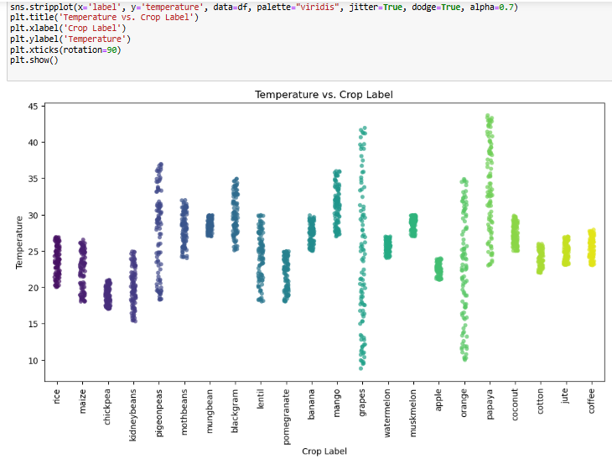
This plot can help in selecting the right crop based on the temperature of a region.
Farmers and agricultural planners can use this information to optimize crop yields by matching crops to their ideal temperature ranges.
Different crops prefer different temperature ranges. Rice is grown in temperatures around 20-25°C.
Cotton is grown in a broader temperature range, approximately 20-35°C.
Mango and coconut prefer higher temperatures, around 25-40°C.
Some crops, like pomegranate and lentil, have a narrower temperature range, indicating they are more sensitive to temperature changes.
There is some overlap in the temperature ranges for different crops, suggesting that some crops can be grown in similar temperature conditions.
However, there are clear distinctions for others, highlighting their specific temperature requirements.

Slide 15
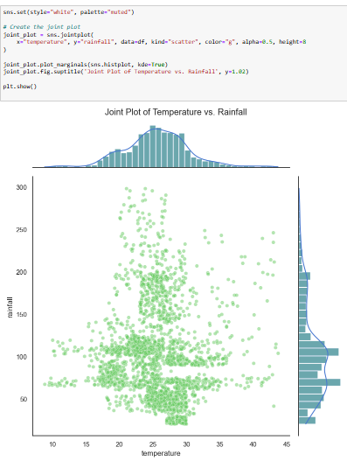
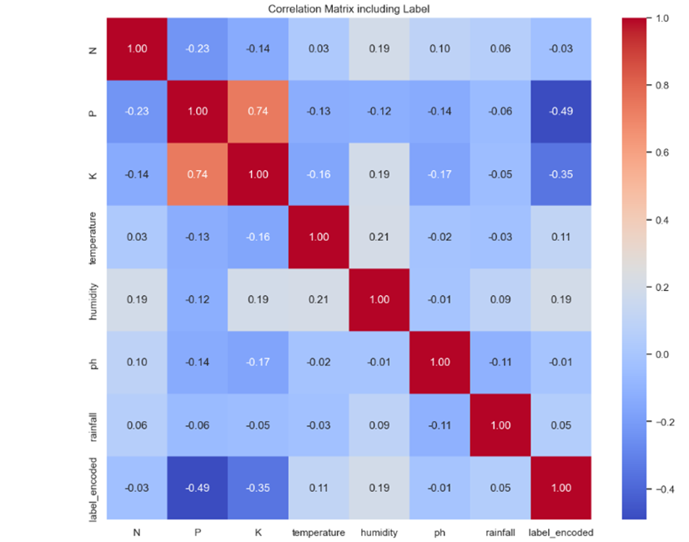
Temperature Vs Rainfall Plot
Correlation matrix for all the geographical factors

Slide 16
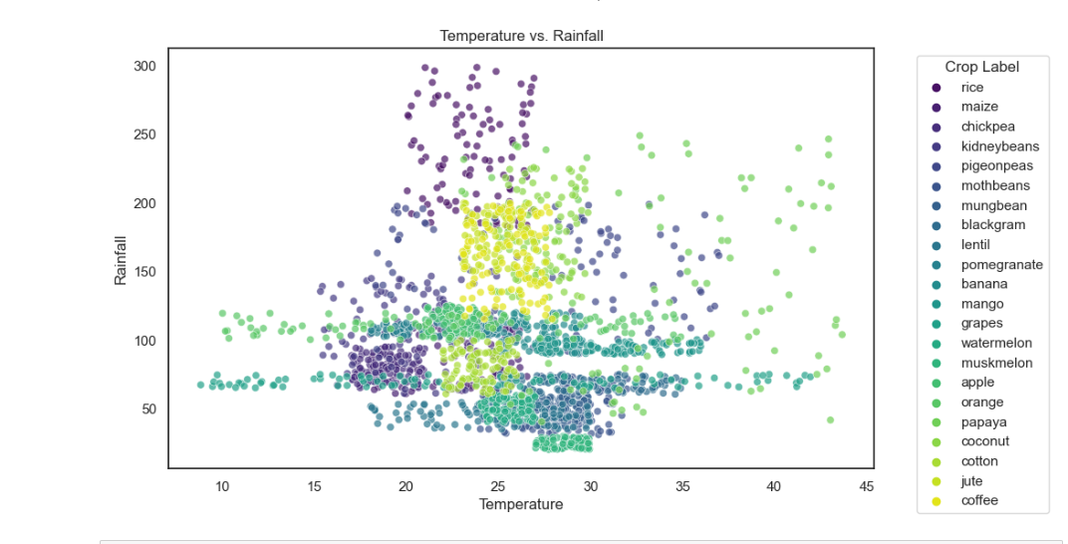
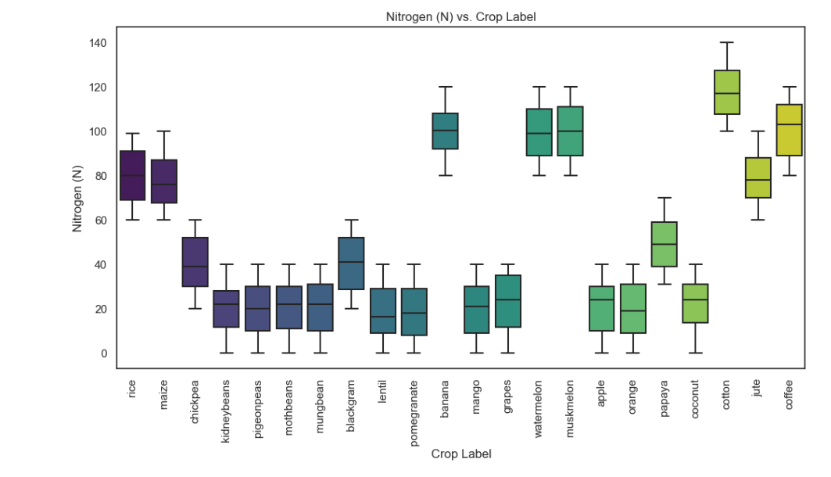
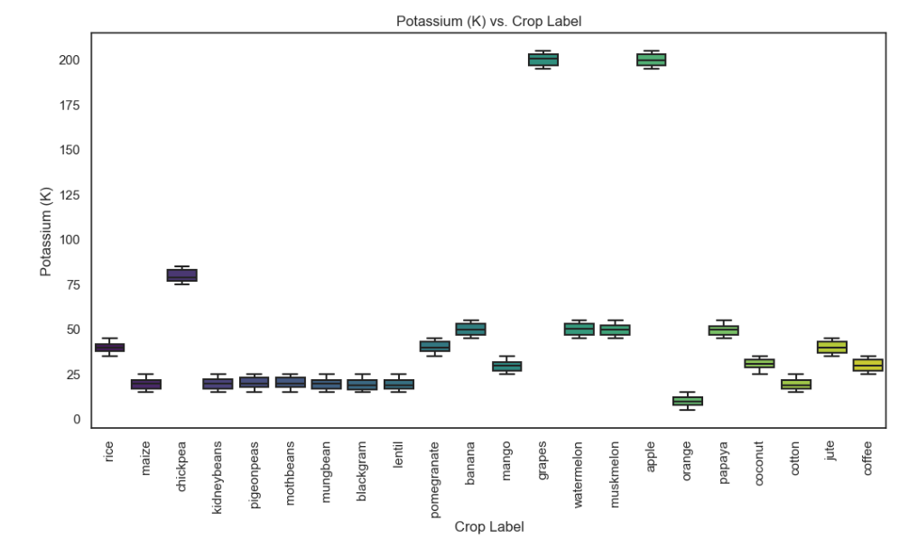
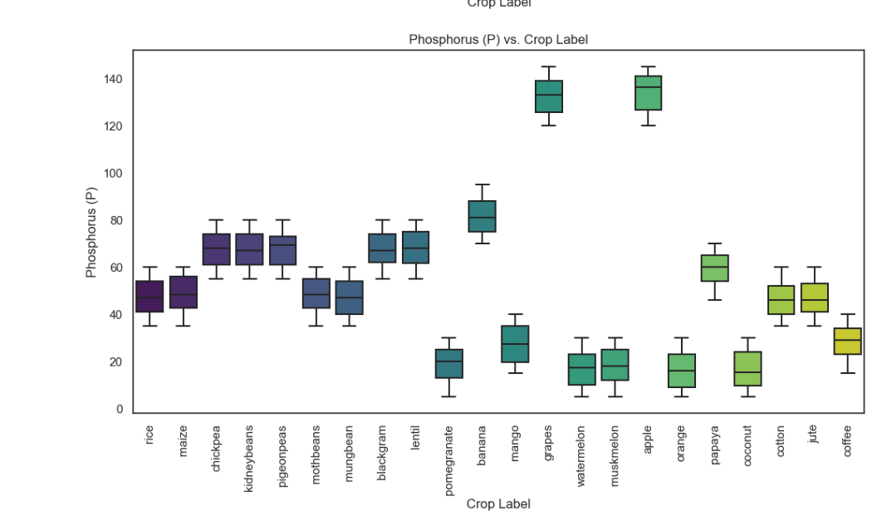

Slide 17
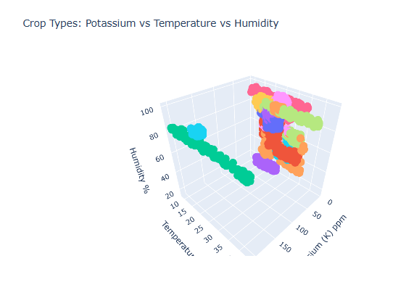
3d plots

Slide 18
Key Insights to Expect from These Plots
Nutrient Balance: The N-P-K plot will help identify the optimal nutrient balance for different crops. Crops with similar nutrient requirements will cluster together.
Environmental Suitability: The Temperature-Humidity-pH and Temperature-Rainfall-pH plots will reveal which crops are best suited for particular environmental conditions.
Climate Adaptation: The Rainfall-Humidity-Temperature plot will show how crops adapt to different climatic conditions, helping in planning for climate-resilient agriculture.
Soil and Climate Interaction: The Nitrogen-Temperature-Humidity, Phosphorus-Potassium-Temperature, and pH-Nitrogen-Rainfall plots will provide insights into how soil properties interact with climate factors, crucial for understanding crop-specific requirements.
Optimal Growth Conditions: The pH-Temperature-Humidity plot will highlight the ideal soil and climate conditions for various crops, aiding in precision agriculture practices.

Slide 19
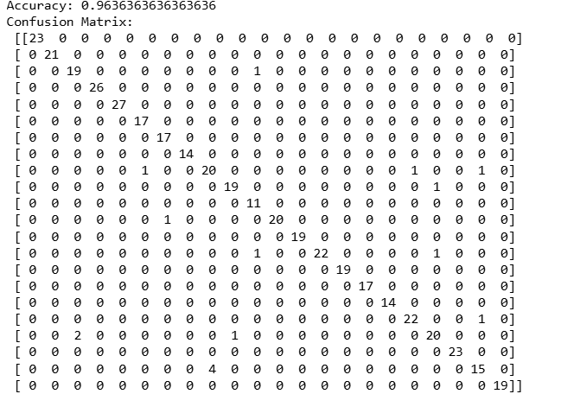
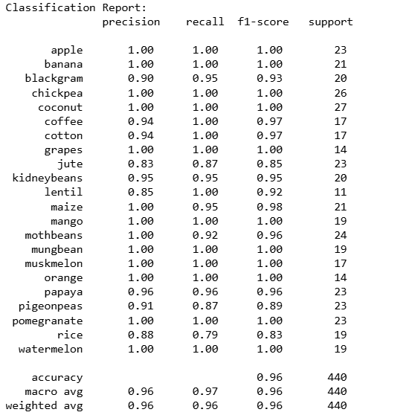
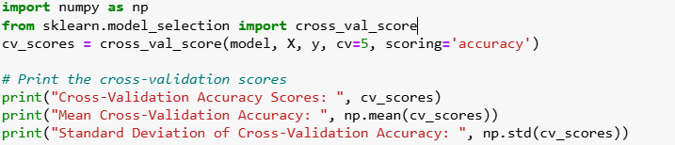
REGRESSION MODELS
LOGISTIC REGRESSION- Performed Logistic regression algorithm with 80-20 train & test, got accuracy of 96% and cv accuracy score as 97%.

Slide 20
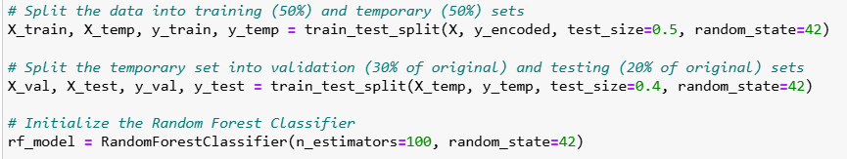
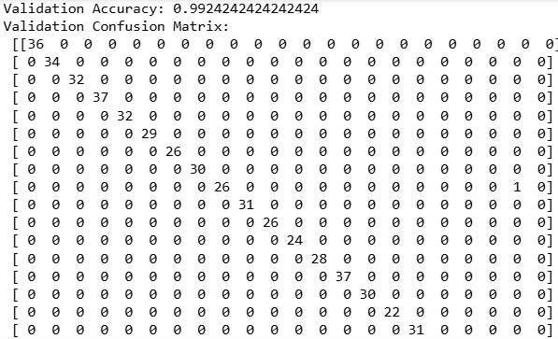
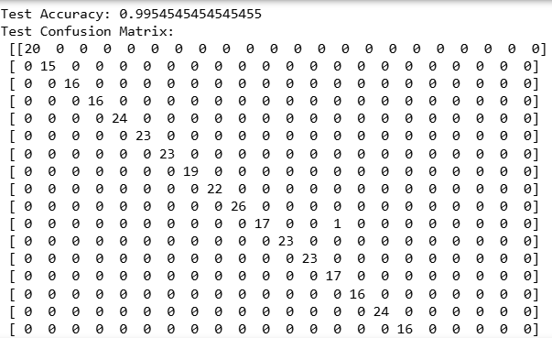
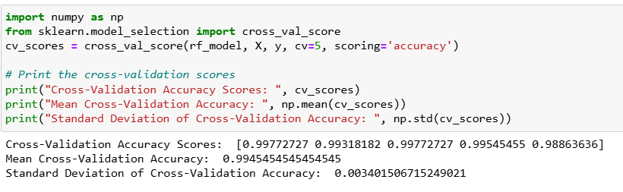
RANDOM FOREST CLASSIFIER- Performed Random forest classifier algorithm and got an accuracy of 99% and cv accuracy score as 99%.

Slide 21
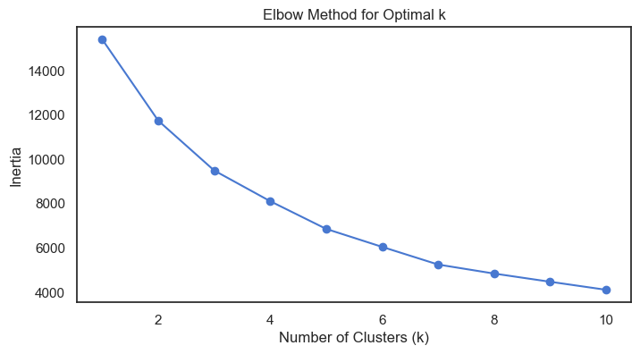
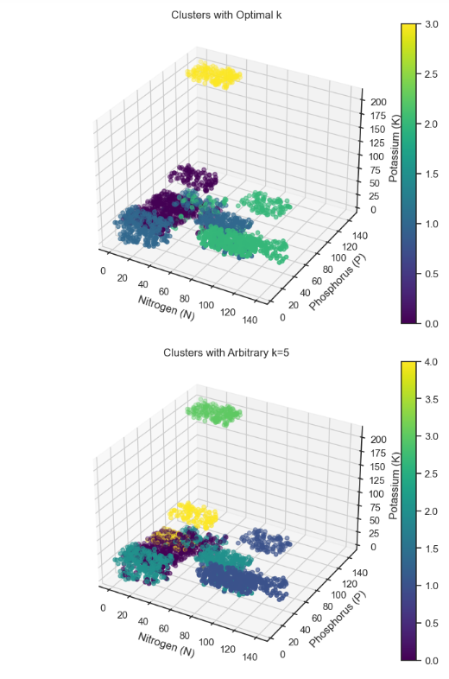

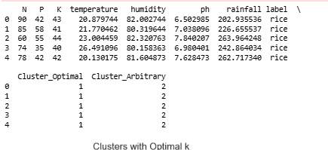
KMEANS CLUSTERING
For the kmeans clustering we got 5 clusters after performing the elbow method.

Slide 22
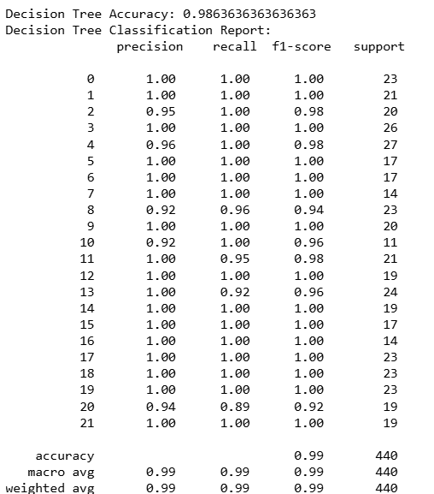
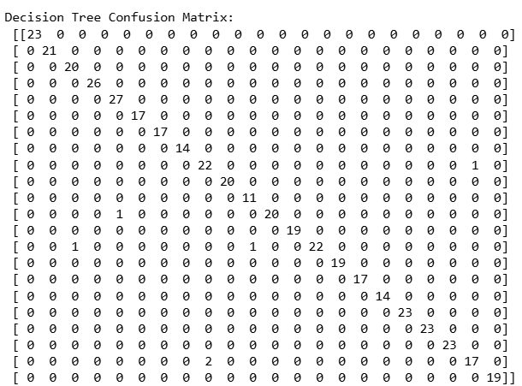
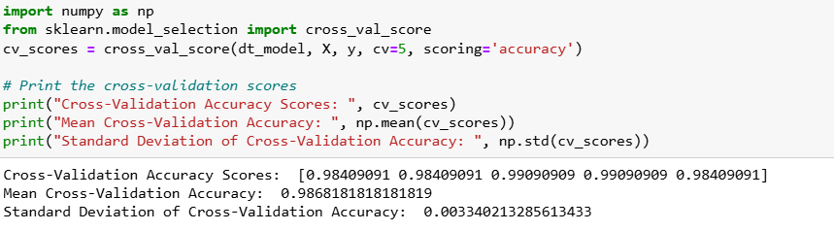
DECISION TREE CLASSIFIER- performed the decision tree classifier and got an accuracy of 99% and cv accuracy as 98%.

Slide 23
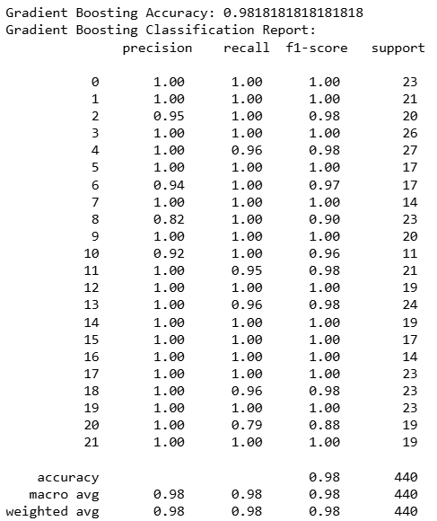
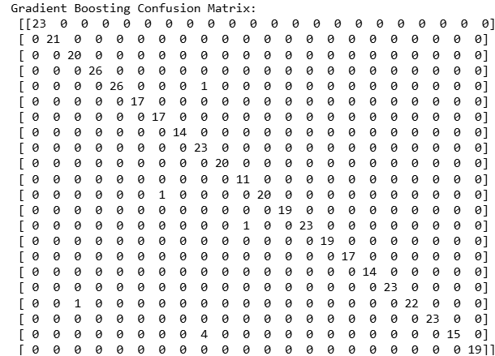
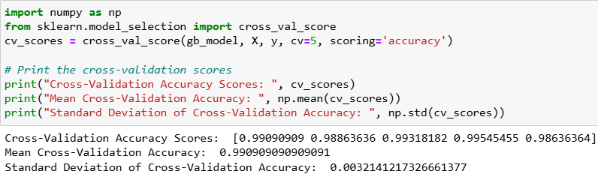
GRADIENT BOOSTING CLASSIFIER- for the gradient boosting algorithm we got an accuracy of 98% with a cv accuracy as 99%.

Slide 24
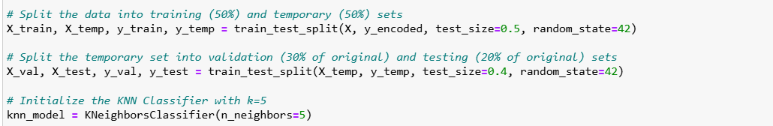
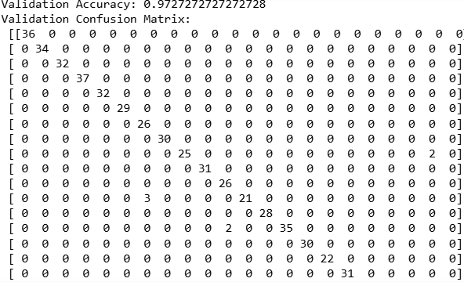
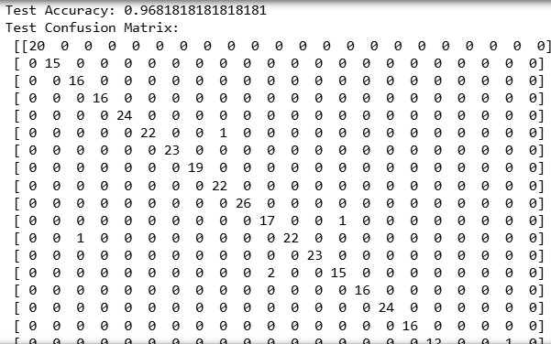
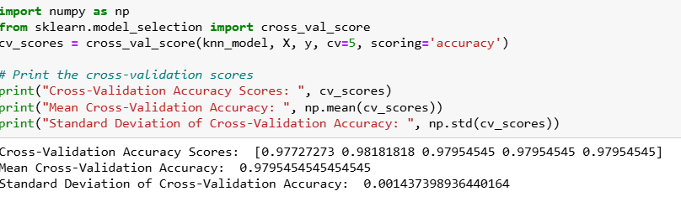
KNN MODEL- For the knn model we 1st split the data into 50-50 and later we split into 30-20 and got an accuracy of 97% and 96% respectively with the cv accuracy as 97%

Slide 25
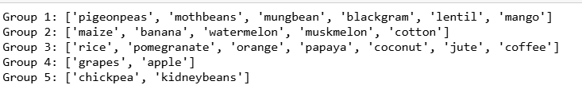
Summary with Feature Ranges-
Group 1: Includes legumes and a fruit crop (mango) that prefer warm climates, moderate to high humidity, and moderate nutrient requirements. Ranges for features: N (40-80 kg/ha), P (20-40 kg/ha), K (20-40 kg/ha), temperature (20-35°C), humidity (50-80%), pH (6.0-7.5), rainfall (500-1000 mm).
Group 2: Contains crops that thrive in warm to hot climates, with high nutrient requirements, especially potassium. Ranges for features: N (80-120 kg/ha), P (40-80 kg/ha), K (60-120 kg/ha), temperature (25-35°C), humidity (50-80%), pH (5.5-7.5), rainfall (800-1500 mm).

Slide 26
Group 3: Features crops that need high humidity and rainfall, suitable for warm to hot climates. Ranges for features: N (60-100 kg/ha), P (30-50 kg/ha), K (60-100 kg/ha), temperature (20-30°C), humidity (70-90%), pH (5.5-6.5), rainfall (1200-2000 mm).
Group 4: Contains fruit crops that prefer cooler climates and well-drained soils with moderate nutrient needs. Ranges for features: N (40-60 kg/ha), P (30-50 kg/ha), K (80-120 kg/ha), temperature (15-25°C), humidity (50-70%), pH (6.0-7.0), rainfall (500-800 mm). - Group 5: Includes legumes that can fix nitrogen, preferring moderate climates and having moderate nutrient and water requirements. Ranges for features: N (20-40 kg/ha), P (20-40 kg/ha), K (20-40 kg/ha), temperature (20-30°C), humidity (40-60%), pH (6.0-7.5), rainfall (400-700 mm).

Slide 27
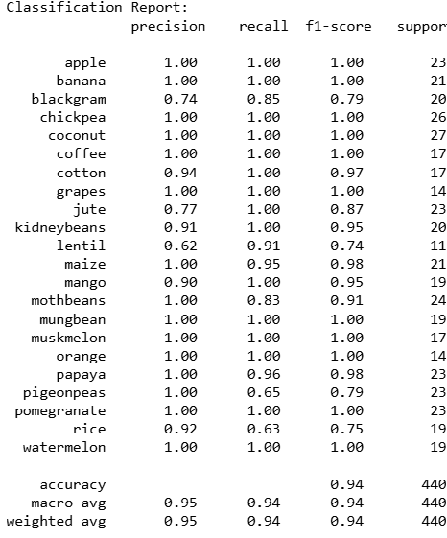
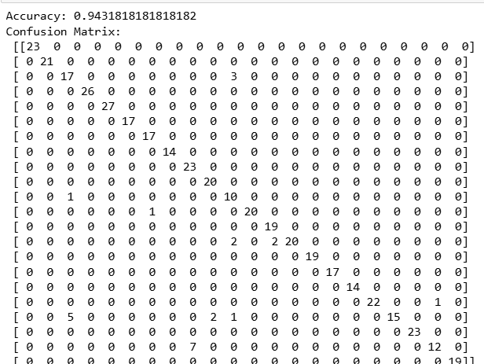
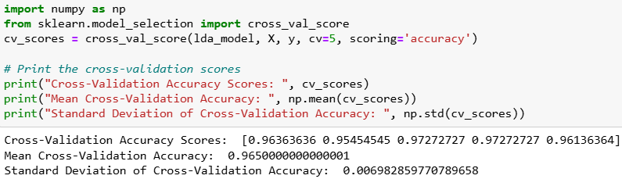
LINEAR DISCRIMINANT ANALYSIS
For LDA we got an accuracy of 94% with cv accuracy as 96%.

Slide 28
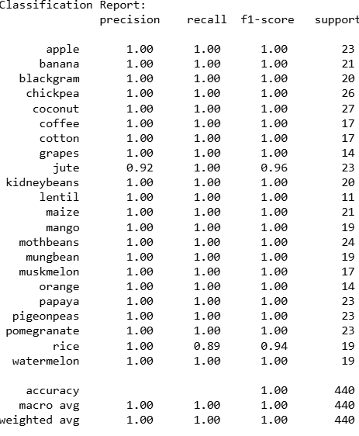
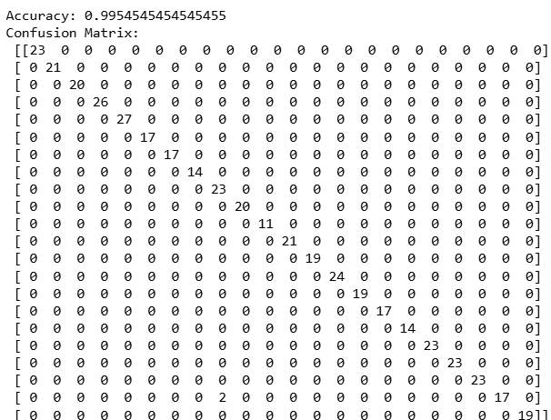
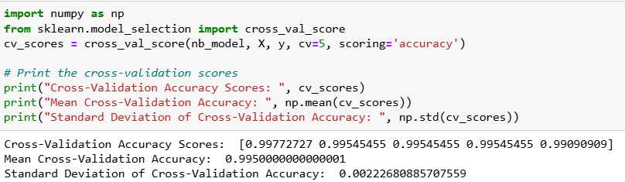
GAUSSIAN NAIVE BAYES MODEL
For gaussian model we got an accuracy of 99% and CV accuracy as 99%.

Slide 29
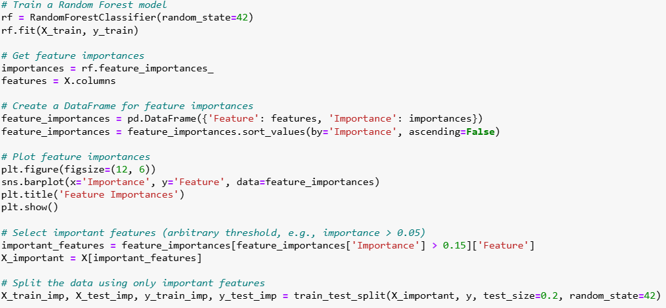
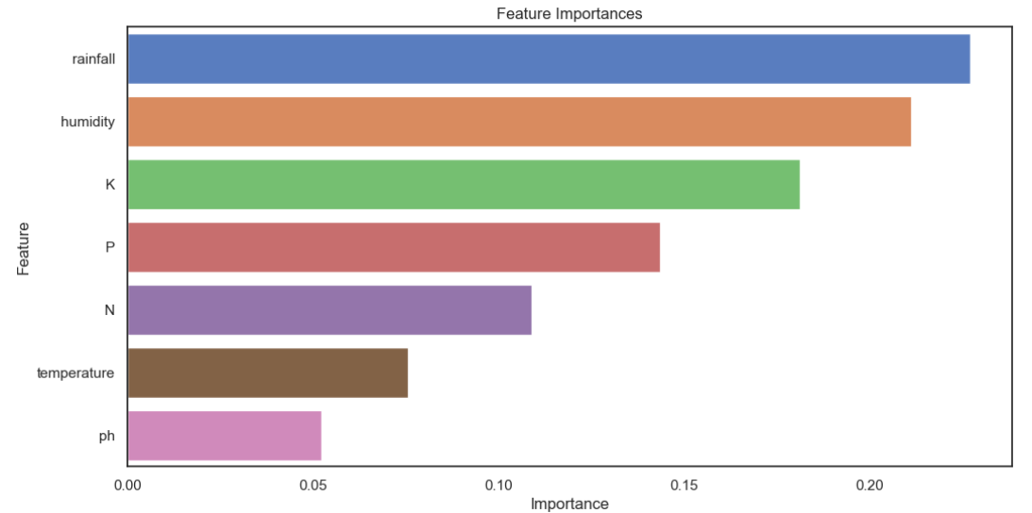
FEATURE IMPORTANCE

Slide 30
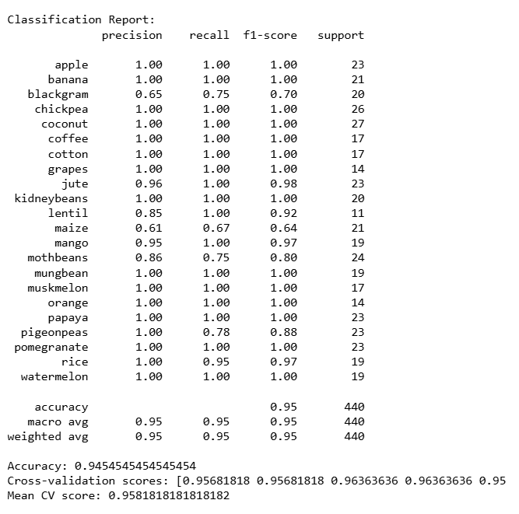
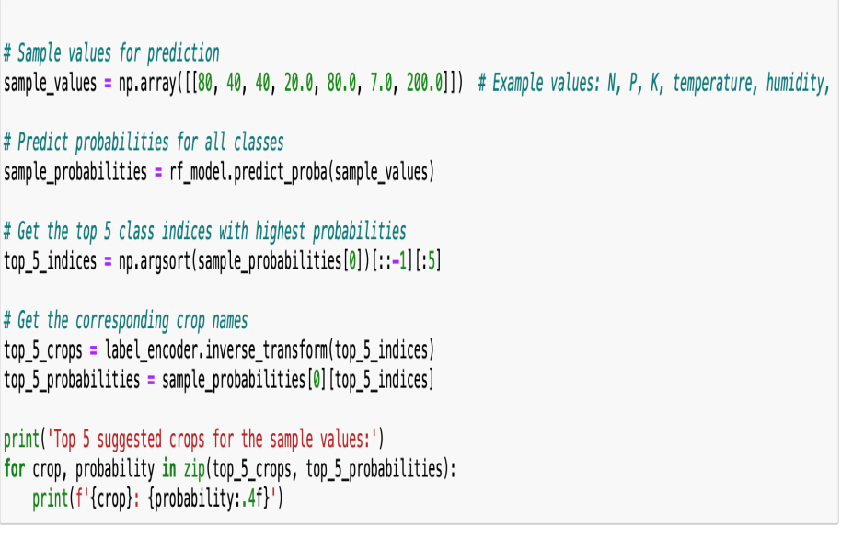
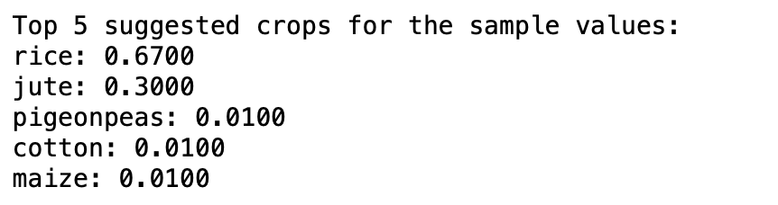
For feature importance we found the top 3 factors as humidity, temperature and K value. We got an accuracy of 95%.

Slide 31
Algorithm for front end
Given the diversity of crops and varying environmental conditions (nutrients, climate factors), Random Forest's ability to handle non-linearity, feature importance, and complex interactions makes it a strong candidate for this task. It can provide reliable predictions for recommending the best crop based on the given conditions, which is crucial for practical agricultural decision-making.
Comparison with Other Models
Linear Models: Might miss non-linear relationships and interactions.
K-Nearest Neighbors (KNN): Can be less effective with high-dimensional data and does not provide feature importance.
Support Vector Machines (SVM): Can handle non-linearity but may require more parameter tuning and does not naturally provide feature importance.
Neural Networks: Powerful but require more data and computational resources, and are harder to interpret.

Slide 32
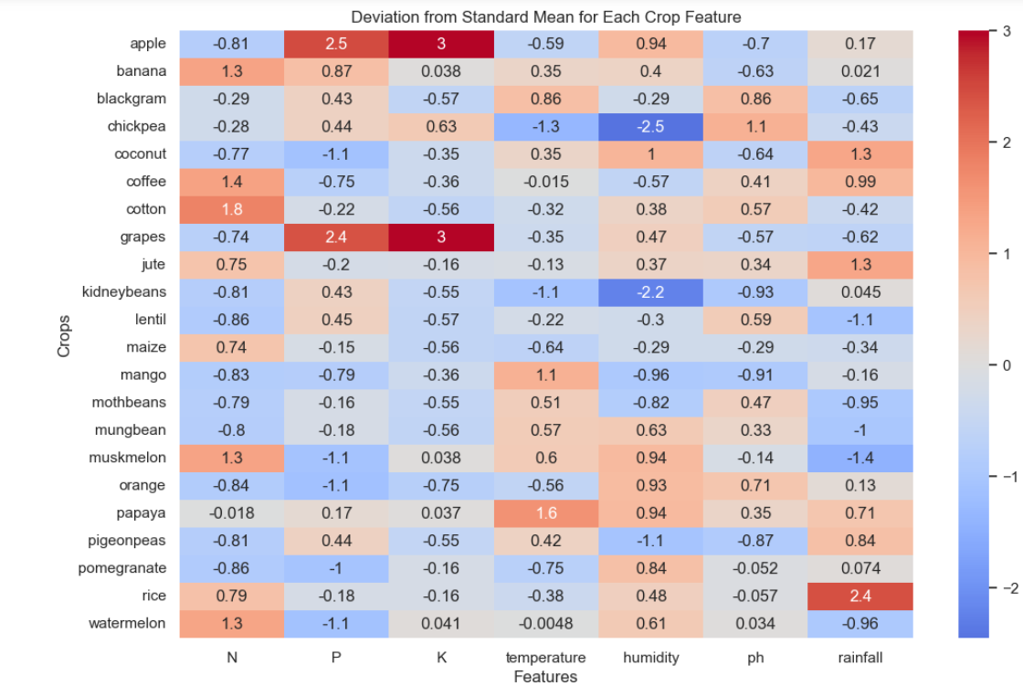
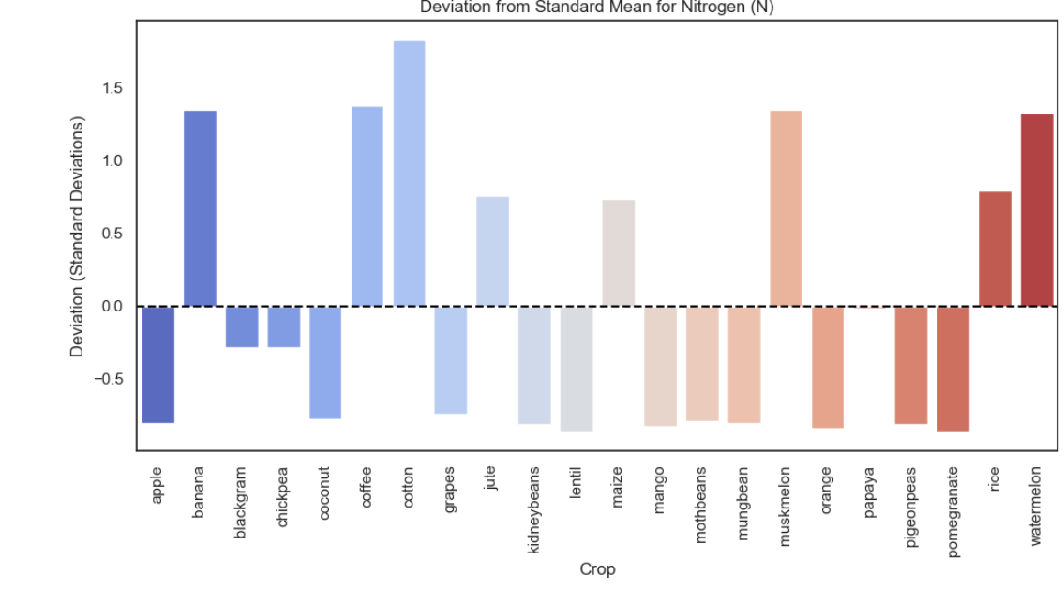
Standard Deviation and standard mean for each crop feature.
Deviation from Standard mean for Nitrogen(N).

Slide 33


Deviation from Standard Mean for Phosphorus
Standard deviation from standard mean for Potassium

Slide 34


Standard Deviation from Standard mean for Temperature.
Standard Deviation from standard mean for Humidity

Slide 35


Standard Deviation from Standard mean for PH
Standard Deviation and Standard mean for Rainfall

Slide 36



Standard Deviation from Standard mean for Group1
Standard Deviation from Standard mean for group2

Slide 37



Slide 38
Front end implementation
Webpage built with Streamlit for an interactive user experience.
User Inputs: Accepts nitrogen, phosphorus, potassium, temperature, humidity, pH, and rainfall.
Prediction Button: Users click "Predict" to get crop recommendations
.Top 5 Crops: Displays top 5 recommended crops with probabilities.
User-Friendly Design: Clean interface for easy navigation and interaction.

Slide 39



Slide 40
References
https://www.sciencedirect.com/science/article/pii/S0168169920302301#b0225
https://www.sciencedirect.com/science/article/abs/pii/S0168192308003043
https://ieeexplore.ieee.org/document/10205756
https://ieeexplore.ieee.org/document/9418351
https://ieeexplore.ieee.org/document/9788221
https://ieeexplore.ieee.org/document/9418375

