Slide 1

DATA 515 A
Software Engineering for Data Scientists Data Essentials
David Beck^{1,2}, Joseph Hellerstein^{1,3},
Dimitrios Gklezakos³
eScience Institute
²Chemical Engineering
³Computer Science Engineering
University of Washington
March 27, 2018

Slide 2
Notes
Sources of data – start with Kaggle
Identify two related tables
Tables & SW Eng basics
Elements of a table -> structure and relationships
Keys, foreign keys
Transformations of tables -> operations
Select, join, merge
Recursive operations – operations create tables and can operate on tables
Transforming tables with SQL
Key engineering issues
Correctness
Performance
Homework

Slide 3
Data Essentials
Data sources
Tables and some software engineering basics
Transforming tables using SQL
Homework 1

Slide 4
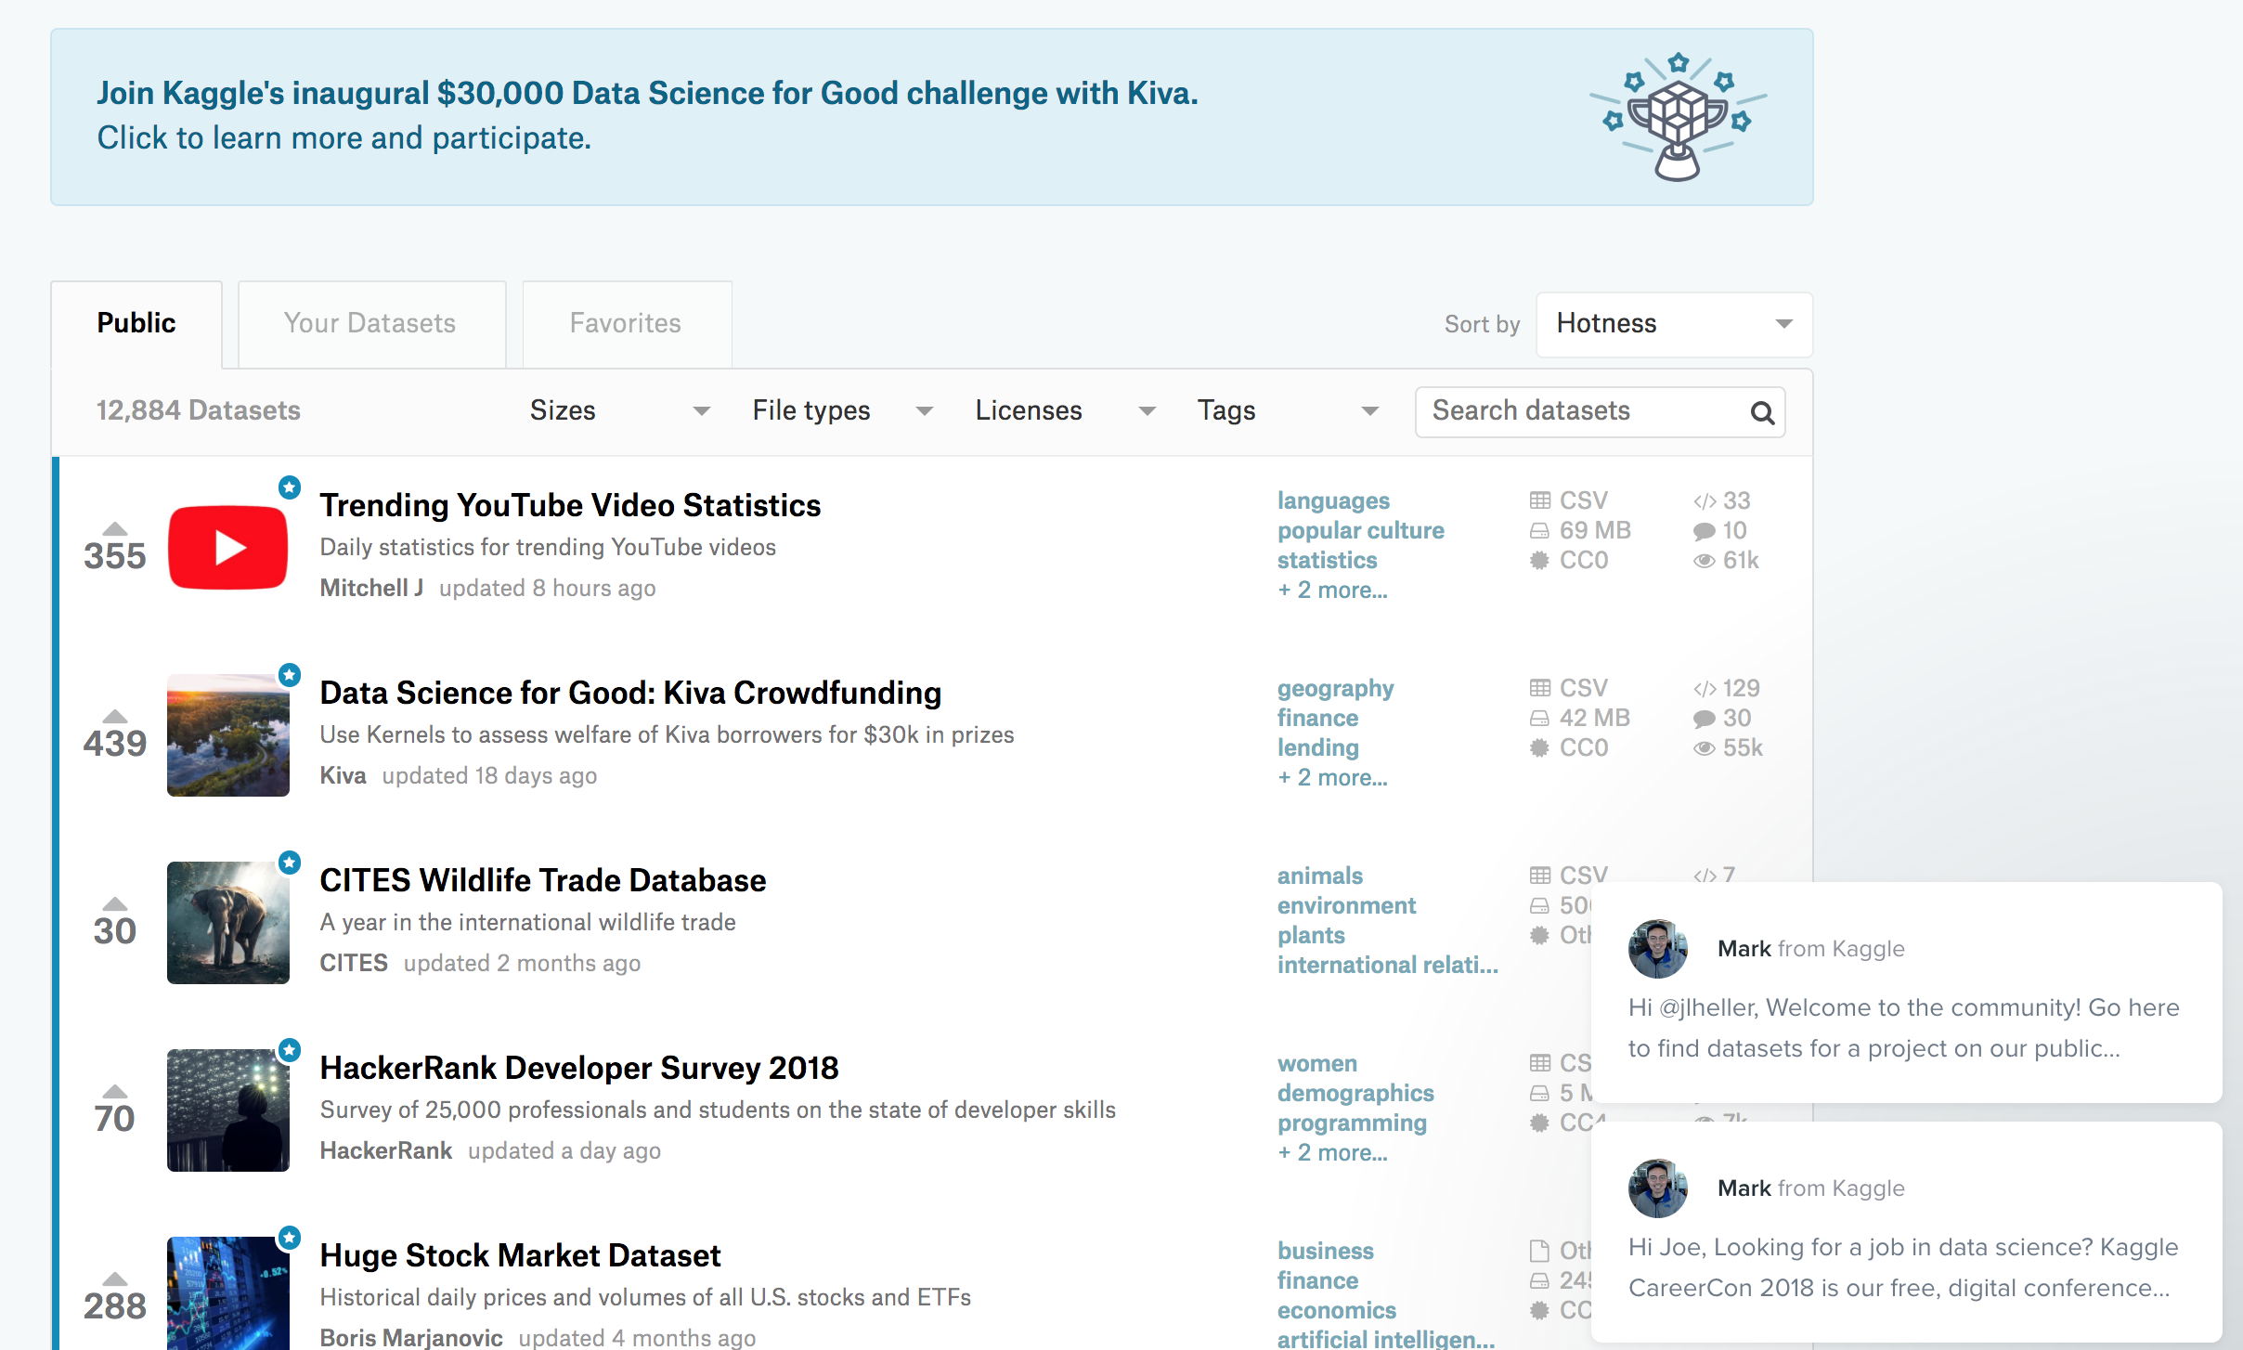
http://www.kaggle.com/datasets

Slide 5
Thinking Like a Software Engineer
Components
Pieces that are assembled to make a whole
An assembly of components becomes another component
Operations
What a component can do

Slide 6
What are the components of a table?
video_id | category_id | trending_date
a5$xcyda | 33 | 02/01/2015
xB#2gy8t | 12 | 03/30/2014
yQ??2gy8t | 44 | 10/14/2014
A Column has a name and a list of data that are all of the same type.
A Row has an index and a list of data with types corresponding to those of each column.
A Cell has a column name and row index and a single data value.
A Table is a collection of columns with the same length with one row for each index of the list for the Columns.

Slide 7
Operations On Tables: Select Columns
video_id | category_id | trending_date
a5$xcyda | 33 | 02/01/2015
xB#2gy8t | 12 | 03/30/2014
yQ??2gy8t | 44 | 10/14/2014
video_id | category_id
a5$xcyda | 33
xB#2gy8t | 12
yQ??2gy8t | 44

Slide 8
Operations On Tables
video_id | category_id | trending_date
a5$xcyda | 33 | 02/01/2015
xB#2gy8t | 12 | 03/30/2014
yQ??2gy8t | 44 | 10/14/2014
Select N columns of a Table
Produces a new table with N columns
Select M rows of a Table
Produces a new table with M rows
Concatenate Tables vertically (add rows)
Concatenate Tables horizontally (add columns)
Join Tables on a common column
Operations on Tables produce Tables.

Slide 9
Construct This Table From Operations
video_id | category_id | trending_date
a5$xcyda | 33 | 02/01/2015
xB#2gy8t | 12 | 03/30/2014
yQ??2gy8t | 44 | 10/14/2014
video_id | category_id | trending_date
a5$xcyda | 33 | 02/01/2015
xB#2gy8t | 12 | 03/30/2014
yQ??2gy8t | 44 | 10/14/2014

Slide 10
SQL Provides Table Operations
column1 | column2 | … | columnN
SELECT column1, column2....columnN
FROM table_name
WHERE CONDITION
ORDER BY column_name {ASC|DESC};
SELECT SUM(column_name)
FROM table_name
WHERE CONDITION
GROUP BY column_name;

Slide 11
Operations On Tables
video_id | category_id | trending_date
a5$xcyda | 33 | 02/01/2015
xB#2gy8t | 12 | 03/30/2014
yQ??2gy8t | 44 | 10/14/2014
SQL for a Table with video_id, category_id
SELECT video_id, category_id from table

Slide 12
sqlite3 Demo
Interacting with sqlite3
Batch command to interact with sqlite3

Slide 13
Table Keys
youtube data has the tables
CAvideos, USvideos, GBvideos, FRvideos, DEvideos
Full set of columns (class.db has a subset.)
video_id, trending_date, title, channel_title, category_id, publish_time, tags, views, likes,dislikes, comment_count, thumbnail_link, comments_disabled, ratings_disabled, video_error_or_removed, description
A key is a collection of columns that uniquely identify a row
Why is this important?
What’s a key for the youtube data?
What’s a likely key for the youtube data?

Slide 14
Joining Tables
video_id | category_id | trending_date
a5$xcyda | 33 | 02/01/2015
xB#2gy8t | 12 | 03/30/2014
yQ??2gy8t | 44 | 10/14/2014
video_id | tags
a5$xcyda | interesting
xB#2gy8t | adult
yQ??2gy8t | interesting
a5$xcyda | adult
Ax$$%34 | interesting
video_id | category_id | trending_date | tags
a5$xcyda | 33 | 02/01/2015 | Interesting
a5$xcyda | 33 | 02/01/2015 | adult
xB#2gy8t | 12 | 03/30/2014 | adult
yQ??2gy8t | 44 | 10/14/2014 | interesting

Slide 15
Checking Table Construction
How do I know that I’ve created the table that I intended to?
Check the following
Number and names of columns
Data type of columns
Number of rows
Key(s)
How verify that a collection of columns is a key?

Slide 16
Foreign Keys
A foreign key is a column in one table that is a key for another table.
video_id | category_id | trending_date
a5$xcyda | 33 | 02/01/2015
xB#2gy8t | 12 | 03/30/2014
yQ??2gy8t | 44 | 10/14/2014
CAvideos
video_id | category_id | trending_date
a5$xcyda | 33 | 02/12/2015
xRZ2gy8t | 8 | 03/30/2014
yQ??2gy8t | 44 | 10/14/2014
USvideos

Slide 17
Homework #1
(3 points) Write SQL that operates on the class.db database in the Lectures repository. Your code should be in a text file that is executed by executeSQL.sh. The SQL should create a table with the following columns:
video_id: TEXT
category_id: INTEGER
language: TEXT (one of ‘us’, ‘gb’, ‘fr’, ‘de’, ‘ca’)
(2 points) What column or columns in #1 are a minimal key? (By minimal is meant that no column can be removed and the result will still be a key.)
(2 points) What test can you perform to see if columns in #2 are a key? Are a minimal key?

