Slide 1
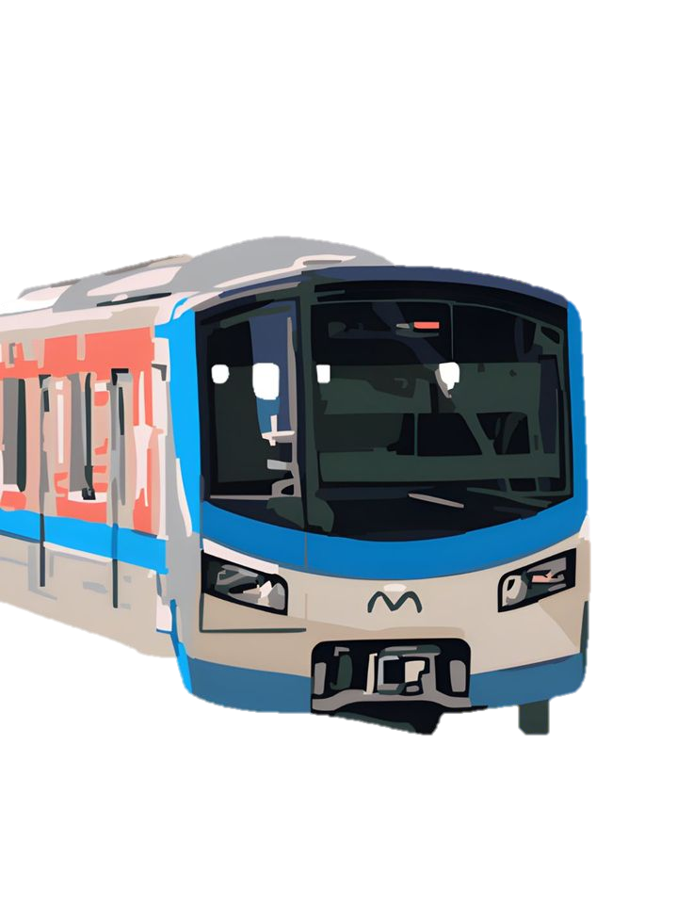

SOFTWARE
ENGINEERING
THEORY CLASS – TICKET VENDOR MACHINE
PROJECT BY: DANG DOAN MINH TAN – 523V0017
MOUNTHADY SOUK AKHOM – 523K0076

Slide 2
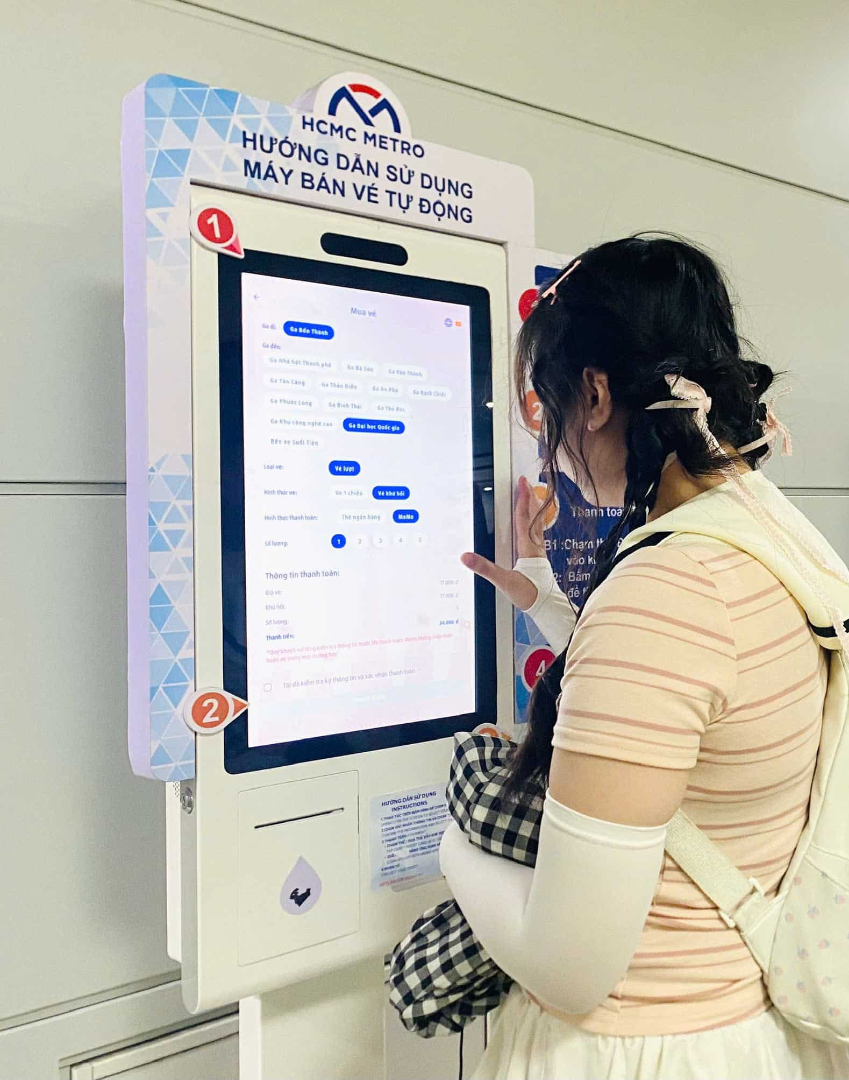
ABOUT THE PROJECT
We create a hypothetical Ticket Vendor Machine for the Ho Chi Minh City Metro system as it is always under going maintenance.
The ticket vendor machine offers users to put in the station the user is at and then the station the user wants to arrive. After that, it’ll calculate the time to go in between stations and the total fare, in which the user can use one in four ways to pay for the fare: Visa card, actual cash, VN Pay and Zalo Pay
Mission and Goal: To build a ticket vending machine using 3-Tier Architecture, C#, .NET, and MSSQL.

Slide 3
FUNCTIONAL REQUIREMENTS
ID | Requirement Statement
FR1 | The system shall display a list of available destinations and corresponding fares.
FR2 | The system shall allow the user to select a single destination.
FR3 | The system shall accept payment via Credit Card.
FR4 | The system shall accept payment via digital wallet QR Code (e.g., Momo, VNPay, ZaloPay).
FR5 | The system shall communicate with the banking system to validate and process credit card transactions.
FR6 | The system shall communicate with digital payment service providers to process QR code transactions.
FR7 | The system shall issue a paper ticket with a bar code upon successful payment.
FR8 | The system shall display a transaction error message if payment fails.
FR9 | The system shall allow the user to cancel the transaction at any time before payment is completed.
FR10 | The system shall display instructions and prompts to guide the user through the ticket purchasing process.

Slide 4
NON-FUNCTIONAL REQUIREMENTS
ID | Requirement Statement | Type | Metric
NFR1 | Response Time: The system shall display the destination menu within 2 seconds after the "Start" button is pressed. | Performance | Response Time
NFR2 | Response Time: The system shall complete the payment validation (Credit Card or QR Code) and issue the ticket within a maximum of 10 seconds from the moment the payment is confirmed. | Performance | Response Time
NFR3 | Reliability: The system shall be operational and available for use 99.5% of the time during public transport operating hours (e.g., 05:00 to 23:00). | Reliability/Availability | MTBF/Availability (%)
NFR4 | Reliability: The system shall successfully process 99.9% of all completed payment transactions without error. | Reliability/Accuracy | Success Rate (%)
NFR5 | Security: The system shall use industry-standard encryption (e.g., SSL/TLS) for all communication with external banking and digital wallet systems. | Security | Encryption Standard
NFR6 | Usability: The touch screen interface shall be readable and usable in direct sunlight and in low-light conditions. | Usability | Accessibility/Visibility
NFR7 | Maintainability: The system shall provide remote diagnostic capabilities for monitoring ticket stock, paper levels, and hardware status. | Maintainability | Remote Monitoring

Slide 5
DOMAIN REQUIREMENTS
DR1 | The system shall comply with the fare structure and zoning regulations defined by the Ben Thanh Metro Authority.
DR2 | The system shall be integrated with the Smart Ticketing System database to ensure up-to-date route and fare information.
DR3 | The system shall track and report the sale of tickets by route for daily and monthly auditing purposes.
DR4 | The system shall print tickets that conform to the physical dimensions and bar code format specified by the public transport access gates.

Slide 6
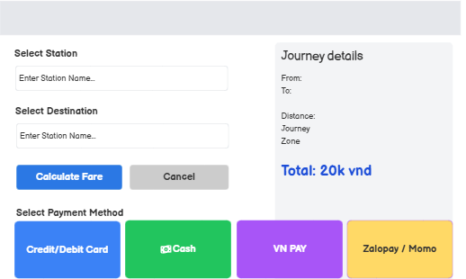
LOW FIDELITY WIREFRAMES
We use Balsamiq to show the basic layout of how the UX/UI will look like

Slide 7
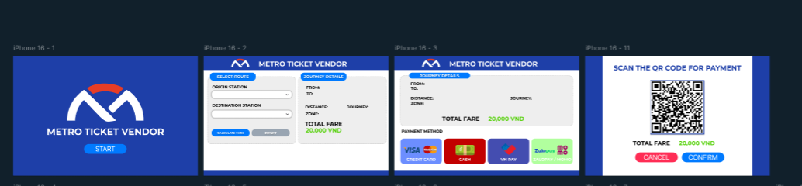
HIGH FIDELITY WIREFRAMES
We use Figma to show the desired and propose UX/UI will look like

