Slide 1
OOP Quiz

Slide 2
Requirements
Building a C# based GUI application
Including the creation of a task sheet on OOP

Slide 3
The team
Name | Position
Ákos ”Áki” Koncz | Project Manager
Viktor Ákos Ónodi-Kiss | Coding
Bendegúz Városi | Presentation
Károly Ádám Hézső | Pictures

Slide 4
The team: Tasks
Ákos Koncz
Viktor Ákos Ónodi-Kiss
Leading the project
Task distribution
GitHub
Making an application
Create a graphical application (GUI)

Slide 5
The team: Tasks
Bendegúz Városi
Károly Ádám Hézső
Making the presentation
Collecting the quiz questions
Picture collection
Editing
Compilation

Slide 6
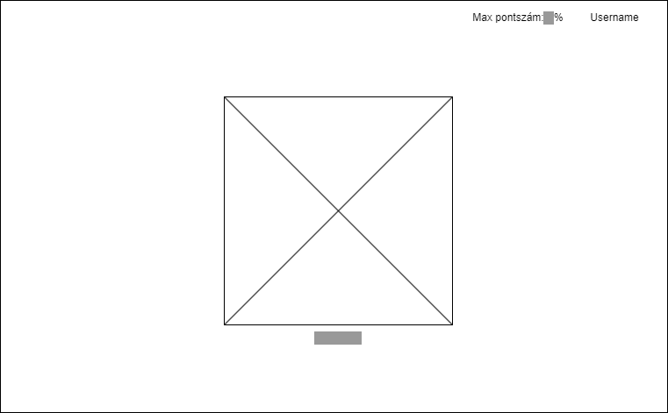
Design: wireframe
The wireframe shows the structure of the website.
The wireframe is used to build the structure of the website, at this point we have already taken into account the possibilities offered by Bootstrap.
The wireframe was accepted by the customer.

Slide 7
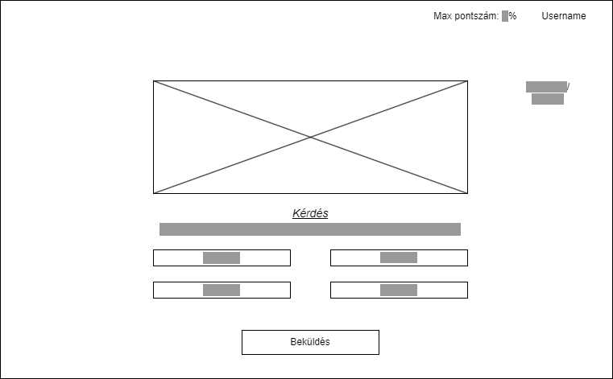
Design: wireframe
The wireframe shows the structure of the website.
The wireframe is used to build the structure of the website, at this point we have already taken into account the possibilities offered by Bootstrap.
The wireframe was accepted by the customer.

Slide 8
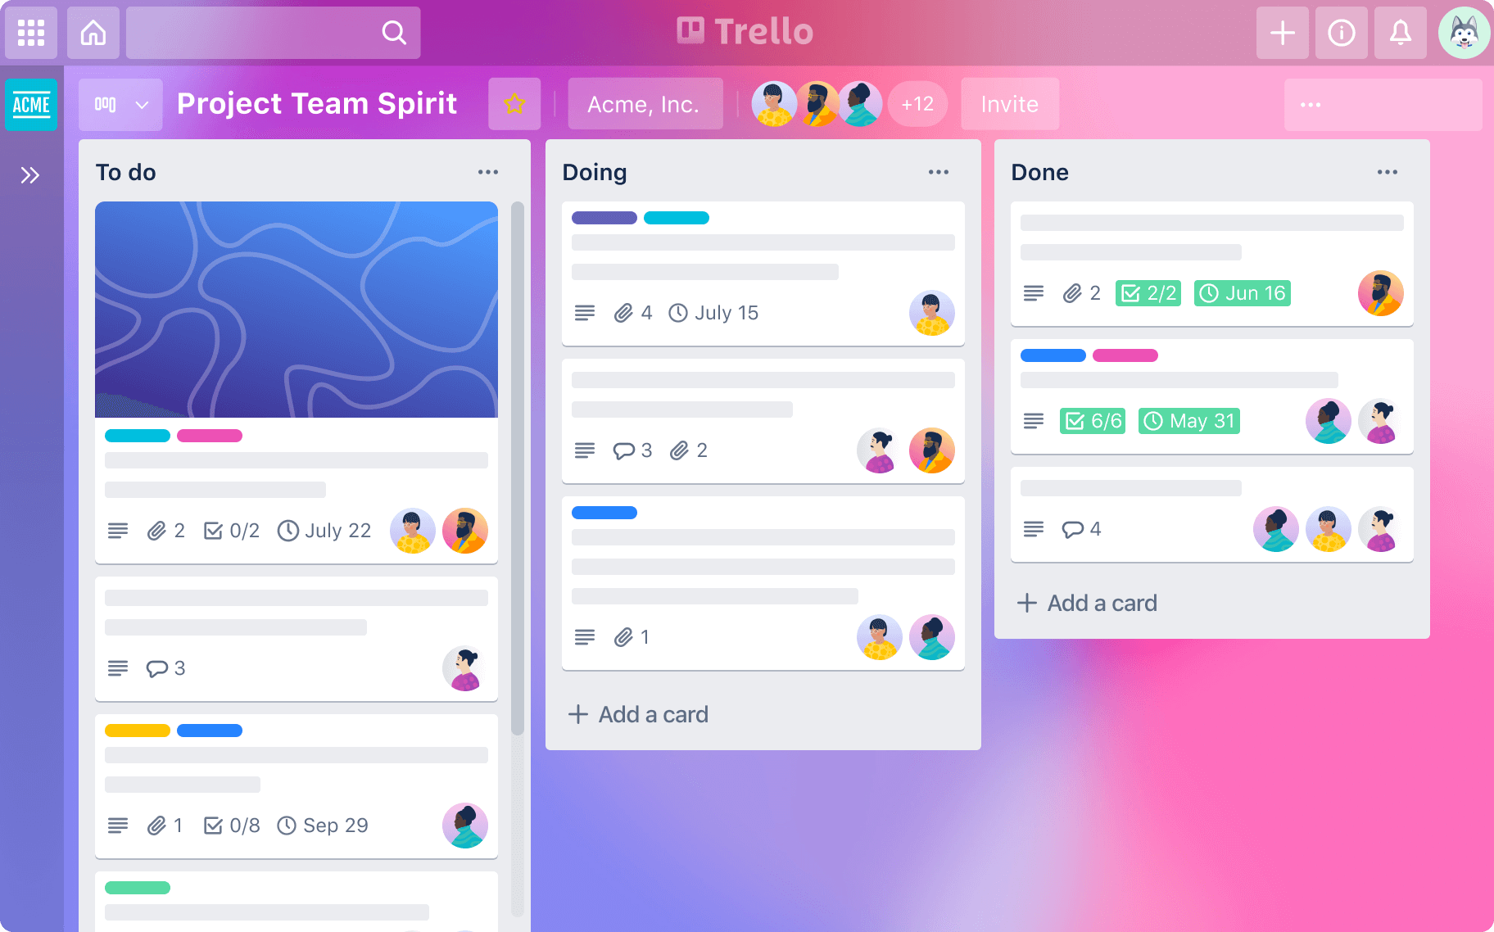
Trello
Using Trello we could follow the project development with cards and lists.

Slide 9
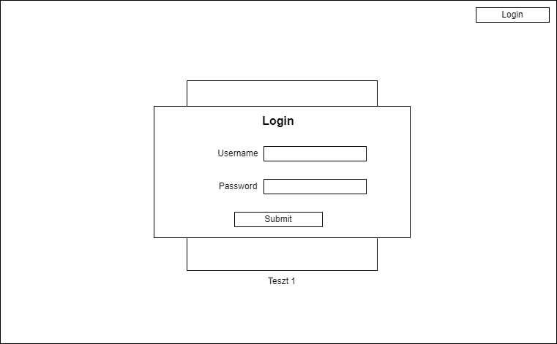
prototype

Slide 10
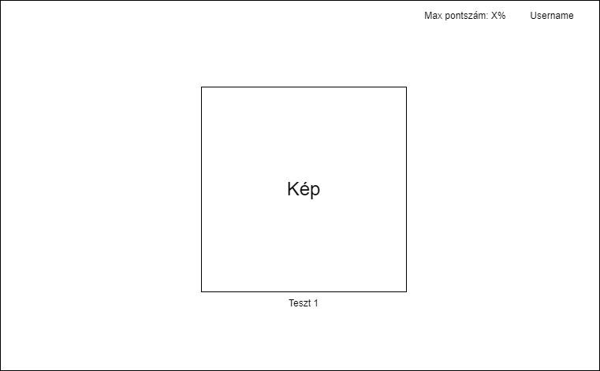
prototype

Slide 11
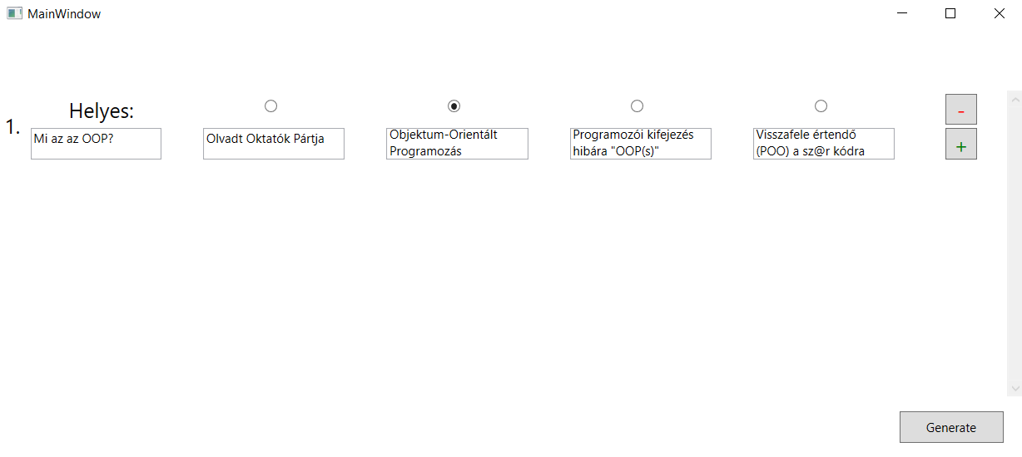
prototype

Slide 12
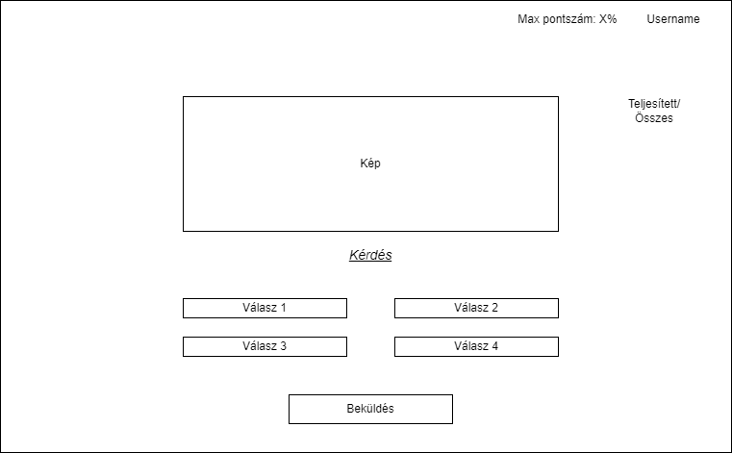
prototype

Slide 13
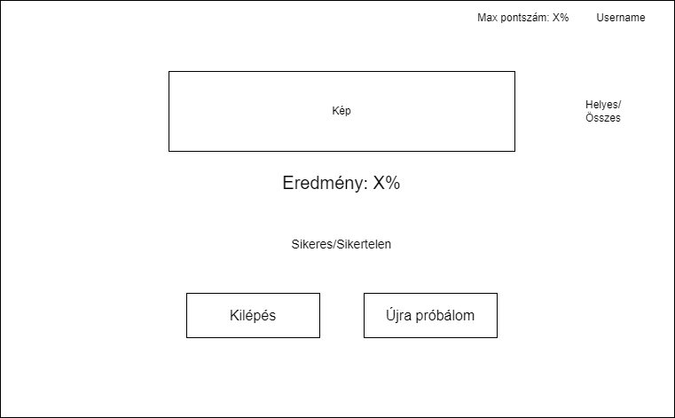
prototype

Slide 14

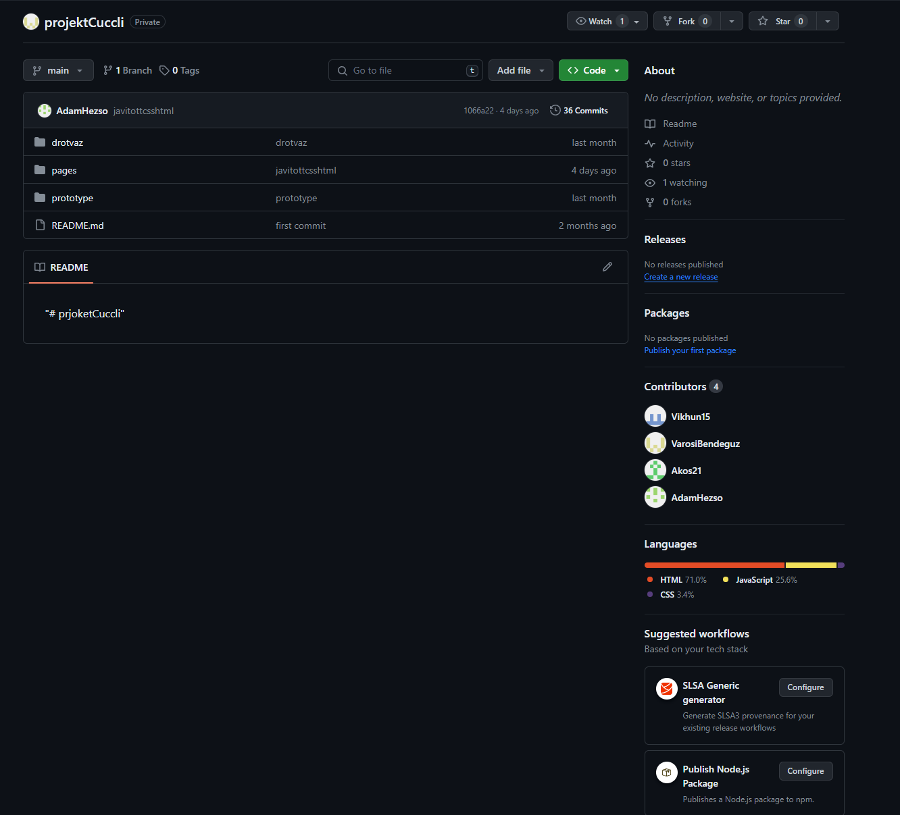
GitHub
GitHub is often used by programmers.
We used this version-management tool to coordinate out workloads and we also kept the entire project synced and stored there, in the cloud storage.

Slide 15

Visual studio 2022
Visual Studio is the best IDE to build rich, beautiful, cross platform applications for Windows, Mac, Linux, iOS, and Android. Build rich clients apps using a range of technologies such as; WinForms, WPF, WinUI, MAUI, or Xamarin
The technology we used was WPF

Slide 16
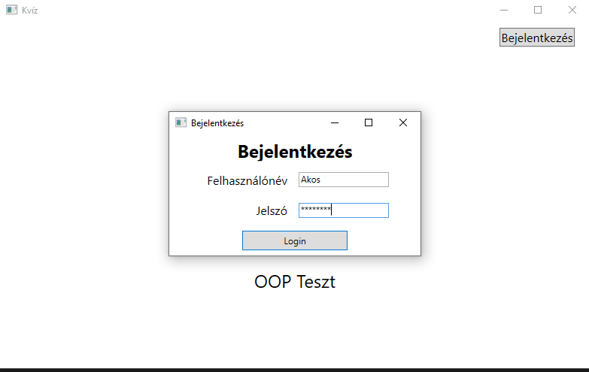

Slide 17
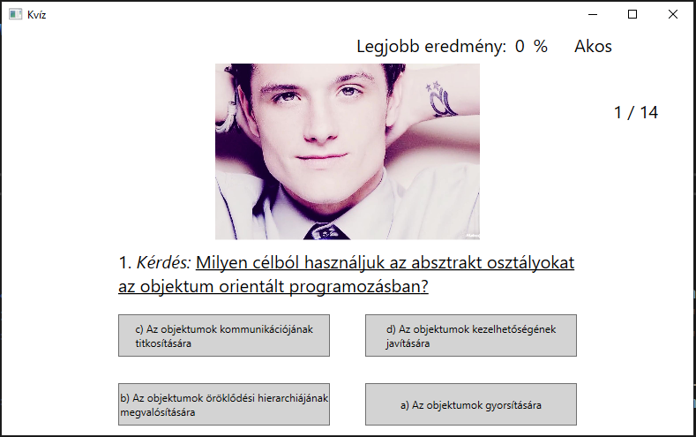

Slide 18
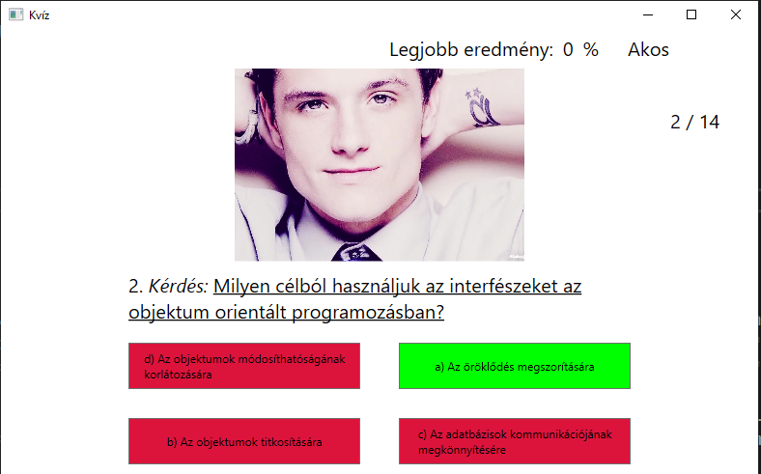

Slide 19

Thank you for your attention!

