Slide 1


Freely distributed Password Cracking tools
Ákos Lévárdy

Slide 2
Progress report 2 Contents:
Introduction - Virtual box – Kali Linux
Cracking password hashes with Hashcat
Cracking password hashes with John the Ripper
Comparison
Passwords strength
Password managers
Conclusion

Slide 3
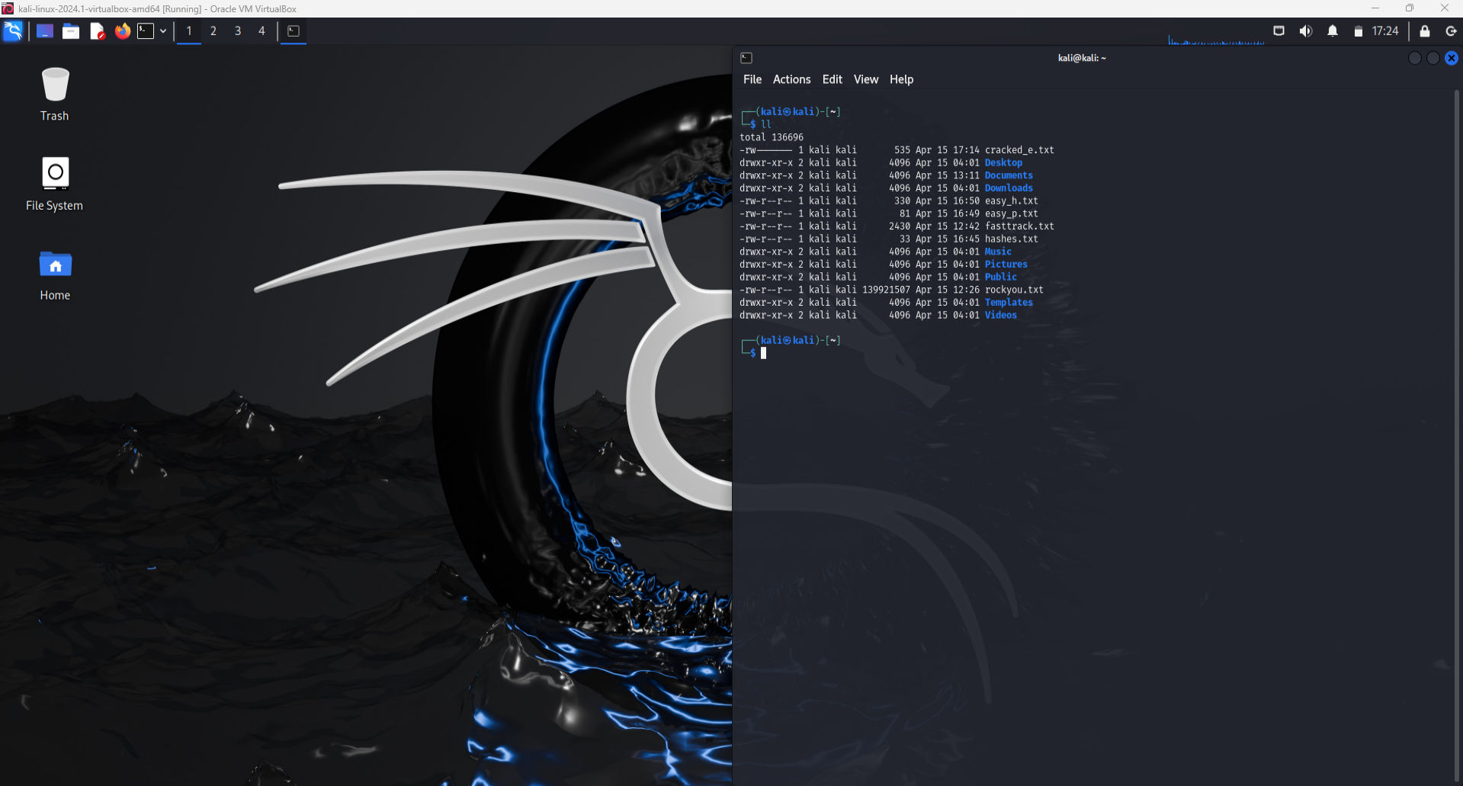
Virtual box – kali linux
Set up Kali Linux
Hashcat / JTR preinstalled
Notes:
I set up Virtual box with Kali linux OS
After the setup I found out Kali linux already has Hashcat and JTR preinstalled
So I could start testing them right away
Wordlist found in Kali Linux: /usr/share/wordlists/rockyou.txt.gz
- after unzipping this file we have a wordlist with over 14 million (14,344,392)
common passwords people use/used
- The ”rockyou.txt” wordlist is compiled from data breaches, primarily from
a significant breach of the social networking site RockYou in 2009. During
this breach, hackers gained access to RockYou’s user database, which contained
millions of usernames and passwords stored in plaintext. The breach exposed
the weak security practices of the time, as RockYou stored passwords without
proper encryption.

Slide 4
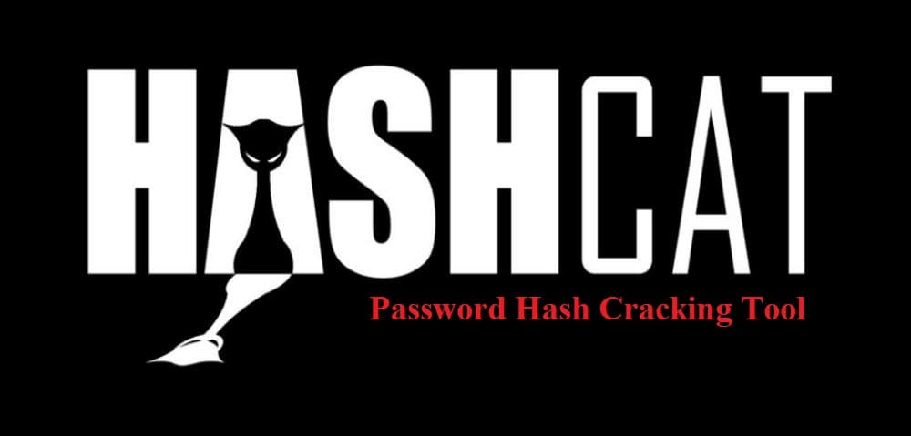
Hashcat
Tested Cracking passwords with:
Different hashing algorithms
Different lengths for passwords
Different attack modes

Slide 5
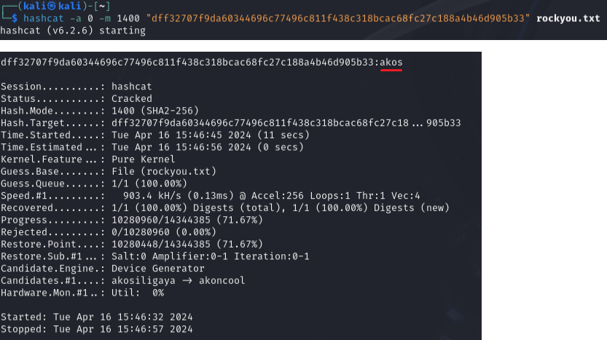
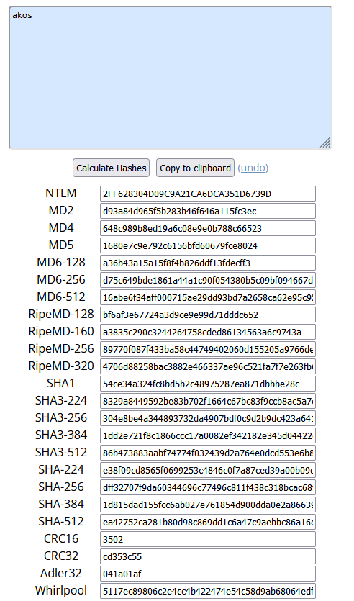
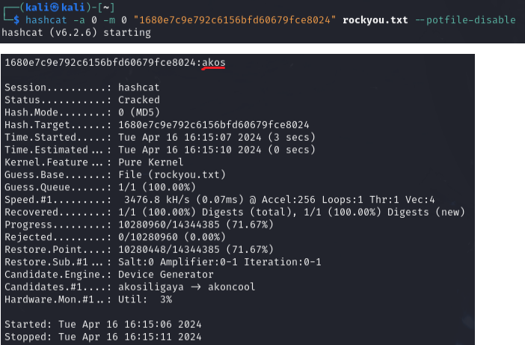
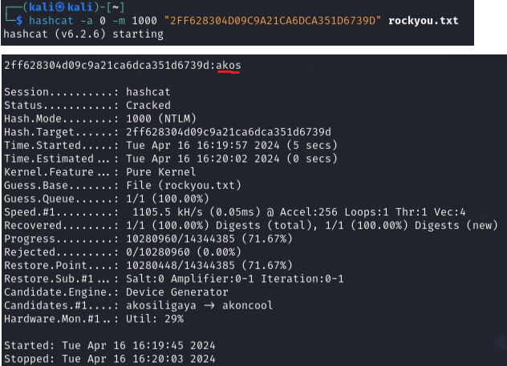
Different Hash types:
Password: akos
Hashes: MD5, NTLM, SHA-256
Attack mode: 0 – Straight
Hash directly provided
Notes:
Hash types: total 93
- for example: MD5, HMAC-MD5, SHA1, NTLM, SHA256, Plaintext ...

Slide 6
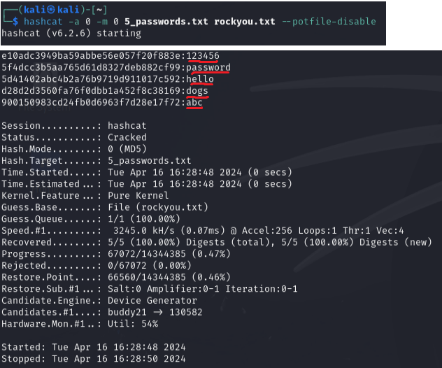
Different lengths for passwords:
Hash: MD5
Lengths: 3, 4, 5, 6, 7
Attack mode: 0 – straight(wordlist)
Cracking passwords hashes from .txt

Slide 7
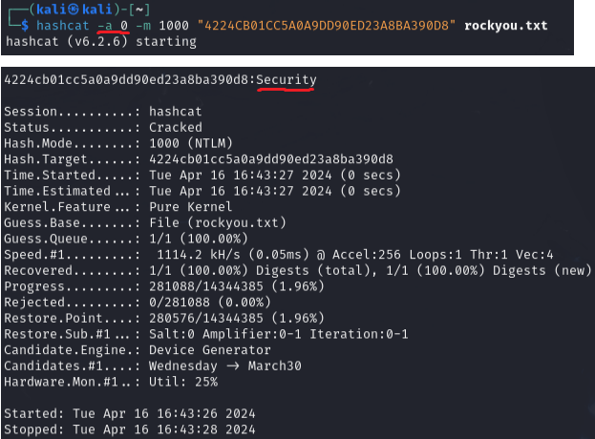
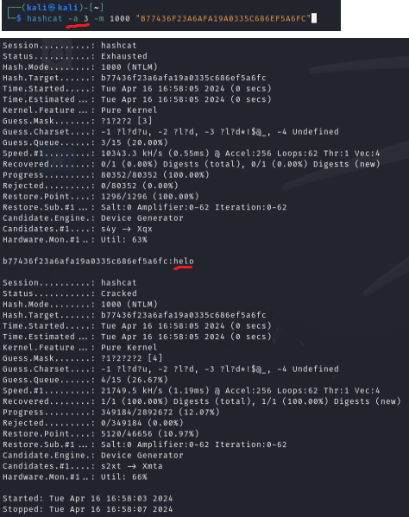
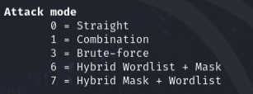
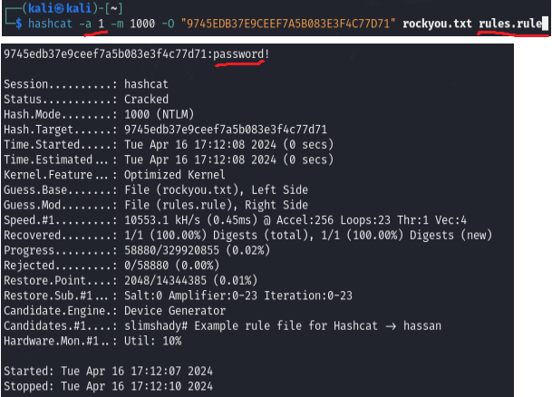
Different Attack modes:
Straight
Brute-force
Combination

Slide 8
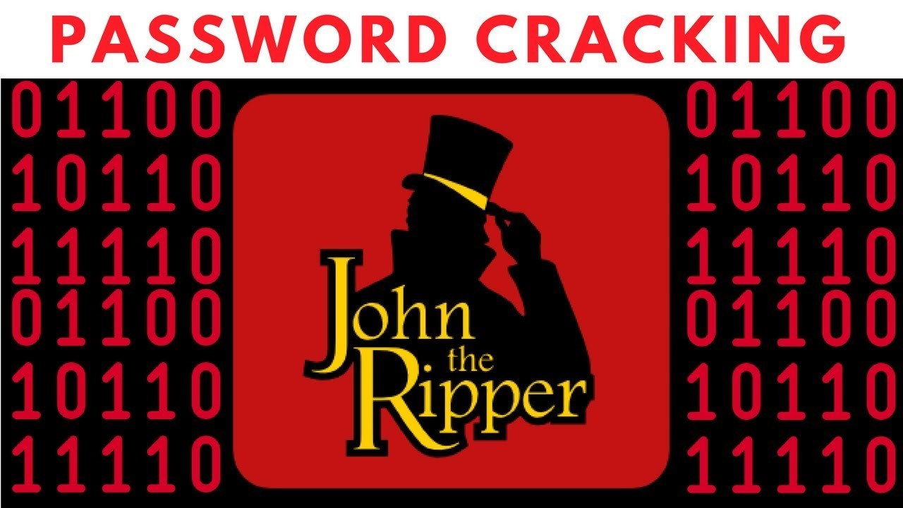
John the ripper
Tested Cracking passwords with:
Adding new user with password
Adding password to .zip file

Slide 9
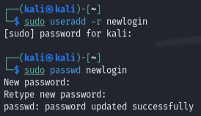
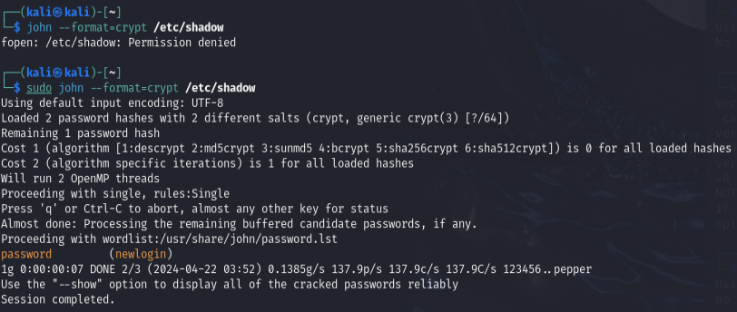
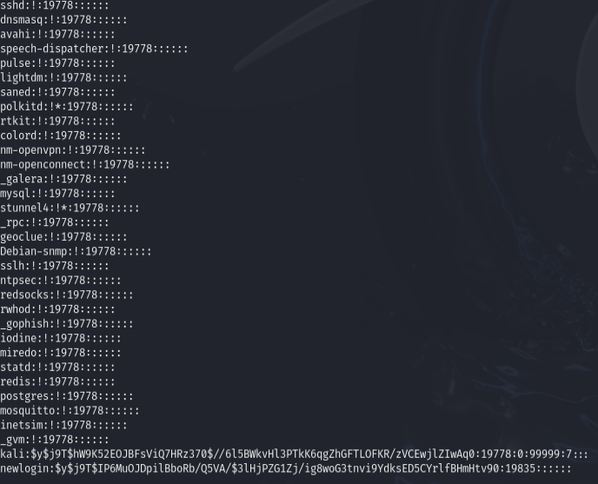
New user -> newlogin
Password found in -> sudo cat /etc/shadow
John format -> crypt (linux user passwords)

Slide 10
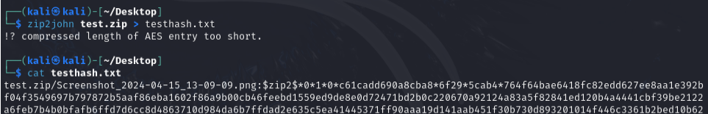
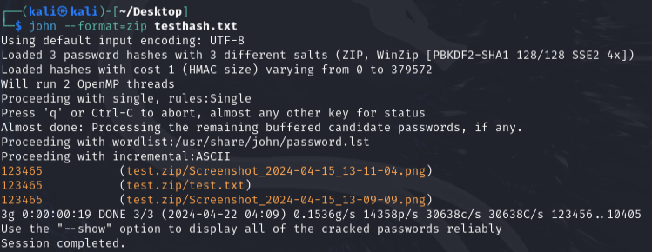
Adding password for .zip file
To extract -> needs password
Zip2john -> gets hash of password from zip file
John format -> zip (if cracking rar -> format=rar)

Slide 11
Comparing Hashcat vs John the ripper
Speed – Hashcat is faster uses – GPU and FPGA
Ease of Use – John the Ripper is easier for beginners
When to Use Which
Hashcat – access to powerful GPUs and need high-speed cracking
John the Ripper – handling different hash types with minimal configuration
Notes:
Speed
Hashcat is generally faster than John the Ripper because it is optimized for working with a wide range of hardware accelerators like GPUs (graphics processing unit) and FPGAs (Field programmable gate array). This allows Hashcat to perform high-speed brute-force attacks, combinatorial attacks, and more, using the massive parallel processing power of modern GPUs.
John the Ripper has a mode called Jumbo that supports GPU acceleration, but its primary strength lies in CPU-based attacks. John's performance can be very good on CPUs, but typically, Hashcat outperforms John when it comes to GPU acceleration.
Ease of Use
Hashcat has a steep learning curve due to its extensive range of options and configurations, which can be overwhelming for beginners. However, it has a consistent syntax and well-documented options, which, once mastered, can be highly effective and flexible.
John the Ripper is often considered easier for beginners, especially in its default mode. It automatically selects the best strategies and algorithms based on the hashes it detects, which simplifies the process for new users. However, making full use of its capabilities (especially in Jumbo mode) still requires learning a variety of options and configurations.
When to Use Which
Use Hashcat when:
You have access to powerful GPUs and need to perform high-speed, high-volume cracking.
You are dealing with a very large set of hashes or need to use advanced attack modes that leverage GPU power.
You need to crack hashes that are better supported by Hashcat's more modern algorithms and optimizations.
Use John the Ripper when:
You are working on a system with limited or no GPU resources.
You need a tool that's good at automatically handling different hash types with minimal configuration.
You are engaging in pentesting scenarios where you might benefit from the flexibility and scriptability of John the Ripper, especially with custom rules and modes designed to crack complex password patterns.

Slide 12
Password strength
Length - With simply lowercase letters, there are 268268 potential permutations for an 8-character password.
Character Set - Combine capital and lowercase letters, numerals, and special characters, a password like ”P@ssw0rd!” is more robust
Randomness - Passwords that are generated at random tend to be more secure than those that are based on popular terms or patterns.
Predictability Avoiding – staying away from patterns or sequences that are simple to figure out (like ”123456”)
Notes:
Length: Because they give hackers more room to search, longer passwords
are typically more secure than shorter ones. The number of combinations
that are feasible increases exponentially with each extra character.
– With simply lowercase letters, there are 268268 potential permuta-
tions for an 8-character password.
– There are 26122612 potential permutations for a 12-character pass-
word using the same character set, which is a far bigger number.
Character Set: Adding a range of characters to your password, such as
digits, special characters, lowercase and uppercase letters, and numbers,
makes it more difficult to crack and less vulnerable to brute-force attacks.
– Since ”password” is a single lowercase letter, it is a weak password.
– Because it combines capital and lowercase letters, numerals, and spe-
cial characters, a password like ”P@ssw0rd!” is more robust than
others.
Randomness: Passwords that are generated at random tend to be more
secure than those that are based on popular terms or patterns. Dictio-
nary or pattern-based attacks are less likely to guess or break random
passwords.
Predictability Avoiding: Keeping your password strong means staying
away from patterns or sequences that are simple to figure out (like ”123456”
or ”qwerty”). To further improve security, keep personal information like
names, birthdays, and frequent words to a minimum.

Slide 13
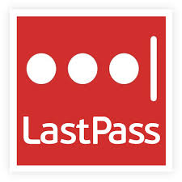
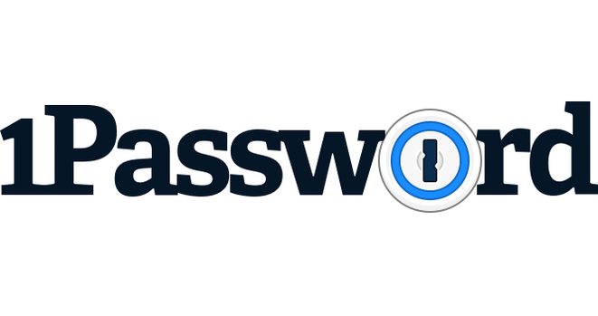

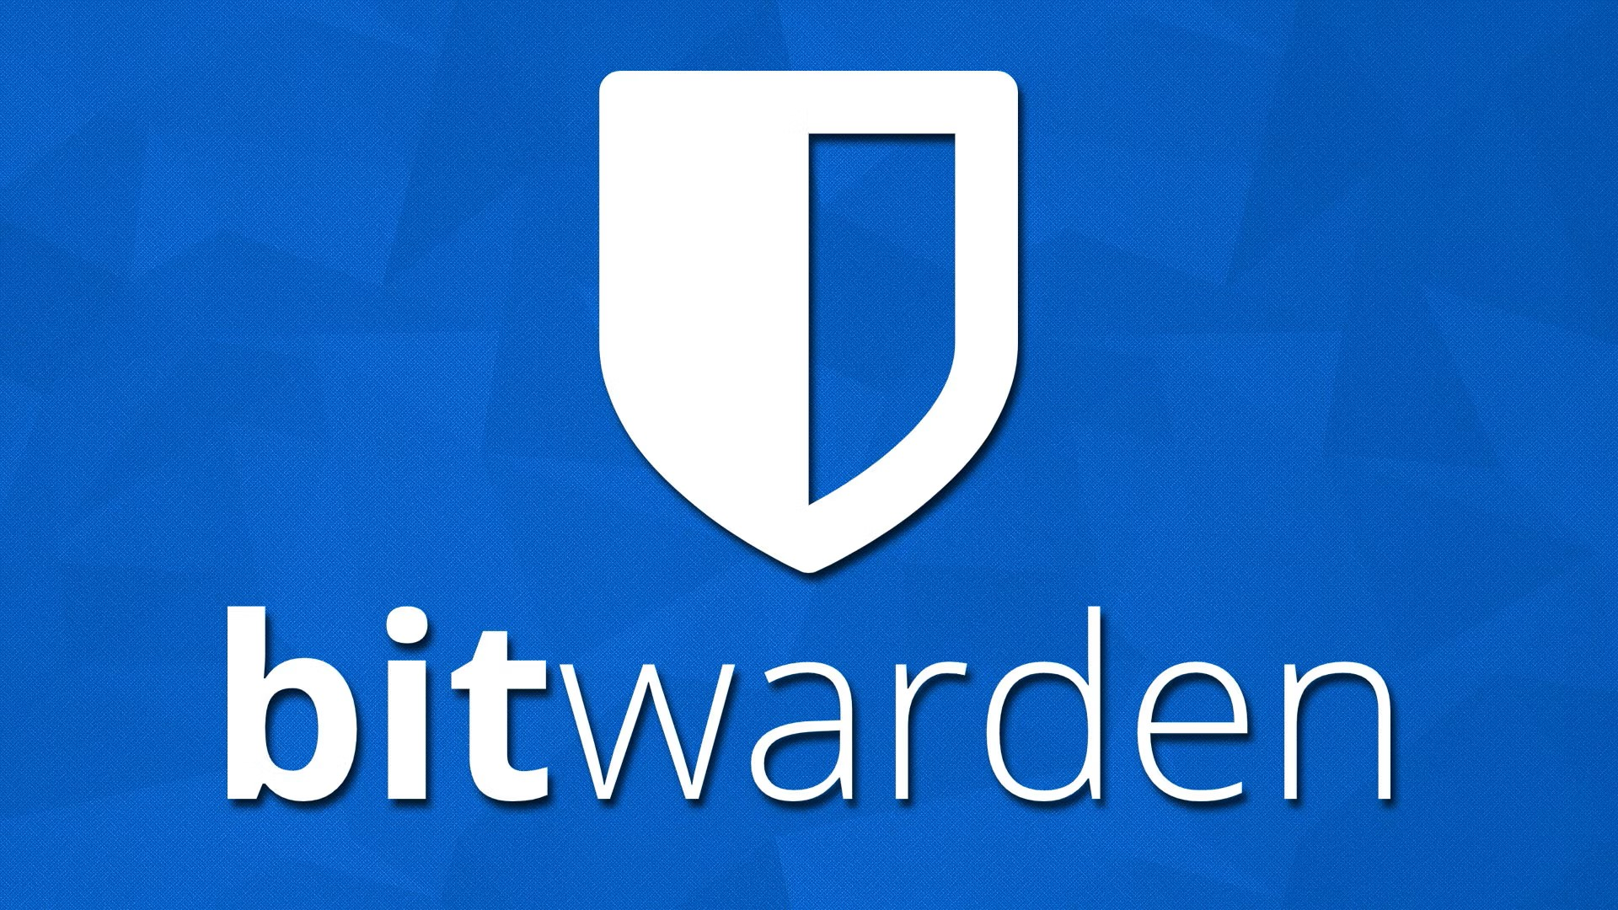
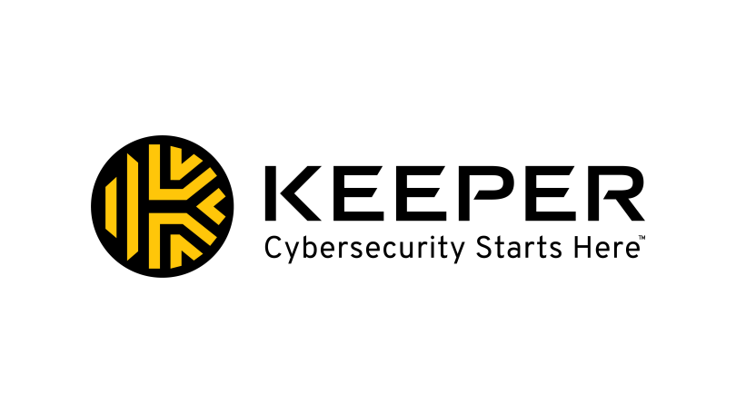
Password managers
Store all passwords – 1 Master Password unlocks all the others
Top 5 most used password managers:
LastPass
1Password
Dashlane
Bitwarden
Keeper
Notes:
Password managers are software tools designed to securely store and manage passwords for various online accounts and services. They work by encrypting and storing your passwords in a centralized vault, which is typically protected by a master password or passphrase. When you need to log in to a website or app, the password manager can automatically fill in the credentials for you, saving you the trouble of remembering or typing them manually.
LastPass:
Features: LastPass offers a user-friendly interface, secure password storage, and automatic form filling. It also provides two-factor authentication (2FA) and the ability to generate strong passwords.
Platforms: Available on Windows, macOS, Android, iOS, and Linux, with browser extensions for Chrome, Firefox, Safari, Internet Explorer, and Edge.
1Password:
Features: 1Password is known for its strong security focus, offering features like a built-in watchdog to watch for password breaches and secure document storage.
Platforms: It's available on Windows, macOS, iOS, Android, and Linux, with browser extensions that work across multiple browsers.
Dashlane:
Features: Dashlane provides an intuitive interface and robust security features, including dark web monitoring and a VPN for browsing securely and privately.
Platforms: Supports Windows, macOS, iOS, Android, with browser extensions for Chrome, Firefox, Edge, and Safari.
Bitwarden:
Features: Bitwarden is an open-source password manager which is highly praised for its transparency and security. It allows you to host your password server and offers both free and premium versions.
Platforms: Available on Windows, macOS, Android, iOS, and Linux, along with browser extensions for most major browsers.
Keeper:
Features: Keeper offers high-level security features, including encrypted messaging and secure file storage, making it more than just a password manager.
Platforms: Compatible with Windows, macOS, Linux, iOS, and Android, along with browser extensions for Chrome, Firefox, Safari, Internet Explorer, and Edge.

Slide 14

Progress report 2 summary
Set up – Virtualbox with Kali Linux
Test Hashcat – different modes
Test John the Ripper – different use cases
Compare – speed, ease of use, when to use
Password strength
Password managers

Slide 15

Thank you for your attention!

