Slide 1

STATISTICS CASE STUDY - SUBMISSION
Group Name:
Anand Rathi APFE1680514
Vishesh Arora APFE1680117
Michael Dsouza APFE1680516
Santhosh Francis APFE1680312

Slide 2
Abstract
A consumer finance company which is the largest online credit marketplace, facilitating personal loans, business loans, and financing for elective medical procedures. When the company receives a loan application, the company has to make a decision for loan approval based on the applicant’s profile.
To evaluate the Type I and Type II risk associated with the approval/rejection status of the loan.
Considering only consumers whose loan application is approved, our aim is to understand how consumer attributes and loan attributes influence the tendency to default.
The company wants to understand the driving factors behind loan default and utilize this knowledge for its portfolio and risk assessment. Specifically, the company wants to determine which driver variables are having the most influence on the tendency of loan default.

Slide 3
Problem solving methodology
Univariate Analysis
Start
Data
Understanding
Data
Cleaning
Exploratory Data
Analysis
Hypothesis test
Multivariate Analysis
Finalization of Results
End

Slide 4
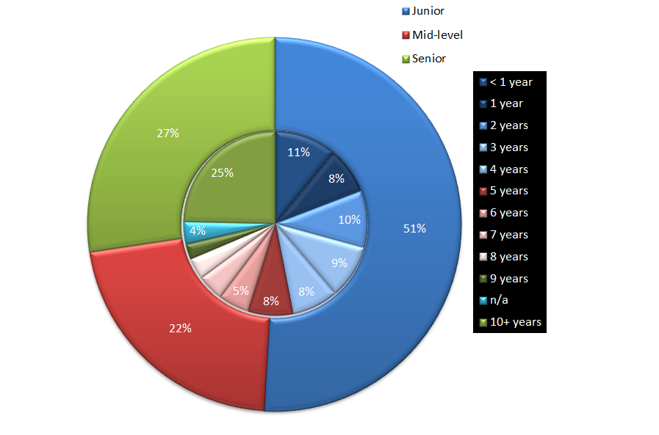
Data Cleaning
Impute the NA(4%) values for all driver variables .
Remove rows with loan_status = “Fully Paid”
Create bin variable loan_status_1
Create new bin variables for int_rate and emp_length respectively
Senior
Junior
Mid-Level

Slide 5
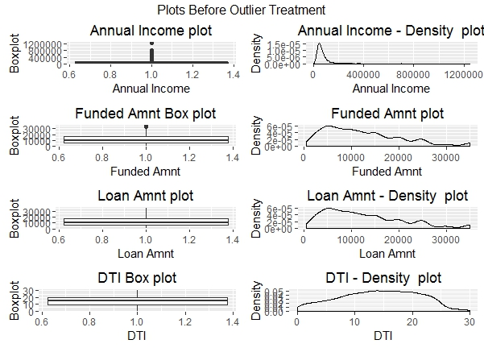
Exploratory Data Analysis
Performing EDA for the driver variables and identifying outliers to be removed.

Slide 6
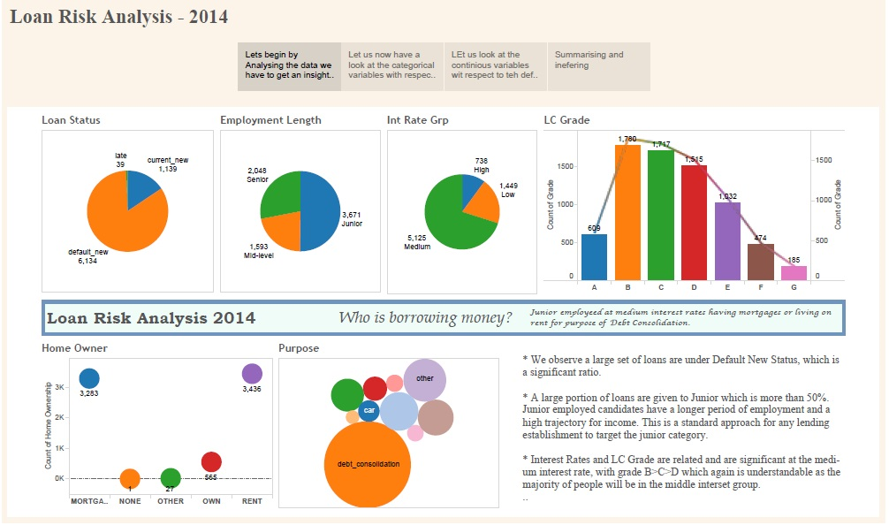
EDA Dashboard

Slide 7
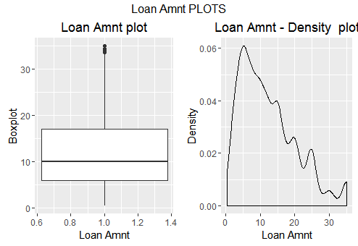
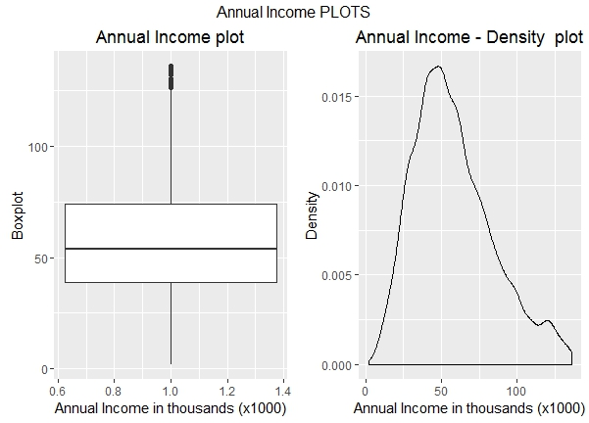
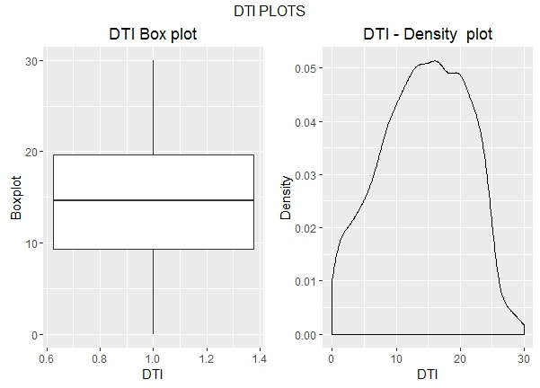
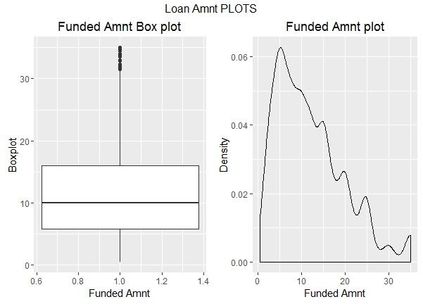
Univariate Analysis – Continuous variables
Loan Amount & Funded amount are right skewed indicating that the majority loan applied and disbursed are for small amounts.
DTI (kurtosis:2.22, Skewness:-0.18) & Annual income (kurtosis:3.0, Skewness: 0.67) are near normally distribution .

Slide 8
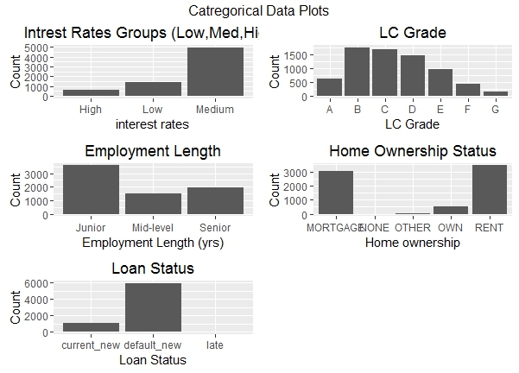
Univariate Analysis – Categorical Data
Maximum loans are given in Medium interest rates.
Maximum Loans are given to Juniors
Most of the loan takers are either Rented or Mortgage

Slide 9
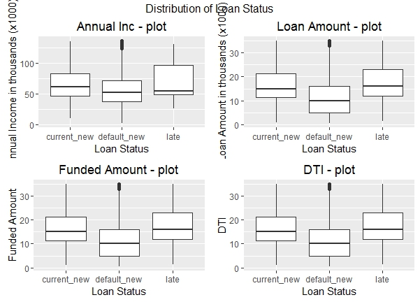
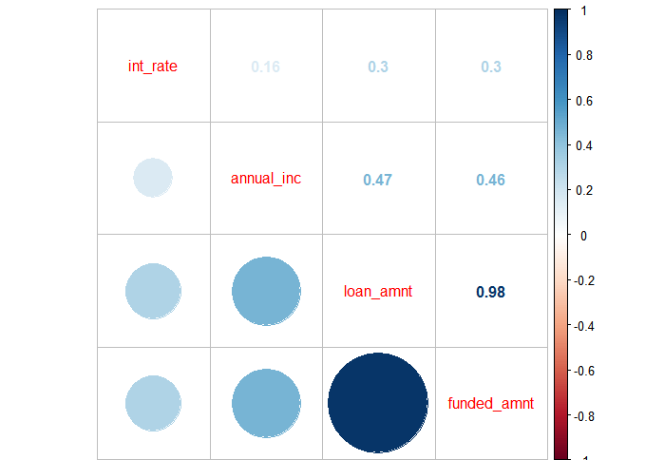
Multivariate Analysis
There is Significant difference in means of various variables with respect to High interest rates & High interest rates as seen from all box charts.
Loan Amount & Funded amount are highly co-related as expected.
No other variables are co-related.

Slide 10
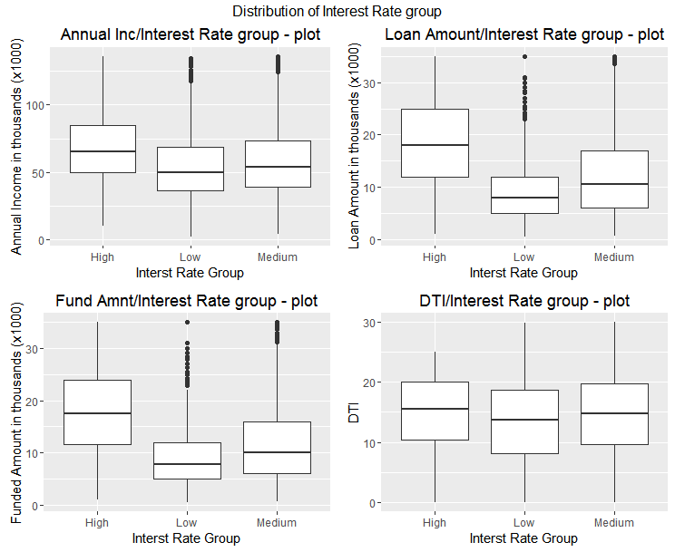
Multivariate Analysis
There is Significant difference in means of various variables with respect to High interest rates & High interest rates as seen from all box charts.

Slide 11
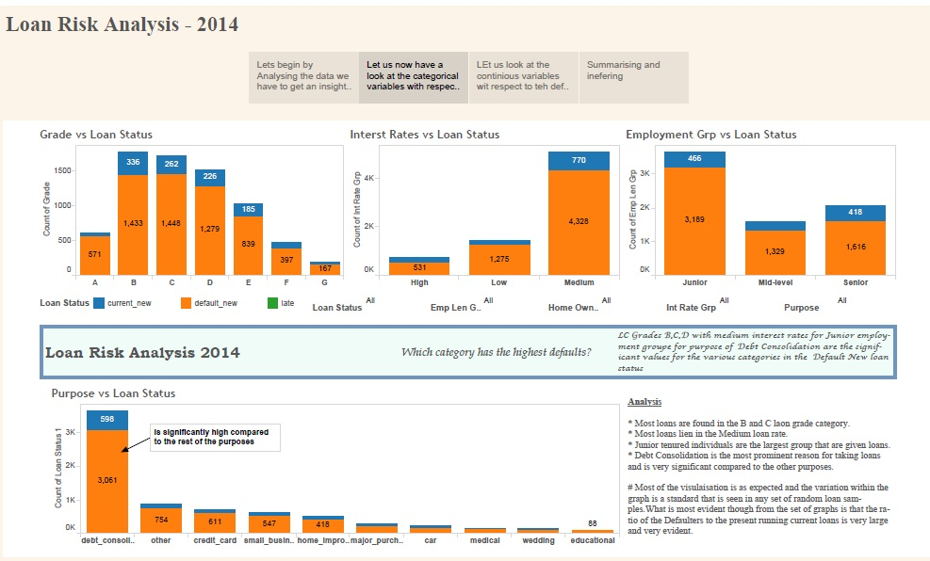
Multivariate analysis Dashboard

Slide 12
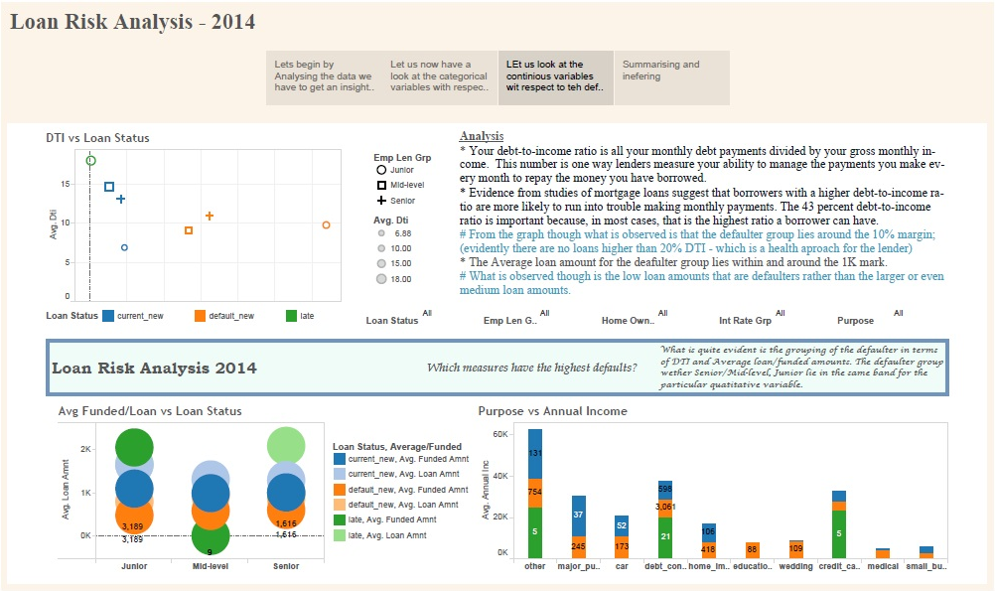
Multivariate analysis Dashboard

Slide 13
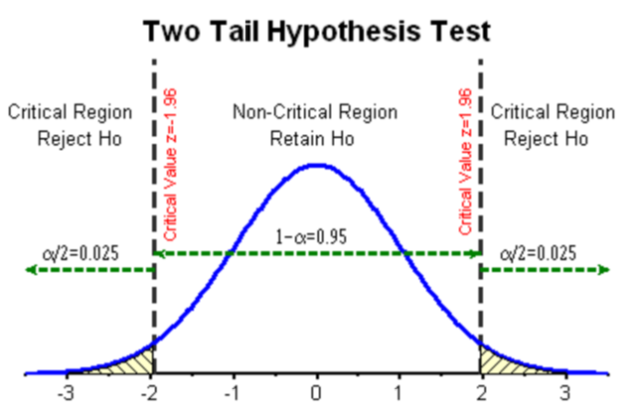
Hypothesis Test – Loan Status Current Vs Default
Ho: Mean Annual Income of Current = Mean Annual Income of Default
H1: Mean Annual Income of Current ≠ Mean Annual Income of Default
Result : Reject the Null Hypothesis
Mean Annual income of Current is significantly greater than mean Annual income of Defaulters.
Since the average annual income of Current is higher than Default, the loan is up-to-date on all outstanding for “Current”. Higher income people default less?
Ho: Mean Loan Amount of Current = Mean Loan Amount of Default
H1: Mean Loan Amount of Current ≠ Mean Loan Amount of Default
Result : Reject the Null Hypothesis
The average loan amount for customers with “Current” status is significantly higher than the average loan amount for customers with “Default” status as it is finalized based on the annual income, thus the loan amount approved for “Current” is significantly higher than “Default”.
Ho: Mean Funded Amount of Current = Mean Funded Amount of Default
H1: Mean Funded Amount of Current ≠ Mean Funded Amount of Default
Result : Reject the Null Hypothesis
Average funded amount for customers with “Default” status is lower when compared with the customers with “Current” status; Alternatively people are more careless or increase the tendency to default for small amounts.
Ho: Mean DTI of Current = Mean DTI of Default
H1: Mean DTI of Current ≠ Mean DTI of Default
Result : Reject the Null Hypothesis
Though the mean of Current DTI is close to the mean DTI of Defaulters, it is significantly higher than the Defaulters. Shows that People who are paying Higher Debts WRT their income are not defaulting as compared to Lower debt payers this supports the argument that More defaulters are takers of small debts
With respect to the given sample …

Slide 14
Hypothesis Test – High Interest rate Vs Low Interest rate
Ho: Mean annual income with high interest rate = Mean annual income with low interest rate
H1: Mean annual income with high interest rate ≠ Mean annual income with low interest rate
Result : Reject the Null Hypothesis
Mean Annual Income with High Interest rate is significantly different from the Mean Annual Income with Low Interest rate. People with Higher Annual income fine with taking loan at Higher Interests rates.
Ho: Mean Loan Amount with high interest rate = Mean Loan Amount with low interest rate
H1: Mean Loan Amount with high interest rate ≠ Mean Loan Amount with low interest rate
Result : Reject the Null Hypothesis
Average Loan Amount with High Interest rate is significantly different than average Loan Amount with Low Interest rate. Shows that customers who are applying for a higher Loan amount are willing to take loan at higher Interests rates.
Ho: Mean Funded Amount with high interest rate = Mean Funded Amount with low interest rate
H1: Mean Funded Amount with high interest rate ≠ Mean Funded Amount with low interest rate
Result : Reject the Null Hypothesis
Average Funded Amount with high Interest rate is much Higher than Mean Annual Income with Low Interest rate .Shows that customers who are taking High Loan are willing to take loan at Higher Interests rates .
Ho: Mean DTI with high interest rate = Mean DTI with low interest rate
H1: Mean DTI with high interest rate ≠ Mean DTI with low interest rate
Result : Reject the Null Hypothesis
Mean DTI with High Interest rate is Higher than Mean DTI with Low Interest rate .
Shows that People whose DTI are High are willing to take loan at Higher Interests rates
With respect to the given sample …

Slide 15
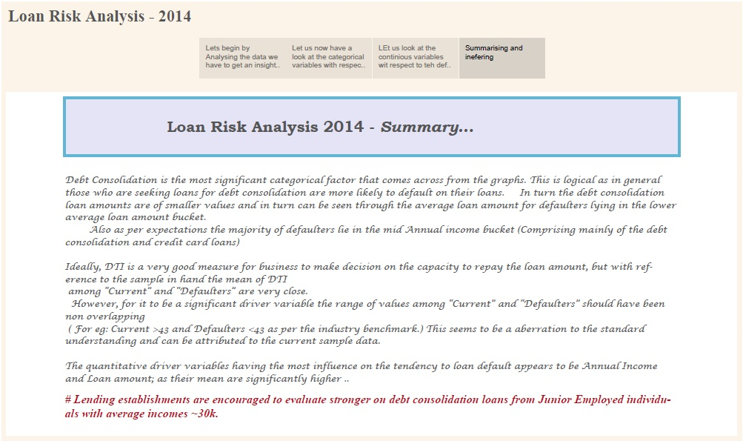
Summary

Slide 16
Conclusion
Lending establishments are encouraged to evaluate stronger on debt consolidation loans from Junior Employed individuals with average incomes ~30k.

Slide 17


Slide 18


