Slide 1
Mycar Dream Assignment
SUBMISSION
Anand Prakash Rathi
DDA 1610162

Slide 2
Predicting the car mileage
Automatic process of predicting the car mileage which fits the customer preferences, based on the dataset of car features and attributes obtained by market surveys.

Slide 3
Linear regression : 5-step process
Predictive model which can follow
these three constraints thoroughly:
The model should
not contain more than 5 variables.
According to the business needs,
set the VIF to 2.
The model should be highly predictive in nature
i.e it should show 80% (R squared)
of accuracy.
Bussiness understanding
Data Preparation
Model Development
Model Evaluation & testing
Model Evaluation & testing

Slide 4
Model 2: After stepAIC
Displacement 1.260e-02 6.611e-03 1.907 0.057685 . <== To be removed
Horsepower -2.496e-02 1.315e-02 -1.898 0.058764 .
Weight -5.825e-03 6.757e-04 -8.621 7.11e-16 ***
Model_year -8.184e-01 6.274e-02 -13.044 < 2e-16 ***
Brand_Nameaudi 3.692e+00 1.398e+00 2.641 0.008778 **
Brand_Namedatsun 3.858e+00 1.014e+00 3.806 0.000177 ***
Brand_Namefiat 3.888e+00 1.253e+00 3.102 0.002135 **
Brand_Namehonda 2.904e+00 1.182e+00 2.458 0.014644 *
Brand_Namemazda 1.850e+00 1.139e+00 1.624 0.105703
Brand_Nameplymouth 1.701e+00 6.949e-01 2.447 0.015071 *
Brand_Namepontiac 2.549e+00 9.515e-01 2.678 0.007877 **
Brand_Namerenault 3.532e+00 1.939e+00 1.822 0.069695 .
Brand_Namesaab 2.462e+00 1.735e+00 1.419 0.157231
Brand_Nametoyota 2.080e+00 8.945e-01 2.325 0.020846 *
Brand_Namevolkswagen 3.924e+00 8.949e-01 4.384 1.70e-05 ***
---
Signif. codes: 0 ‘***’ 0.001 ‘**’ 0.01 ‘*’ 0.05 ‘.’ 0.1 ‘ ’ 1
Residual standard error: 3.249 on 255 degrees of freedom
Multiple R-squared: 0.8307, Adjusted R-squared: 0.8207
F-statistic: 83.39 on 15 and 255 DF, p-value: < 2.2e-16
---
Multiple R-squared: 0.8283, Adjusted R-squared: 0.8214
>vif(model_2)
Displacement Horsepower Weight Model_year Brand_Nameaudi Brand_Namedatsun
12.656997 6.626011 8.435481 1.347406 1.086195 1.204496
Brand_Namefiat Brand_Namehonda Brand_Namemazda Brand_Nameplymouth Brand_Namepontiac Brand_Namerenault
1.155027 1.150579 1.184085 1.074859 1.061200 1.056233
Brand_Namesaab Brand_Nametoyota Brand_Namevolkswagen
1.123834 1.207262 1.274632

Slide 5
Model 3Results
Horsepower -1.085e-02 1.092e-02 -0.994 0.321382 <== To be removed
Weight -4.999e-03 5.208e-04 -9.598 < 2e-16 ***
Model_year -8.027e-01 6.252e-02 -12.840 < 2e-16 ***
Brand_Nameaudi 3.191e+00 1.380e+00 2.312 0.021590 *
Brand_Namedatsun 3.536e+00 1.005e+00 3.519 0.000512 ***
Brand_Namefiat 3.628e+00 1.252e+00 2.897 0.004089 **
Brand_Namehonda 2.911e+00 1.188e+00 2.451 0.014918 *
Brand_Namemazda 1.406e+00 1.121e+00 1.254 0.211009
Brand_Nameplymouth 1.658e+00 6.981e-01 2.375 0.018280 *
Brand_Namepontiac 2.540e+00 9.564e-01 2.656 0.008415 **
Brand_Namerenault 3.388e+00 1.947e+00 1.740 0.083068 .
Brand_Namesaab 1.610e+00 1.685e+00 0.955 0.340236
Brand_Nametoyota 1.847e+00 8.906e-01 2.074 0.039088 *
Brand_Namevolkswagen 3.941e+00 8.995e-01 4.382 1.72e-05 ***
Multiple R-squared: 0.8283, Adjusted R-squared: 0.8189
> vif(model_3)
Horsepower Weight Model_year Brand_Nameaudi Brand_Namedatsun Brand_Namefiat
4.527848 4.960361 1.324270 1.047704 1.171037 1.141351
Brand_Namehonda Brand_Namemazda Brand_Nameplymouth Brand_Namepontiac Brand_Namerenault Brand_Namesaab
1.150569 1.134592 1.073754 1.061175 1.054643 1.049441
Brand_Nametoyota Brand_Namevolkswagen
1.184788 1.274498

Slide 6
Model 4 Results
Weight -5.411e-03 3.141e-04 -17.229 < 2e-16 ***
Model_year -8.219e-01 5.947e-02 -13.819 < 2e-16 ***
Brand_Nameaudi 3.193e+00 1.380e+00 2.314 0.021477 *
Brand_Namedatsun 3.406e+00 9.961e-01 3.420 0.000729 ***
Brand_Namefiat 3.636e+00 1.252e+00 2.904 0.004010 **
Brand_Namehonda 2.829e+00 1.185e+00 2.388 0.017669 *
Brand_Namemazda 1.310e+00 1.117e+00 1.173 0.242059 <== All bold to be removed
Brand_Nameplymouth 1.683e+00 6.976e-01 2.412 0.016547 *
Brand_Namepontiac 2.468e+00 9.537e-01 2.588 0.010197 *
Brand_Namerenault 3.389e+00 1.947e+00 1.740 0.083005 .
Brand_Namesaab 1.438e+00 1.676e+00 0.858 0.391851
Brand_Nametoyota 1.779e+00 8.880e-01 2.003 0.046195 *
Brand_Namevolkswagen 3.949e+00 8.994e-01 4.391 1.65e-05 ***
Multiple R-squared: 0.8276, Adjusted R-squared: 0.8189
> vif(model_4)
Note: All VIF are below 2 , so it meets one of criteria , so we stop here. and we remove all on significant Features
Selected: Weight + Model_year + Brand_Namedatsun +Brand_Namevolkswagen

Slide 7
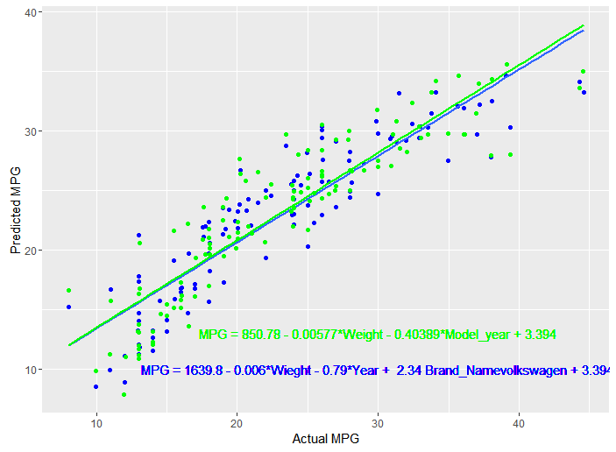
Model 5 & Final Model Result
Weight -5.939e-03 2.732e-04 -21.737 < 2e-16 ***
Model_year -7.958e-01 5.973e-02 -13.323 < 2e-16 ***
Brand_Namedatsun 2.143e+00 9.821e-01 2.182 0.03000 * <== Remove this
Brand_Namevolkswagen 2.569e+00 8.647e-01 2.971 0.00324 **
---
Residual standard error: 3.371 on 266 degrees of freedom
Multiple R-squared: 0.8099, Adjusted R-squared: 0.8071
Remove all brands
Weight -6.639e-03 2.168e-04 -30.63 <2e-16 ***
Model_year -7.631e-01 5.003e-02 -15.25 <2e-16 ***
Multiple R-squared: 0.8054, Adjusted R-squared: 0.8044
Final Features in Model:
MPG, Weight, Model_year , Brand_Namevolkswagen
PredictedR2= 0.82

Slide 8
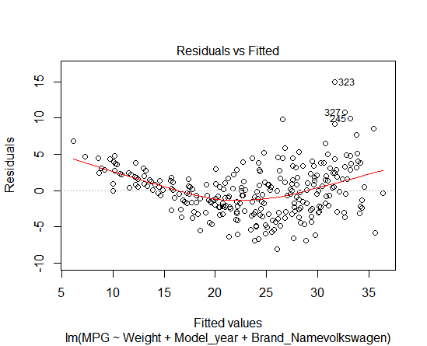
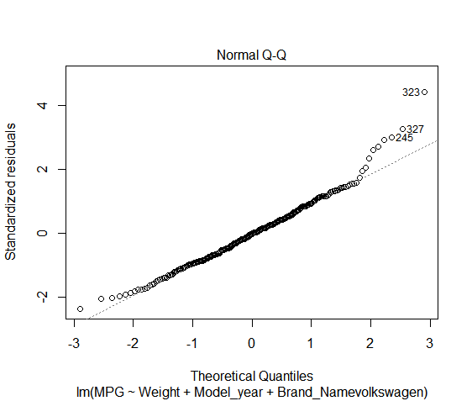
<Results>
Plot 2

Slide 9
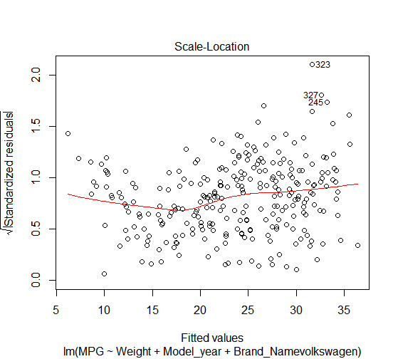
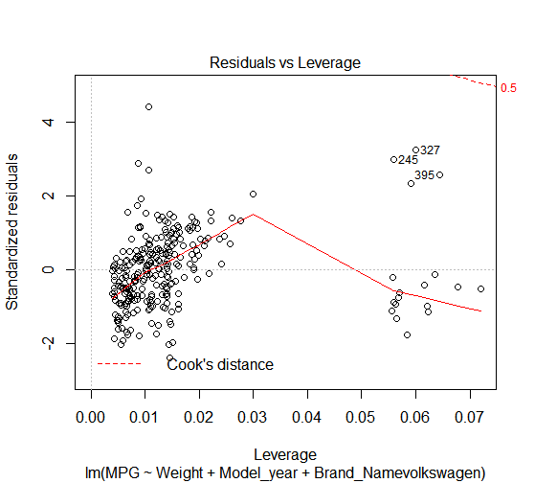
<Results>
Plot 3

Slide 10
<Conclusions>
We have following Model : MPG = 1639.8 - 0.00605 * Weight - 0.7957* ModelYear + 2.34386888 * volkswagen
Model Accuracy : Adjusted R-squared: 0.804 @ 95% confidence level Test Result : PredictedR2= 0.81 There is a significant Co-relation between MPG & Weight, Model Year & Volsvagan
Plots: Residual Vs Fitted : Shows that residuals have non-linear patterns. Residual Normal Q-Q Plot : plot shows if residuals are almost normally distributed.slight right skew Spread-Location plot: This plot shows that residuals are spread equally along the ranges of predictors.
Residuals vs Leverage: No influential cases found.

