Slide 1
Wage Prediction
Wage prediction from a timeseries data

Slide 2
Business Objective :
To build a Multivariate regression Model for Wage Prediction
Given Data
LOCATION : Factor w/ 9 levels "AUS","AUT","CAN",..: 1 1 1 1 1 1 1 1 1 1 ...
TIME : num 1991 1992 1993 1994 1995 ...
CPI : num 3.18 1.01 1.75 1.97 4.63 ...
GDP : num 17973 18988 20004 21182 22233 ...
TT : num 51.6 49.4 48.1 49.6 51.2 ...
Unemp : num 9.58 10.73 10.87 9.72 8.47 ...
WorkingPop: num 66.8 66.7 66.6 66.6 66.6 ...
Wages : num 38864 39626 40003 40295 40115 ...

Slide 3
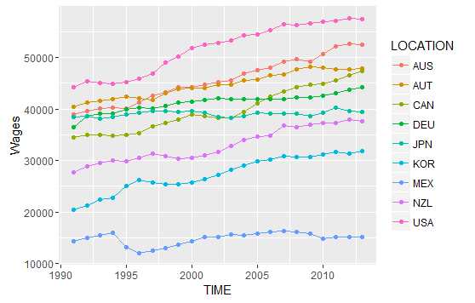
Wages / time / Country

Slide 4
Methodology:
It’s a Simple Regression Problem
Create Dummies for factor [LOCATION]
Divide data with train & test
Create simple additive formula with one sinewave element on time.
Check VIF , remove highly correlated predictors using stepAIC
Run Final Model
Compare Predicted Values with Actuals , Plot it
Calculate Goodness of Fit of test data

Slide 5
Final Coefficients
Coefficients:
(Intercept) 4.558e+05 1.137e+05 4.010 0.000101 ***
LOCATIONAUT -2.274e+03 4.594e+02 -4.950 2.24e-06 ***
LOCATIONCAN -7.266e+03 4.192e+02 -17.334 < 2e-16 ***
LOCATIONDEU -4.793e+03 4.811e+02 -9.963 < 2e-16 ***
LOCATIONJPN -5.993e+03 5.925e+02 -10.115 < 2e-16 ***
LOCATIONKOR -1.526e+04 8.296e+02 -18.398 < 2e-16 ***
LOCATIONMEX -1.681e+04 1.320e+03 -12.730 < 2e-16 ***
LOCATIONNZL -7.917e+03 6.179e+02 -12.812 < 2e-16 ***
LOCATIONUSA 9.415e+02 6.015e+02 1.565 0.119902
TIME -2.317e+02 5.785e+01 -4.006 0.000103 ***
GDP 5.991e-01 5.210e-02 11.501 < 2e-16 ***
TT 1.667e+01 7.451e+00 2.238 0.026920 *
WorkingPop 5.052e+02 7.946e+01 6.358 3.13e-09 ***

Slide 6
Model Summary
Residual standard error: 1111 on 131 degrees of freedom
Multiple R-squared: 0.9893, Adjusted R-squared: 0.9884
F-statistic: 1014 on 12 and 131 DF, p-value: < 2.2e-16

Slide 7
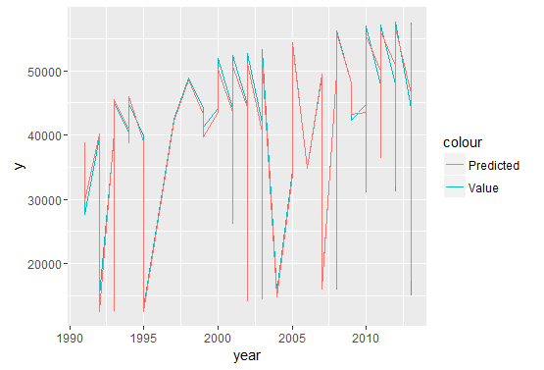
Prediction & Actual wrt Time

Slide 8
Result
Goodness of Fit on Test Data : 0.9903858

