Slide 1
Telecom Churn Case Study SUBMISSION
Your
Roll Number

Slide 2
Conclusion - SVM
As per the SVM model has the best performance.
With this model we should be able to interpret with 80% accuracy the churn out for a given customer set.

Slide 3
<Conclusion>

Slide 4
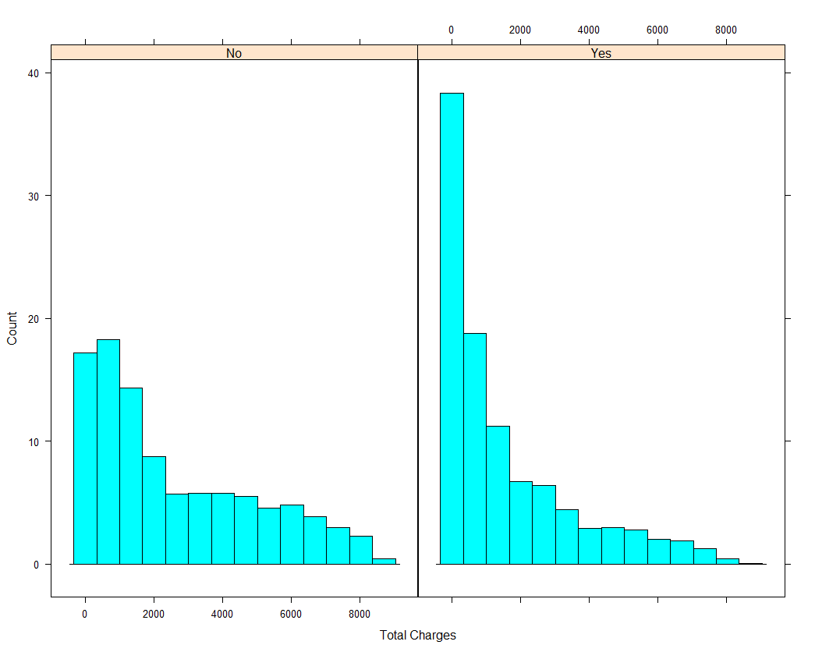
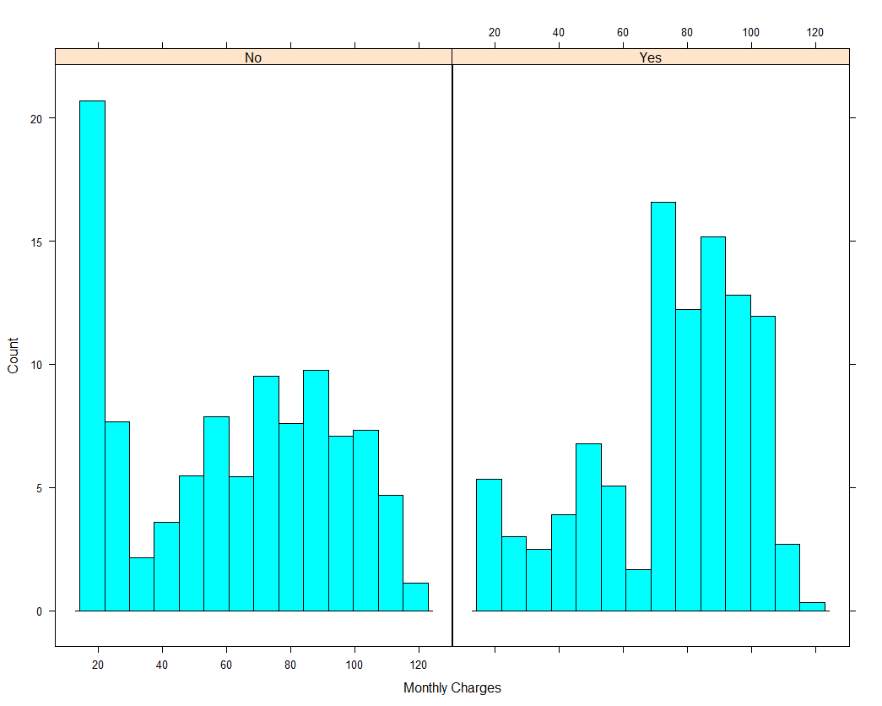
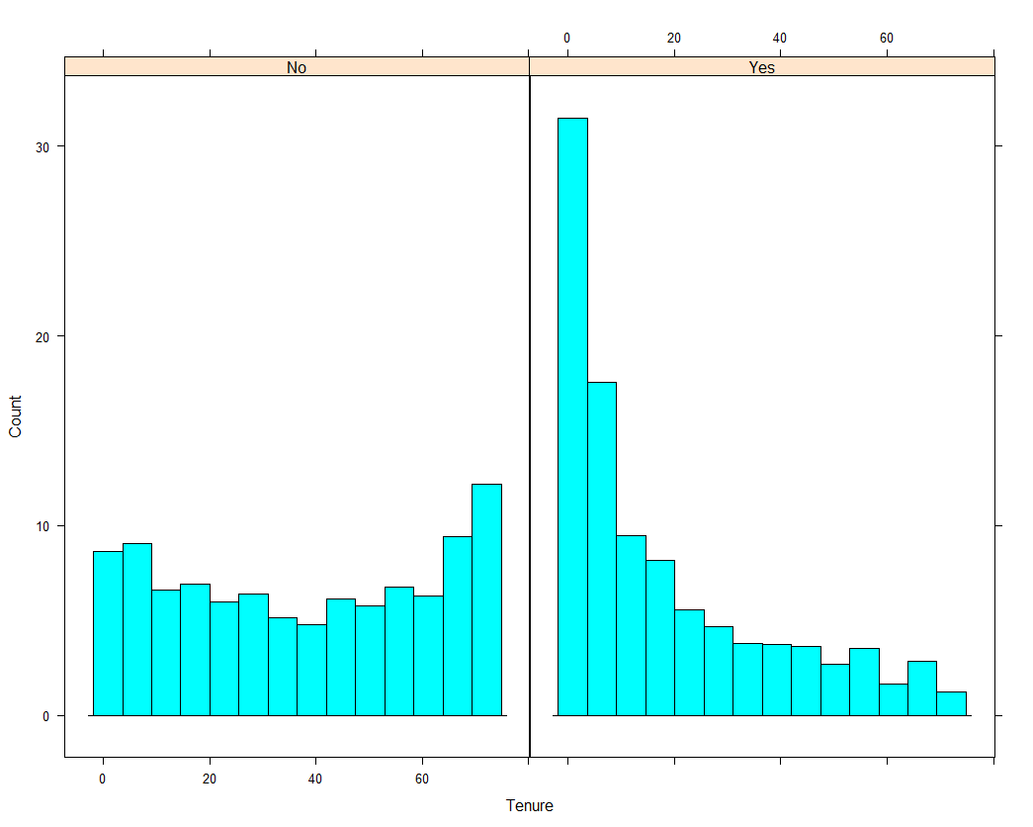
<EDA plots and insights>

Slide 5
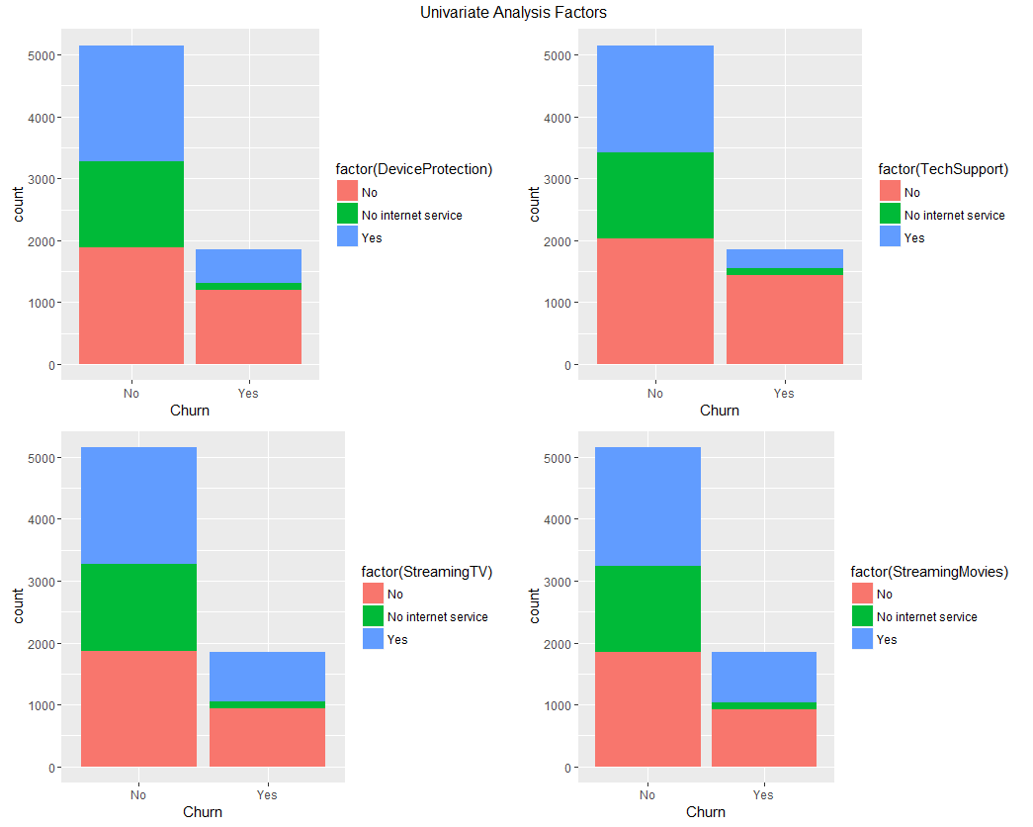
<EDA plots and insights>

Slide 6
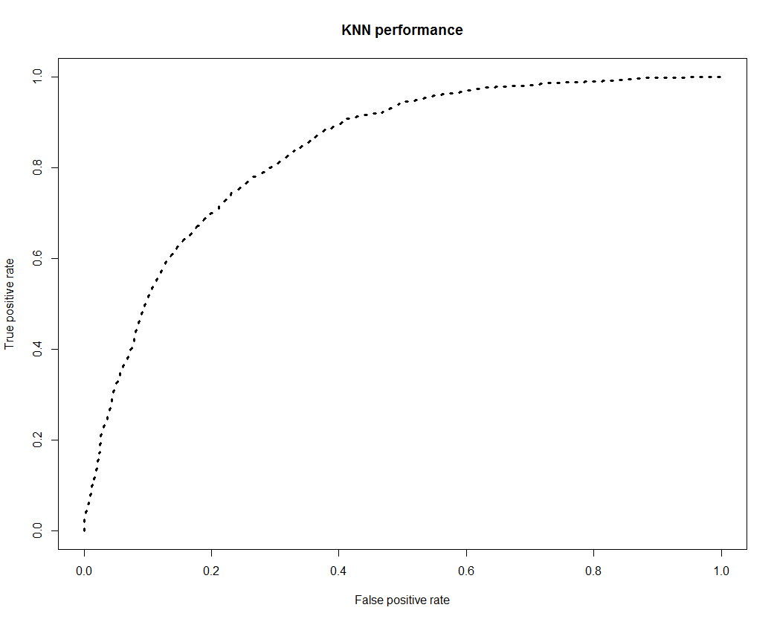
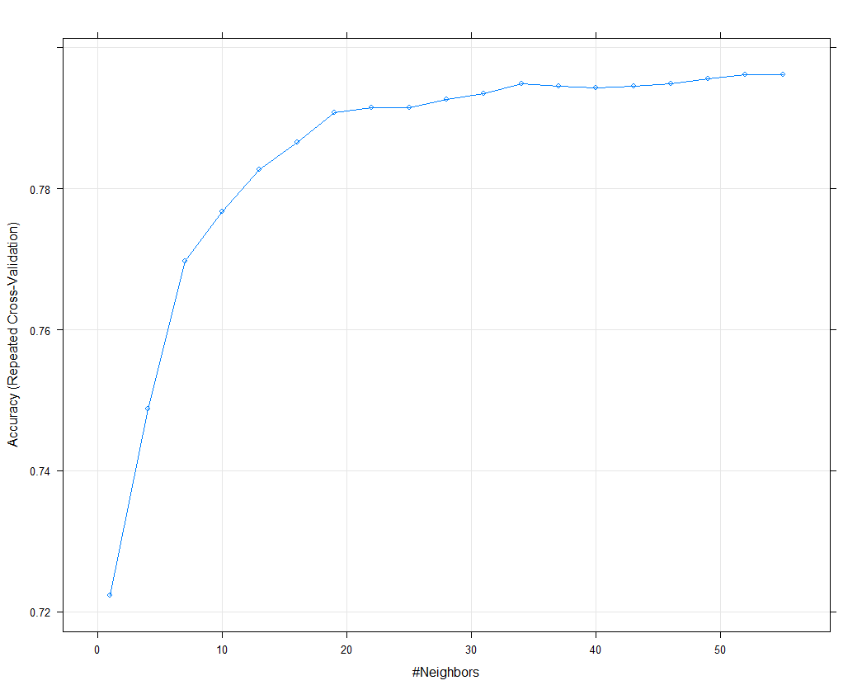
<K-NN model insights and results>
Threshold value | Values (Numeric)
Overall Accuracy | 0.796
Sensitivity | 0.5745
Specificity | 0.8758
AUC | 0.8359187
'Positive' Class | Yes

Slide 7
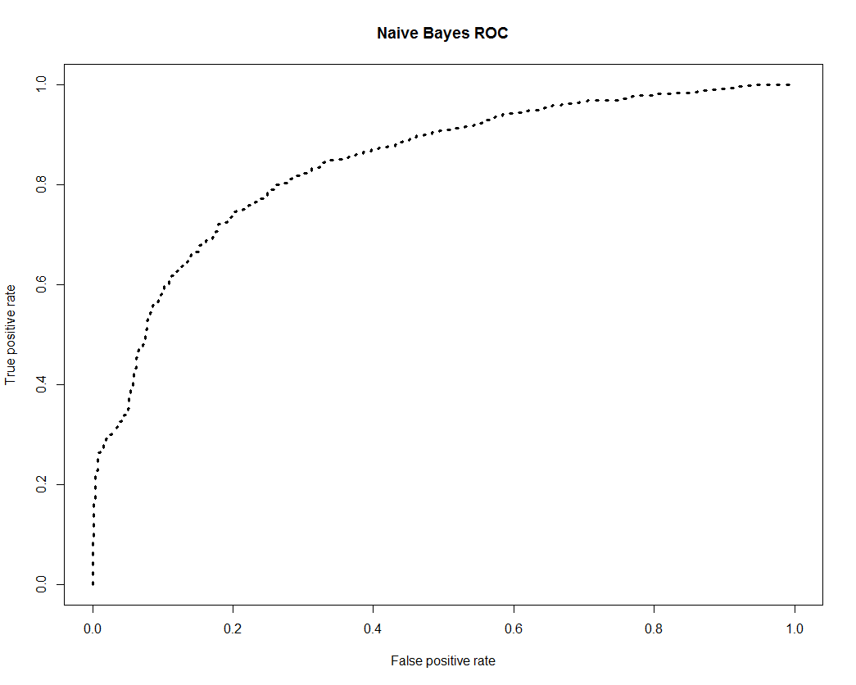
< Naïve Bayes model insights and results >
Threshold value | Values (Numeric)
Overall Accuracy | 0.7356
Sensitivity | 0.7038
Specificity | 0.8241
'Positive' Class | No
AUC | 0.8409598

Slide 8
< Logistic Regression model insights and results>
Significant variables in final model (add more rows if requires) | Coefficients value (Numeric)
(Intercept) | < 2e-16
Tenure | < 2e-16
MonthlyCharges | < 2e-16
ContractOne.year | 9.34e-14
ContractTwo.year | < 2e-16
PaperlessBillingYes | 8.84e-07
PaymentMethodElectronic.check | 1.06e-09
Final model metrics | Values (Numeric)
AIC value | 4216.7
Null deviance | 5673.9
Residual Deviance | 4202.7

Slide 9
< Logistic Regression model insights and results >
Threshold value set at > 0.5
Threshold value | Values (Numeric)
Overall Accuracy | 0.7908
Sensitivity | 0.5045
Specificity | 0.8939
AUC | 0.8450588
Train Dataset |  | Test Dataset
C-statistic | 8.323861e -01 | C-statistic | 8.338867e-01
KS-statistic | 0.5165529 | KS-statistic | 0.5324693
Model Evaluation (write Accept or Reject) |  | Accept

Slide 10
<SVM Model insights and results>
Threshold value | Values (Numeric)
Overall Accuracy | 0.7989
Sensitivity | 0.8946
Specificity | 0.5332
'Positive' Class | No
AUC | <TBA>

