Slide 1



CAREER CRAFTER Empowering the Futures , Breaking Unemployment Barriers
Theme : Ed-Tech
Team Name : Debugger's

Slide 2


Table of contents
01
02
03
04
Problem Statement
Idea/Approach Details
Tech Stack and Flow chart
Future Aspects and Status

Slide 3

Problem Statement
Key Issues:
Spike in Graduate Unemployment: Graduates from higher education face significant unemployment challenges.
Promises vs. Reality: Many post-graduate training programs fail to deliver on their promises of employment.
Unclear Causes: The root causes of high graduate unemployment remain poorly understood.
Systemic Gaps: Current education and training systems potentially contribute to this issue.

Slide 4

Idea Approach/Details
Incorporating advanced analytics for comprehensive analysis of graduate unemployment by identifying hidden patterns and correlations within the quantitative data.
Through the utilization of ML algorithm model, aid in identifying key factors influencing unemployment, such as mismatches in skills, economic trends, and industry demands.
Personalized skill gap analysis by empowering individuals with actionable steps to bridge the gap between their skill set and the demands of the job market.
By integrating AR and ML into the soft skills assessment section of the interview, ultimately contributing to a more informed hiring decision, beyond traditional methods.

Slide 5
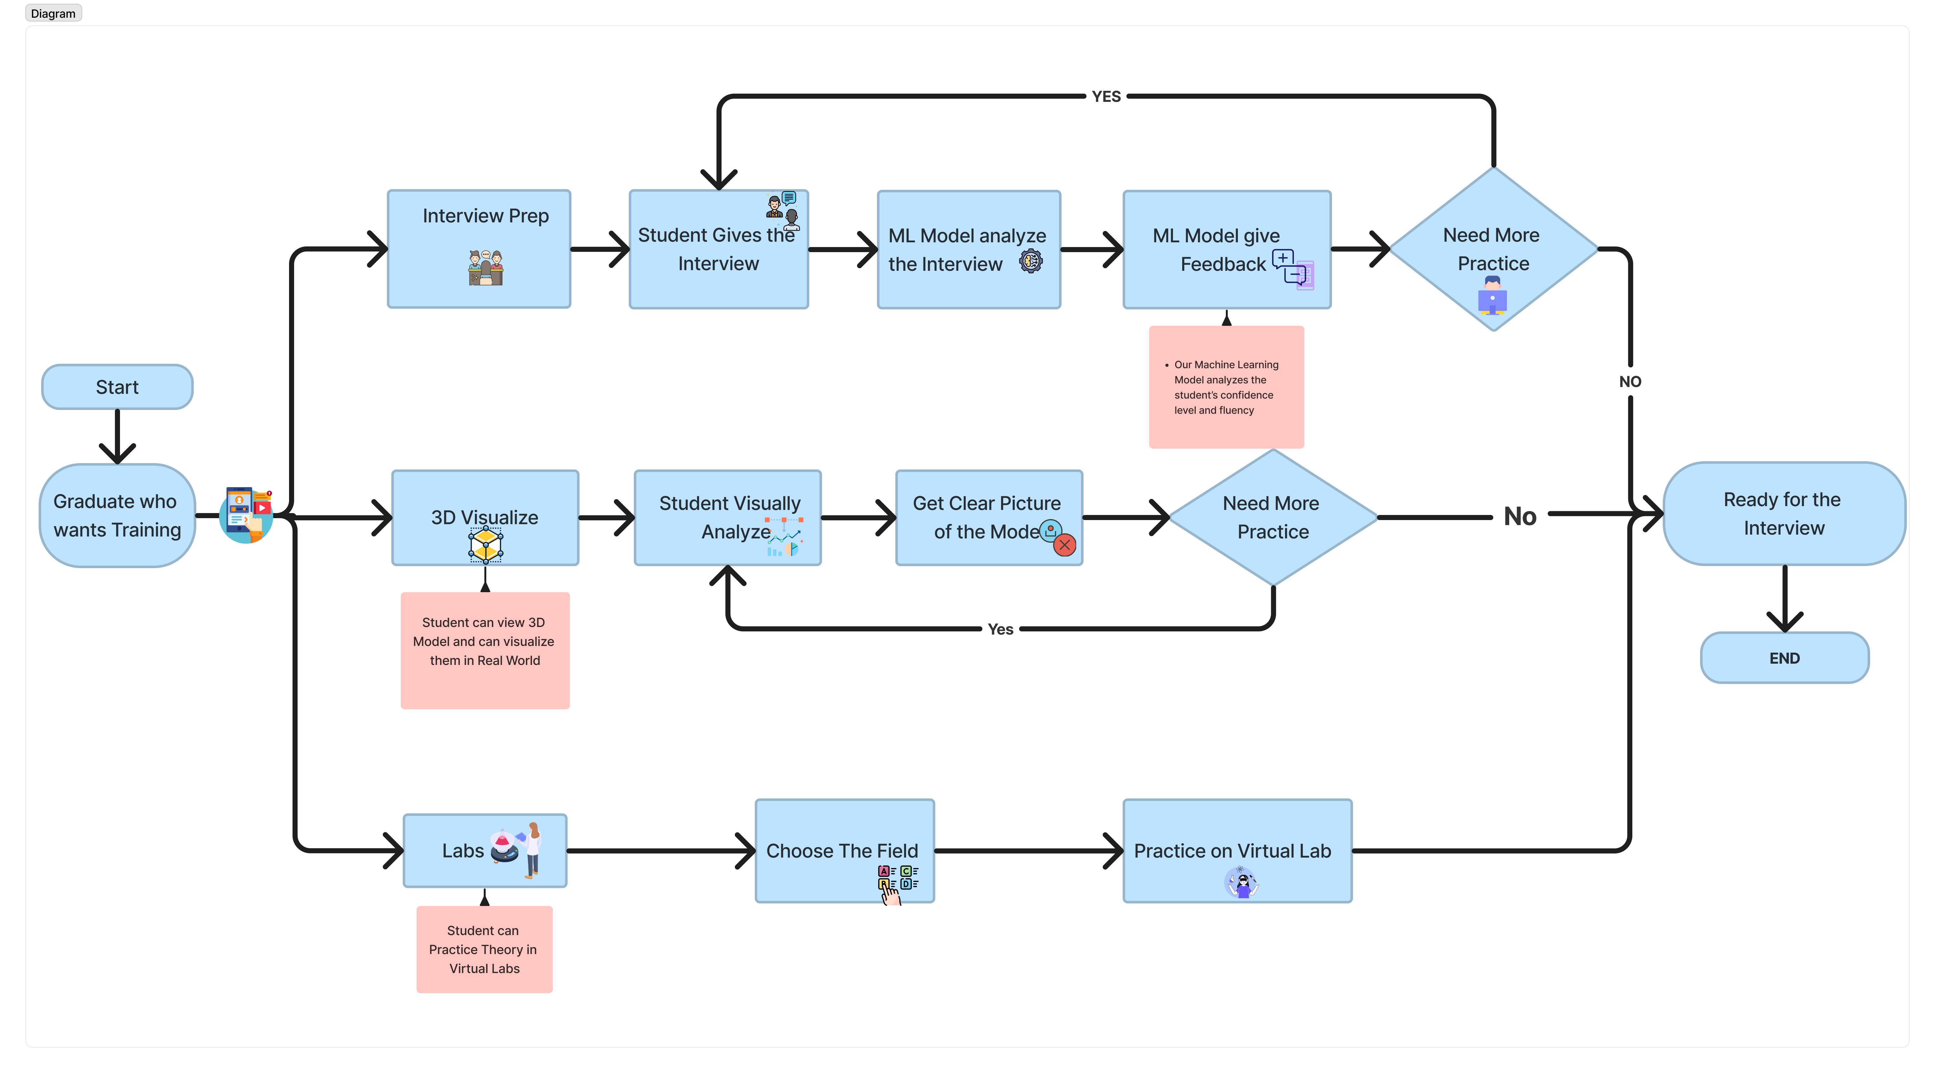










TECH STACK
Flow chart
<
Figma
React
Unity 3D
Flutter
Firebase
Tensor
Flow
Python
Git
GitHub
AWS
SQL

Slide 6

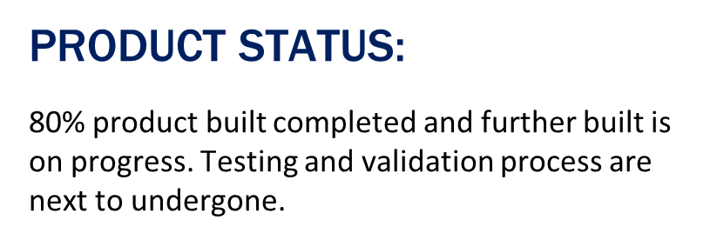
Future Aspect
Lab-view experiences boost technical skills, making individuals job-ready in diverse industries.
AR and VR enhance interview practice, providing dynamic realism. ML-driven feedback boosts performance and confidence
Aligning skill development with trending tech ensures relevance in competitive job markets.
By addressing the root causes of unemployment and providing comprehensive solutions, this initiative contributes to long-term societal and economic benefits, creating a skilled and adaptable workforce.

