Slide 1

Serving Beyond Borders: My Experience with RICE West Nile, Uganda
Presented by
Akpan, Emmanuel Effiong
(IT Support Assistant)
Date: May 19, 2026

Slide 2
About RICE West Nile, Arua Uganda
Summary of Key Activities
Challenges Spotted
Key Achievements
Community and personal integration
Professional and social Experience
Cultural shock
Challenges and mitigation strategies
Impacts and Lessons Learnt
Looking ahead
Appreciation
Conclusion
Outline

Slide 3

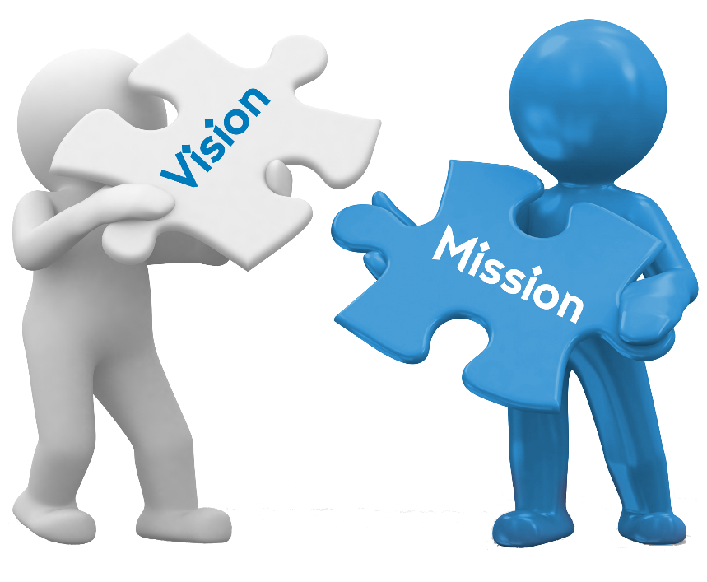


About RICE West Nile
Vision
“Self-reliant and Healthy communities living with dignity"
Mission
To develop the capacities of communities for self-reliance and sustainable livelihoods
Our Core Values
Novelty
Equity
Integrity
Partnership

Slide 4




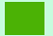


About RICE West Nile (Contd)
4 Coordination Offices: Moyo, Yumbe – Bidi Bidi, Imvepi & Arua City
11 projects running
Legend
Coverage
Program Office
Founded in 2004
Interventions in 14 Districts
Head Office in Arua City

Slide 5
Core Program Areas
RICE West Nile delivers its key strategic objectives through 5 Core Program Areas namely;
01
02
Health Promotion
Sustainable Livelihoods
05
Environment & Climate Change
03
04
Skills Development
Research, Innovation and Advocacy

Slide 6
Summary of Key Activities
Community Participation
Operational efficiency improvements
Digital systems implementation
across departments
Cross-cultural professional growth
M&E Field Support in refugee camps

Slide 7
Key Achievements
Systems Developed and in Progress
Procurement Management System
01
02
Human Resource Management System
Monitoring and Evaluation Framework
03
04
Asset Management System
Communication Management System
05
Governance, Audit, Risk and Compliance Information System
06

Slide 8
Outcomes
Improved accountability
Status
Better decision-making
Faster reporting turnaround
Procurement: Deployed, and has undergone first stage review
System Outcomes and Status
Centralized data access
Human Resource: Deployed, undergone 1st and 2nd stage review
Communication: Deployed, pass 1st and 2nd stage review and waiting approval
MEAL: Deployed, undergone 1st and 2nd stage review and waiting approval
GARCIS: Deployed, and has undergone first stage review
Asset: Deployed, and has undergone first stage review

Slide 9
Key Achievements (Contd)
Understood NGO governance and structure
Worked across departments (HR, MEAL, Programs)
Improved strategic thinking and execution
Observed leadership decision-making processes
Learnt the Ugandan immunization schedule
Learnt the new malaria vaccine
Organizational and Leadership Exposure

Slide 10
Community & Personal Integration
Life in Uganda
Church & Faith
International Women’s Day
Community sensitization (River Enyau) under Environment and climate change project
Youth warm-up activity
Community Engagement
Impact

Slide 11
Field Experience (Professional)
Conducted monitoring visit
Engaged with beneficiaries
Collected field data
Assessed program impact
Engaged with field staffs
Imvepi
Bidibidi

Slide 12
Field Experience (Professional)
conducted outreaches on weekly bases
participated in hospital auditing
participated in hospital weekly reporting of maternal ,parental, death surveillance and response
Participated in child health weekdays for immunization, deworming vitamin supplement, health education
Conducted health education at the hospital and in field

Slide 13
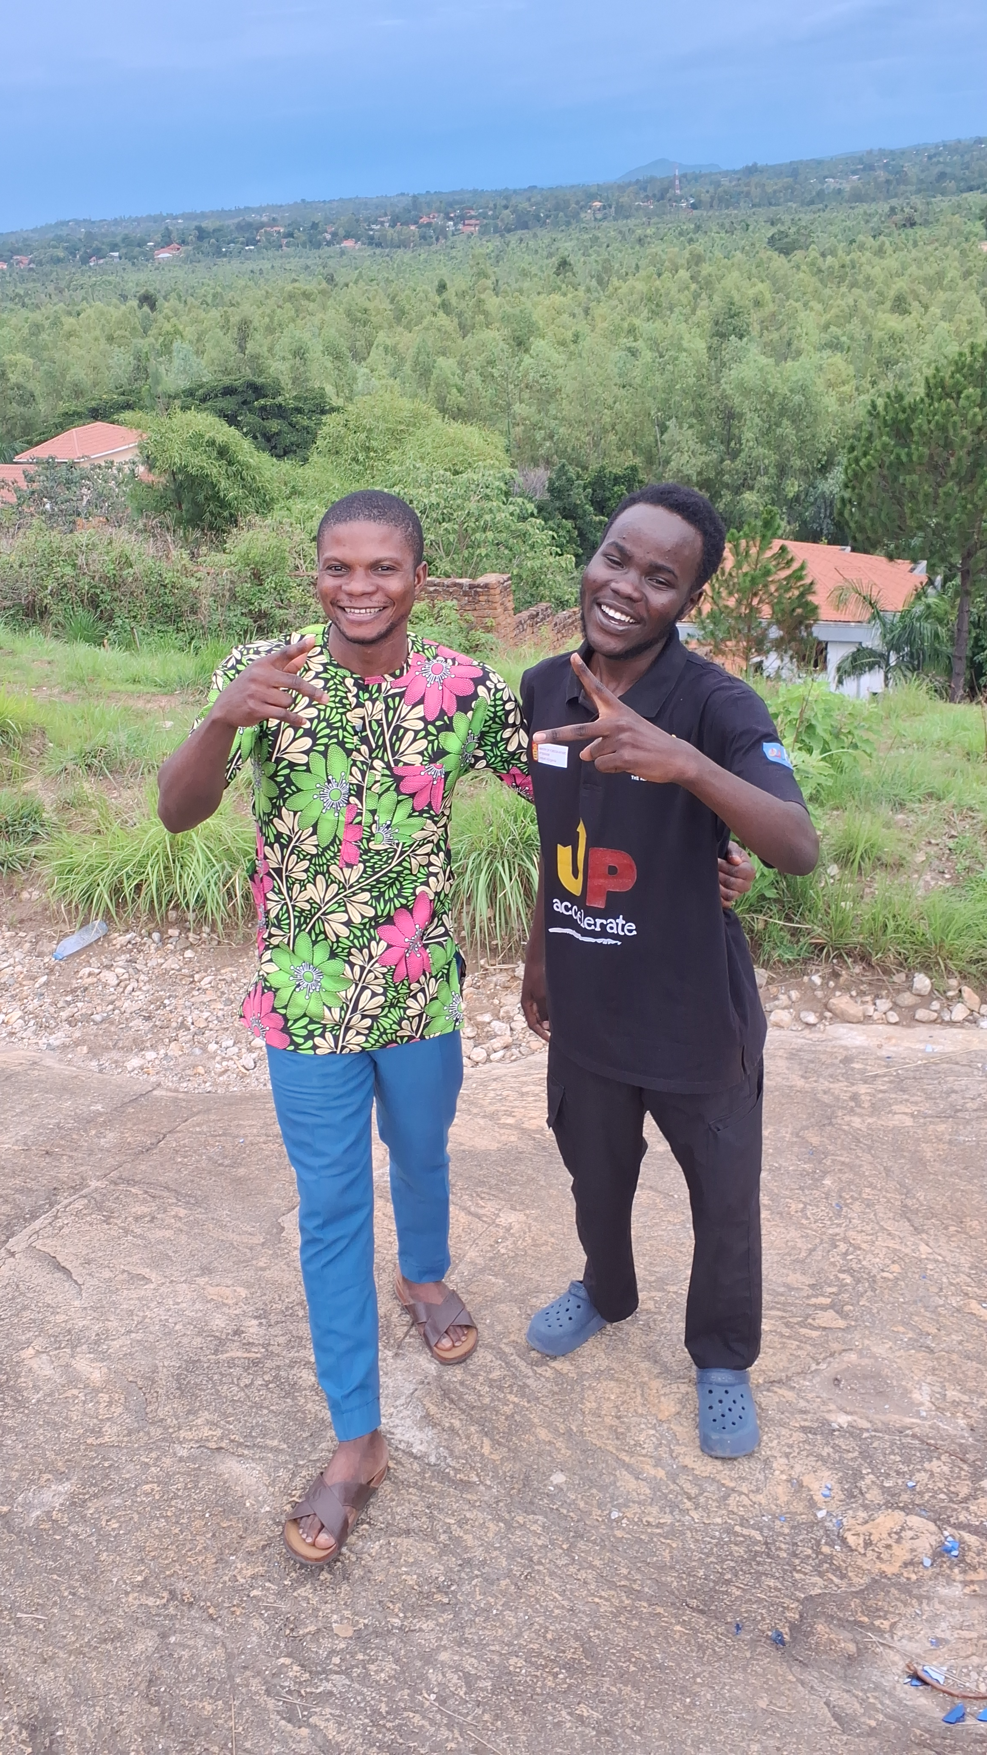
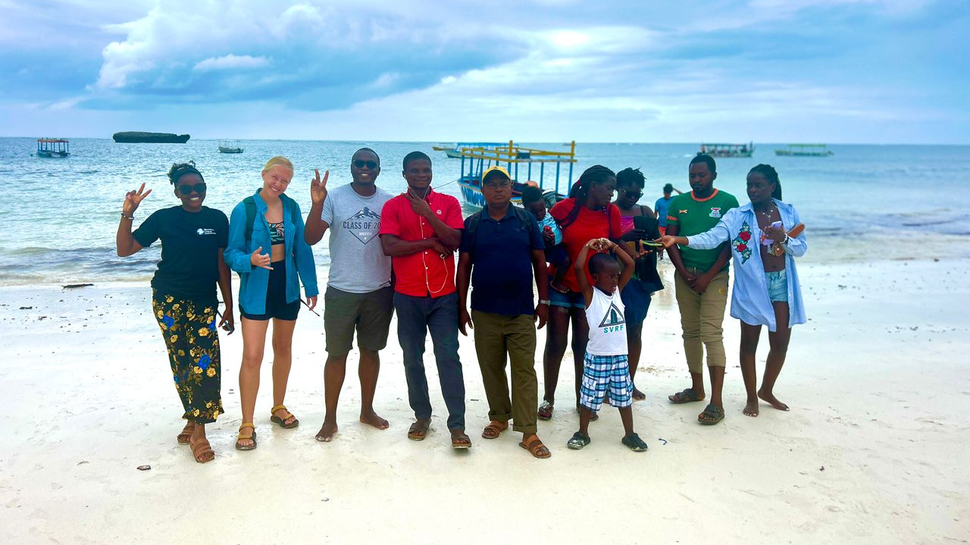
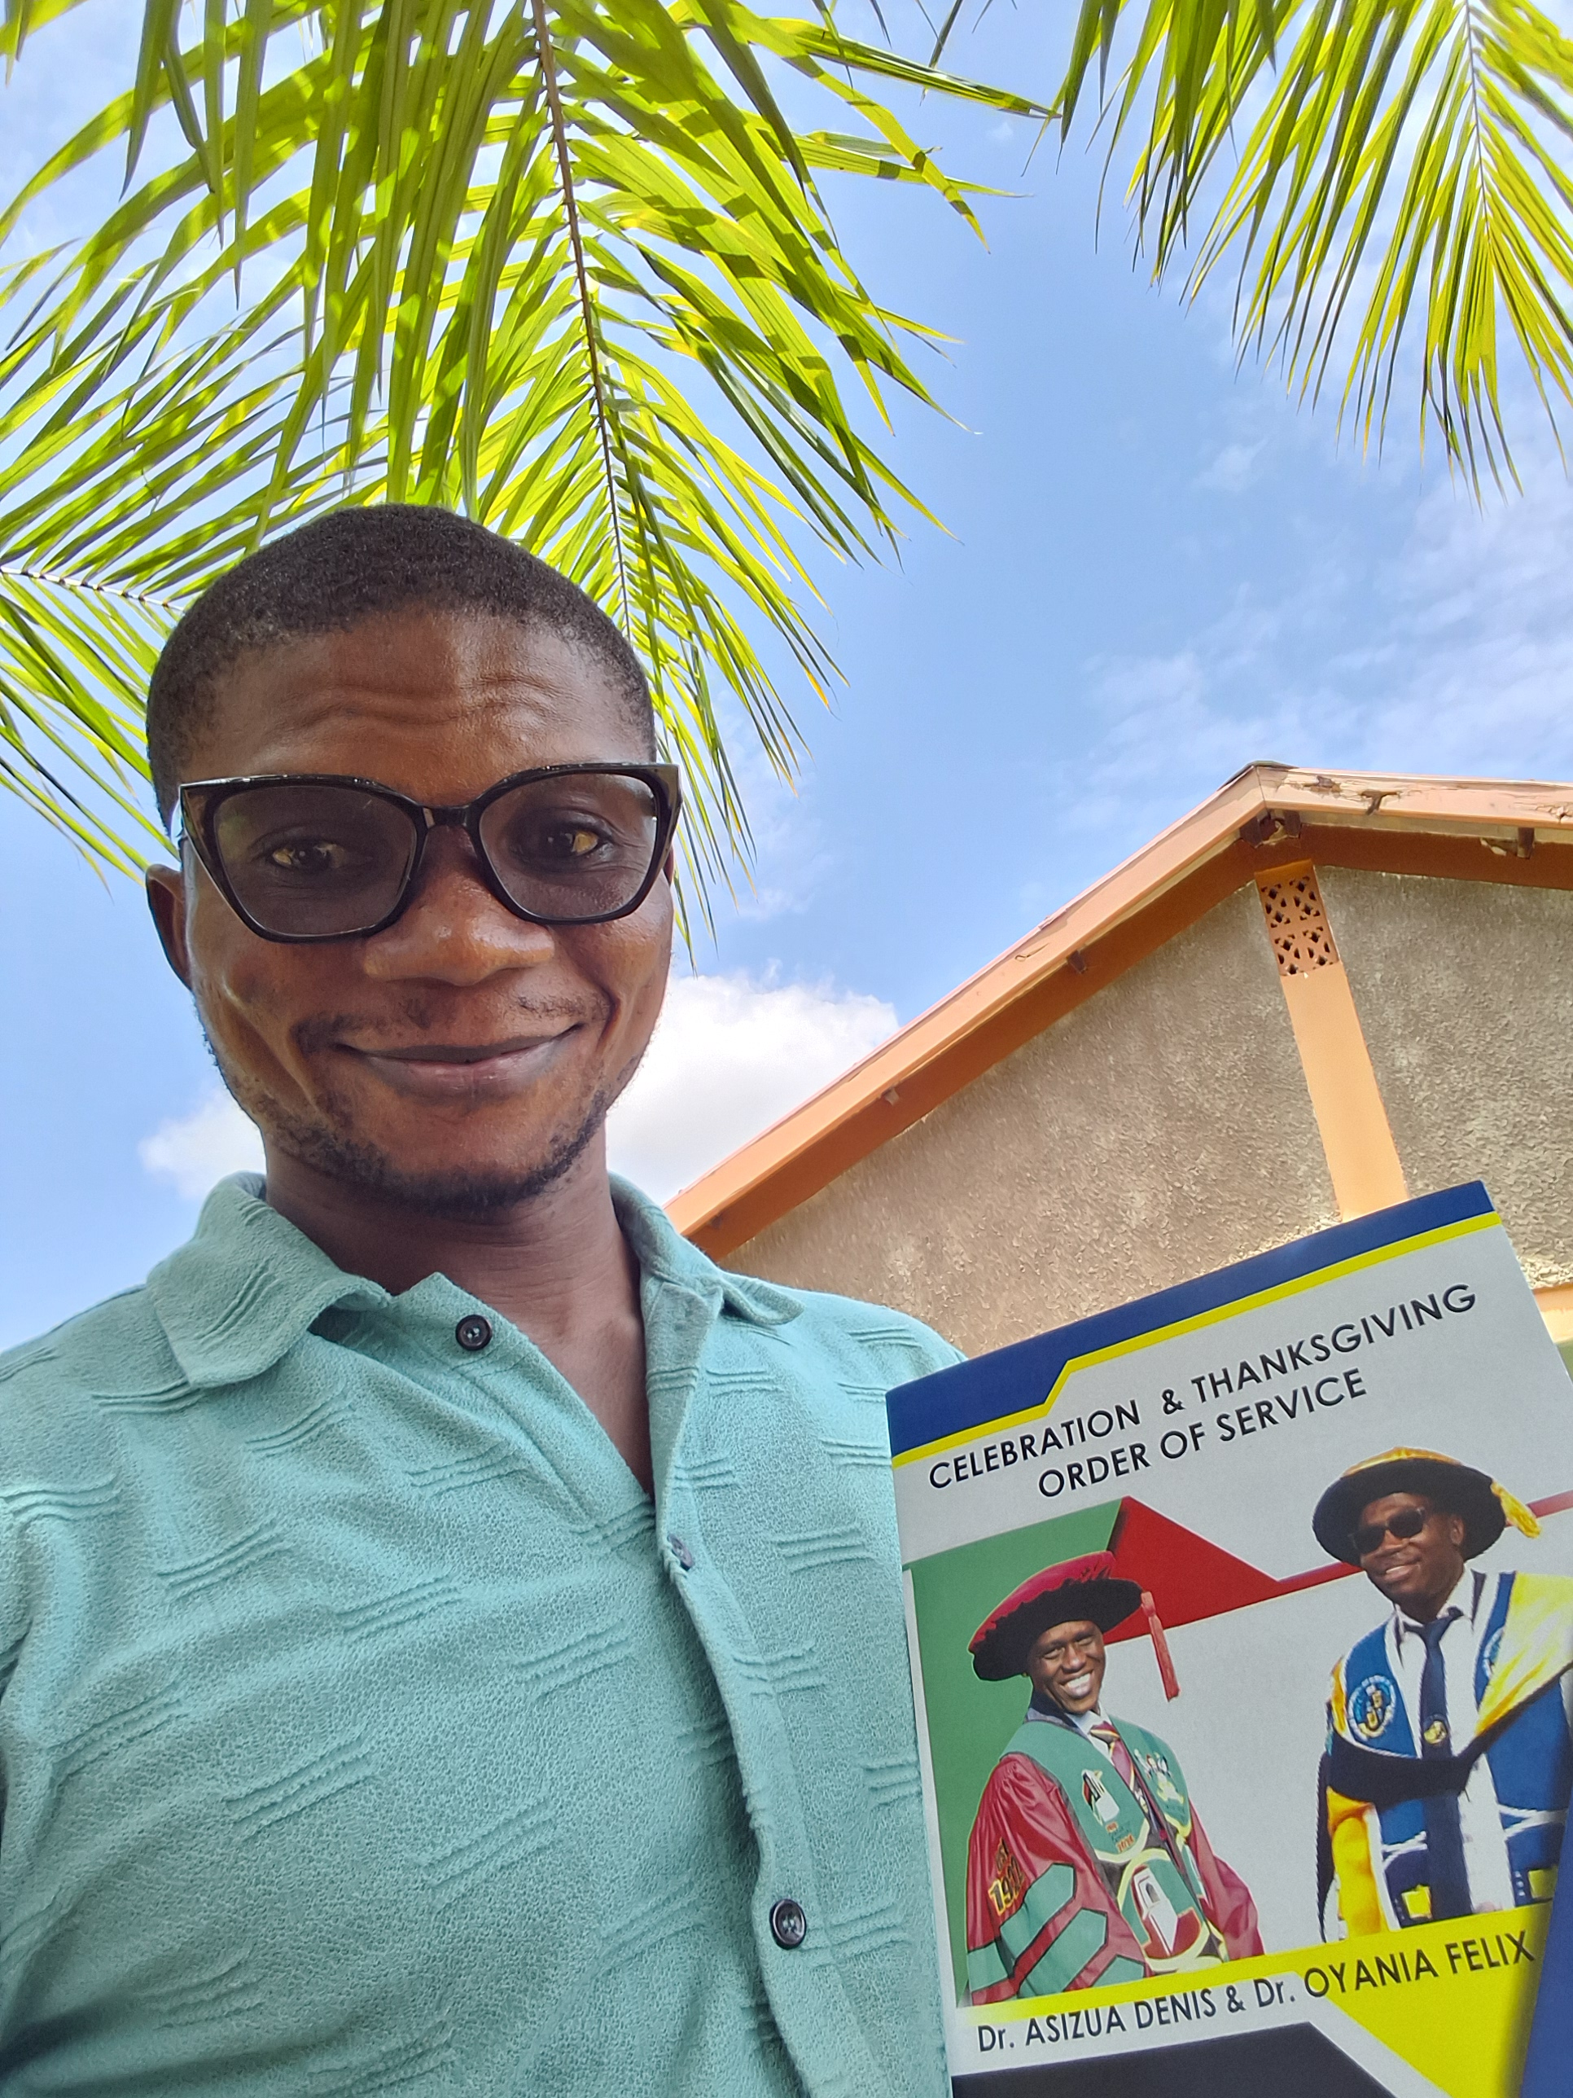
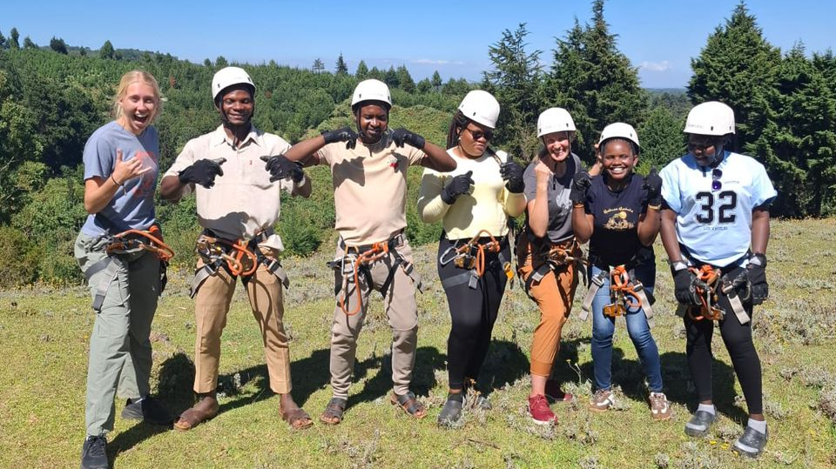
Social and Personal Experience
Notes:
At Indian ocean with my fellow gsl
for vacation in kenya Fox flying in Kenya with my fellow gls during vacation

Slide 14
Addressing elders by their name without attaching tittles to show respect elders
kneeling for someone while greeting them its only done by ladies
Culture shock

Slide 15
Challenges & Mitigation Strategies
Challenges
Mitigation Strategies
Food adaptation and dietary differences due to new environment
Gradual adaptation
to local meals
Challenge in terms of communication due to language barriers especially at workplace
Basic learning + team support

Slide 16
Challenges & Mitigation Strategies (contd)
Challenges
Mitigation Strategies
High Expectations of Refugees/Host community
Level expectations
Build strong team Relationship
Cultural gaps

Slide 17
Impact & Lessons from the whole Journey
1
Technical Growth:
Built scalable systems for real-world use
Professional Growth:
Strengthened M&E and cross-functional collaboration
Learnt the Ugandan immunization schedule
2
3
Personal Growth:
Developed empathy and global perspective
Core Lesson:
Data is powerful when it represents people
4
Importance of accurate data

Slide 18
Looking Ahead
Continue building impact-driven systems
Apply experience to future humanitarian/tech role

Slide 19


Appreciation
I am deeply grateful to Almighty God for making this journey truly remarkable and filled with meaningful experiences. My sincere appreciation goes to the Mennonite Central Committee for the opportunity, and to the RICE West Nile leadership and team for their support and collaboration during this time of service. I am especially thankful to my supervisors and mentors whose guidance shaped my growth, as well as to the refugee and host communities who welcomed me and gave real purpose to the work. I also appreciate my church family in Uganda for their encouragement and sense of belonging, and my support system in Nigeria for their constant prayers and motivation. This journey would not have been possible without all of you.

Slide 20
This journey in Uganda has been a truly transformational experience for me, both professionally and personally. It gave me the opportunity to make meaningful contributions to RICE West Nile while also growing in my skills, especially in leadership and technology. Beyond the work, it shaped my perspective, strengthened my resilience, and deepened my understanding of impact-driven service. As I move forward, I carry not just the experience, but a strong commitment to continue creating solutions that matter and making a positive difference wherever I find myself.
Conclusion

Slide 21
Sosongo
Weebale nnyo
Wasingya
Thank you
Merci
Eyalama
Alakara

