Slide 1
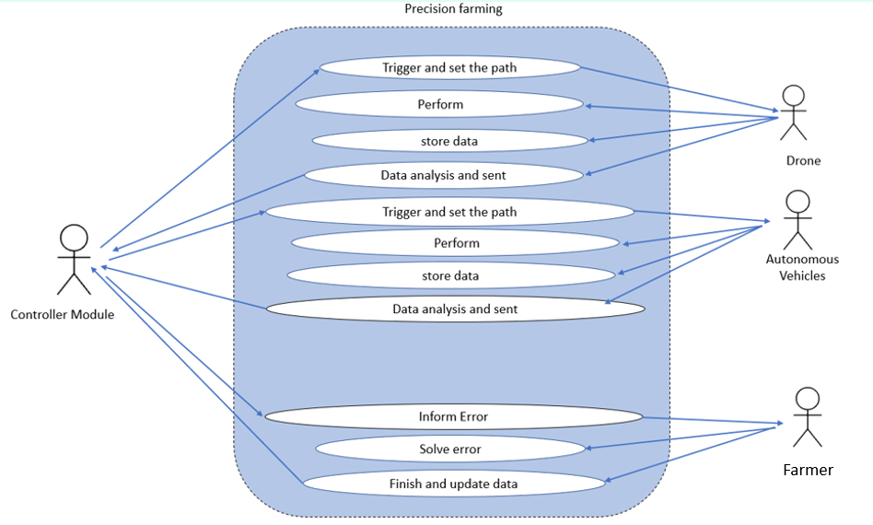

Slide 2
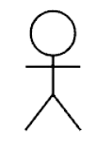
Drone Section
Trigger and set the path
Get monitoring data
Monitor and store data
Data analysis and sent
Survey Drone
Trigger and sent data
spray pesticide
Pest control Drone
Finish spray pesticide sent data
Controller
Trigger and sent data
Perform Watering
Watering Drone
Finish Irrigation and sent data
Trigger and sent data
Collect Weed data
Weed Monitoring Drone
Finish and sent data
Trigger and sent data
Collect Harvesting data
Finish and sent data
Harvesting Monitoring Drone

Slide 3
Autonomous Section
Trigger and sent data
Start weed removing
Finish and sent data
Weed Removing
Vehicles
Controller
Trigger and sent data
Start Harvesting
Finish and sent data
Harvesting vehicles

Slide 4
Farmer Control
Inform Error
Solve Error
Farmer
Finish and sent data
Controller

