Slide 1
Customer Data Analysis
PRDA-04 · Shopping behaviour in 10 Istanbul malls, 2021–2023
Power BI · Tableau · MySQL · Excel

Slide 2
About the dataset
Source: MySQL database project_customer_segmentation, table customer
One row per transaction: invoice, customer, gender, age
Product category, quantity and amount paid (TL)
Payment method, date and shopping mall
Goal: who buys what, how they pay, and who brings revenue
99,457
transactions
10
shopping malls
Jan 2021 – Mar 2023
time period

Slide 3




Data checks and preparation
Clean data
Price is already the total
No missing values, no duplicate rows or invoices
price = quantity × unit price, so Revenue = price (68.55M TL)
One row per customer
Partial last month
Every customer_id appears once: count transactions, not repeat buyers
March 2023 has only 8 days of data

Slide 4
Key figures
99,457
298,712
68.55M TL
689 TL
Transactions
Items sold
Revenue
Avg order value
3 items per purchase on average · average age 43.4 · about 2.6M TL revenue per month

Slide 5
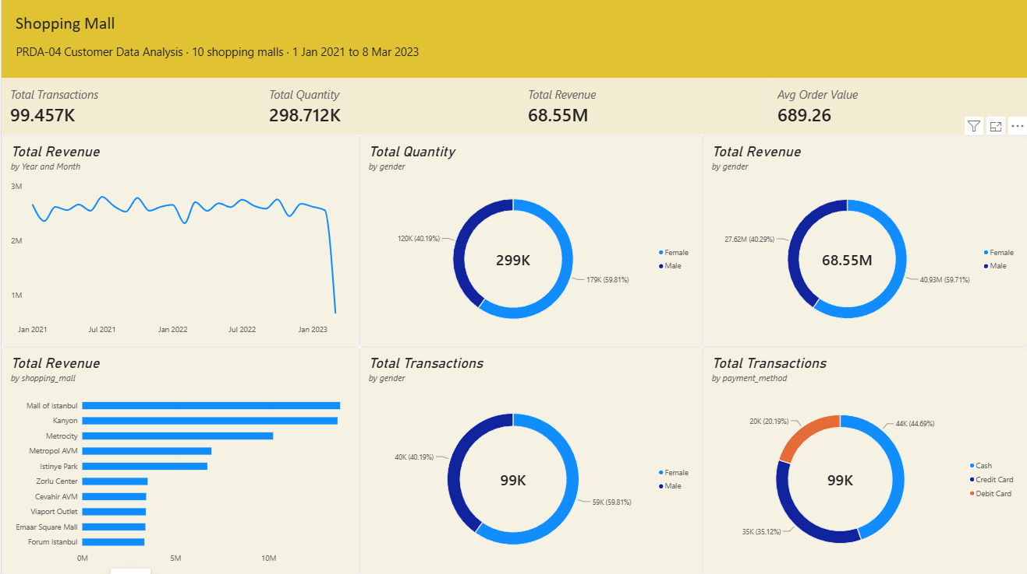
Power BI: overview, gender and payment

Slide 6
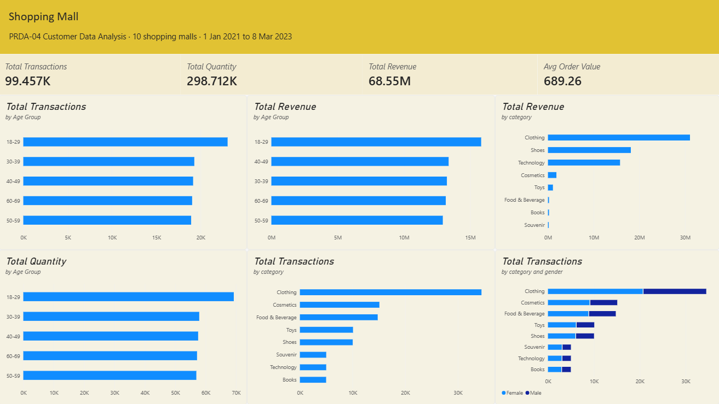
Power BI: age and category

Slide 7
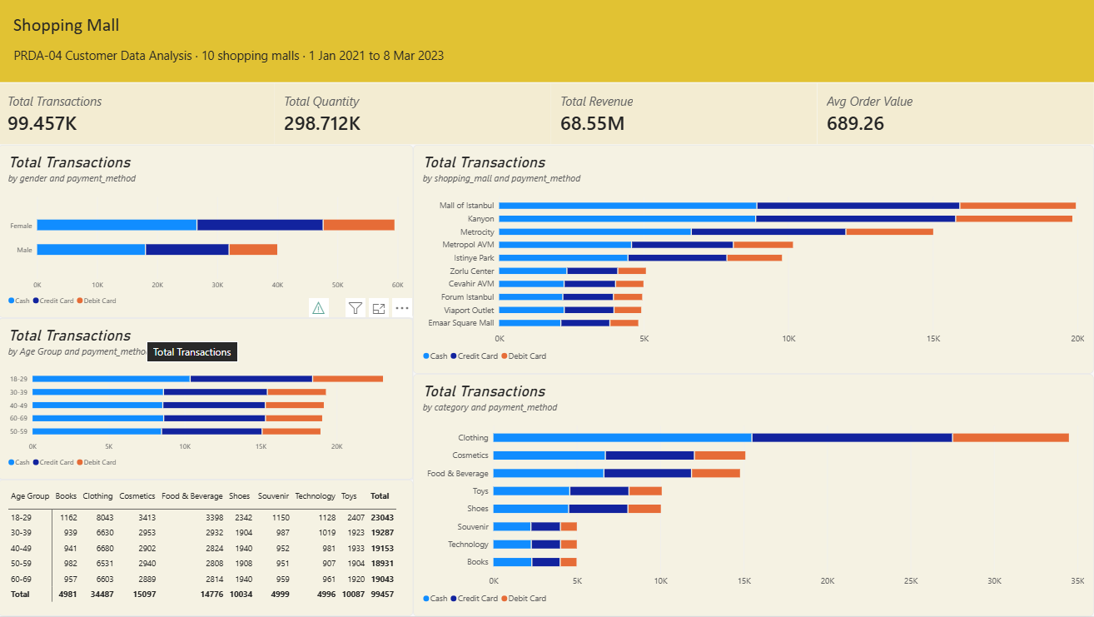
Power BI: payment method relations

Slide 8
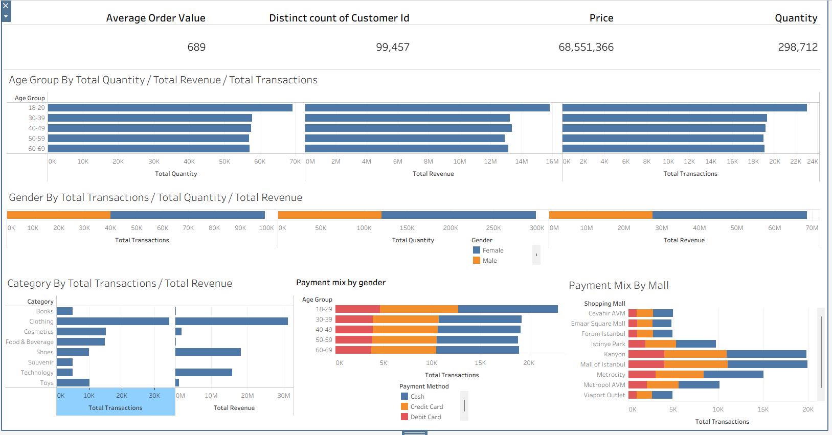
Tableau dashboard: page 1

Slide 9
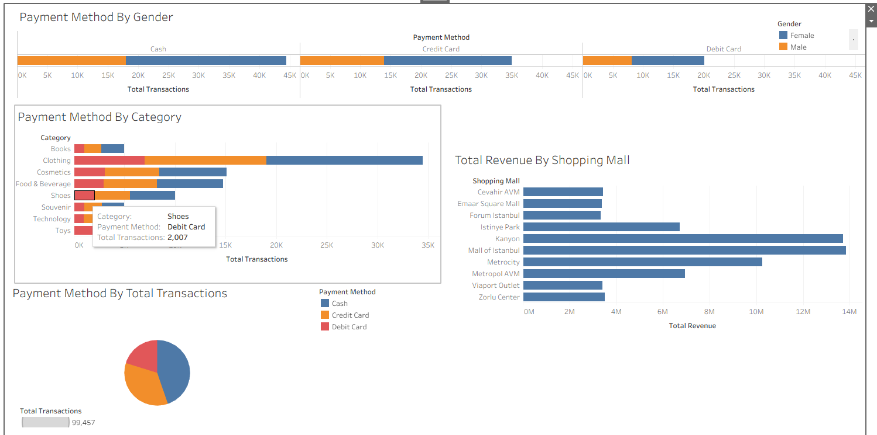
Tableau dashboard: page 2

Slide 10
Q1–Q3: Women lead on every measure
59.8%
of purchases made by women
Women bought 178,659 items and spent 40.93M TL. But the average order is the same for both (688 vs 691 TL): there are simply more female shoppers.

Slide 11
Q5–Q7: All ages shop about equally
≈1,900
purchases at every single age
18-29 leads on purchases, items (69,245) and revenue (15.83M TL) only because it covers 12 ages instead of 10. Average order is 683–698 TL in every group.

Slide 12
Q4/Q8: Three categories bring 95% of revenue
94.8%
of revenue from Clothing, Shoes, Technology
Food & Beverage is 15% of purchases but only 0.3% of revenue: one item costs 5.23 TL, compared with 1,050 TL for Technology.

Slide 13
Q4/Q8: Every group buys the same mix
Age group | Clothing | Cosmetics | Food & Bev. | Shoes | Toys | Books | Souvenir | Tech
18-29 | 34.9% | 14.8% | 14.7% | 10.2% | 10.4% | 5.0% | 5.0% | 4.9%
30-39 | 34.4% | 15.3% | 15.2% | 9.9% | 10.0% | 4.9% | 5.1% | 5.3%
40-49 | 34.9% | 15.2% | 14.7% | 10.1% | 10.1% | 4.9% | 5.0% | 5.1%
50-59 | 34.5% | 15.5% | 14.8% | 10.1% | 10.1% | 5.2% | 5.0% | 4.8%
60-69 | 34.7% | 15.2% | 14.8% | 10.2% | 10.1% | 5.0% | 5.0% | 5.0%
% of each age group's purchases. Each category's share changes by less than 1 point between age groups.
Gender: every category is 58–60% female. Mall: Clothing is 34–35% of purchases in every mall.

Slide 14
Q10: Cash is the most used payment method
55.3%
of purchases paid by card
Cash 44,447 (44.7%), Credit Card 34,931 (35.1%), Debit Card 20,079 (20.2%).

Slide 15
Q9: Payment mix is the same for everyone
45 / 35 / 20
Cash / Credit / Debit in every group
The same split holds for every category and mall too (within about 1.5 points), and the average order is 687–691 TL for each method.

Slide 16
Two malls bring 40% of revenue
27.6M TL
from Mall of Istanbul and Kanyon
Five malls bring only about 3.4M TL each. Monthly revenue is steady at about 2.6M TL, with a small dip every February.

Slide 17






Key insights
Women are 60% of sales
All ages shop equally
Same order value as men (about 690 TL)
About 1,900 purchases at every age
Clothing is the leader
Revenue is concentrated
45% of revenue from one category
3 categories = 95%, 2 malls = 40%
Cash is most used
No hidden patterns
45% cash, 55% card
Category and payment mix same for all groups

Slide 18
Suggestions for the company
1
Focus on top categories
2
Cross-sell low-price items
Clothing, Shoes and Technology: stock, space, promotions
Food and cosmetics as bundles that lead to clothing
3
Grow male shoppers
4
Market to all ages
Men spend as much per order: target campaigns
Use age to choose channels, not offers
5
Start a loyalty programme
6
Encourage card payments
Track repeat visits and give personal offers
Faster checkout and better customer data
7
Learn from top malls
8
Plan for February
Apply Mall of Istanbul and Kanyon ideas elsewhere
Seasonal campaign to fill the yearly dip

Slide 19
Conclusion
99,457 sales worth 68.55M TL with steady monthly revenue. Customer groups behave alike; revenue depends on three categories and two malls. Protect those, grow male shoppers and start a loyalty programme.

